Slide 1

ThermoWand®
Approach to Rapid Development

Slide 2
IMT Approach
IMT APPROACH
ITM is taking advantage of new technology called Internet of Things (IoT), Visualization Engineering. Node-RED is a tool for wiring together hardware devices, APIs and online services in new and interesting ways.
IMT is using Node-Red technology, a methodology that uses visualization for deploying Software as a Service (SaaS). ITM using Cloud Deployment of IMT Devices, adding smart technology to the first ever Medical temperature taking device.
ITM will be deploying Smart ThemalWands™ with Business Intelligence built in that will take advantage of rich Cloud Analytics available from third party companies such as Tableau, IBM Watson, Microsoft Cloud Azure IoT, SAP and Oracle.

Slide 3
What is IoT?
SOME DEFINITIONS
What is Node-Red?
Node-RED is a visual wiring tool for the Internet of Things hardware development.
IMT is taking advantage of using Node-Red, and third party analytics!
What is Cloud Analytics?
Cloud analytics is a service model in which elements of the data analytics process are provided through a public or private cloud. Cloud analytics applications and services are typically offered under a subscription-based or utility (pay-per-use) pricing model. This is one of IMT’s revenue streams (see Business Plan for all revenue streams)
The Internet of Things. Industrial Internet. Internet of Everything.
All shorthand for the pervasive opportunity to create new economic value by making things smart.
The Internet of Things (IoT) refers to the ever-growing network of physical objects that feature an IP address for internet connectivity, and the communication that occurs between these objects and other Internet-enabled devices and systems.

Slide 4
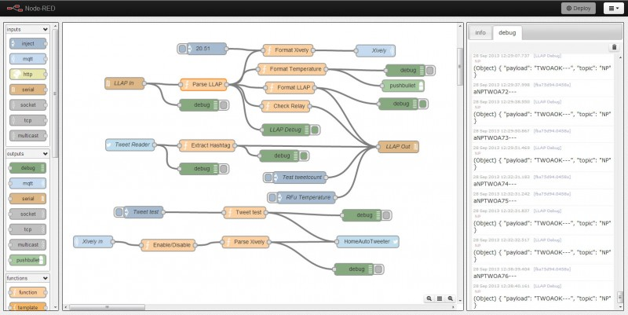
Node-Red
NODE-RED EXAMPLE
Example of design Architecture using Node-Red

Slide 5
Dashboarding via the WEB
STEPS AHEAD
Using the data that is collected from ITM Thermal devices that is locally stored and centralized dashboards are created using the data that is acquired using IMT’s ThemalWand™. This is achieved by transmitting the thermal data is near real-time to the World Wide Web as raw data by each ThermoWand™ device the data is then mined and reported on via a web based dashboard for viewing and decision making.
This process stores the raw data into a Open Source IMT database for post processing and customer consumption. ITM device data is placed into either local databases or can be copied to a federated database for use by one or many consumers or a government agency such as the CDC who already has existing public global database for public consumption (see figure 2). IMT will be the first to store human temperature data for historical trending, real-time viewing where predetermined thresholds would be set which would be used to set Alerts. Alerts can be set per device or 1 to many readings such that an entity such as a hospital can set thresholds for 24 hour collections.

Slide 6
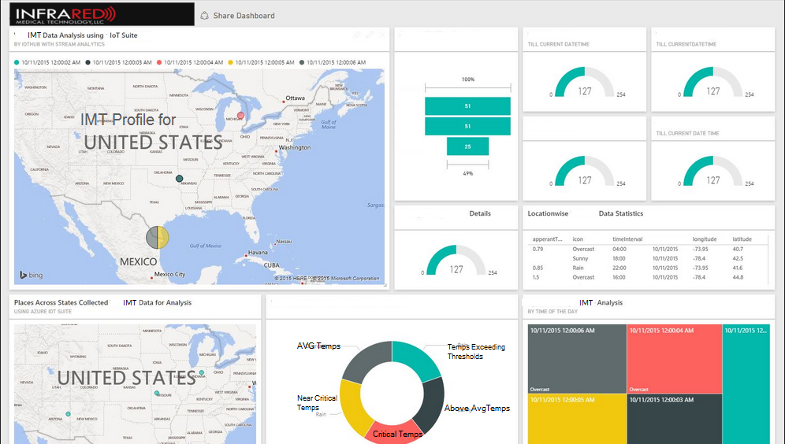
DASHBOARD EXAMPLE

Slide 7
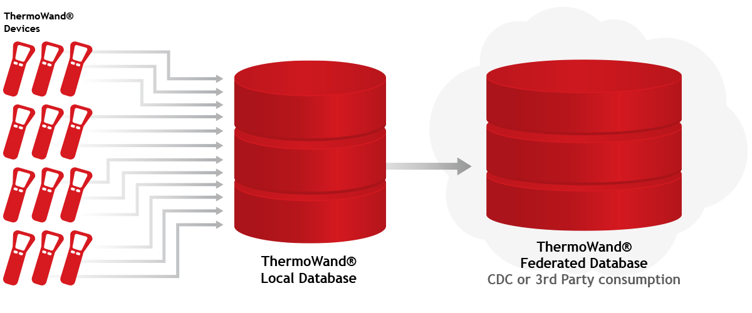
Collecting & Analyzing Data
COLLECTING & ANALYZING DATA
ThermoWand™ has built in Cloud Technology, and that data is collected for data mining and post analytical purposes. Data can be aggregated analyzed then correlated to medical databases to determine if trends exist. Alarms can be set to so if a certain number of readings are exceed a predetermined set-point notifications will be sent out via email or Cell Phone. Web applications developed for one to many IMT Devices.

Slide 8
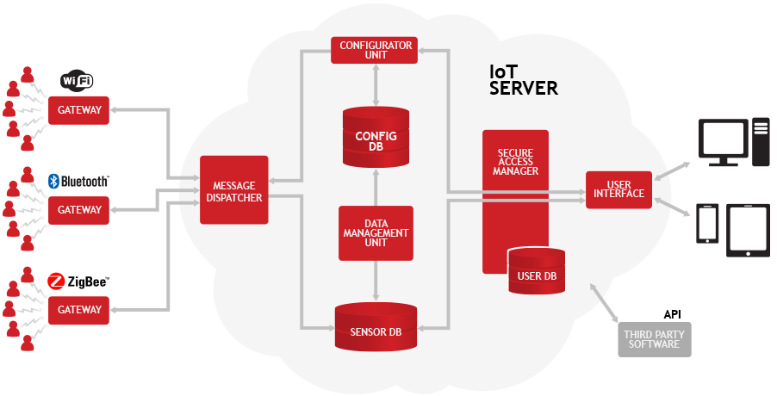
Topology of ThermoWand™ Sensors
TOPOLOGY OF THERMOWAND SENSORS

Slide 9
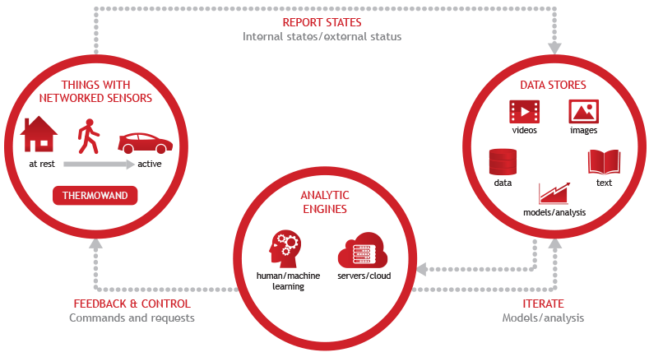
IMT Analytics Topology
IMT ANALYTICS TOPOLOGY

Slide 10
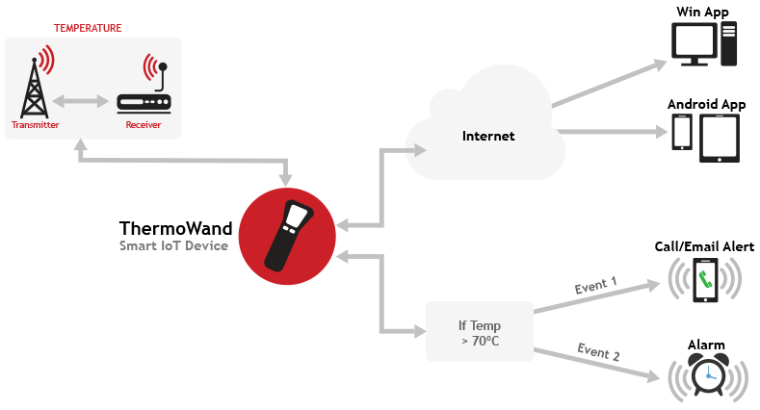
One-to-Many Deployment
ONE-TO-MANY DEPLOYMENT

Slide 11
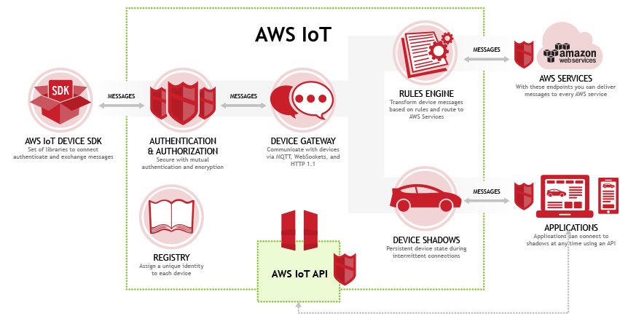
IMT Security Model
(Reference Architecture)
IMT SECURITY MODEL
AWS Reference Architecture (Reference: http://aws.amazon.com/iot/how-it-works/)

Slide 12
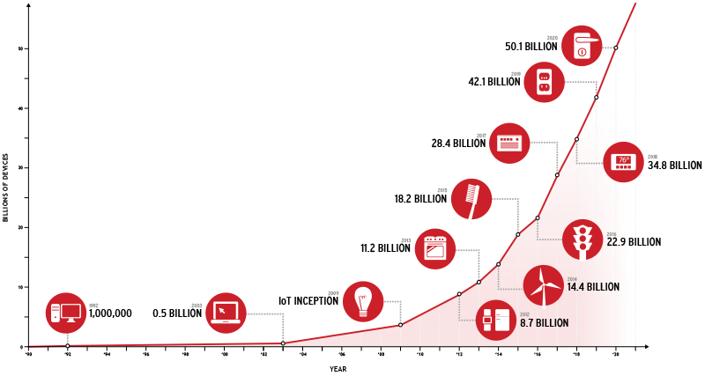
The Internet of Things
An Explosion of Connected Possibilites
EXPLOSION OF POSSIBILITIES
The number of devices that are connected over time.

Slide 13
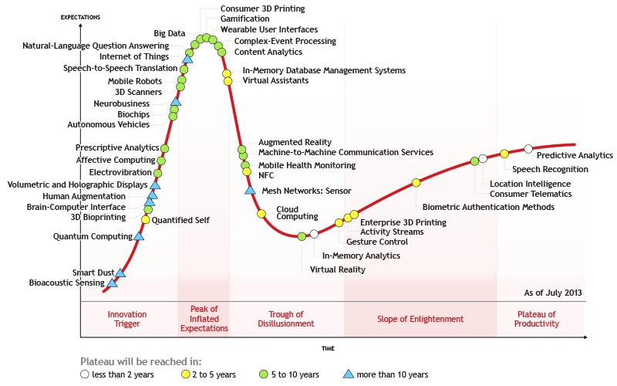
Technology Expectations
TECHNOLOGY EXPECTATIONS
With the number of connected devices increasing exponentially, the amount of technological advances are exploding as well.

Slide 14
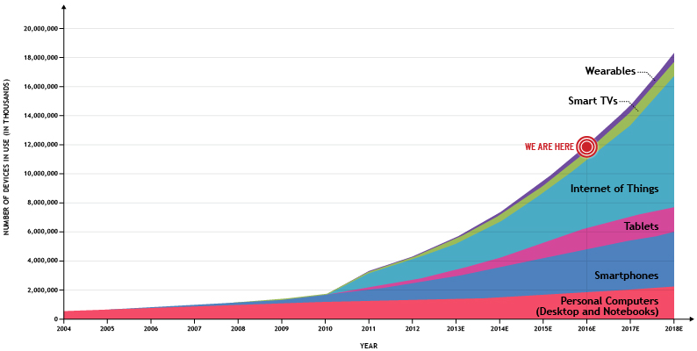
Global Internet Devices Installed Base Forecast
GLOBAL INTERNET DEVICES INSTALLED
Source: Gartner, IDC, Strategy Analytics, Machina Research, company filings, BII estimates

