Slide 1

E-VISION
A SECOND LIFE FOR BATTERIES
A Sustainable Solution for Batteries
Notes:
Hi, my name is Robert, I am from E-vision Systems. Our technology regenerates lead acid batteries giving them a second life. Using a non-invasive, capacity-restoration technology, we can extend the lifespan of a battery well beyond the makers‘ original specifications saving time and money, and protecting the environment.

Slide 2
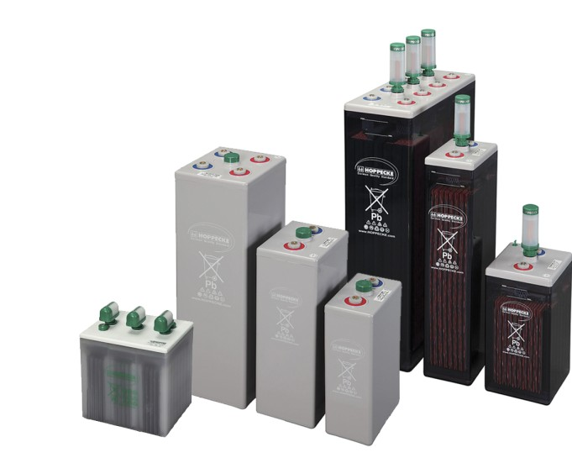
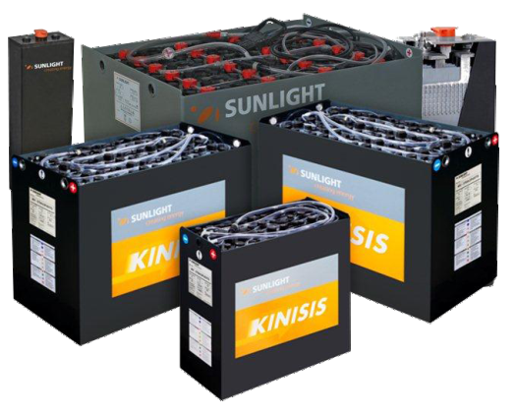
THE PROBLEM
80%
of batteries fail prematurely
Replacement needed before reaching designed lifespan
Notes:
Lead-Acid batteries tend to degrade and lose their capacity often well before reaching their designed lifespan mainly due to sulfation.

Slide 3


REGENERATE YOUR BATTERIES
AND MAKE USE OF THEIR
FULL POTENTIAL!
E-Vision Systems, s.r.o. Dr. Vladimíra Clementisa 10 821 02 Bratislava, Slovakia
Robert Cepka
Ph: 00421 905 500 222
Email: robert@e-vision.biz
www.e-vision.biz
Notes:
We are E-Vision & we can regenerate batteris.
Thank you very much

Slide 4
text item #1
text item #2
text item #3
text item #4
text item #5
text item #6
text item #1
text item #2
text item #3
text item #4
text item #5
text item #6

Slide 5
text item #1
text item #2
text item #3
text item #4
text item #5
text item #6
text item #1
text item #2
text item #3
text item #4
text item #5
text item #6

Slide 6
text item #1
text item #2
text item #3
text item #4
text item #5
text item #6
text item #1
text item #2
text item #3
text item #4
text item #5
text item #6

Slide 7
text item #1
text item #2
text item #3
text item #4
text item #5
text item #6
text item #1
text item #2
text item #3
text item #4
text item #5
text item #6

Slide 8
text item #1
text item #2
text item #3
text item #4
text item #5
text item #6
text item #1
text item #2
text item #3
text item #4
text item #5
text item #6

Slide 9
text item #1
text item #2
text item #3
text item #4
text item #5
text item #6
text item #1
text item #2
text item #3
text item #4
text item #5
text item #6

Slide 10
text item #1
text item #2
text item #3
text item #4
text item #5
text item #6
text item #1
text item #2
text item #3
text item #4
text item #5
text item #6

Slide 11
text item #1
text item #2
text item #3
text item #4
text item #5
text item #6
text item #1
text item #2
text item #3
text item #4
text item #5
text item #6

Slide 12
text item #1
text item #2
text item #3
text item #4
text item #5
text item #6
text item #1
text item #2
text item #3
text item #4
text item #5
text item #6

Slide 13
text item #1
text item #2
text item #3
text item #4
text item #5
text item #6
text item #1
text item #2
text item #3
text item #4
text item #5
text item #6

Slide 14
text item #1
text item #2
text item #3
text item #4
text item #5
text item #6
text item #1
text item #2
text item #3
text item #4
text item #5
text item #6

Slide 15
text item #1
text item #2
text item #3
text item #4
text item #5
text item #6
text item #1
text item #2
text item #3
text item #4
text item #5
text item #6

