Slide 1
Product pricing
Your Name

Slide 2
Cars table
## [1] "sdddddd"
Heading 1
LARGE TEXT
dfdfdf
fdf

Slide 3
Table 2
speed | dist
4 | 2
4 | 10
7 | 4
7 | 22
8 | 16
9 | 10

Slide 4
Test 3
some text here - some - text
speed | dist
4 | 2
4 | 10
7 | 4
7 | 22
8 | 16
9 | 10

Slide 5
Test 4
some text here - some - text
Ozone | Solar.R | Wind | Temp | Month | Day
41 | 190 | 7.4 | 67 | 5 | 1
36 | 118 | 8.0 | 72 | 5 | 2
12 | 149 | 12.6 | 74 | 5 | 3

Slide 6
Table
speed | dist
4 | 2
4 | 10
7 | 4
7 | 22
8 | 16
9 | 10
Sepal.Length | Sepal.Width | Petal.Length | Petal.Width | Species
5.1 | 3.5 | 1.4 | 0.2 | setosa
4.9 | 3.0 | 1.4 | 0.2 | setosa
4.7 | 3.2 | 1.3 | 0.2 | setosa
4.6 | 3.1 | 1.5 | 0.2 | setosa
5.0 | 3.6 | 1.4 | 0.2 | setosa
5.4 | 3.9 | 1.7 | 0.4 | setosa

Slide 7
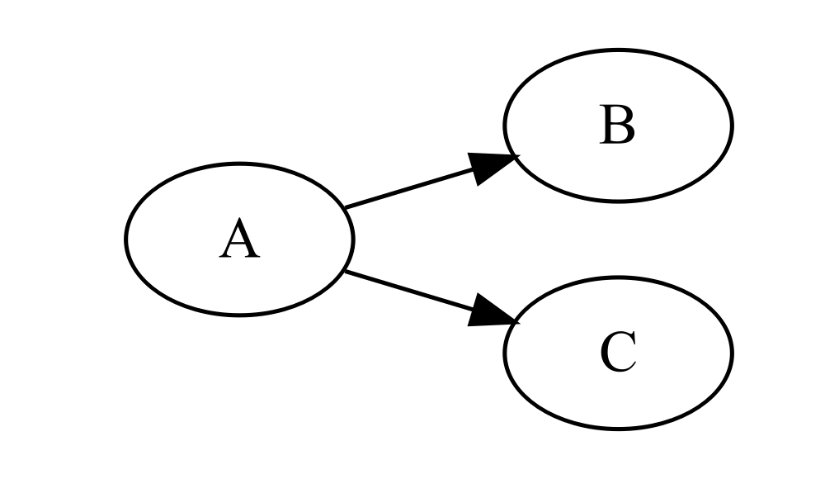
Diagrammer
TRUE

