Slide 1


Results
Roberto Guzmán

Slide 2

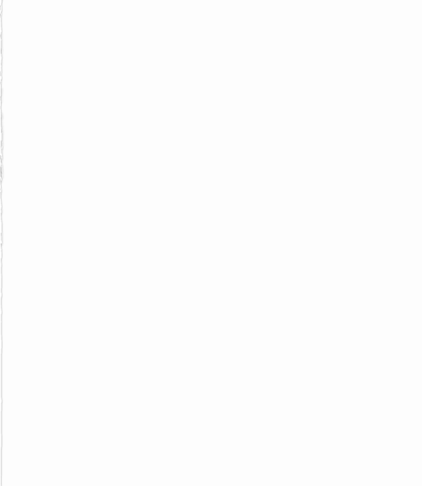
Dekho cars
Linear Regression
300 samples
Slope = 0.022
Coef. Of Det. testing = 0.21

