Slide 1
Multitier Application Architecture
The controller & the view
Eduardo Juárez

Slide 2
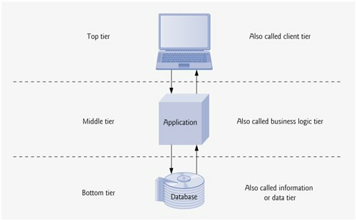
Multitier Application Architecture

Slide 3
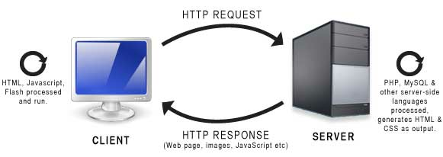
Making a Request
When given a URL, a web browser performs a simple HTTP transaction to retrieve and display the web page found at that address
GET /books/downloads.html HTTP/1.1

Slide 4
GET Request
GET /books/downloads.html HTTP/1.1
GET is an HTTP method indicating that the client wishes to obtain a resource from the server
/books/downloads.html Path name
HTTP/1.1 Protocol / version

Slide 5
Receiving a response
Any server that understands HTTP (version 1.1) can translate the request and respond appropriately
HTTP/1.1 200 OK
HTTP/1.1 Protocol / version
200 Numeric code of the status of the transaction
OK Description of the status
HTTP/1.1 404 Not found
HTTP/1.1 403 Forbidden
HTTP/1.1 500 Internal Server Error

Slide 6
Request methods: GET and POST
Method | GET Request | POST Request
Common use | To get or retrieve information from the server | To send data or documents to the server
How they send information | As part of the URL: www.google.com/search?q=http | As part of the HTTP message, as specified in an XHTML form

Slide 7
Interactions between PHP and HTML
Dynamic form generation
Retrieval and treatment of data sent using forms
File upload from the client to the server
Forms generated dynamically
Data sent / files to upload

Slide 8
HTML forms
<form method="method" action="URL">
<input type="inputtype" name= "name" value= "value" ... >
<input type=“inputtype" name= “name" value= "value" ... >
<select name= "name" >..</select>
<textarea name= "name" >..</textarea>
...
</form>
method – GET | POST
URL – script that will process the data from the form
inputtype - text | password | checkbox | radio | reset | submit

Slide 9
Form elements
Text and Password
  User:
  <input type=“text” name=“user” size=“10” maxlenght=“10”>
  Password:
  <input type=“password” name=“pwd” size=“10” maxlenght=“10”>
Radio:
  Monday <input type=“radio” name=“day” value=“mon”>
  Tuesday<input type=“radio” name=“day” value=“tue”>
  Wednesday <input type=“radio” name=“day” value=“wed”>

Slide 10
Form elements (cont.)
Checkbox:
  <input name="createDirectory" type="checkbox" value="authorized">
  Create directories
  <input name="createFile" type="checkbox" value="authorized">
  Create files
TextArea
  <textarea name="observations" cols="100" rows="10" >
  Write your comments here
  </textarea>

Slide 11
Form Elements (cont.)
Select
  <select name=“operatingSystem">
  <option value="UNX">Unix</option>
  <option value="LNX">Linux</option>
  <option value="WIN">Windows</option>
  </select>
Submit
  <input name=“save" type="submit" id=“save" value=“Save">
Reset
  <input name=“Reset" type="reset" id=“Reset" value=“Reset">

Slide 12
How to receive values from an HTML form
PHP has associative arrays (that use indexes of the String type) for the two sending methods of the form:
  $_POST
  $_GET
There is a visible difference in the browser at the submit moment:
  GET makes the URL from the following elements:
    URL indicated in action followed by ?
    Pairs name=value concatenated with &, one per parameter or form field
  POST only shows the URL of the action attribute, data is sent as part of the headers
For PHP, the difference is which array should be used to receive user’s input

Slide 13
How to receive values from an HTML form (cont.)
To build a HTML form that sends values to a PHP script, there are some possibilities, every one of them valid:
  Create the form in a HTML file and in action indicate the name of the PHP script that should receive the data
  Generate the HTML form with a PHP script, including in action the name of another PHP script that should receive the data.
  Include both the HTML form and the PHP script in the same file, and indicate in action the name of this only script(the script will “reload itself”).

Slide 14
How to receive values from an HTML form (cont.)
Following the past examples of form elements, suppose the submit of the form was made, in the script associated to action we would have that:
  $_POST[‘user’] will have the value with which the text was filled called user.
  $_POST[‘password’] will have the value with which the password was filled password (for PHP it would be the same that a text although in the form it appears masked with *).
  $_POST[‘day’] will have as value the value attribute of the option selected from the radio with the same name.
  $_POST[‘createFile’] will take the value authorized if the checkbox was marked or “” otherwise.
  $_POST[‘operatingSystem’] will take the value property from the option selected by user.

Slide 15
How to receive values from an HTML form (cont.)
The test
  If ($_POST[‘buttonName’]==‘buttonValue’) {
  ....
  }
  It is useful for the following cases:
Identify what buttons were used to submit the form: the test is true only for the button that was used in the submit and the rest of the buttons will take the empty string value.
If the HTML of the form is combined with the PHP script in the same file, the test allows to recognize when the script is sent for first time to the browser, from the case of a form submission.

Slide 16
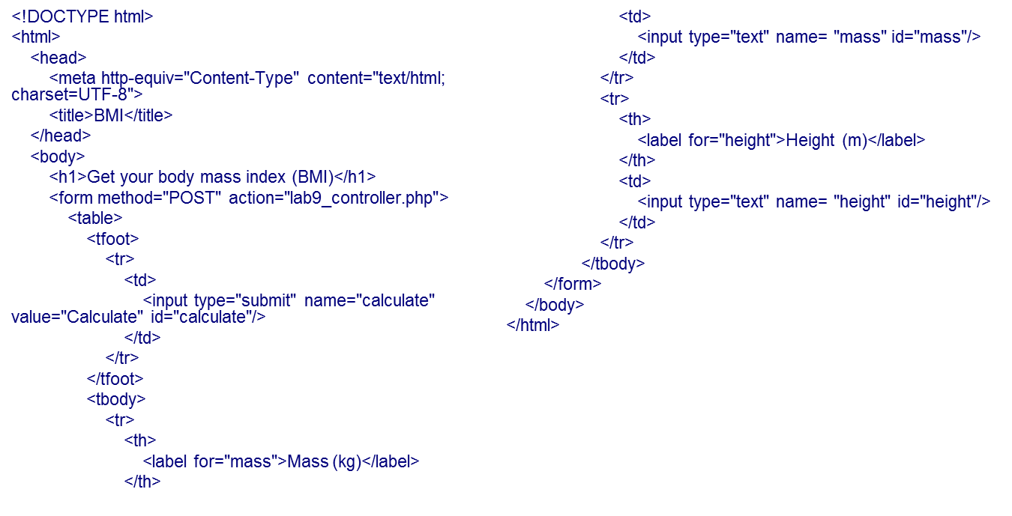
Exercise
In htdocs/bmi_studentid/ copy the following code in a file named lab9_view.html

Slide 17
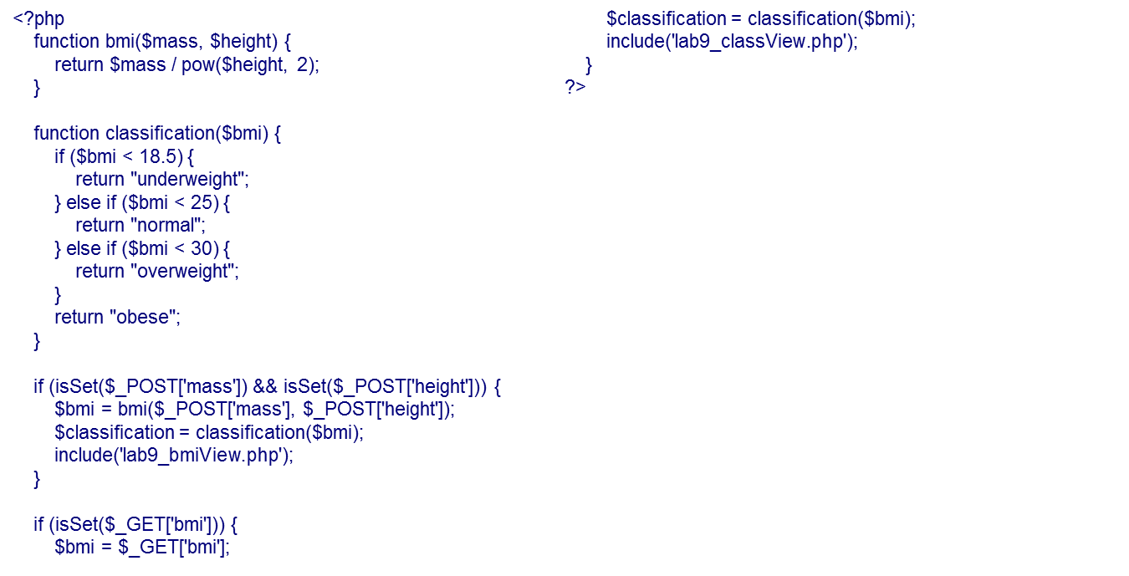
Exercise
In htdocs/bmi_studentid/ copy the following code in a file named lab9_controller.php

Slide 18
Exercise (cont.)
Copy the following code in a file named lab9_bmiView.php
<!DOCTYPE html>
<html>
<head>
<meta http-equiv="Content-Type" content="text/html; charset=UTF-8">
<title>BMI</title>
</head>
<body>
<p>
Your body mass index is <strong><?php echo $bmi ?></strong> and the World Health Organization classifies it as <strong><?php echo $classification ?></strong>
</p>
<a href="lab9_view.html">Calculate again</a>
</body>
</html>

Slide 19
Exercise (cont.)
Copy the following code in a file named lab9_classView.php
<!DOCTYPE html>
<html>
<head>
<meta http-equiv="Content-Type" content="text/html; charset=UTF-8">
<title>BMI</title>
</head>
<body>
<p>
Your body mass index is <strong><?php echo $bmi ?></strong> and the World Health Organization classifies it as <strong><?php echo $classification ?></strong>
</p>
<a href="lab9_view.html">Calculate again</a>
</body>
</html>

Slide 20
Exercise (cont.)
In your web browser open lab9_view.html and test the web page.
Call the controller lab9_controller.php?bmi=23 and see what happens.
Explain to yourself the code of the whole site.
Modify the controller so it returns a HTTP state 404 if there is an invalid GET parameter. For that you can use the php function header();

