Slide 1
Building a Well Structured Program
Using functions and managing memory

Slide 2
Learning Outcomes
Using and Writing Functions
Memory management
Introduction to pointers
Function calls
Arrays and Structures
Dynamic memory allocation
Understanding function calls - the function pointer

Slide 3
Functions
Group - functions enable grouping of commonly used code into a reusable and compact unit.
Modularise - programs containing many functions main should be implemented as a group of calls to functions undertaking the bulk of the work
Reuse - become familiar with rich collections of functions in the ANSI C standard library
Portability - using functions from ANSI standard library increases portability

Slide 4
Overview the input output functions
Printf
Scanf
Format specifiers
The address operator used in scanf

Slide 5
printf
Provides formatted input and output
Input for printf is a format specification followed by a list of variable names to be displayed
Note the use of escape characters e.g. \n generates a newline
printf(“variable %d is %f\n”, myint, myfloat);
Examples
/*Use the printf function to Display a welcome message on the users screen*/
printf("Welcome to the C Language!\n);"
printf("b=%f fb=%f\n",b,fb);

Slide 6
scanf
Provided an input format and a list of variables
scanf(“%d”, &myint);
Note variable name has & in front
/*Request input from the user*/
printf("Enter the first integer\n");
scanf("%d", &i1); /*Read in the integer*/
printf("Enter the second integer\n");
scanf("%d", &i2);

Slide 7
Escape Characters
Escape Sequence | Description
\n | Newline, position cursor at the start of a new line
\t | Horizontal tab, move cursor to the next tab stop
\r | Carriage return. Position cursor to the beginning of the current line; do not advance to the next line.
\a | Alert, sound system warning beep
\\ | Backslash, print a backslash character in a printf statement
\” | Double quote print a double quote character in a printf statement.

Slide 8
Format Specifiers for printf and scanf
Data Type | Printf specifier | Scanf specifier
long double | %Lf | %Lf
double | %f | %lf
float | %f | %f
unsigned long int | %lu | %lu
long int | %ld | %ld
unsigned int | %u | %u
int | %d | %d
short | %hd | %hd
char | %c | %c

Slide 9
Practice Session
Modify the root-newton example by making it compute the root of the function
x³-2x-5
With the derivative function
3x²-2

Slide 10
while( fabs(b-a)>(FLT_EPSILON*b))
{
x = (a+b)/2;
/*The function whose root is to be determined*/
fx = pow(x,3)-2*x-5;
if(sign(fx)==sign(fa))
{
a = x;
fa = fx;
printf("a=%f fa=%f\n",a,fa);
}
else
{
b = x;
fb = fx;
printf("b=%f fb=%f\n",b,fb);
}
}
printf(" The root is :%f\n",x);

Slide 11
Standard Library Functions
Header | Description
<stdio.h> | Functions for standard input and output
<float.h> | Floating point size limits
<limits.h> | Contains integral size limits of system
<stdlib.h> | ​​Functions for converting numbers to text and text to numbers, memory allocation, random numbers, other utility functions
<math.h> | Math library functions
<string.h> | String processing functions
<stddef.h> | Common definitions of types used by C

Slide 12
Functions in the library math.h
Function | Returns
sqrt(x) | Square root
exp(x) | Exponential function
log(x) | Natural logarithm (base e)
log10(x) | Logarithm (base 10)
fabs(x) | Absolute value
pow(x,y) | X raised to the power of y
sin(x) | Trignometric sine (x in radians)
cos(x) | Trignometric cosine (x in radians)
tan(x) | Trignometric tangent (x in radians)
atan(x) | Arctangent of x (returned value is in radians)

Slide 13
Using Functions
Include the header file for the required library using the preprocessor directive
#include <libraryname.h>
Note no semi colon after this
Variables defined in functions are local variables
Functions have a list of parameters
Means of communicating information between functions
Functions can return values
printf and scanf good examples of function calls
Use the –lm option to compile an application using math library functions e.g.
gcc myprog.c –o myprog -lm

Slide 14
Practice
•Build and run the example function1.c
•Add more calls to the blorf() function in the main pprogram
•Build and run function2.c
•Note this avoids the use of the function prototype
•Move the soup function after the main function compile and run what happens?
•Add a prototype and build and run again

Slide 15
Practice
Modify the root finding examples for the newton and bisection method to call a function defined by a c- function (rather than inline as performed in the code example)
Compile and run functions.c.
Run the program several times and observe that it always provides. The same output.
Seed the random number generator using the statement srand(time(NULL));
Run the program several times and observe the output

Slide 16
Pointers and Arrays
Pointers are a powerful feature of C used for managing data in memory and the memory addresses of that data
Arrays
Strings
Structures
Complex data types e.g. stacks, linked lists, queues etc

Slide 17
Review the Steps of Variable Declaration
A variable is an area of memory that has been given a name.
The variable declaration
float f1;
This is the command to allocate an area of memory for a float variable type with the name f1.
The statement
f1=3.141
is a command to assign the value 3.141 to the area of memory named f1.

Slide 18
What is a Pointer
Pointers are variables that contain memory addresses as their values.
Pointer declared using the indirection or de-referencing operator *
Example
float *f1ptr;
f1ptr is pointer variable and it is the memory location of a float variable

Slide 19
Using the Pointer Operators
The redirection operator returns the address of a variable
& applied to f1 returns the address of f1
float f1;
float *f1ptr; /* Declare a pointer variable to an integer*/
f1=3.141;
f1ptr=&f1; /*f1ptr is set to the address of f1*/

Slide 20
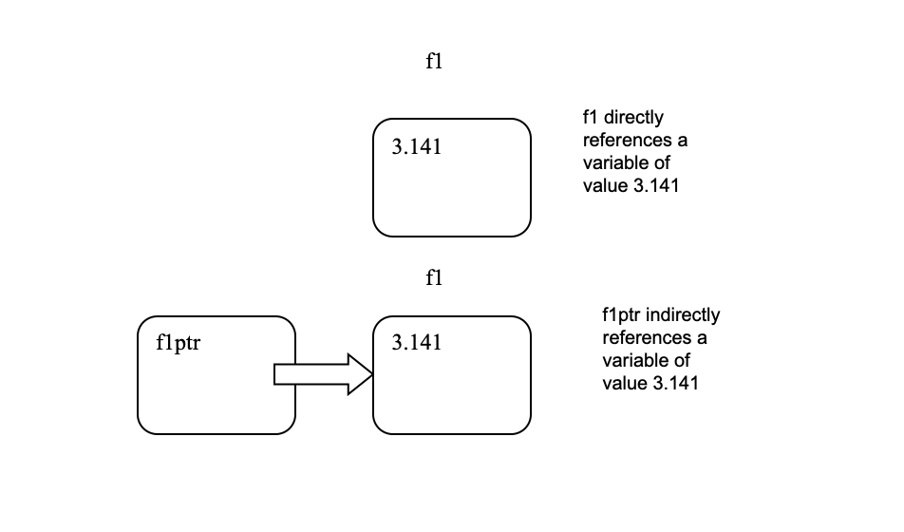
Pointer Variables

Slide 21
Using the Pointer Operators
int some_var; /*1*/
int *ptr_to_some_var; /*2*/
ptr_to_some_var = &some_var; /*3*/
printf ("%d\n\n", *ptr_to_some_var); /*4*/
/*1*/ Declare an integer
/*2*/ Declare a pointer
/*3*/ Assign a value to the pointer variable
/*4*/ Use the pointer in a function (dereference the value)
Compile and run the example pointers.c

Slide 22
Function Calls
Call by value
Copy of variable passed to function
If that variable is modified within the function then upon return from the function since only the copy has been modified, the actual variable is not modified
Call by reference
Pass the address of a variable (i.e. a pointer) to a function
The variable pointed to can be modified within that function

Slide 23
Call By Value
•finval=FuncByValue(finval);
float FuncByValue(float fval)
{
return fval*fval;
}

Slide 24
Call by Reference
FuncByReference(&finref), Use & to pass the address of a variable to the function;
Value of the referenced variable passed to the function is modified after returning from the function.
void FuncByReference(float *fvalptr)
{
*fvalptr = *fvalptr * *fvalptr;
}

Slide 25
Initialising and Creating an Integer Array
Initialisation
int iarray[5]={1,2,3,4,5};
Or… initialise elements individually
Note first element is referenced using 0
iarray[0]=1;
……..
iarray[4]=5;

Slide 26
Demonstration
•Putting it all together
–Function calls
–Simple array examples
•Numerical Method Examples
–Numerical differentiation
–Numerical Integration

Slide 27
Practice
Compile and run the following programs (see the pointers folder)
a. array.c initialising and using arrays with pointers
b. bubblesort.c
Bubble sort example, using call by reference to manipulate data passed into a function c. arrayref.c Using pointer notation to manipulate arrays

Slide 28
Practical examples
•Compile and run the following programs
–Numerical Differentiation
•2 and four point methods
–Numerical Integration
•Trapezium method
•Simpsons rule (includes lagrange interpolation function)

Slide 29
Multidimensional Array
Using the variable of a particular Type, the declaration for a multi dimensional array is made as follows:
Type variable[size1][size2];
To access or assign an element to an element of a multidimensional array we use the statement:
variable[index1][index2]=avalue;

Slide 30
Matrix Initialisation
•Alternatively the bracket initialisation method can be used, for example the integer matrix[2][4] can be initialised as follows:
int matrix[2][4]
{
{1,2,3,4},
{10,20,30,40}
};

Slide 31
Arrays are pointers
The array variable is a pointer whose value is the address of the first element of the array.
For a one dimensional array access a value using the following pointer notation:
int ielement= *(iarray+1);
This assignment increments the array pointer to the second element in the array (the first element is always index 0)
uses the * operator to dereference the pointer

Slide 32
Pointer Arrays
A string is a pointer to an array of characters
An array of strings is an array of pointers
Multidimensional array is essentially an array of pointer arrays

Slide 33
Memory Leaks
TAKE VERY SPECIAL CARE IN USE OF POINTERS AND MANAGEMENT OF ARRAYS
A common problem when using arrays is that the program might run off the end of the array particularly when using pointer arithmetic.
When passing an array to a function it is good practice to pass the size of that array making the function more general.

Slide 34
Practice
•Compile and run the following programs
–Program array.c initialising and using arrays with pointers
–Program bubblesort.c is a bubble sort example, using call by reference to manipulate data passed into a function
–Program arrayref.c uses pointer notation to manipulate arrays

Slide 35

Practice
Modify the integration examples to compute the error function, defined by
Modify the program so that erf(x) is computed for a range of values

