Slide 1
Ethereum: The new form of Currency
By: Robert Hall

Slide 2
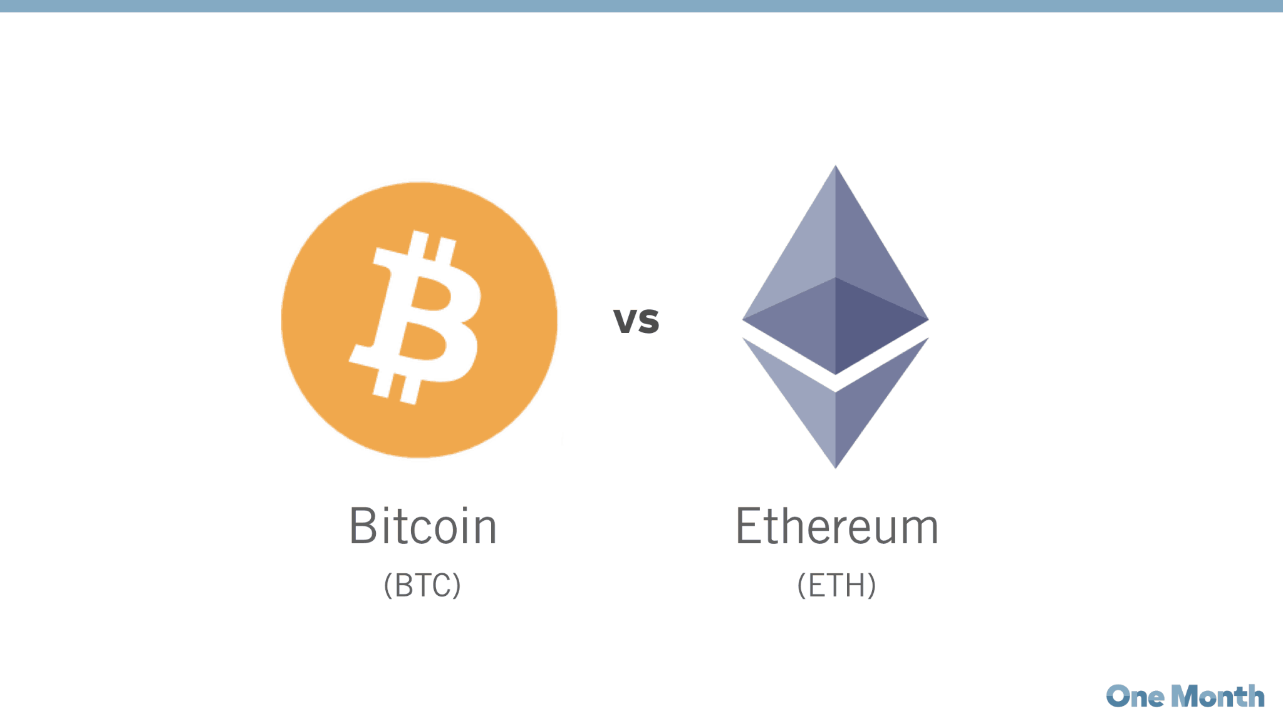
What is Ethereum?
To understand what Ethereum is, one must first understand what its predecessor, Bitcoin is.
Bitcoin is described as a decentralized peer-to-peer network that permits the issuance and transfer of money digitally, thus it is called a “digital currency”.
Ethereum took this concept of a digital currency and took it one step further.
On Ethereum’s Blockchain or public ledger which records and manages transactions, resides a currency called Ether.
Ethereum takes the idea of cryptocurrency one step further by building a programmable state machine which allows for entire programs and logic to be deployed.
While Bitcoin is a decentralized, peer-to peer network that relies on no central authority, that doesn’t mean it is anonymous. In fact participants can be tracked as their transactions propagate throughout the network.

Slide 3
How does it Work?!
While the low-level cryptography, mathematics and computational theory that serves as the foundation of the Ethereum Network is too intricate to cover exhaustively, it can abstracted in order to provide a sufficient level of understanding.
For those brave souls who wish to delve into the deepest crevices of Ethereum’s inner workings, a 36 page whitepaper is available for free on ethereum.org.
Ethereum uses the peers on its network to store blocks. These blocks maintain data and the current state of the network.
Transactions and client balances, like who owns what ether and where it has been sent are stored within these blocks.
This process takes a lot of time and power, therefore the client that successfully completes the verification of a block gets a reward.

Slide 4
Smart Contracts & Gas Fees
Due to the decentralized nature, the multiple nodes/validators of network transactions and the network state must come to consensus on the current state of the network, otherwise the chain of states(blocks) couldn’t continue to grow.
This process is dictated by the consensus algorithm. Ethereum is deterministic because of this process.
Since Ethereum is a distributed network where code and transactions can be deployed and later executed, storage and execution is dependent on nodes.
In order to incentivize these nodes to expend computational resources completing transactions and the running the bytecode of smart contracts, a gas fee is provided.

Slide 5
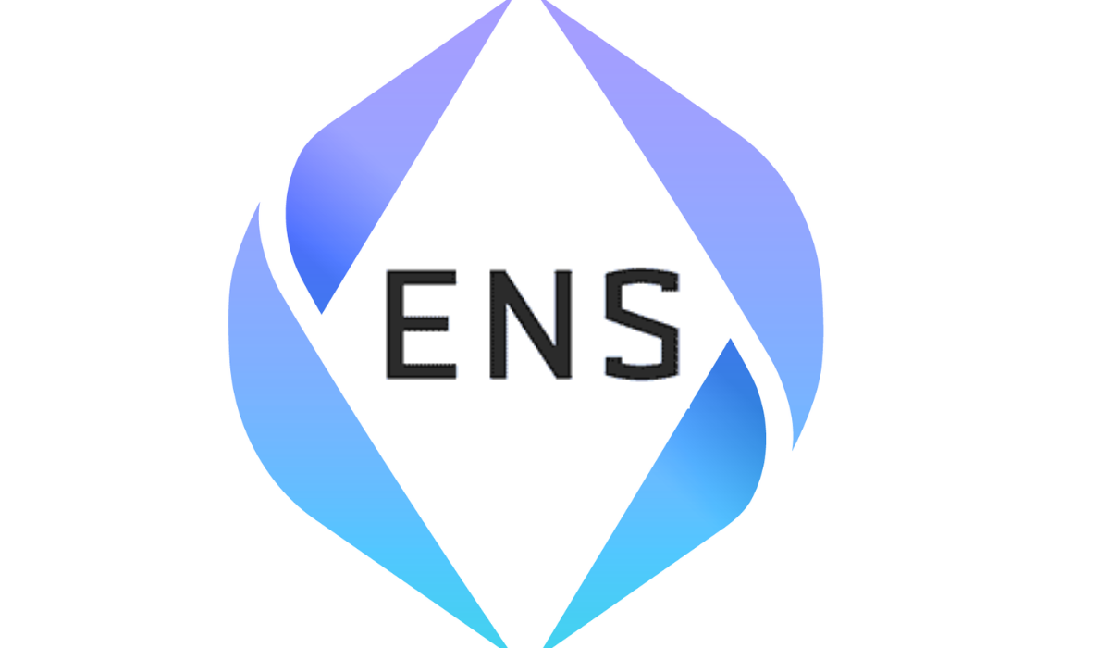


So what can you do with Smart Contracts?

Slide 6
Introduce DApps
Known as Decentralized Apps, these applications make use of the smart contract and EVM to build entire programs on top of the blockchain. They often make use of a traditional web front end and interact with the blockchain through clients or nodes.
Some popular Dapps are,
Ethereum Name Service(ENS)
Augur
UniSwap
OpenSea

Slide 7
Limitless Possibilities
Dapps allow for new kinds of applications.
Applications like ENS provide decentralized domain names which can’t be controlled by a specific party.
Decentralized Exchanges allow for money and currency to change hands in brand new ways.
Augur allows people to make bets against others online. While Uniswap lets people trade currency and provide it to others.

Slide 8
Downsides
Speed
While the EVM is innovative, the network can be slow to confirm transactions when popular and active. Consensus algorithms like PoS and PoW take time.
Storage
The blockchain cannot hold gigabytes of data like other storage mediums, small amounts of data like bytecode and hashes aren’t a problem however,
Cost
Gas fees are necessary in order to attract contributors to the network. Nodes can choose what work to compute and this can get costly.

Slide 9
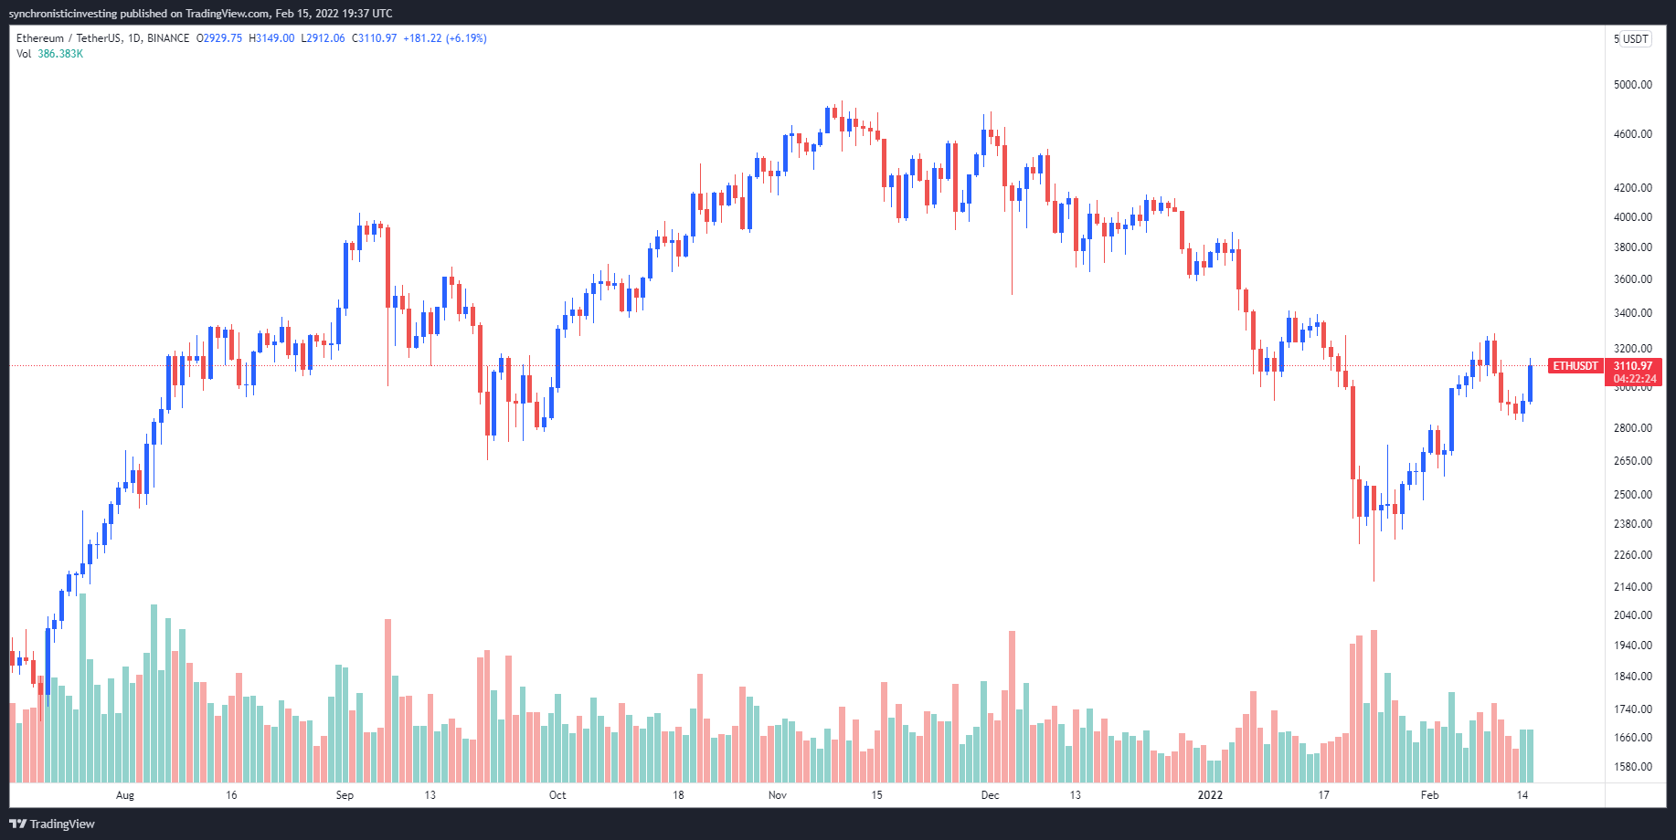
So whats next?
Ethereum is still growing and evolving with changes and proposals(EIP), but other blockchains can revolutionize the space.
There are many problems that need to be solved before we find the perfect cryptocurrency.

Slide 10
References
https://ethereum.org/en/dapps/#what-are-dapps
https://ethereum.org/en/what-is-ethereum/
https://dappradar.com/rankings/protocol/ethereum
https://en.bitcoin.it/wiki/Main_Page

