Slide 1

Tips and Tricks Azure CLI
Ravikanth Chaganti

Slide 2
ABOUT ME
Distinguished Member Technical Staff @ Dell EMC
Multi-year Microsoft MVP (PowerShell)
Founder and Editor of PowerShell Magazine (https://powershellmagazine.com)
Published Author:
Windows PowerShell Desired State Configuration Revealed
Pro PowerShell Desired State Configuration
Organizer: PowerShell Conference Asia (http://psconf.asia)

Slide 3

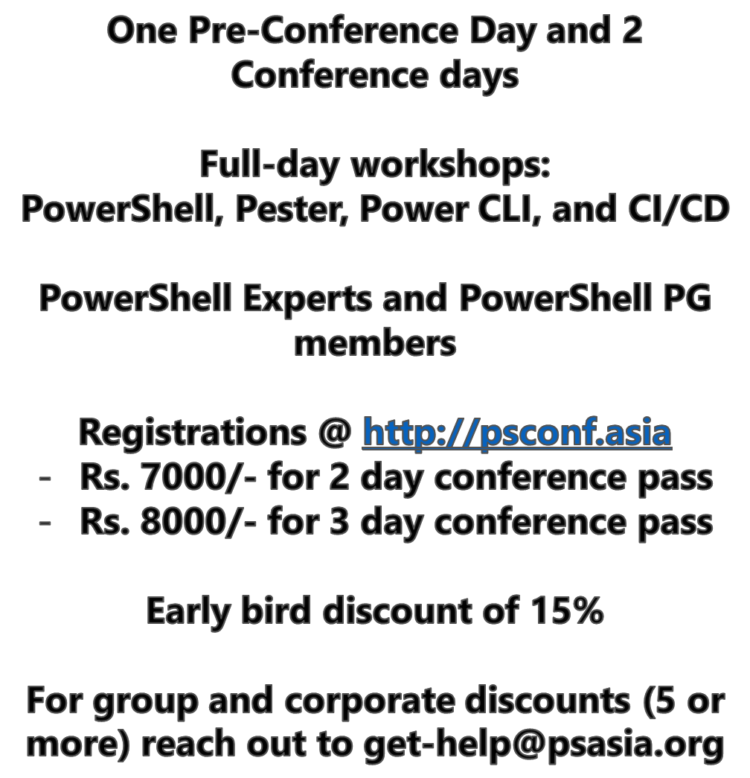

Slide 4
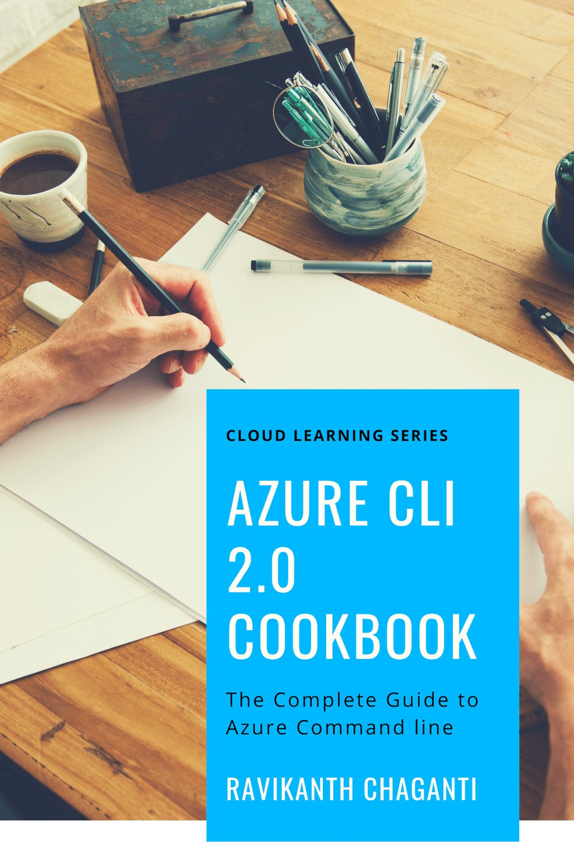
Coming soon …
http://book.azc.li

Slide 5
Azure CLI
Open Source; https://github.com/Azure/azure-cli
Written in Python
Current version is 2.0.63
Usage: az [group] [subgroup] [command] {parameters}
Supports interactive execution
Supports JMESPath for queries
Supports extensions

Slide 6
DEMO
Getting Started with Azure CLI 2.0

Slide 7
Azure CLI Queries
Parsing command output is not fun!
Azure CLI defaults to JSON output; support table, csv, and tsv
Command output can be converted to objects in PowerShell
But, there is a better way!
Use the –query global switch
Uses JEMSPath query specification

Slide 8
DEMO
Azure CLI 2.0 Queries

Slide 9
Azure RESOURCE Queries
Azure CLI 2.0 queries are great, but ….
Can be extremely slow
Expensive
Azure Resource Graph to the rescue!
Installs as an extension
Requires Kusto Query Language (KQL) knowledge

Slide 10
DEMO
Azure Resource Graph with Azure CLI 2.0

Slide 11
summary
Azure CLI 2.0 offers a good alternative to Azure PowerShell
Offers querying capabilities
Can integrate well with PowerShell or Shell Scripts or any other programming/scripting language

Slide 12
Questions?

