Slide 1
Approaching Complex Infrastructure Automation With PowerShell DSC
From the field!
Ravikanth Chaganti, Dell EMC

Slide 2
About_Author
Sr. Principal Engineer at Dell EMC
CDM and Azure MVP
Founder & Editor, PowerShell Magazine
Published Author
Windows PowerShell Desired State Configuration Revealed (Apress)
Pro DSC (Apress; upcoming title)
Several other self-published books!

Slide 3
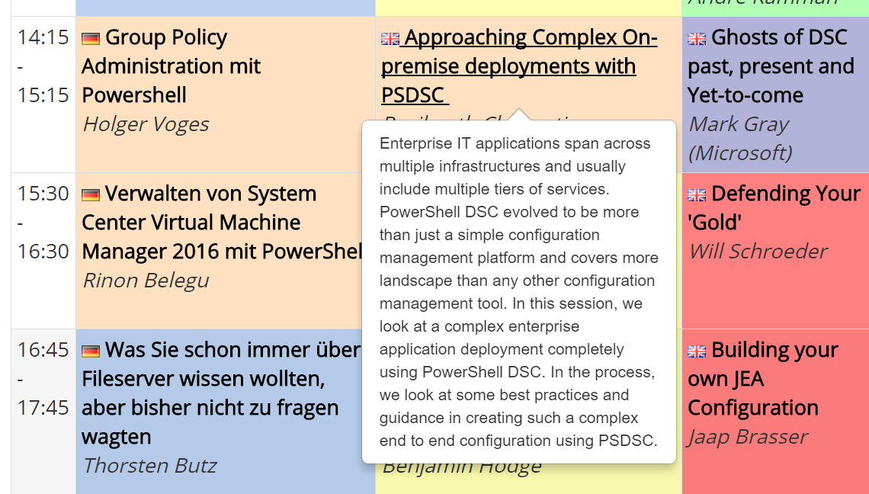


Slide 4
Orchestration vs Configuration

Slide 5
Granular Resource Modeling
(Find-DscResource | Select-Object -Property Name -Unique).Count
831

Slide 6
Summary
Make sure you add a summary slide
Use 3-5 bullet points to reiterate key points

Slide 7
Next Steps...
Now: 15 min break
Grab a coffee
Stay here to enjoy next presentation
Change track and switch to another room
Ask me questions or meet me in a breakout session room afterwards

Slide 8
Questions?

