Slide 1
Azure at the command line Choosing the right tool!
Ravikanth Chaganti
Distinguished Member Technical Staff, Dell EMC
Microsoft MVP

Slide 2
Agenda
Azure Command line
Azure CLI 2.0
PowerShell Az Module
Q & A

Slide 3
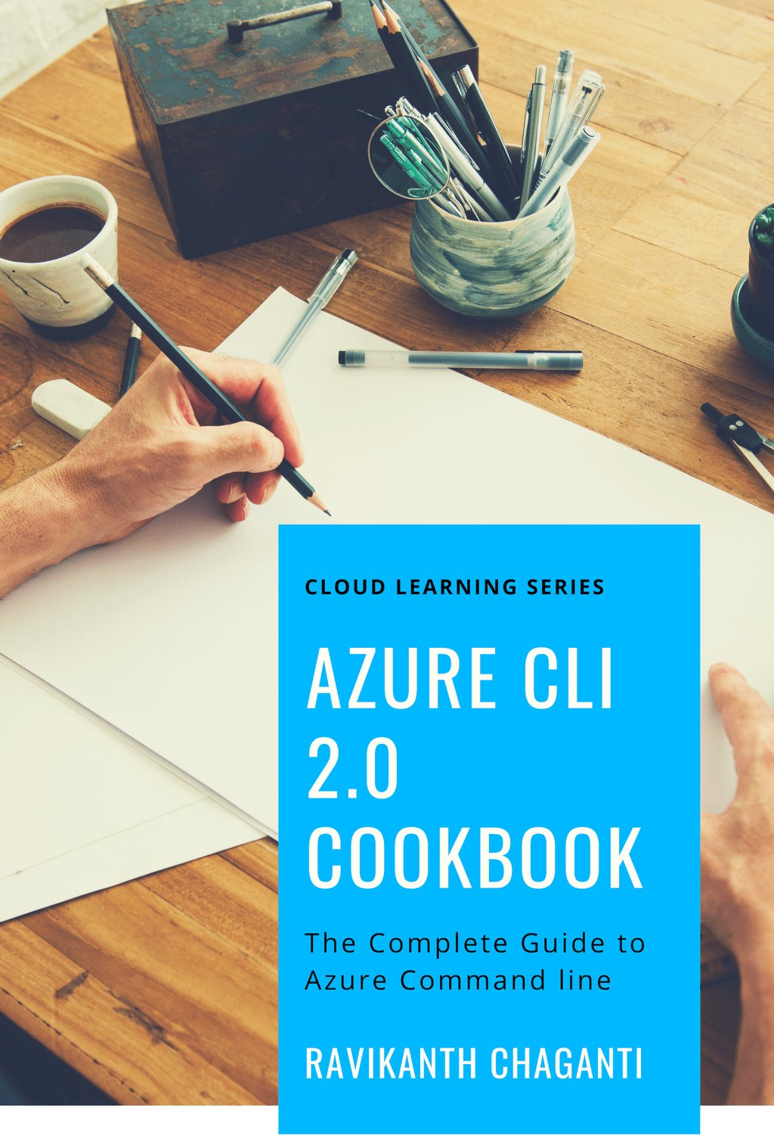
>_ whoami
Distinguished Member Technical Staff @ Dell EMC
Microsoft MVP (CDM)
Published Author
Founder and Editor @ PowerShell Magazine
Twitter.com/Ravikanth
GitHub.com/rchaganti
http://book.azc.li

Slide 4

Azure @ Command Line
Azure CLI 1.0
Azure CLI 2.0
Az PowerShell Module

Slide 5

Azure @ Command Line
 | Azure CLI 2.0 | Az Module
Windows
Linux
macOS
Cloud Shell
VS Code
Container
Open Source
So, how exactly do we choose between these?

Slide 6
Azure CLI 2.0
Written in Python
Current version is 2.0.54
Usage: az [group] [subgroup] [command] {parameters}
Supports interactive execution
Supports JMESPath for queries
Supports extensions

Slide 7
Demo
Starting with Azure CLI 2.0
Notes:
Azure Cloud Shell (https://shell.azure.com)
Bash Cloud Shell in VS Code
WSL in VS Code
At cmd
Az Interactive

Slide 8
Azure PowerShell Az Module
Current version is 1.1.0
Requires .NET 4.7.2
A rollup module
No interactive experience like Az Cli
Help and documentation still evolving
All PowerShell goodness to work with output
Enables legacy command support through aliases

Slide 9
Demo
Starting with Azure PowerShell Az Module
Notes:
Azure Cloud Shell (https://shell.azure.com)
PowerShell Cloud Shell in VS Code
WSL in VS Code (with pwsh)
At cmd

Slide 10
Summary
Azure CLI
Commands are more intuitive
az interactive can be very helpful for beginners
Scripting requires Unix/Linux shell scripting experience
Azure PowerShell
Beginners may find it difficult to discover commands
Existing PowerShell experience can be very useful

Slide 11
Resources
Az Cli: https://github.com/Azure/azure-cli
Docs: https://docs.microsoft.com/en-us/cli/azure/
Az Module: https://github.com/Azure/azure-powershell
Docs: https://docs.microsoft.com/en-us/powershell/azure

Slide 12






Thank You!
Conference Partner
Session Partners
Overseas Partners

