Slide 1
DSC Partial Configurations and Cross-Machine Synchronization
A Deep Dive
Ravikanth Chaganti

Slide 2
About_Author
Principal Engineer at Dell Inc.
MVP, CDM (Windows PowerShell)
Founder and Editor, PowerShell Magazine
Author
PowerShell Desired State Configuration Revealed
Layman‘s Guide to PowerShell 2.0 Remoting
WMI Query Language via PowerShell
A few more coming soon!

Slide 3
Agenda
Partial Configurations
Demo
Is this right for you?
Cross-Node Synchronization
Demo
Q & A

Slide 4
Partial Configurations
New in WMF 5.0
Enables
Delegated configuration management
Incremental configuration enact

Slide 5
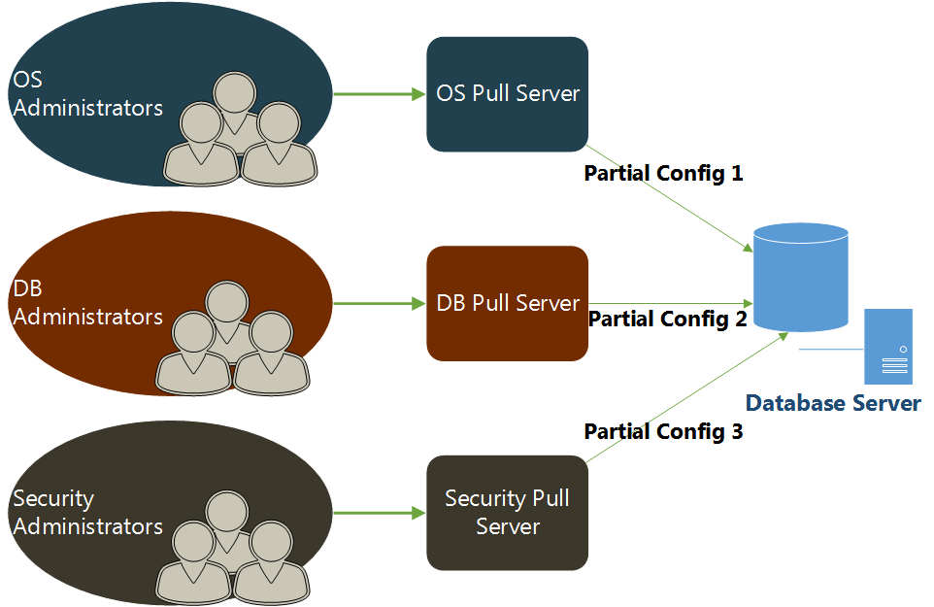
Delegated Configuration Management

Slide 6
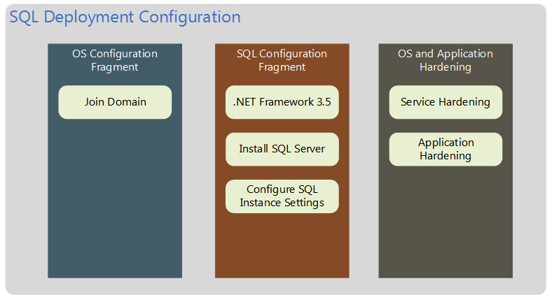
Incremental Configuration Enact

Slide 7
Demo
Partial Configurations

Slide 8
Partial Configurations – Right for you?
Understand the enact process
No conflict checks until runtime
You should know about all fragments upfront
Individual fragment updates may impact operations
Operations Validation #FTW
Should enable collaboration and not separation
Locking resource modules isn‘t always good!

Slide 9
Cross-Node Synchronization
No one deploys infrastructure in silos!
There is always dependency on other nodes in the infrastructure for an application to work.
Cross-Node Synchronization enables this within DSC!
WMF 5.0 provides built-in resources:
WaitForAny
WaitForSome
WaitForAll

Slide 10
Cross-Node Synchronization

Slide 11
Summary
Partial Configurations are great!
Use them wisely
Cross-node synchronization enables building complex DSC configuration for multi-tier deployments

Slide 12
Next Steps...
Now: 15 min break
Grab a coffee
Stay here to enjoy next presentation
Change track and switch to another room
Ask me questions or meet me in a breakout session room afterwards

Slide 13
Questions?

