Slide 1
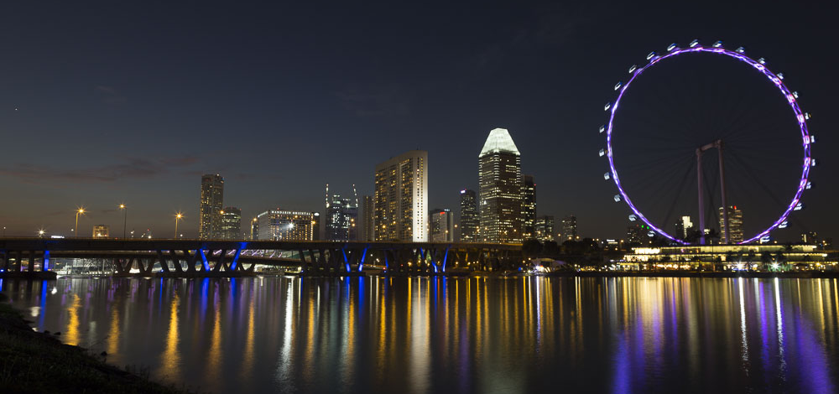





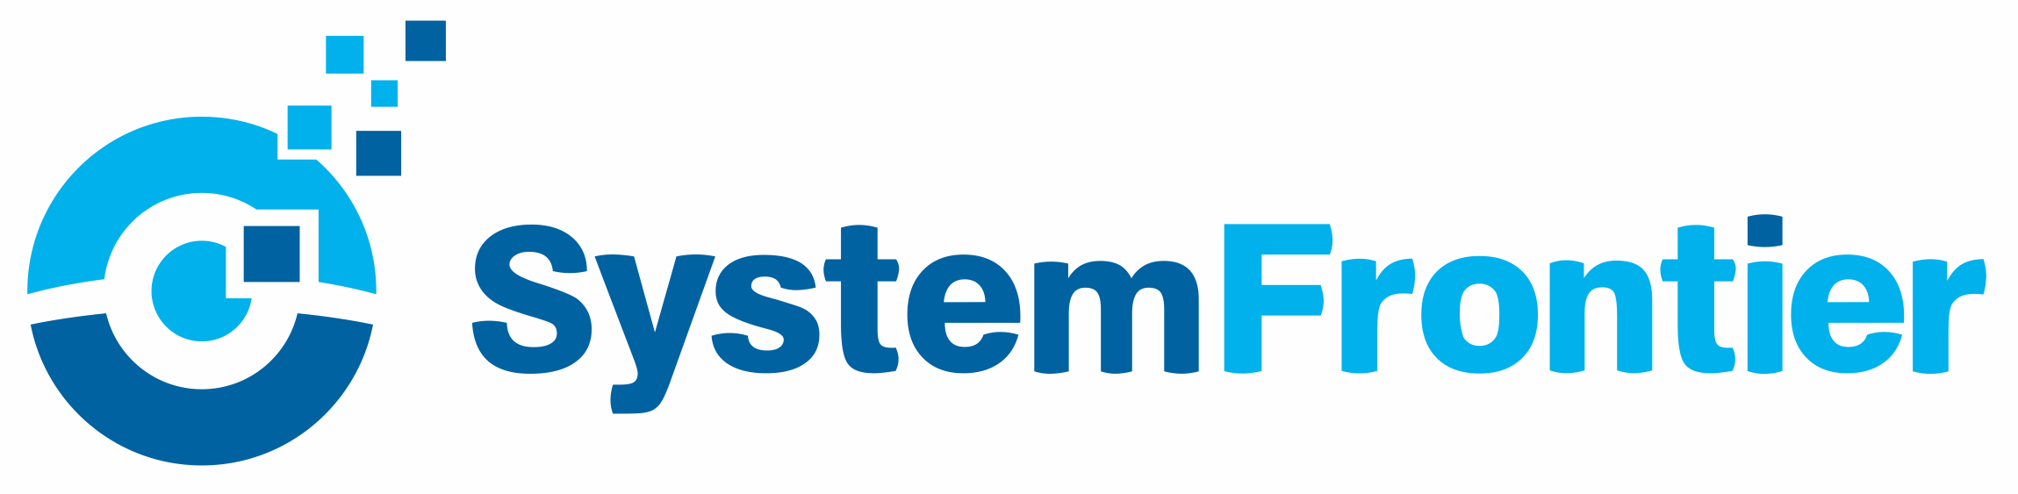




PowerShell Conference Asia
Build Your Own API (BYOA)
Ravikanth Chaganti, Dell EMC

Slide 2

About Me!
Automation fanatic!
Distinguished Member Technical Staff at Dell EMC
Founder and Editor – PowerShell Magazine
Microsoft MVP (CDM)
Published Author
Windows PowerShell Desired State Configuration Revealed (Apress)
Pro PowerShell Desired State Configuration (Apress)
Some more (coming soon!)
PowerShell Conference
Singapore 2018

Slide 3

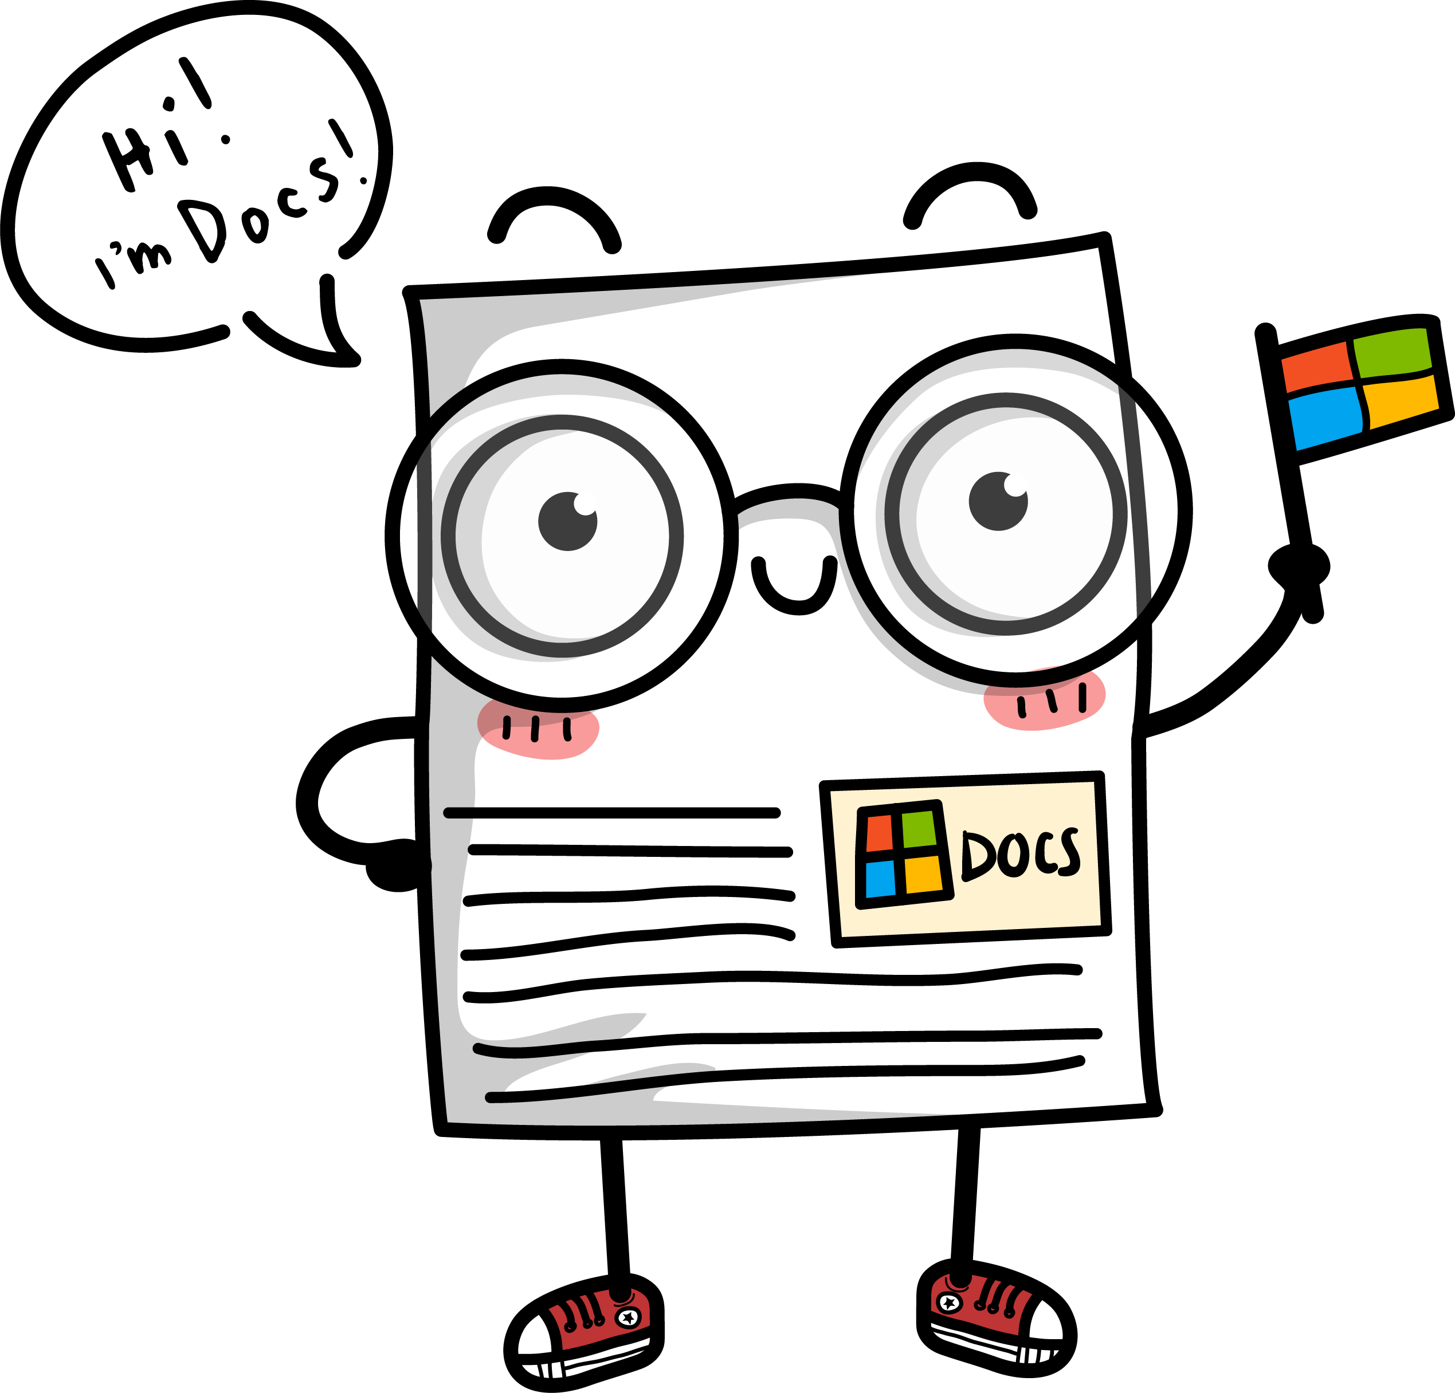
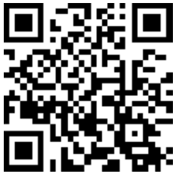
PowerShell quick starts, tutorials, API reference, and code examples!
Advance your career with hands-on training at docs.microsoft
Check it out here:

Slide 4

We really do!
Show some love and join the conversation by tweeting
@MicrosoftTech

Slide 5
Agenda
Why build an API?
HTTPListener Basics
What I built and How?
Considerations when building an API
Questions
PowerShell Conference
Singapore 2018

Slide 6
Why Build an API?
PowerShell is great but …
… not many consoles and applications out there understands it.
... not many developers understand infrastructure and infrastructure automation.
… providing on-demand monitoring, status, and telemetry data visualization is hard!
… building API is fun!
One answer to all … REST API

Slide 7
HTTPListener Basics
HTTPListener provides class in System.Net namespace provides a programmatically controlled HTTP protocol listener.
Supports both synchronous and asynchronous request handling
Several community examples:
Polaris – (https://github.com/powershell/Polaris)
PSHealthz - (https://github.com/devblackops/pshealthz) – Implements Health Endpoint Monitoring Pattern.

Slide 8
Demo
HTTPListener Basics
PowerShell Conference
Singapore 2018

Slide 9
A bit more complex one …

Slide 10
Demo
RedfishListener
PowerShell Conference
Singapore 2018

Slide 11
A little more useful …
Storage Spaces Direct
Hyper-Converged Infra
Disaggregated Infra
Scalable
ROBO
Fully-Converged
Non-Converged
RoCE
iWarp

Slide 12
A little more useful …
DAaaS UI
Deployment Automation As a Service (DAaaS)
Deployment Task Engine
Task Store

Slide 13
A little more useful …

Slide 14
Demo
Deployment Automation as a Service (DAaaS)
DAaaS UI

Slide 15
BYOA in the Cloud …
Several options!
Azure Functions with PowerShell (experimental) was an easy choice.
With Swagger or OpenAPI specification and API management can provide
Documentation of your API
Sign up facility

Slide 16
Demo
DAaaS in Azure

Slide 17
Summary
Build modular automation
Ensure API design follows best practices
Choose the right module to implement API

Slide 18
Don’t Forget!
Fill in your survey – it’s how we do better!
Don’t lose you badge! You need it for the Social Events
Grab the Speakers for a chat – they all have time for you!
Let everyone know what they are missing on Social Media
#PowerShell
#PSConfAsia
@Psconf.Asia
Photos of Marina Bay Credit: Sebastian Szumigalski
PowerShell Conference
Singapore 2018

