Slide 1
PowerShell Data As File System
Ravikanth Chaganti
Distinguished Member Technical Staff, Dell EMC
Microsoft MVP

Slide 2
Agenda
What are Providers?
What is SHiPS?
Demo
Q & A

Slide 3
>_ whoami
Distinguished Member Technical Staff @ Dell EMC
Microsoft MVP (CDM)
Published Author
Founder and Editor @ PowerShell Magazine
Twitter.com/Ravikanth
GitHub.com/rchaganti

Slide 4
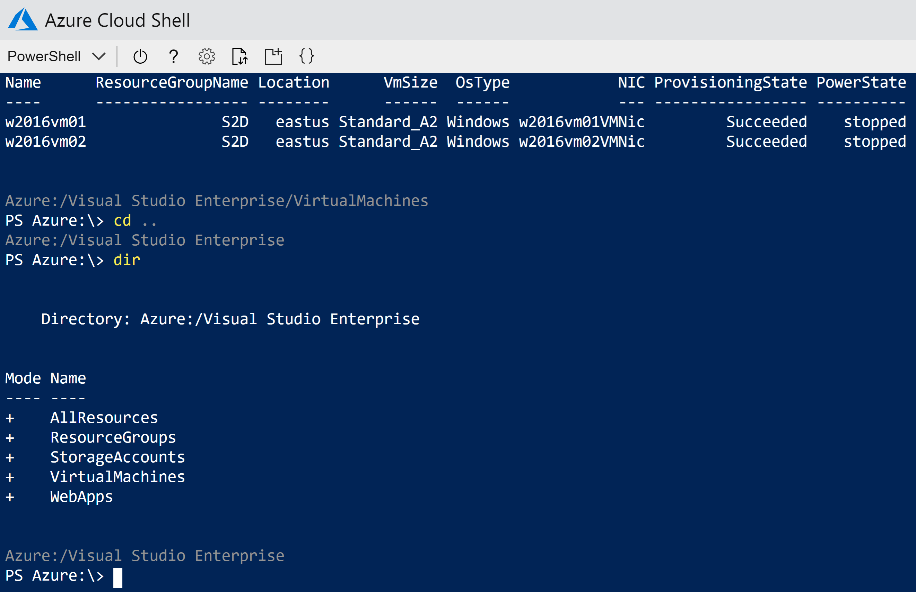
Azure Cloud Shell

Slide 5
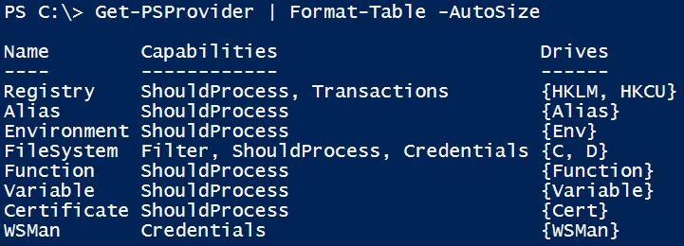
Providers in PowerShell
Not a new concept! Existed since v1.
Provide a method to navigate and manipulate data from data stores through a common interface.
Not easy to develop a provider.

Slide 6
SHiPS History
2014
2017
@beefarino created P2F
@powershell created SHiPS
@powershell created Azure PS Drive & CIM Drive
Thanks to @jianyunt for excellent work on SHiPS

Slide 7
SHiPS – Get Started
Install-Module -Name SHiPSps://GitHub.com/PowerShell/SHiPS
Implements:
Get-Item
Get-ChildItem
Get-Content
Set-Content
No support yet for:
Get-ItemProperty
Set-Item
Set-ItemProperty

Slide 8
Demo
SHiPS Providers

Slide 9
SHiPS – Writing a Provider
Requires
Knowledge of PowerShell classes!
Some level of structured data
Understand the data
Some thoughts on what / how you want to implement the provider
Let us look at EventLogDrive!

Slide 10
Demo
Writing SHiPS-based Providers

Slide 11
Summary
SHiPS makes it easy to implement PS drives.
Identify data source and understand it.
Identify use cases and start with design.

Slide 12






Thank You!
Conference Partner
Session Partners
Overseas Partners

