Slide 1
Microsoft Azure and DevOps
Ravikanth Chaganti, Microsoft MVP – Windows PowerShell & Microsoft Azure
Twitter: @Ravikanth

Slide 2
AGENDA
What is DevOps?
Microsoft Ecosystem
Q & A

Slide 3
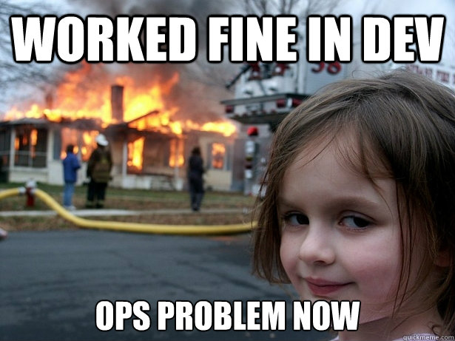
What is DevOps?

Slide 4
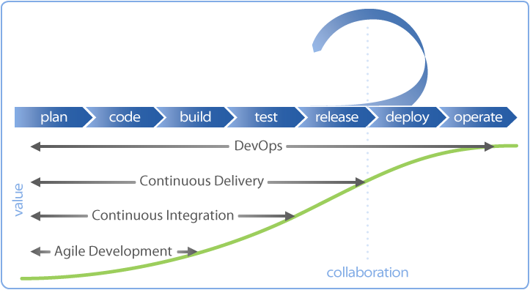
What is DevOps?

Slide 5
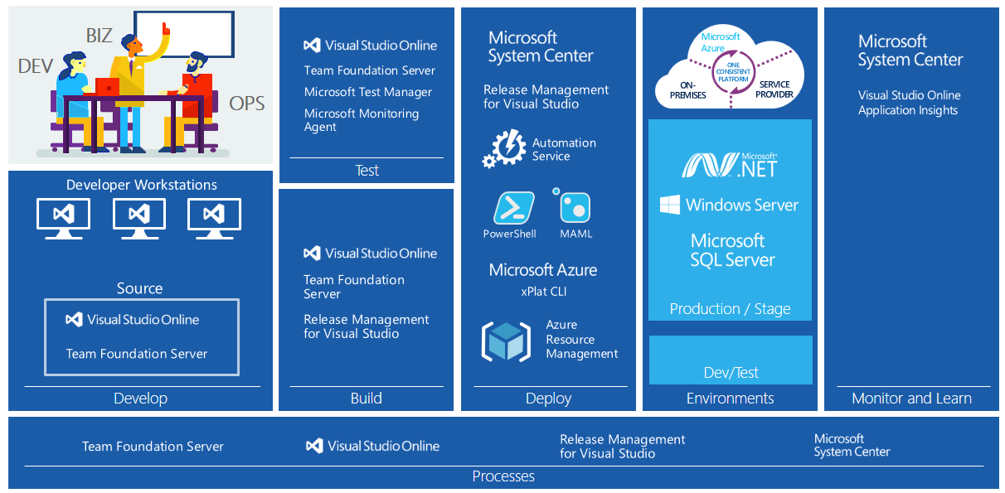
DevOps – Microsoft Eco System

Slide 6
DevOps Practices in Azure Cloud
Infrastructure As Code
https://azure.microsoft.com/en-in/documentation/articles/resource-group-authoring-templates/
Continuous Integration and Deployment
https://azure.microsoft.com/en-in/documentation/articles/cloud-services-continuous-delivery-use-vso/
Release Management
https://msdn.microsoft.com/en-us/library/dn217874(v=vs.140).aspx
Monitoring
https://azure.microsoft.com/en-in/documentation/articles/app-insights-start-monitoring-app-health-usage/

Slide 7
Azure Cloud - Infrastructure As Code
Azure Resource Manager templates enable
Declarative definition of cloud infrastructure
JSON language-based
Idempotent
Quick start templates: https://github.com/Azure/azure-quickstart-templates
Get started with ARM templates: http://azrs.tk/armseries
Application Code
Infrastructure Configuration

Slide 8
Azure Cloud – Continuous Integration
Create and manage build processes
Automatically compile and test your applications in the cloud or on premises
Link builds to test results, work items, code, and releases
Build
Application Code
Unit
Tests
Infrastructure Configuration
Integration Tests

Slide 9
Azure Cloud – Continuous Delivery / Deployment
Trigger a release to a relevant environment and run functional tests
Development
QA
Staging
Production
Development
QA
Build
Application Code
Unit
Tests
Infrastructure Configuration
Integration Tests
Production

Slide 10
Azure Cloud - Monitoring
Monitor what is deployed
Respond to anomalies in performance and availability
Azure Application Insights
Operations Management Suite

Slide 11
DevOps – Microsoft Eco System

Slide 12
Summary
End to end automation should be the goal
Microsoft Azure enables end to end DevOps practices
Choose between Microsoft and alternate eco-system based on what you are building

