Slide 1






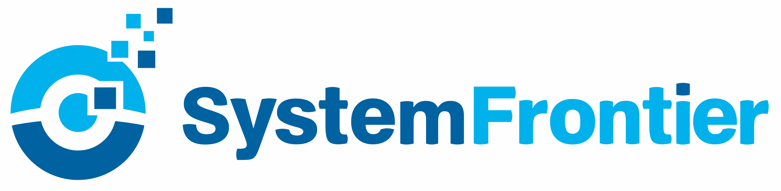




PowerShell Conference Asia
DSC Operations Validation
Ravikanth Chaganti, Dell EMC

Slide 2
Agenda
Testing DSC Resource modules
Unit
Integration
Operations
Q & A

Slide 3
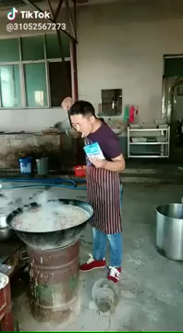
Coding DSC Modules Should Not Be Like …

Slide 4
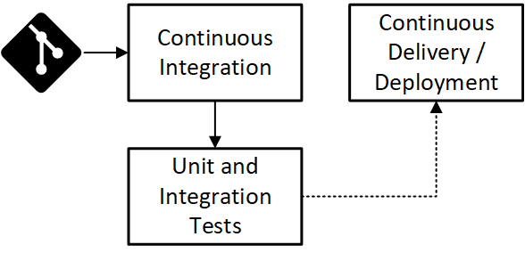
Coding DSC Modules Should Be Like …

Slide 5
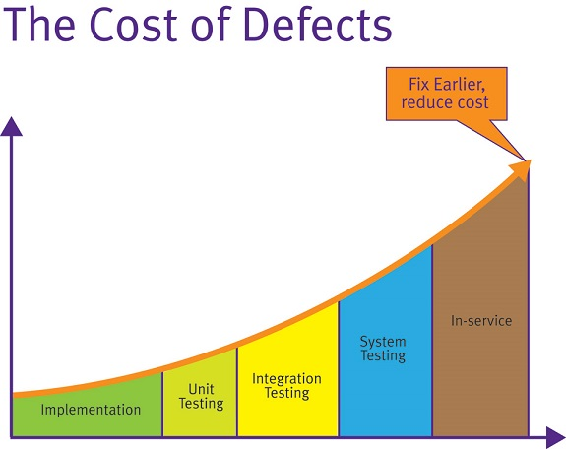
Why test DSC Modules?
Image Source: https://fullstackmark.com/post/7/learning-unit-testing-in-aspnet-core

Slide 6
Pester 101
Test and Mock framework for PowerShell
Enables Test Driven Development (TDD) in PowerShell
Provides Domain-Specific Language (DSL) to write tests.
Pester 101: https://www.youtube.com/watch?v=gssAtCeMOoo

Slide 7
Demo
Pester 101

Slide 8
Unit Tests

Slide 9
Demo
Unit Tests

Slide 10
Integration Tests

Slide 11
Demo
Integration Tests

Slide 12

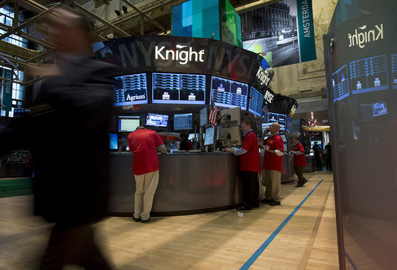
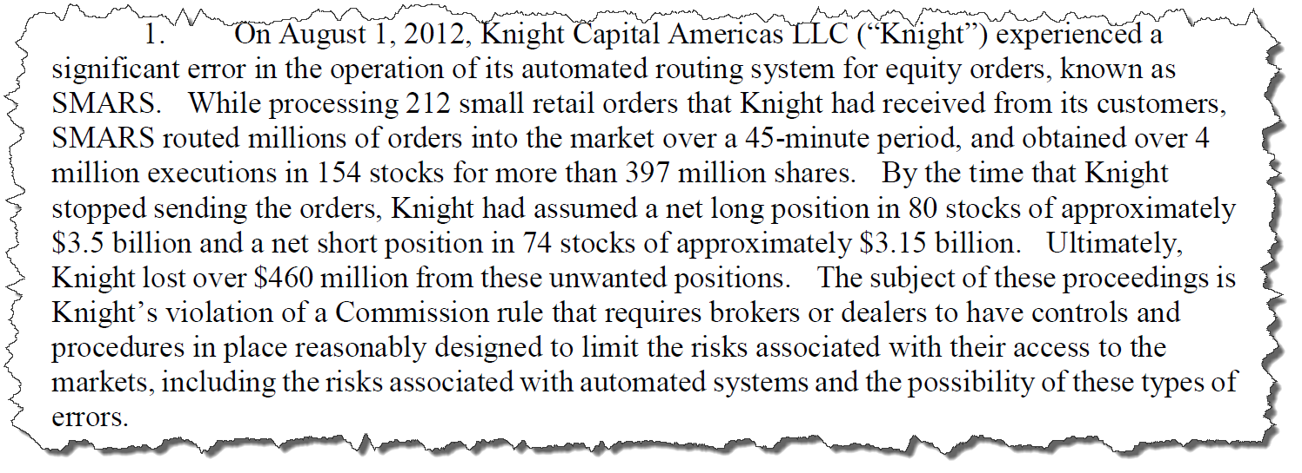
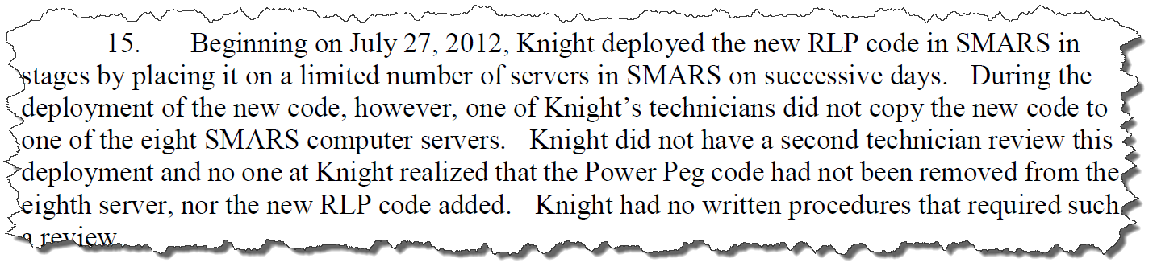
What About Ops Validation?

Slide 13
Demo
Operations Validation

Slide 14

Don’t Forget!
Fill in your survey – it’s how we do better!
Don’t lose you badge! You need it for the Social Events
Grab the Speakers for a chat – they all have time for you!
Let everyone know what they are missing on Social Media
#PowerShell
#PSConfAsia
@Psconf.Asia
Photos of Marina Bay Credit: Sebastian Szumigalski
PowerShell Conference
Singapore 2018

