Slide 1
Operations Validation For Infrastructure as Code
An Overview
Ravikanth Chaganti

Slide 2
About_Author
Principal Engineer at Dell Inc.
MVP, CDM (Windows PowerShell)
Founder and Editor, PowerShell Magazine
Author
PowerShell Desired State Configuration Revealed
Layman‘s Guide to PowerShell 2.0 Remoting
WMI Query Language via PowerShell
A few more coming soon!

Slide 3
Agenda
Why Operations Validation?
Demo
Operations Validation Framework

Slide 4

The Phoenix Project

Slide 5

THE Phoenix Project?
Image: http://www.bloomberg.com/news/articles/2012-08-14/knight-software

Slide 6
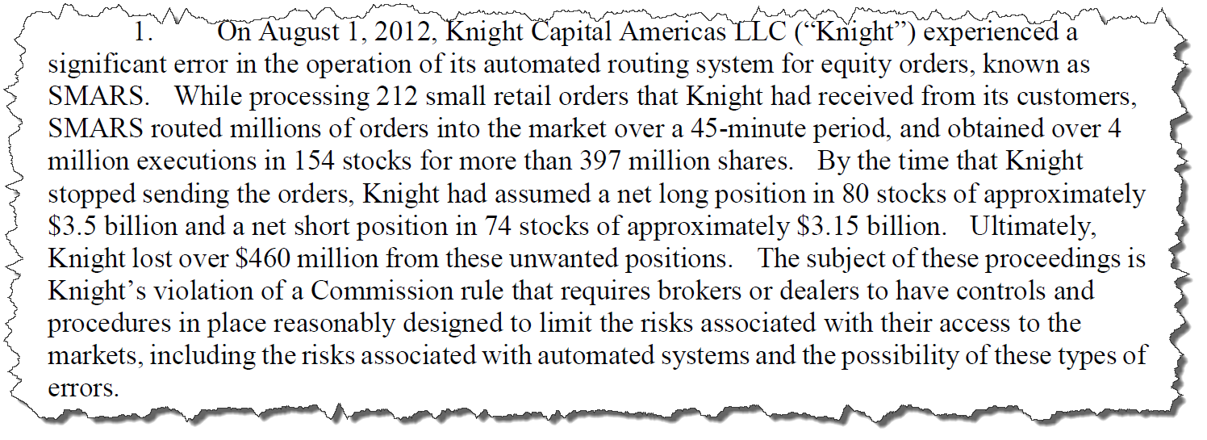
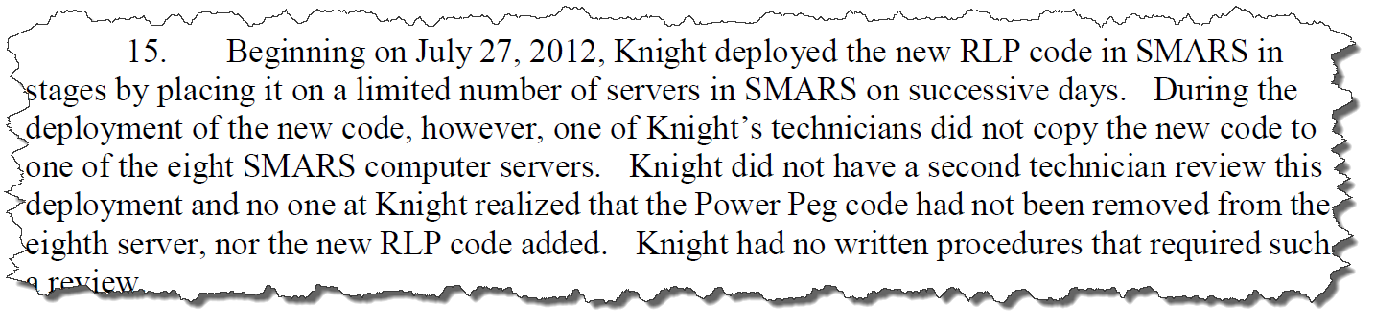
KCG Debacle!

Slide 7

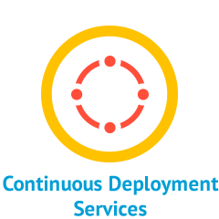


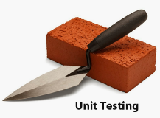
Infrastructure as Code
Reusable Automation
Source Control
Unit Testing
Continuous Deployment

Slide 8


Infrastructure as Code
Reusable automation
Source Control
Unit Testing
Continuous Deployment
Integration and Operations
Validation

Slide 9
Operations Validation
Not same as integration testing
Integration tests validate the desired state
Operational tests validated the functionality at desired state!

Slide 10
Demo
Enough Talk!

Slide 11
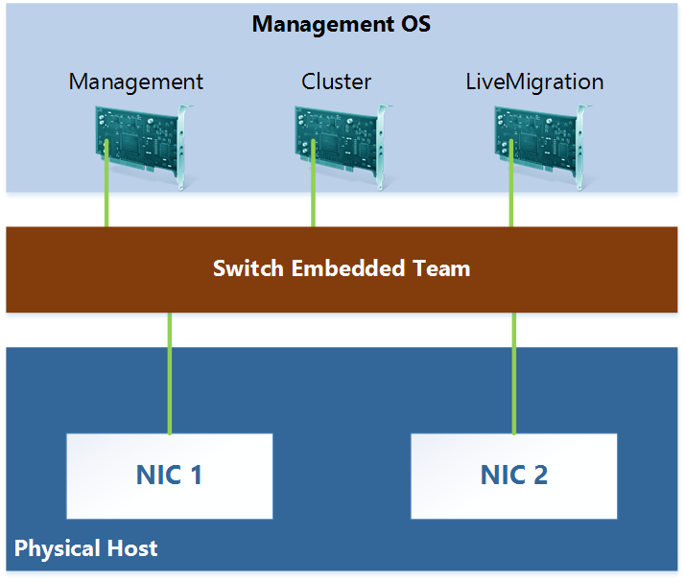
Scenario
Hyper-V Converged Virtual Switch
Common architecture across cluster of nodes
DSC configuration along with tests is an infrastructure blueprint

Slide 12
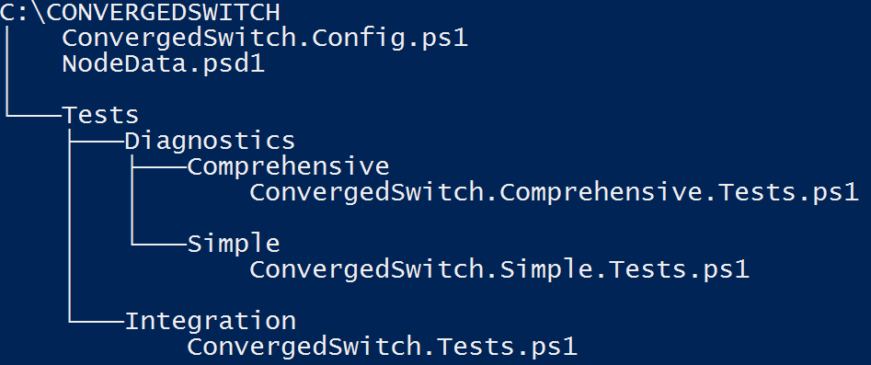
Packaging Blueprints
https://github.com/rchaganti/InfraBlueprints

Slide 13
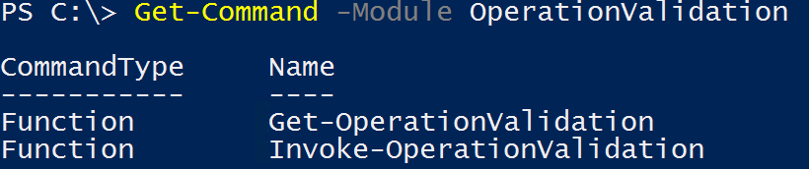
Operations Validation Framework
https://github.com/PowerShell/Operation-Validation-Framework
The module structure required is as follows:
ModuleBase\
Diagnostics\
Simple
Comprehensive

Slide 14
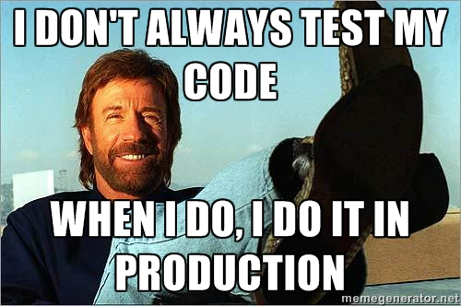
Summary
DON‘T IGNORE OPERATIONS VALIDATION

Slide 15
Next Steps...
Now: 15 min break
Grab a coffee
Stay here to enjoy next presentation
Change track and switch to another room
Ask me questions or meet me in a breakout session room afterwards

Slide 16
Questions?

