Slide 1
>_ Test Driven Learning
Ravikanth Chaganti
@ravikanth

Slide 2
About Me!
Distinguished Member Technical Staff @ Dell EMC
Founder and Editor at PowerShell Magazine
Multi-year recipient of Microsoft MVP award
Published Author
GitHub.com/rchaganti
Twitter.com/ravikanth

Slide 3
Learning PowerShell?
Everyone of us have our preferences!
Books
Video Courses
In-person trainings
Hands-on
PowerShell community has this covered for you!

Slide 4
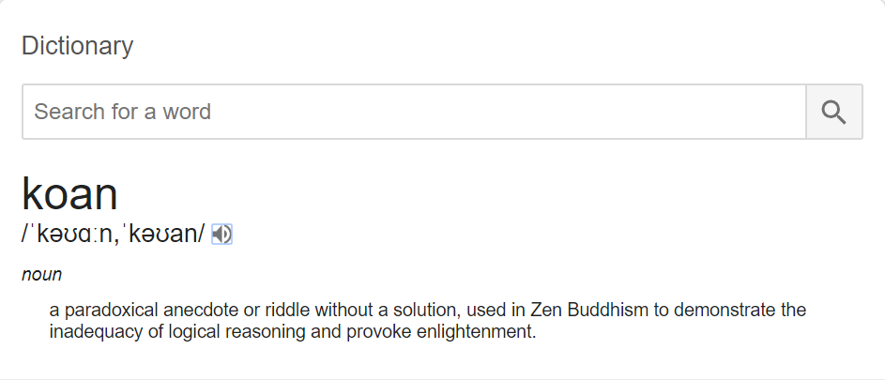
PSKoans
Joel Sallow (@vexx32) developed PSKoans
https://github.com/vexx32/PSKoans
Inspired by Chris Marinos's F# koans
Each kōan (each question) is represented by a failing Pester test
Learner’s goal is to make each test pass by filling out the right answer or writing the correct code
Teaches beginner, intermediate, and advanced PowerShell concepts

Slide 5
PSKoans - Demo

Slide 6
Questions?

Slide 7
Thank you!

