Slide 1


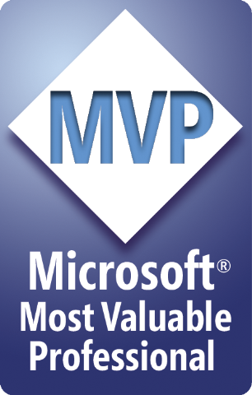


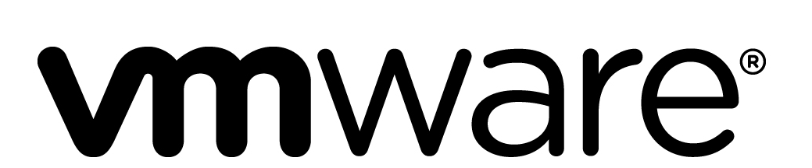
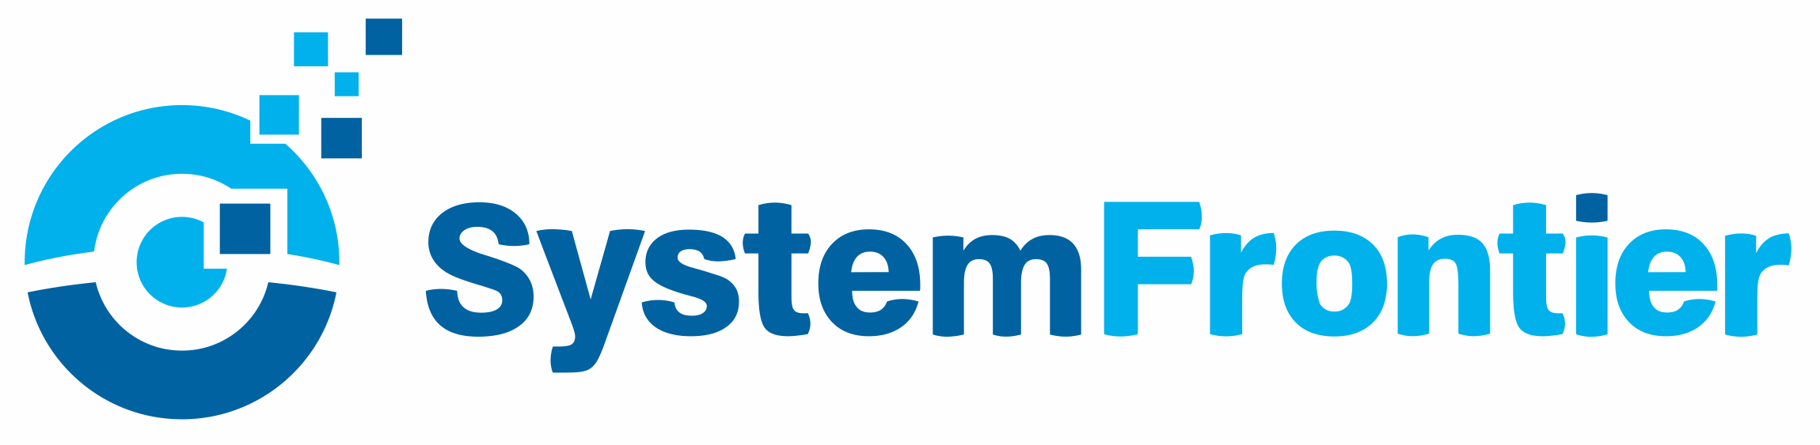




PowerShell Conference Asia
DSC Operations Validation
Ravikanth Chaganti, Dell EMC

Slide 2

About Me!
Automation fanatic!
Distinguished Member Technical Staff at Dell EMC
Founder and Editor – PowerShell Magazine
Microsoft MVP (CDM)
Published Author
Windows PowerShell Desired State Configuration Revealed (Apress)
Pro PowerShell Desired State Configuration (Apress)
Some more (coming soon!)
PowerShell Conference
Singapore 2018

Slide 3
Agenda
Testing DSC Resource modules
Unit
Integration
Operations
Q & A

Slide 4
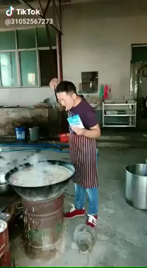
Coding DSC Modules Should Not Be Like …

Slide 5
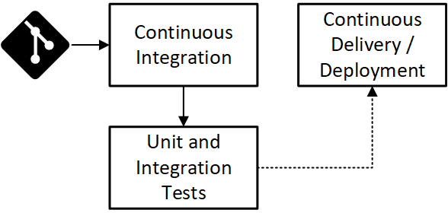
Coding DSC Modules Should Be Like …

Slide 6
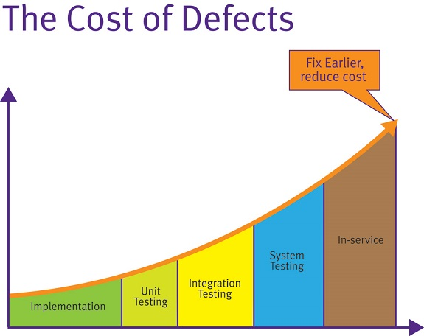
Why test DSC Modules?
Image Source: https://fullstackmark.com/post/7/learning-unit-testing-in-aspnet-core

Slide 7
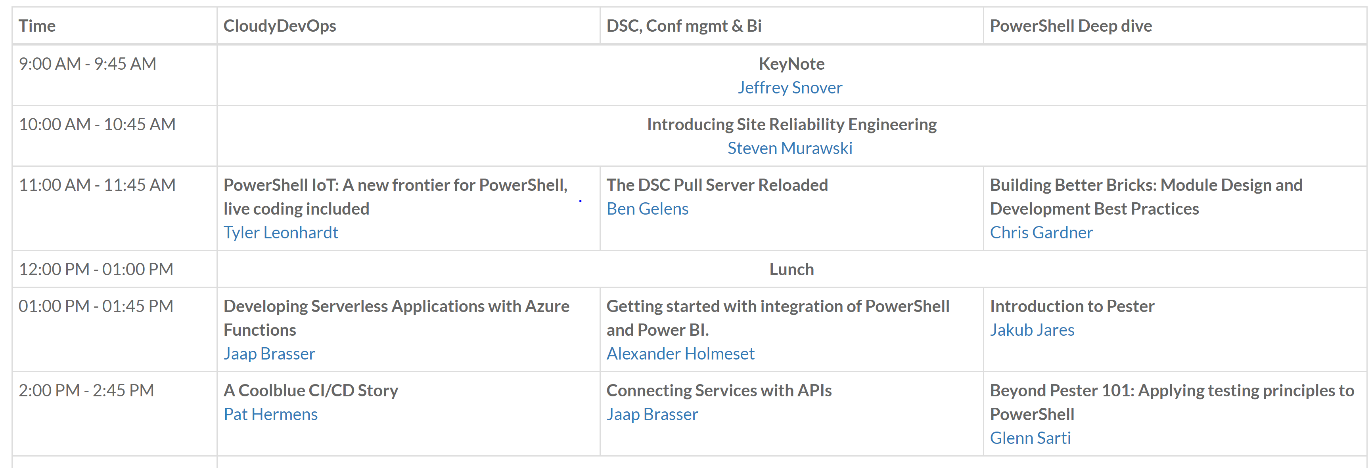
Pester 101
Test and Mock framework for PowerShell
Enables Test Driven Development (TDD) in PowerShell
Provides Domain-Specific Language (DSL) to write tests.
Pester 101: https://www.youtube.com/watch?v=gssAtCeMOoo

Slide 8
Demo
Pester 101

Slide 9
Unit Tests
Test the code and logic!
Use mocking.
No state changes.

Slide 10
Demo
Unit Tests

Slide 11
Integration Tests
No mocking
Test desired state
Not a functional test

Slide 12
Demo
Integration Tests

Slide 13

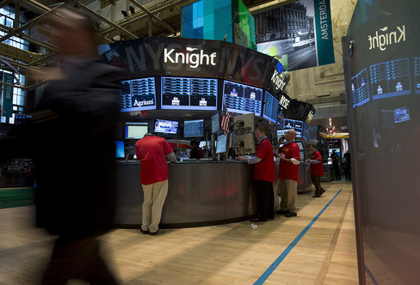
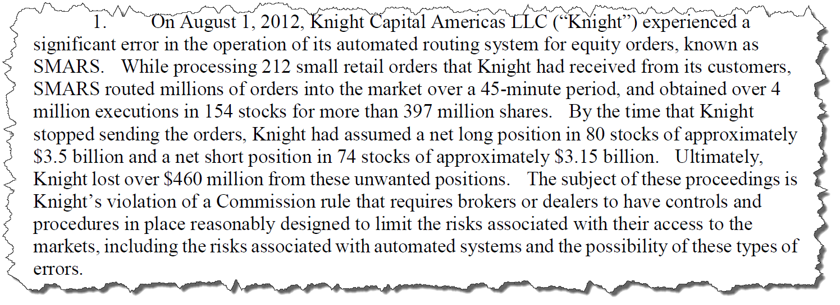
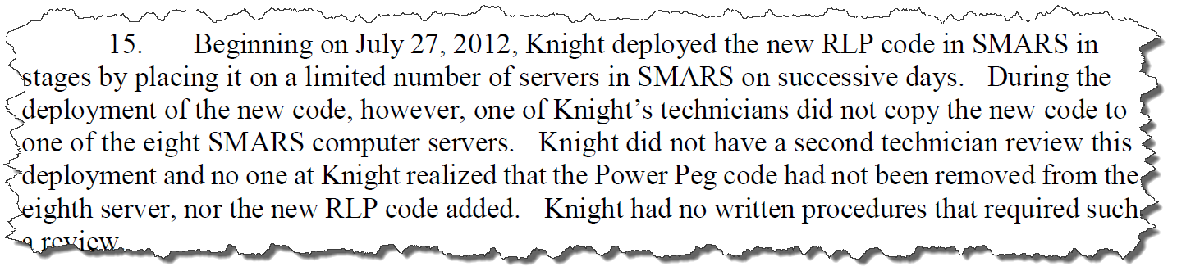
What About Ops Validation?

Slide 14
Demo
Operations Validation

Slide 15
Don’t Forget!
Fill in your survey – it’s how we do better!
Don’t lose you badge! You need it for the Social Events
Grab the Speakers for a chat – they all have time for you!
Let everyone know what they are missing on Social Media
#PowerShell
#PSConfAsia
@Psconf.Asia
Photos of Marina Bay Credit: Sebastian Szumigalski
PowerShell Conference
Singapore 2018

