Slide 1
Monitoring : Think Business Processes
Rodrigue Chakode
11/07/2013 - RMLL 2013

Slide 2
Who I'm
Rodrigue Chakode
  PhD in HPC & Cloud Computing
  R&D Engineer @SysFera
  IT Monitoring enthusiast
    Author of RealOpInsight @NGRT4N Project
      http://realopinsight.com
  Lead of OpenNebula User Group France
  In short, an Architect for Open Technologies

Slide 3
Let's start: Facts
Huge number of checks to deal with in today IT infrastructures
  E.g. 8 checks/host => 8,000 checks for 100 hosts
Too many alarms kill alarm
  credit : S. Bortzmeye
False alerts are the bane of administrators
  Yes, not a matter of being a lazy admin
All operators are not concerned with all of checks

Slide 4
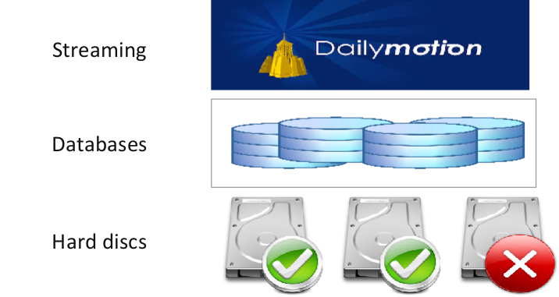
Example of issue to address
How a failure actually impacts services ?
How a failure actually impacts services ?

Slide 5
Is there a disruption of services?
RAID 0 vs RAID 1
  Does your monitoring system can allow you deal with such a knowledge ?

Slide 6
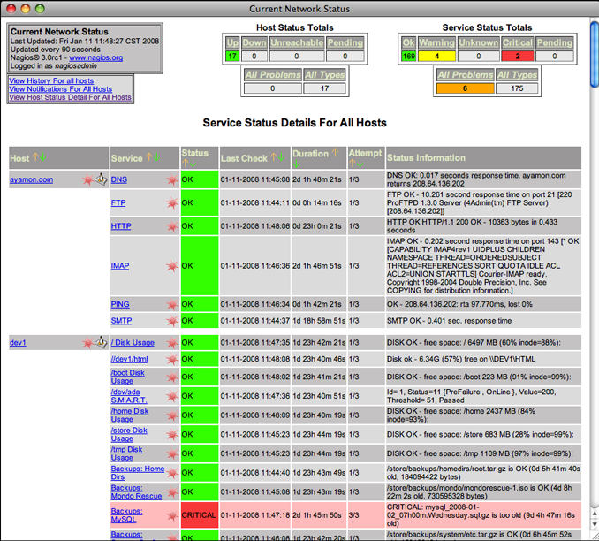
Quid of open source monitoring tools
Flat display of check results (e.g. Nagios Core)

Slide 7
Go beyond individual check statuses
Think high-level services (business processes)
  A failure don't necessarily mean actual problems regarding applications or end-users services
Specialization of dashboard views
  end-user service-centric, platform-centric or operator-centric
  Just collect what is useful for the views
  Be able to get the actual state of a view at a glance

Slide 8
Go towards a relational view of services
A end-user service depends on :
  one or more low-level services
  one or more other business processes
  streaming service ← web service ← network ← databases ← operating system ← hardware...

Slide 9
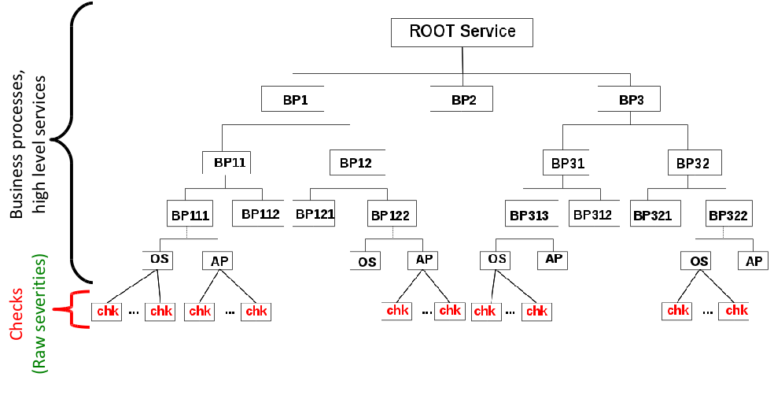
Think hierarchical views

Slide 10
Flexible and fine-grained incident management capabilities
Severity calculation
  Determine how the severity of a node would depend on the severities of its child nodes
Status propagation
  Determine how the severity of a node would be propagated to its parent node

Slide 11
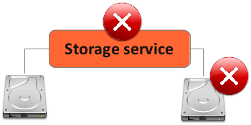
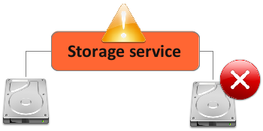
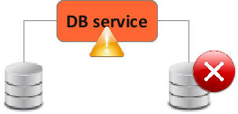
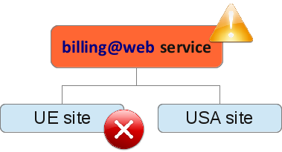
Use cases of severity calculation
RAID 0
RAID 1
Redundant databases
Merchant-site

Slide 12


Acknowledgments

