Slide 1

Effective Monitoring for Demanding Operations Environments
Rodrigue Chakode
Nagios World Conference, Saint-Paul, MN, US
2013-10-01
Notes:
Bonjour,
Je m'appelle Rodrigue Chakode, et je vais vous parler de RealOpInsight, un projet open source que j'ai initié il y a environ trois ans pour permettre la gestion des services de haut-niveau dans un environnement de supervision open source
L'exposé s'articulera autour des points suivants :
Je vais commencer par introduirepour ceux qui ne sont pas familier à la supervsion quelques notions de base dans un contexte de supervision
Ensuite, je vous présenterai l'es enjeux et les problématiques de la supervision des services de haut-niveau
Ceka me permettra de faire un état de l'art de ce qui existe dans ce domaine
Enfin, je présente RealOpInsight,
Je terminerai la présentetion par une petite historique sous forme de retour d'expérience en plein parcours

Slide 2
Agenda
Who I'm
Background
Why Business Service Management (BSM)
Deal with BSM : State-of-art
RealOpInsight: A Software for BSM
History: Experience Feedback

Slide 3


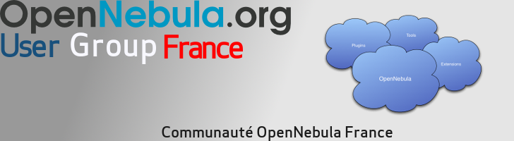

Rodrigue Chakode
Author & Project Lead
PhD, R&D HPC/Cloud Software Engineer
Community Manager
http://fr.linkedin.com/in/rodriguechakode‎

Slide 4
Background
Service : generic term to refer an IT functionality (e.g. mysqld service)
Business Service/Process : a service provided value-added to business applications or to end-users (e.g. hosting service)
Check: a probe allowing to detect the status of an IT service (e.g. check for mysqld service)
Abbreviations
  BS: Business Service
  BP: Business Process
  BSM: Business Service Management
  OSM: Open Source Monitoring
  OSMS : Open Source Monitoring System/Software

Slide 5
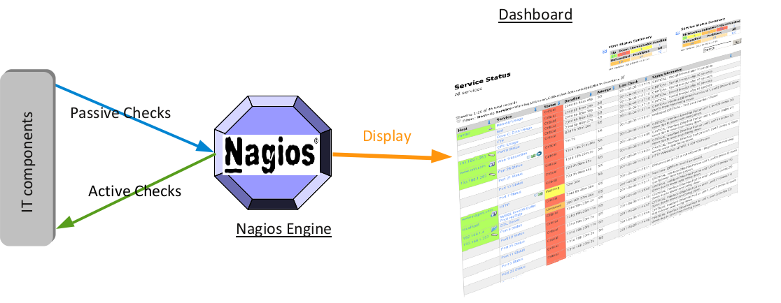
Basic Monitoring Scheme
Flat Display, no notion of business impact !

Slide 6
“Too many alarms kill alarm”
S. Bortzmeye

Slide 7
Today's IT infrastructures facts
Huge number of checks to handle
  E.g. 100 hosts, 8 checks/host => 8,00 checks
False alerts are the bane of administrators
  Not a matter of being a lazy admin
No way for operators to be effective with flat display !

Slide 8
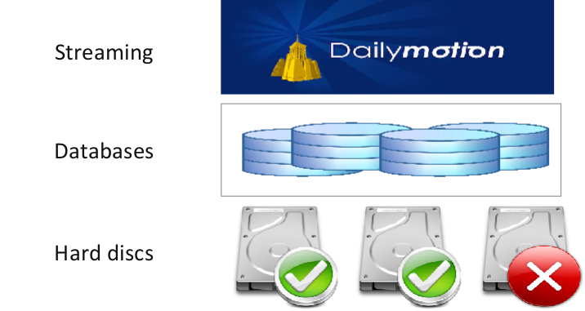
Challenges for effective monitoring
How a failure actually impacts your business ?

Slide 9
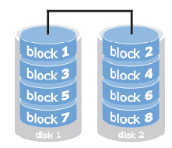
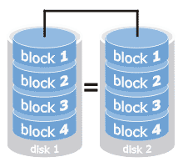


Is there a disruption of services?
RAID 0
(striping)
RAID 1
(mirroring)

Slide 10
“prioritize and orchestrate work based on business needs” http://www.bmc.com/solutions/bsm/

Slide 11
Go beyond individual checks
Think business services
  A failure don't necessarily mean disruptions on business applications or end-user services
Benefits of BSM
  Reduce downtime by up to 75%
  Deliver services up to 30% more efficiently
  Credit: http://www.bmc.com/solutions/bsm/

Slide 12
Think relational services
A business service may depend on :
  one or many IT services, and/or on
  other business services
  E.g. Streaming ← Web Server ← Databases ← Network ← Operating System ← Hardware Devices...

Slide 13
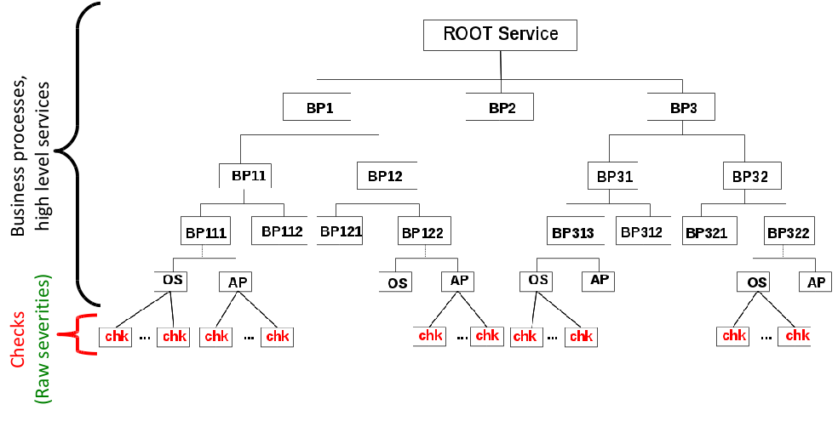
Service hierarchy and mapping

Slide 14
Service hierarchy and mapping
Service map ISN'T Network map

Slide 15
Apply flexible incident management
Only select checks that impact your business services
Apply advanced severity calculation
    Set how the severity of a node is computed from on the severities of its childs
  And advanced status propagation rules
    Set how the severity of a node is propagated to its parent

Slide 16
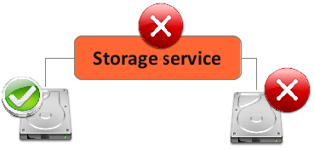
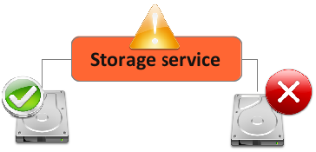
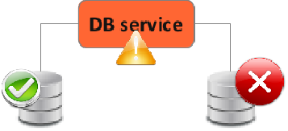
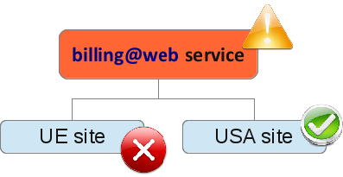
Use cases
RAID 0
RAID 1
Redundant databases
Merchant-site

Slide 17
Specialize your Operations Dashboards
Business service-centric/competency-centric
Deal with large/demanding environments
  Just collect what is useful for each dashboard
Get insight in one shot

Slide 18
“takes the IT you already have, and adds to it the visibility and control of a unified platform”
http://www.bmc.com/

Slide 19
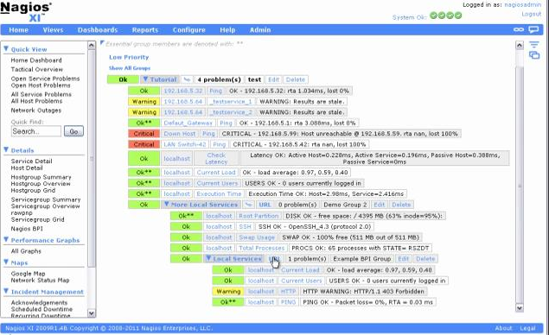
Existing options
Basic features
  Nagios BP Add-on, Shinken Business Rules
  No service map, basic aggregation rules
  Handle a huge number of services could be tricky

Slide 20
RealOpInsight
Powerful Dashboard Toolkit for BSM
  Generic and versatile add-on supporting many OSM tools
Qt-based GUI application
  Powerful and friendly interfaces
  Cross platform (Linux, Windows, Mac OS X)
http://realopinsight.com
“small and efficient and gets the job done” lukaswhite, SourceForget.net

Slide 21
Some Features
Effective Operations Management
  Prioritize incidents based on business impact
Advanced customizable event processing rules
  avg, high impact, decrease, increase...
Distributed monitoring made easy
  Versatile, supports up to 10 monitoring backends simultaneously
Free, Open Source and Cross-platform
  Windows, Linux, OS X
More comprehensive messages
  e.g. “the CPU load on server <IP/hostname> is more than <threshold> percent
System Tray Notifications

Slide 22
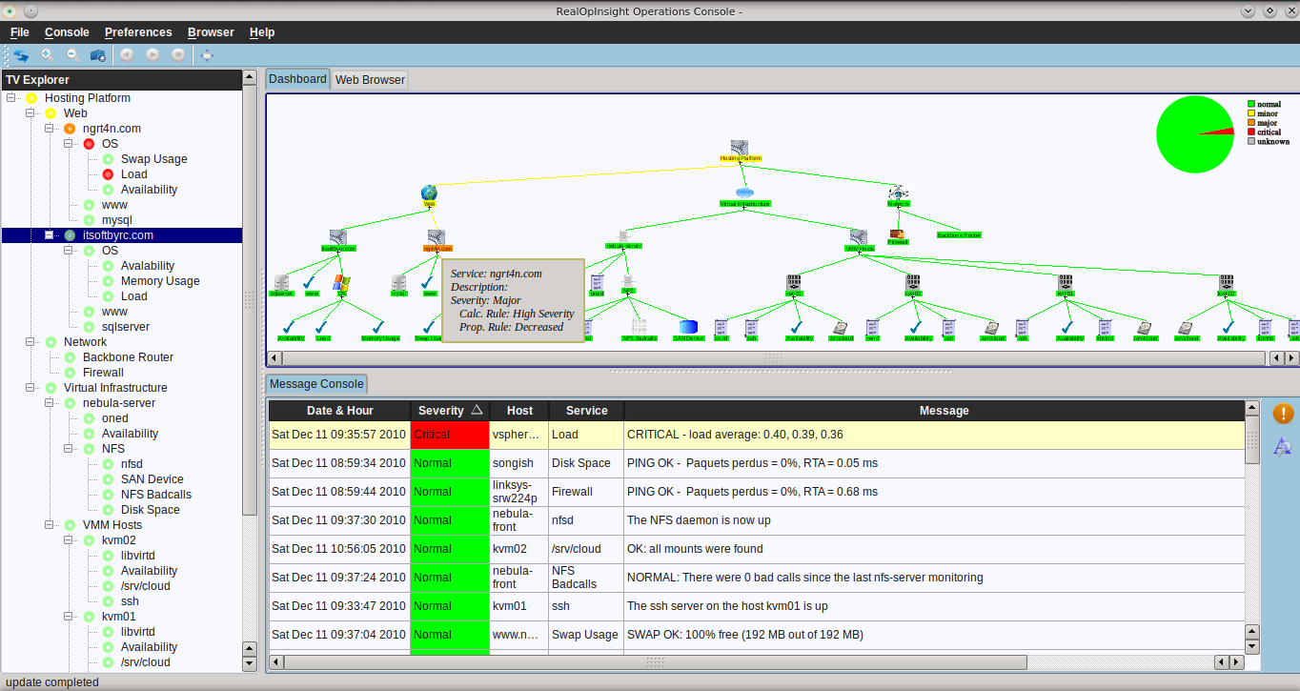
Tree View, Map and Events in one Console
Service Mapping
Tooltips, Zooming, Dragging and Scrolling, Focus, Service-related message filtering...
Service Tree
Tooltips
Focus
Service-related message filtering...
Message Console
Trouble view filtering, Large font mode

Slide 23
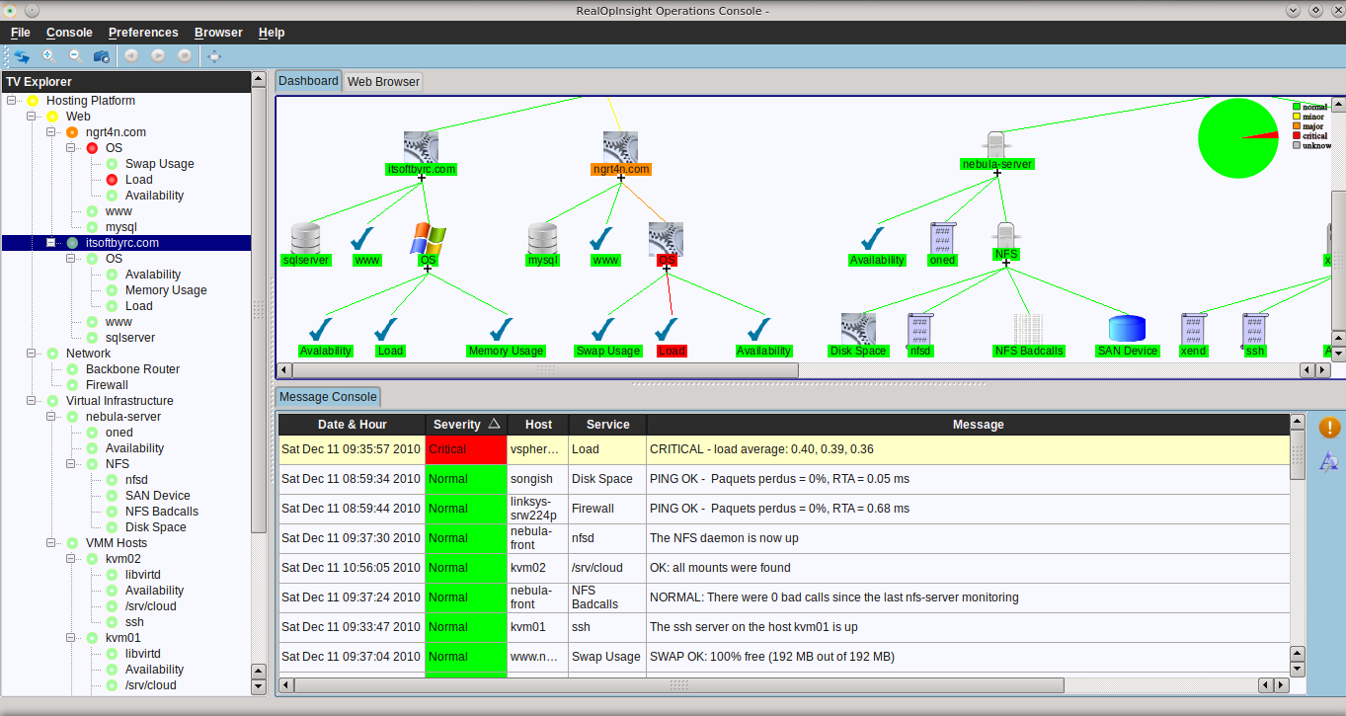
Advanced Incident Management
Severity aggregation
Severity increasing
Severity decreasing
...

Slide 24
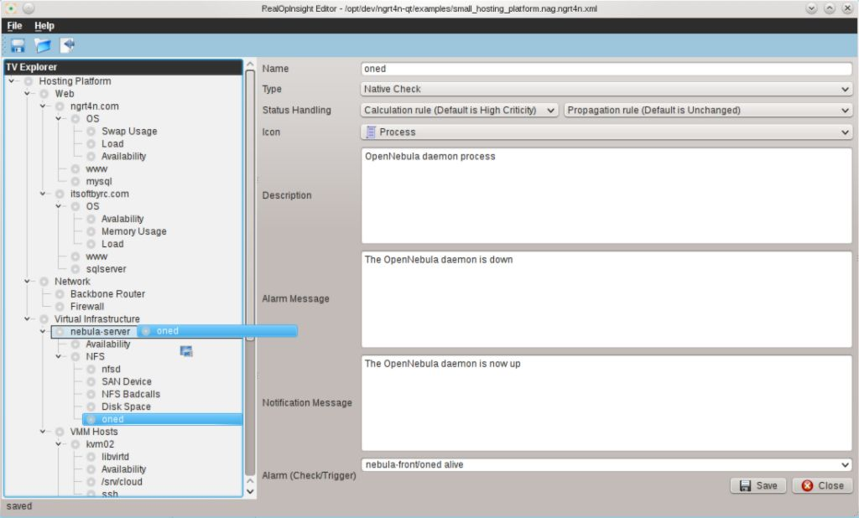
Simple and Efficient Design
Service Views as XML files
Native WYSIWYG Editor
Dynamic Operations Console
Simple Integration

Slide 25
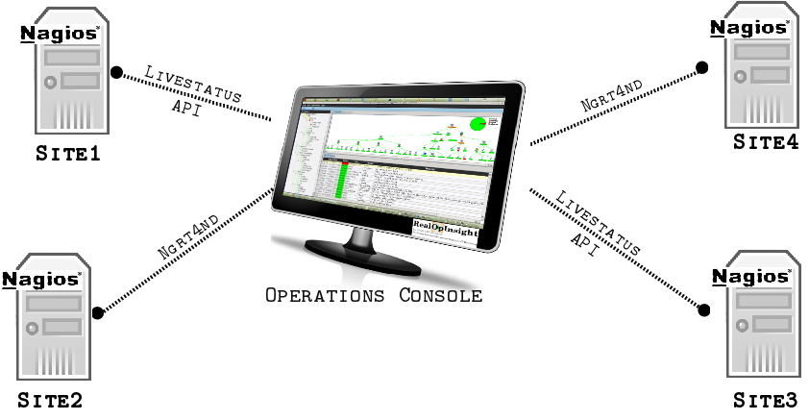
Distributed Monitoring/Unified Dashboard
Loosely-coupled scalable architecture
  Status data retrieved through RPC APIs

Slide 26
Ngrt4nd-based Integration - How To
Specific daemon on Nagios server
  See documentation
Relies on status.data
ZeroMQ-based RPC APIs
  Authenticated data retrieving
Non recommended
  Non-scalable, delayed status data,

Slide 27
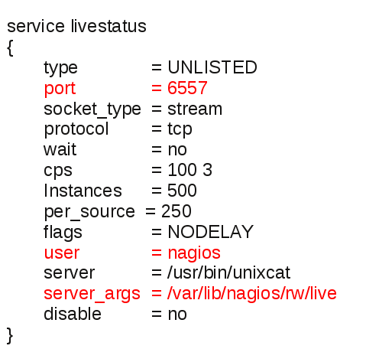
Livestatus-based Integration - How To
Xinetd TCP-based RPC over a native UNIX socket
  Xinetd socket over the Livestatus NEB socket
  /etc/xinetd.d/livestatus
Restart Xinetd
  /etc/init.d/xinetd restart
Recommended
  NEB, scalable, up-to-date data

Slide 28
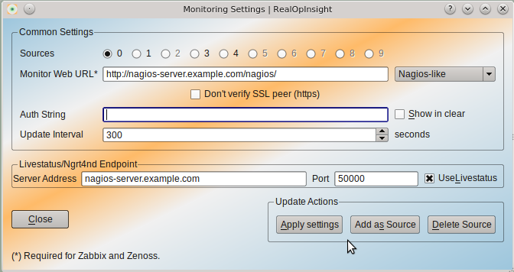
Source Settings
Ngrt4nd
  Monitor Web URL (optional)
  Auth String
  Server address
  Listening port (1983 by default)
  “Use Livestatus” must be disabled
Livestatus
  Monitor Web URL (optional)
  Server address
  Listening port
  “Use Livestatus” must be enabled

Slide 29
Getting started in 3 steps
Run the Editor
  … and edit your service view configuration
Run the Configuration Manager
  … and set the access to the remote API
Run the Operations Console
  … and load the configuration file
Then fall in love!

Slide 30
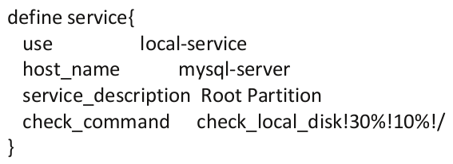

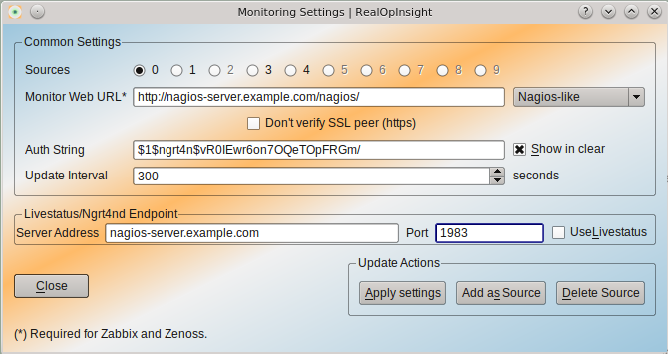
Integration with Nagios
Service in Nagios
Service selection in RealOpInsight
[SourceId:]host_name[/service_description]
Set sources and API access ngrt4nd/Livestatus

Slide 31


History: Experience Feedback 1/2
2008 : the Idea
May 2010 : 1st lines of code
March 2011 (1st release, 1.0)
  <30 downloads a month
May - August 2012 (version 2.0)
  New architecture, GPLv3 License
  SourceForge.net, Nagios Exchange
  Windows Installer
  200 downloads a month

Slide 32

History: Experience Feedback 2/2
December 2012 (v2.1)
  Continuous packaging for openSUSE, Fedora and Ubuntu
March 2013 (v2.2)
  600 downloads a month
May 2013 (v2.3)
  Support for Livestatus API
July - September 2013
  Nagios Affiliate
  v2.4, adding support of distributed environments
Today
  7k+ downloads from 120+ countries

Slide 33

And the story continues..., Thanks
Web Edition (2014)
http://realopinsight.com/index.php?page=contribute
@ngrt4n
http://chakode.realopinsight.com/

