Slide 1
Hash functions
Hash functions are everywhere
What a hash function is and why we need it
What their properties are and why it is not trivial to design a hash function
Hash functions in the real world: From MD5 to SHA-3

Slide 2
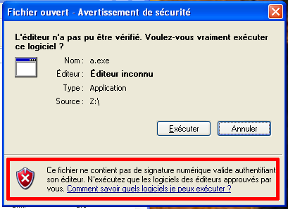
Hash functions are everywhere

Slide 3
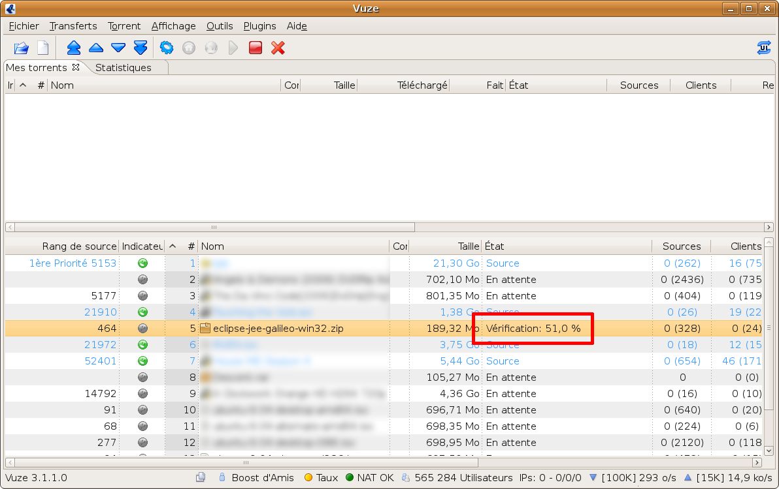
Hash functions are everywhere

Slide 4
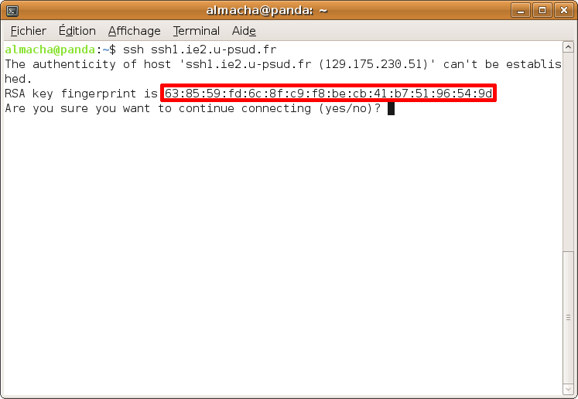
Hash functions are everywhere

Slide 5

Without hash functions
Untrusted Server
Upload big file
Download the big file
Alice
Bob
Is the file downloaded by Bob the same as Alice uploaded?
→ Same problem with mirrors (secondary servers) for Linux distributions.

Slide 6
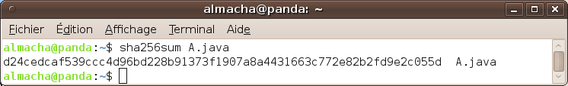
What is a hash function?
File
(Infinite set)
Hash function
Hash
(Finite set)
A hash function is a function that takes an unbounded string (like a file) and returns a small fixed-length (smaller that 1KB) string.
Example: The SHA-256 hash function takes a file and returns a 256 bits string.

Slide 7
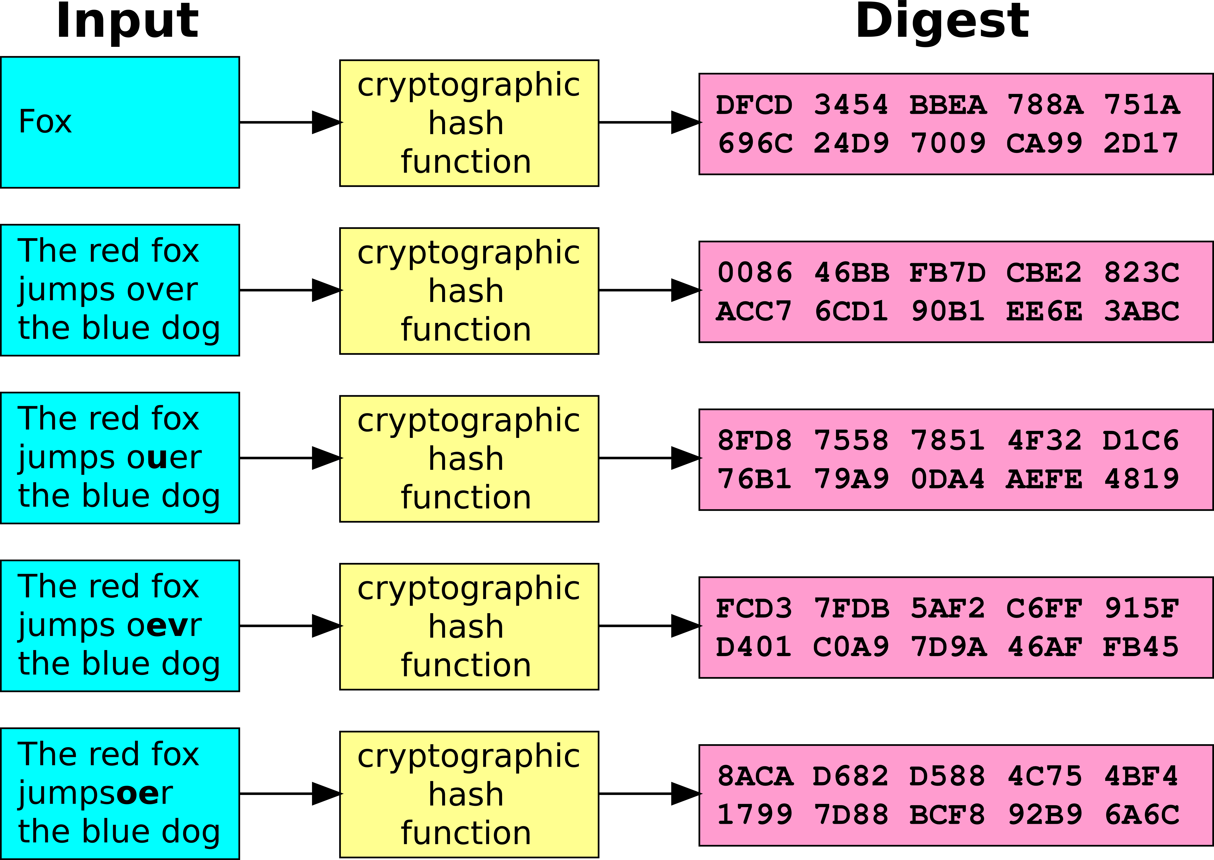
We want to check file integrity
Same input => Same hash
Different input => Probably different hash (unless extremely unlucky)

Slide 8
Why hash functions?
Untrusted Server
File
Mallory edits file
File
Download the big file
Upload big file
Bob
File
File
Alice
File
Compute hash
File
Hash
Compute hash
Compare hashes
Hash
Send file hash (very small)
Hash

Slide 9
A trivial (and bad) hash function
Let A[1..n] be an array of characters (as integers in [0,255]) containing the input file.
Consider the following hash function:
Function f(A[1..n]) =
Let S = 0
For i from 1 to n :
S ← (S + A[i]) mod 1000
Return S

Slide 10
Required properties
It is infeasible to find a message that has a given hash. (preimage resistance)
It is infeasible to modify a message without changing its hash. (second preimage resistance)
It is infeasible to find two different messages with the same hash. (collision resistance)

Slide 11
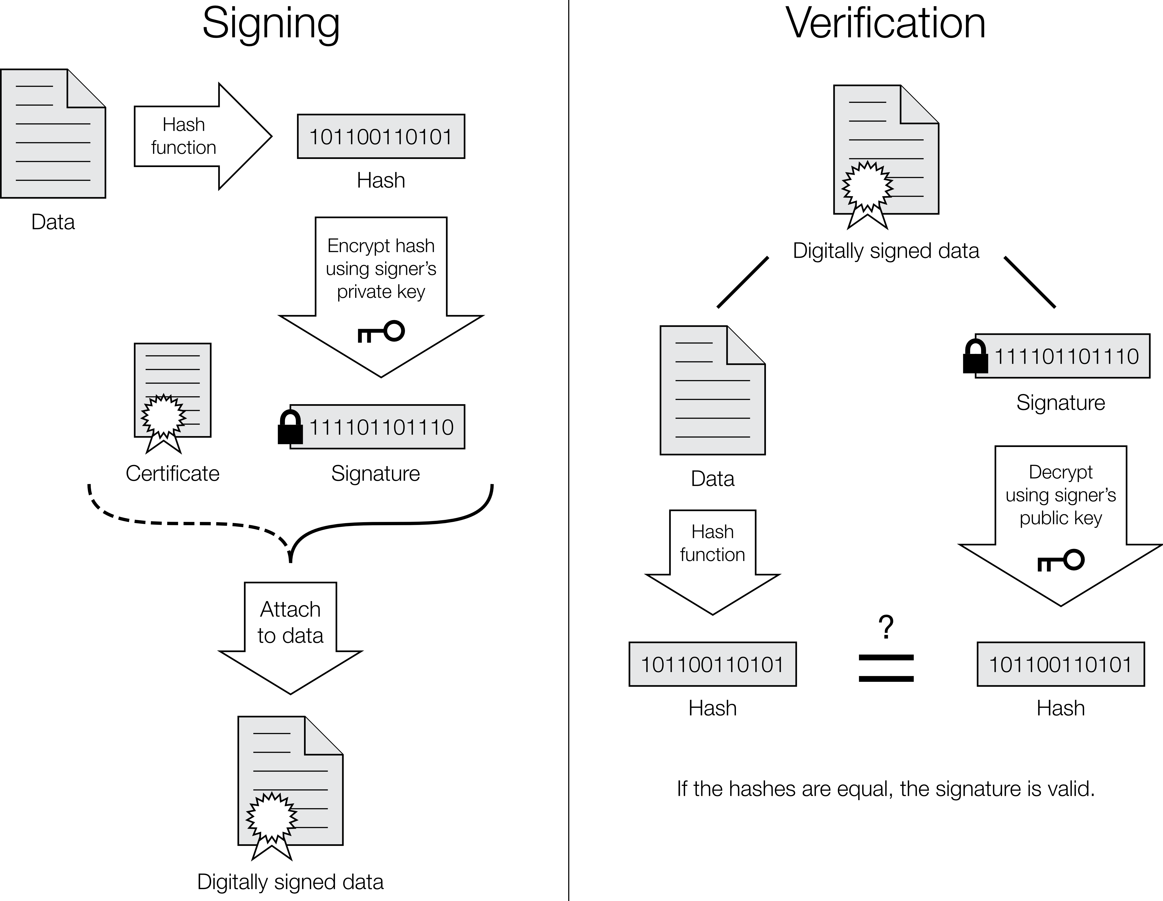
Digital signature

Slide 12
Birthday problem
57 people in a room
P(someone has his birthday the same day as you) = 14%
P(at least 2 people in the room have their birthday the same day) = 99%

Slide 13
Birthday problem
Hash function with n possible outputs
Given a hash,
time to find a file with this hash =
Time to find 2 files with the same hash =
=> The hash has to be twice as long.

Slide 14
Birthday attack
different
but same hash!
Notes:
30 min to explain everything until this slide, included

Slide 15
What we mean by broken
We say that a hash function is broken if it is possible to compute a collision faster than expected with a naive brute force attack.

Slide 16
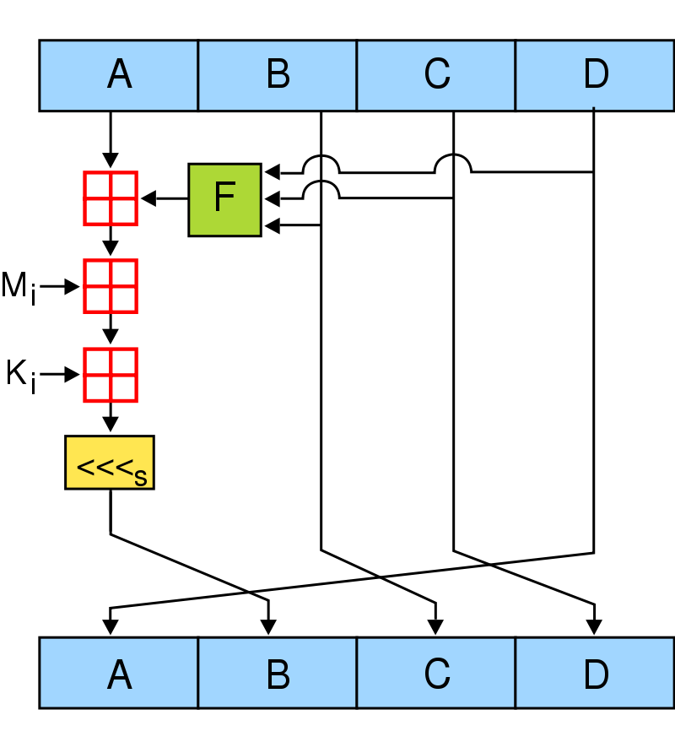
MD4
Designed by Professor Ronald Rivest of MIT in 1990.
Used by eMule to match files.
Used by Windows NT to store passwords.
Used by rsync to compare files.
Weakness discovered in 1991.
Generating a collision now takes only a few seconds.

Slide 17
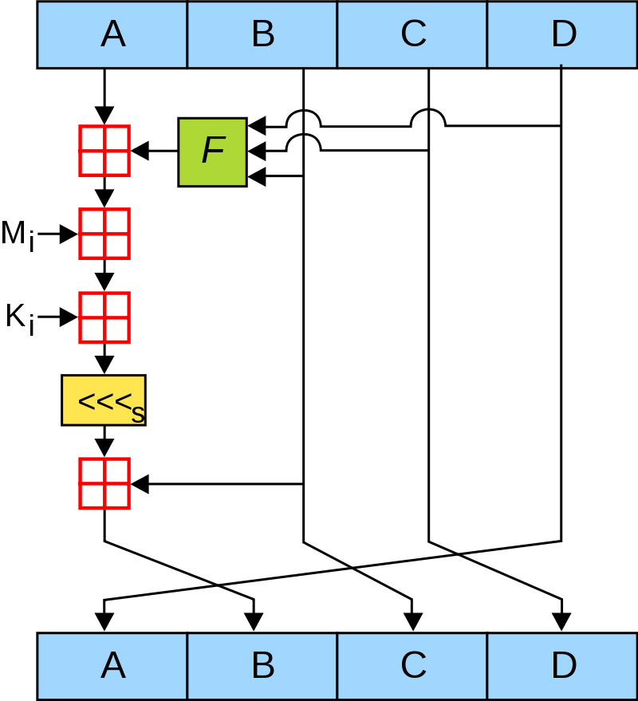
MD5
Designed in 1991 to replace MD4.
Widely used for digital signatures, SSL certificates, password, file integrity checking...
Minor flaw discovered in MD5 design in 1996.
Serious flaw discovered in 2004.
Successful attack on SSL in 2008.
Deprecated by US Government and SSL researchers. Abandoned by VeriSign when issuing SSL certificates.

Slide 18
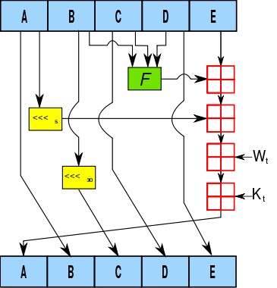
SHA-1
A earlier function called SHA-0 was released by the NSA in 1993, but was withdrawn and a modified version, SHA-1, was published in 1995.
SHA-1 is widely used like MD5, which it has replaced in most SSL certificates.
SHA-1 is used by BitTorrent to find files (when using DHT) and verify file chunks.
The SHA-0 flaw was discovered in 1998.
Algorithms to find collision faster than brute force were found in 2005.
Better algorithm found in 2006, but time required to compute a collision is still too high in practice (hence the now abandoned BOINC project).
Since 2004, NIST is trying to phase out the use of SHA-1 and replace it with SHA-2.

Slide 19
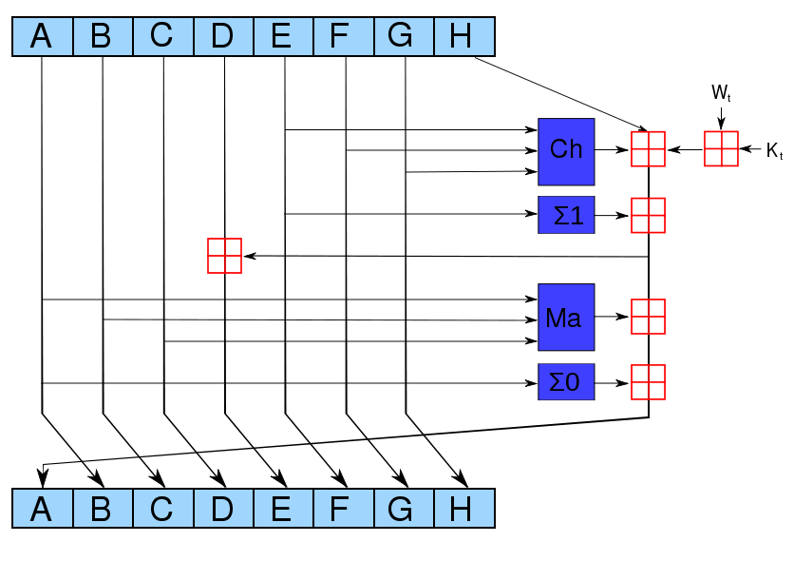
SHA-2
First published in 2001 by the NSA.
Comes in 4 variants: SHA-224, SHA-256, SHA-384, and SHA-512 (numbers of bits in hash).
SHA-2 are the best algorithms currently available.
Not yet widely used because not as widely supported as MD5 and SHA-1.
SHA-256 is used to authenticate Debian packages.
SHA-512 is used to check archival video integrity from the International Criminal Tribunal of the Rwandan genocide.
US Government agencies are required to switch to SHA-2.

Slide 20
The future: SHA-3
Open competition launched by NIST in 2007.
List of candidates published in 2008.
List of 14 candidates accepted for round 2 published in 2009.
Announcement of final candidates scheduled for 2010.
Proclamation of the winner in 2012.

Slide 21
Conclusion
Don't use MD5: it's now broken.
If compatibility is a concern, use SHA-1, but don't plan it for the long term.
If you use only modern systems or if your program can embed SHA-2, then choose SHA-2 (use SHA-256 or 512).
Follow the SHA-3 competition!

