Slide 1

Presented by Steven Mann, LLC

Slide 2
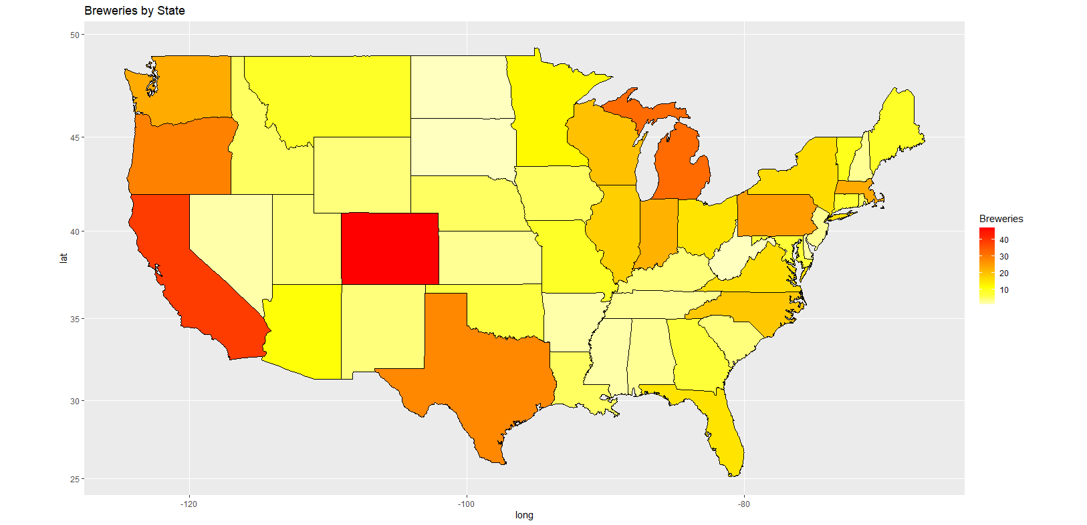

Slide 3
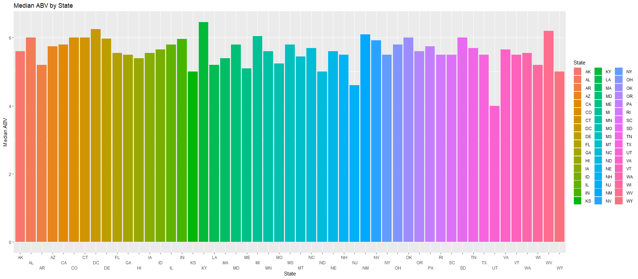

Slide 4
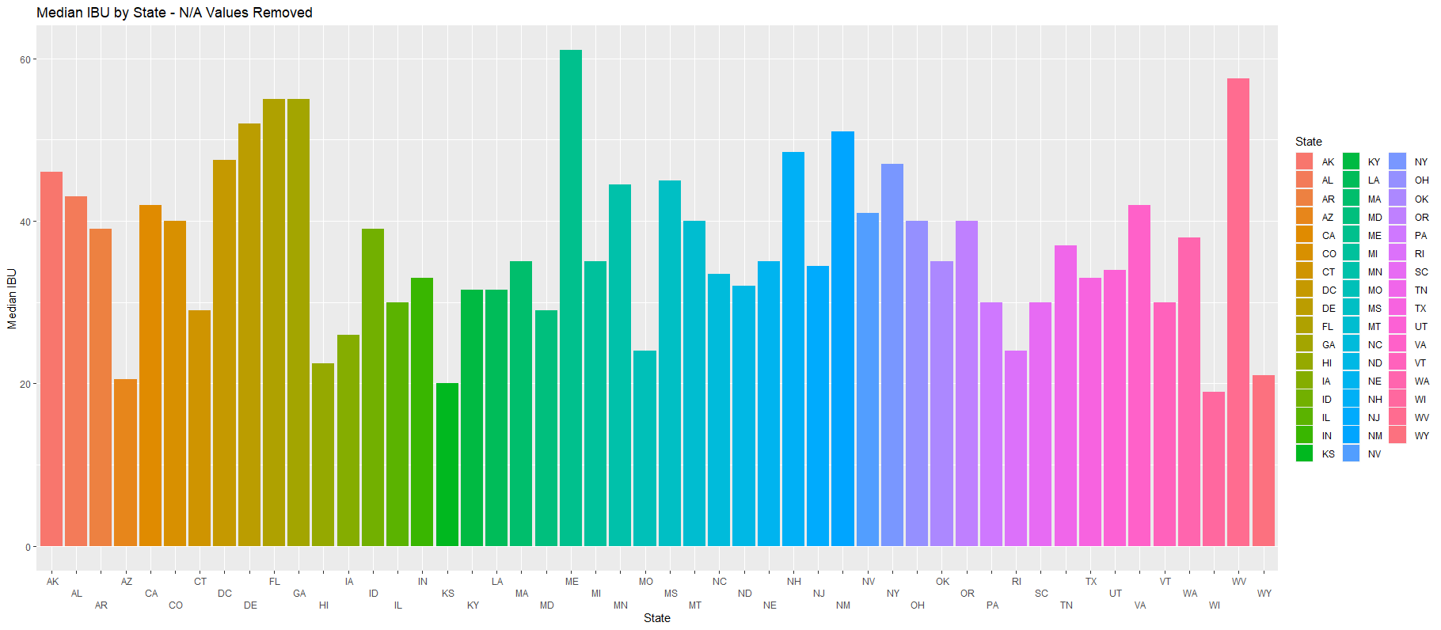

Slide 5
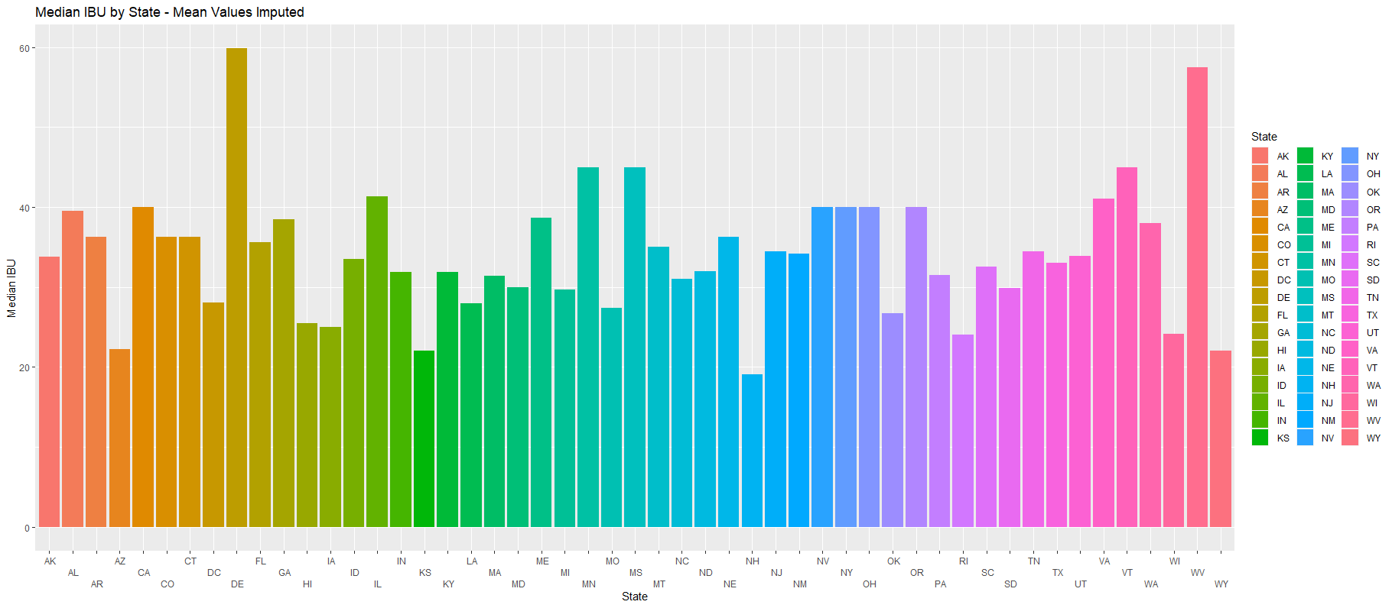

Slide 6
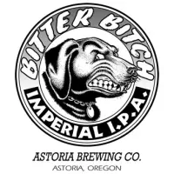
Max IBU: 138
Bitter Bitch Imperial IPA
Astoria Brewing Company
Astoria, Oregon

Slide 7
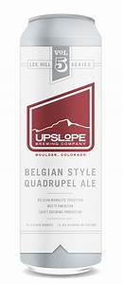
Max ABV: 12.8%
Lee Hill Series Vol. 5 - Belgian Style Quadrupel Ale
Upslope Brewing Company
Boulder, Colorado

Slide 8
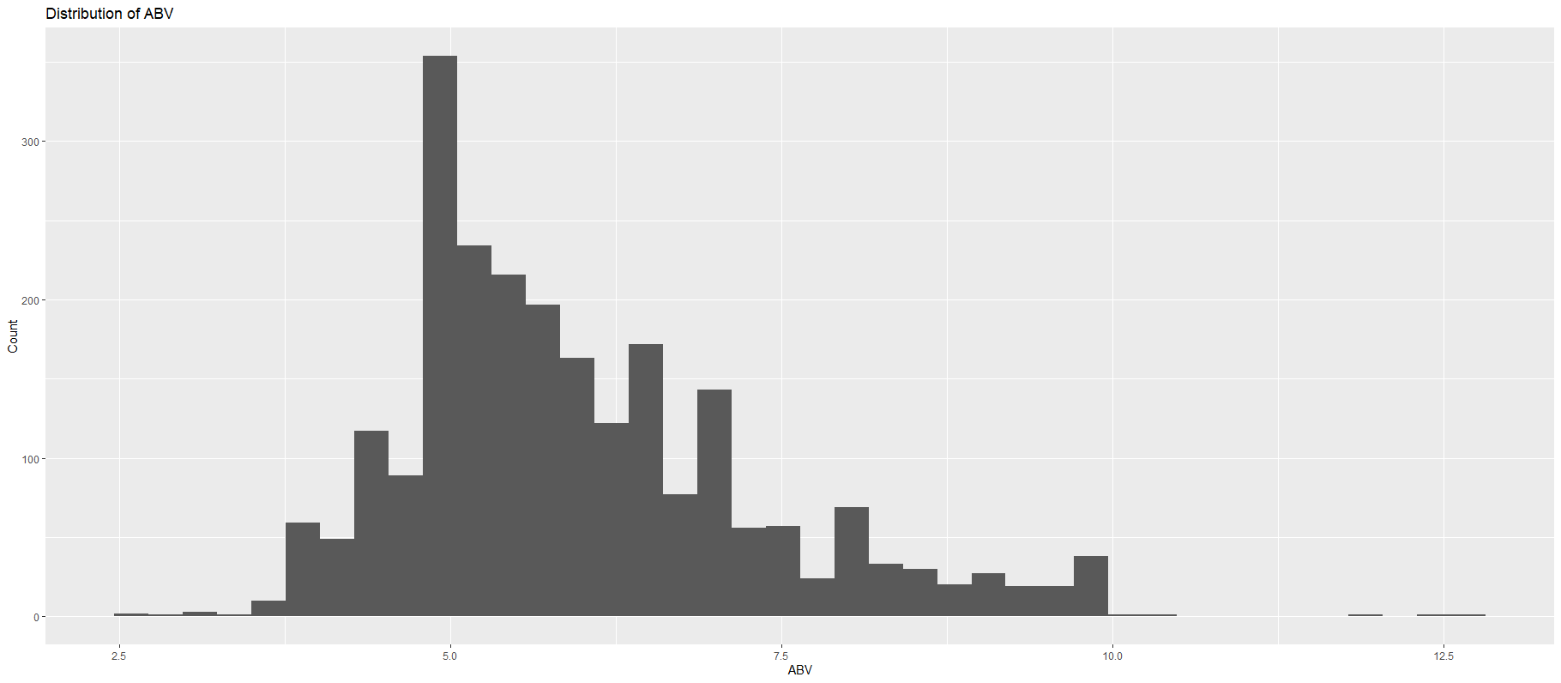
Min:
Q1:
Median:
Q3:
Max:
Mean:
2.70%
5.00%
5.67%
6.70%
12.80%
5.98%

Slide 9
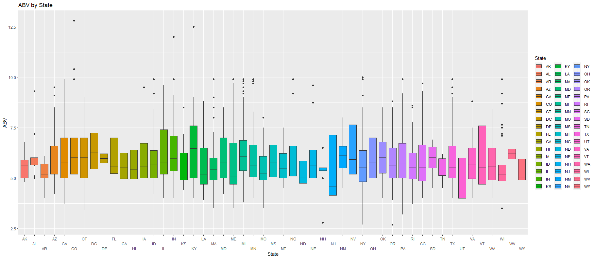

Slide 10
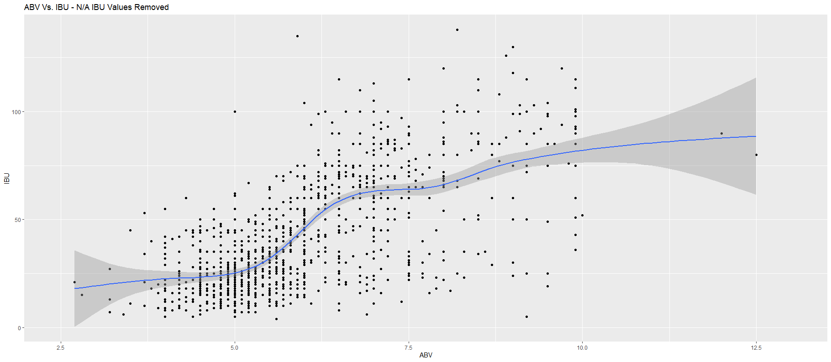

Slide 11
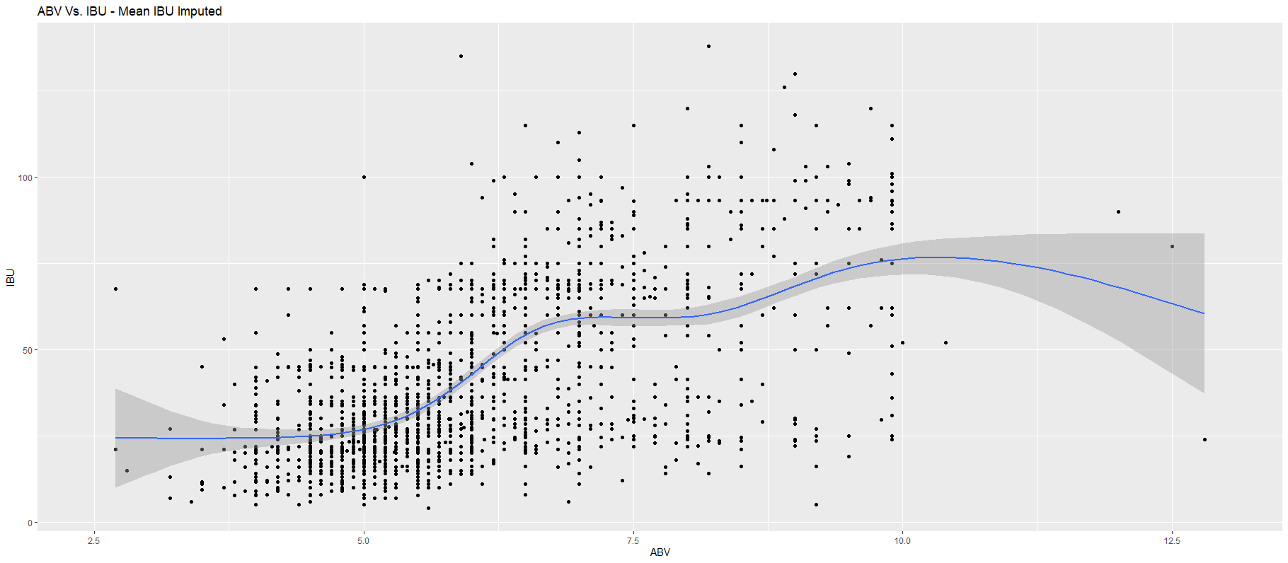

Slide 12
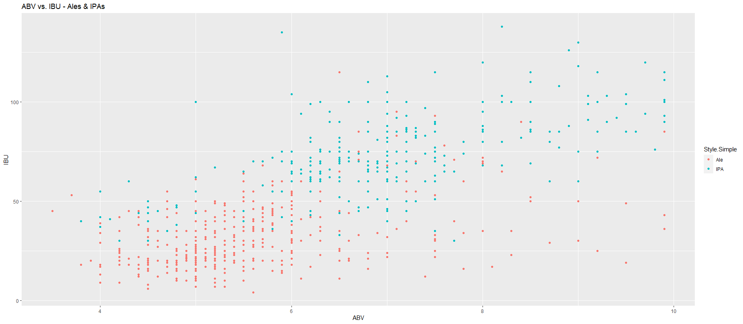

Slide 13
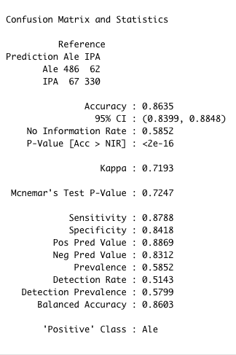
Prediction Stats for classifying ALE vs IPA
Model generated can help us classify a beer as either ALE or IPA based on Bitterness levels and Alcohol content with 86 % accuracy

Slide 14
