Slide 1



Learning behaviours aligned with moral values in a multi-agent system: guiding reinforcement learning with symbolic judgments
PhD Defence of Rémy Chaput
LIRIS CNRS UMR5205 / Université Claude Bernard Lyon 1
Supervised by: Salima Hassas, Olivier Boissier, Mathieu Guillermin
27 October 2022

Slide 2
Apprentissage de comportements alignés sur des valeurs morales dans un système multi-agent : guider l’apprentissage par renforcement avec des jugements symboliques
Soutenance de thèse de Rémy Chaput
LIRIS CNRS UMR5205 / Université Claude Bernard Lyon 1
Supervisé par : Salima Hassas, Olivier Boissier, Mathieu Guillermin
27 Octobre 2022

Slide 3
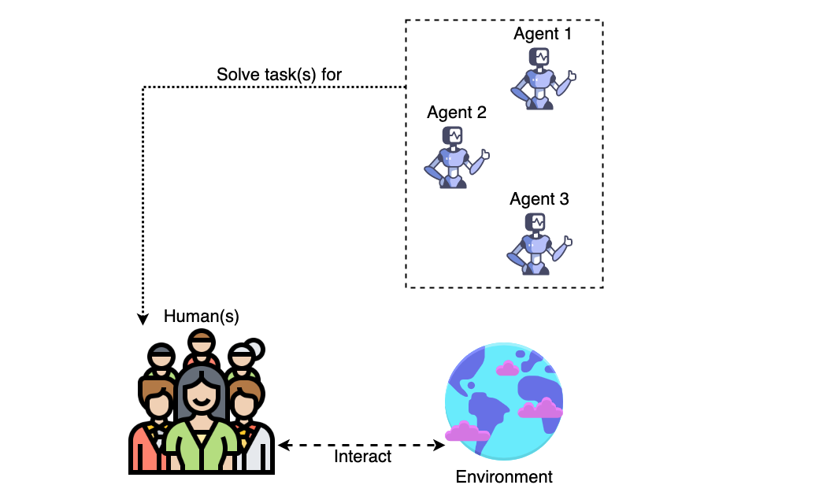
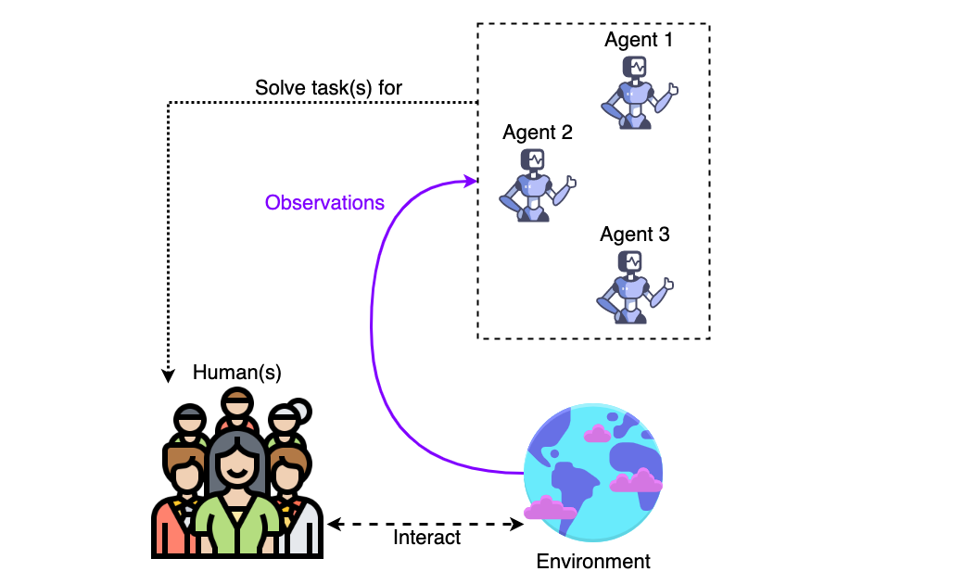
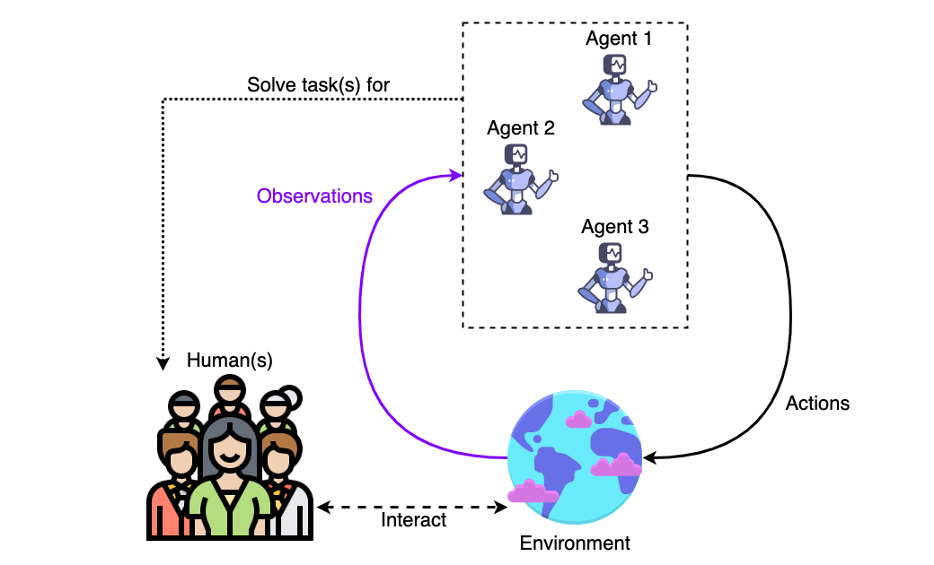
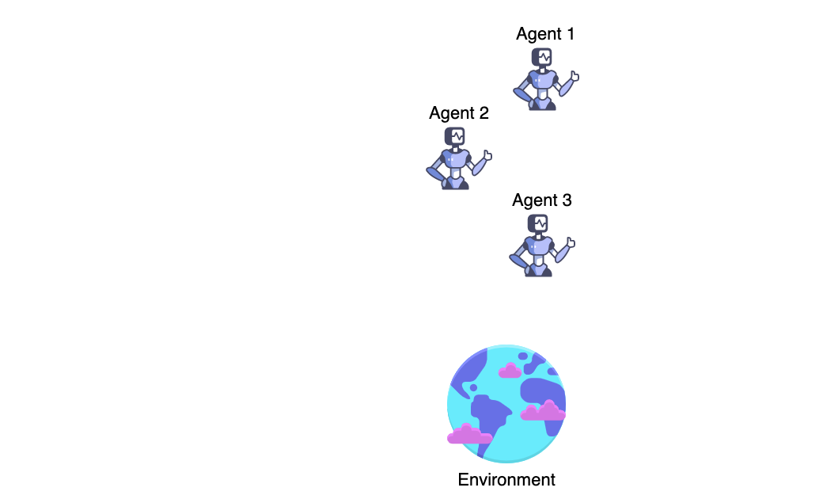
AI systems have an impact over humans

Slide 4
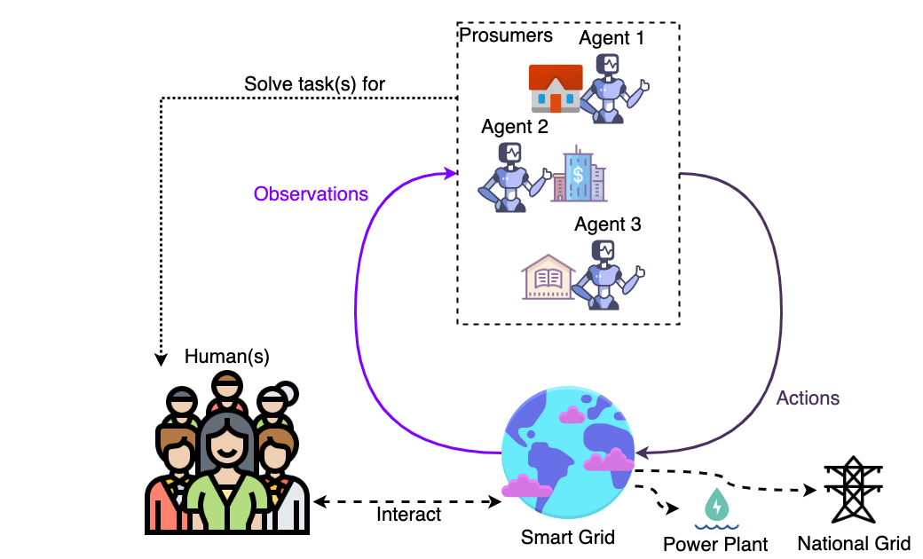
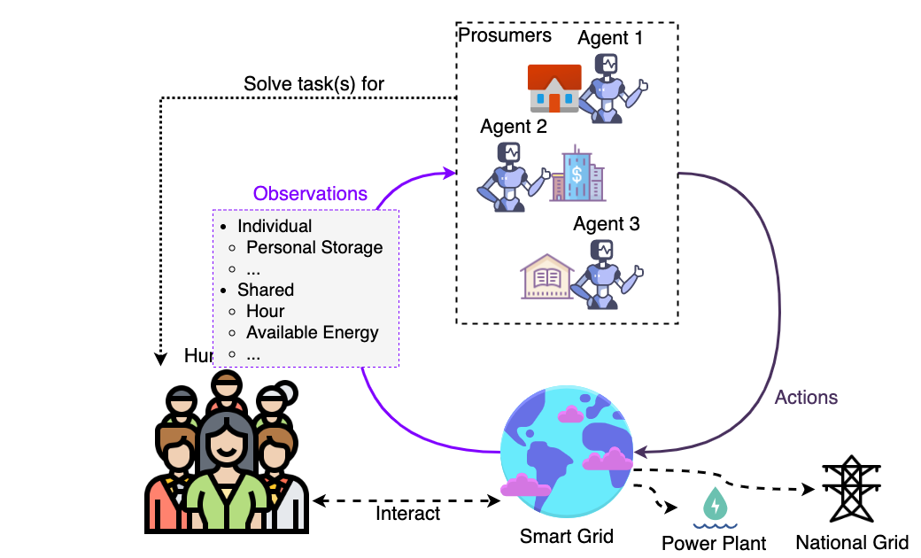
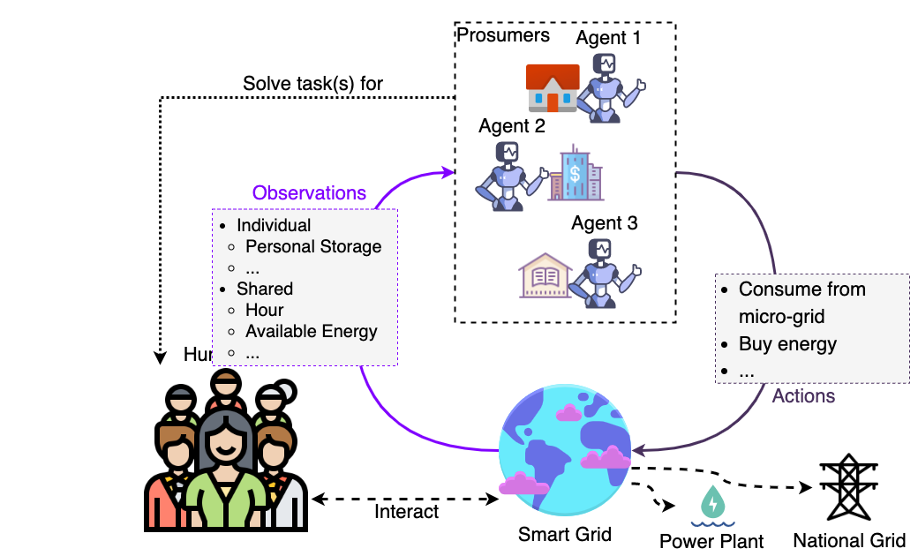
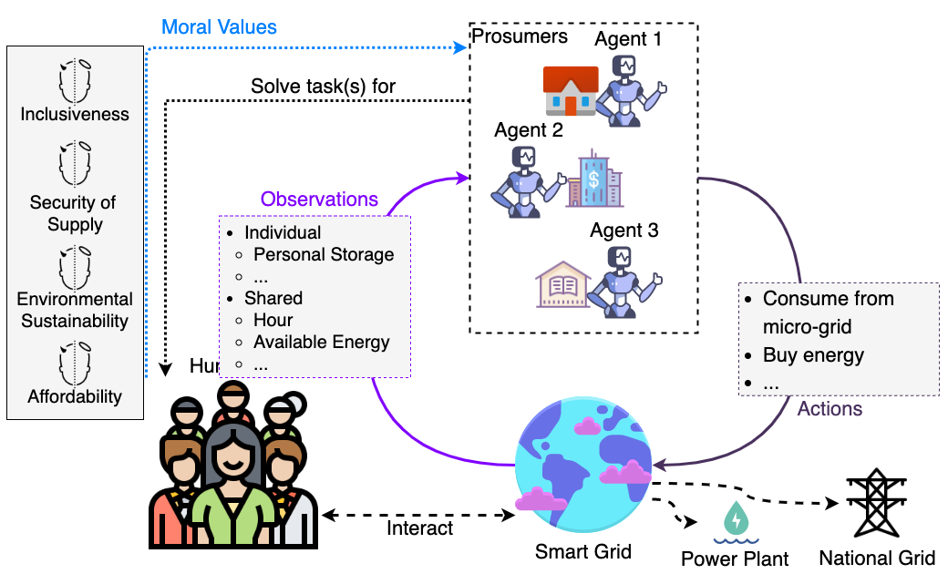
Application to Smart Grids
Notes:
Only a use-case ; contributions are generic

Slide 5
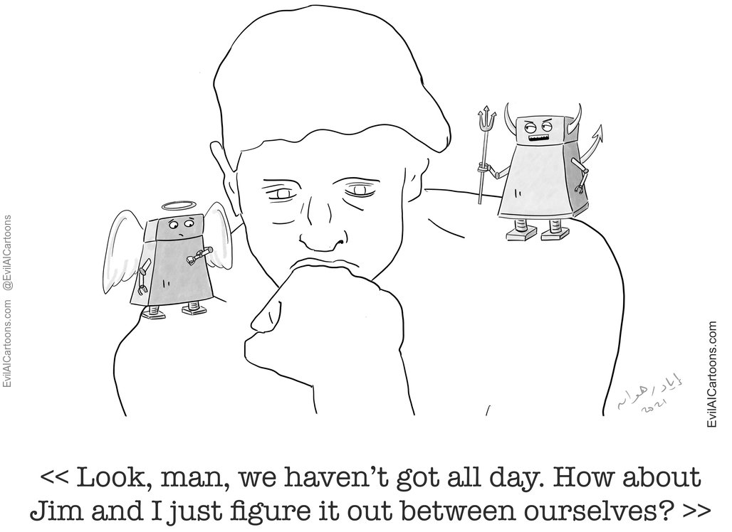
General objective: Learn behaviours morally-aligned
Learning to exhibit behaviours aligned with our moral values
Ensuring that AI systems’ impact is beneficial to humans
Ethics by Design (Dignum, 2019): implementing algorithmic capabilities
Machine Ethics

Slide 6
State of the Art – Machine Ethics
Top-Down
  Formalization of existing ethical principle(s)
  Examples:
    (Cointe et al., 2016) Ethicaa : Logic rules, multiple agents, priority order over principles, judgment mechanism
    (Bremner et al., 2019) Ethical Layer : Planning module, ensures adequacy of plans with rules
  (+) Integration of expert knowledge ; Verifiability
  (-) Difficult to adapt to unexpected or new situations, to changes
Bottom-Up
  Learning a new principle from experiences
  Examples:
    (Anderson et al., 2019) GenEth : Inductive Logic Programming, ethicists’ decisions
    (Wu et al., 2017) RL Shaping : task reward + ethical reward, human “average” behaviour
  (+) Adaptation
  (-) Difficult to understand the expected behaviour
Hybrid
  Combines advantages from both
  e.g., learning while constraining
Notes:
We would like to use them for advantage X but drawback Y

Slide 7
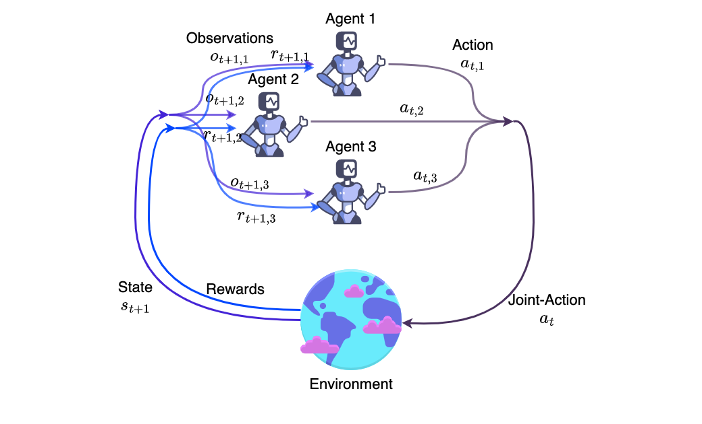
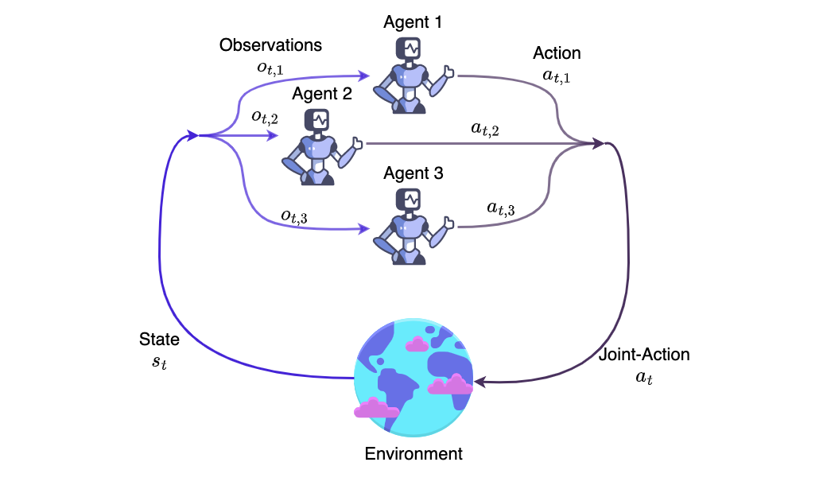
Reinforcement Learning (DecPOMDP) to learn behaviours
(Sutton et al., 2018 ; Bernstein et al., 2002)
Notes:
Reward = how to nudge agent behaviour

Slide 8
Objectives and research questions
Objectives
Handle complex environments – Multiple persons
Handle complex environments – Multiple values
Handle complex environments – Multiple situations
Adapt to shifting ethical consensus
Learning
• How to learn behaviours aligned with moral values, in a complex environment, and to adapt to changes?
Judging
• How to guide the learning of agents based on several moral values?
Dilemmas
• How to learn to address dilemmas in situation in interaction with human users?
Learn behaviours with non-dilemma situations
Specify desired behaviour
Learn behaviours with dilemma situations
Notes:
4 transverse
Others specific to 1 RQ
RQ3 => contextualized prefs

Slide 9
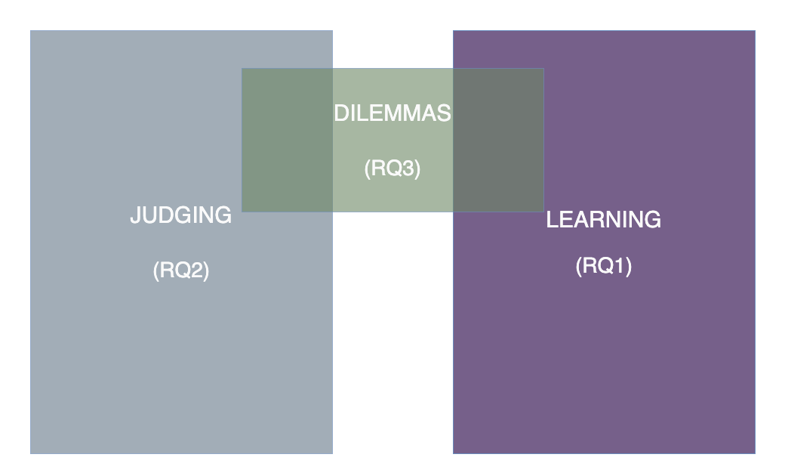
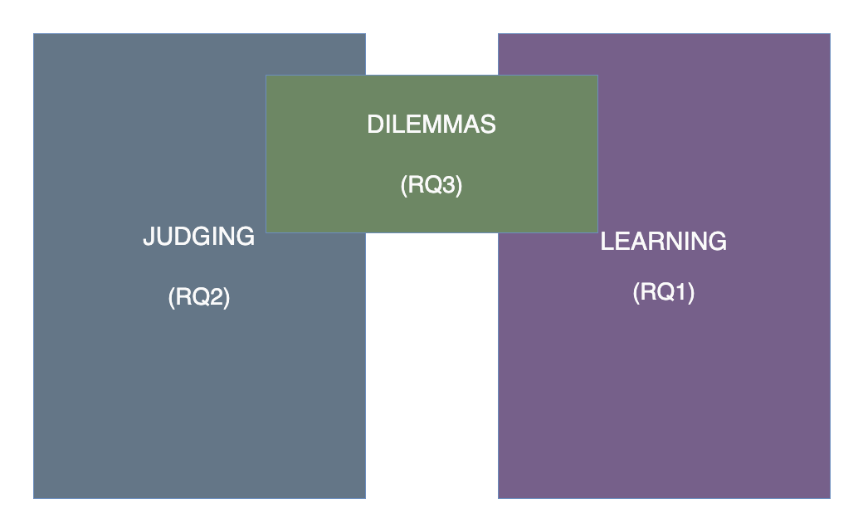
Notes:
9min

Slide 10
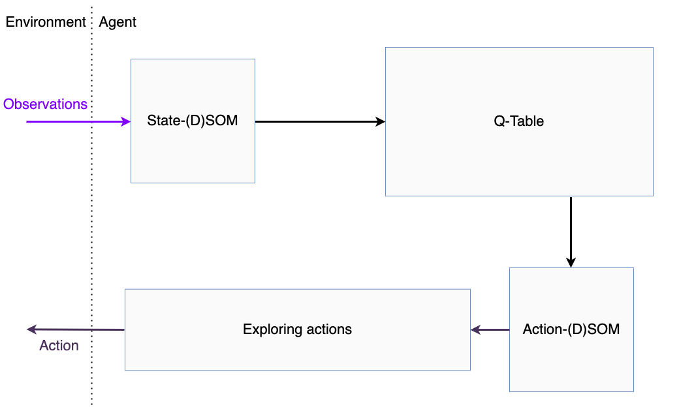
Q-(D)SOM : Combining Q-Table and (D)SOMs

Slide 11
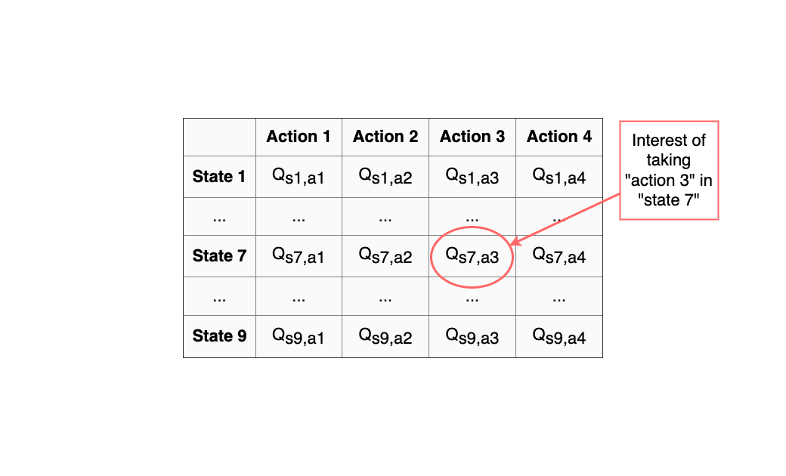
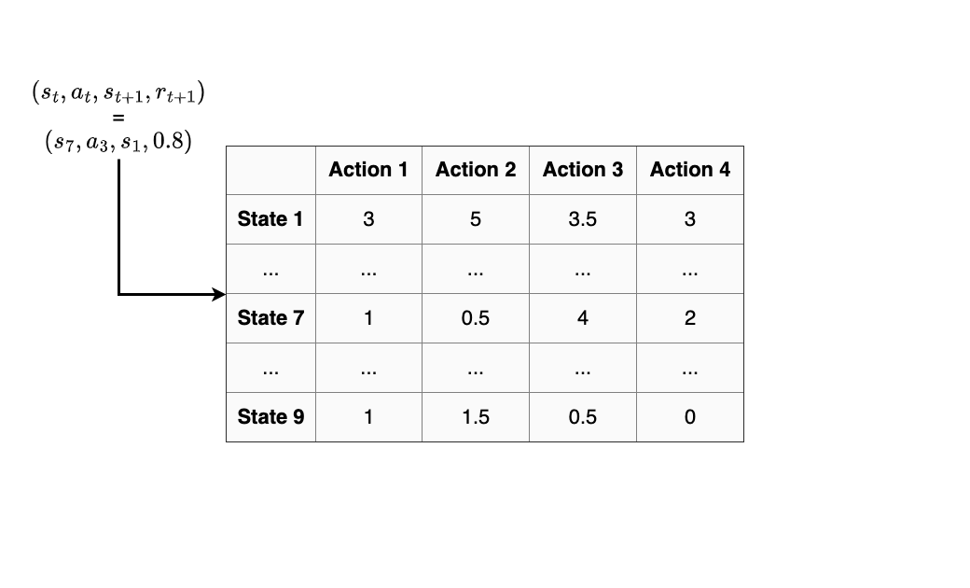
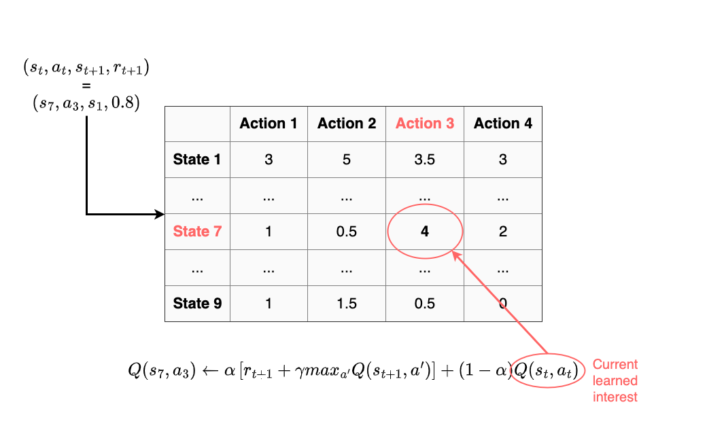
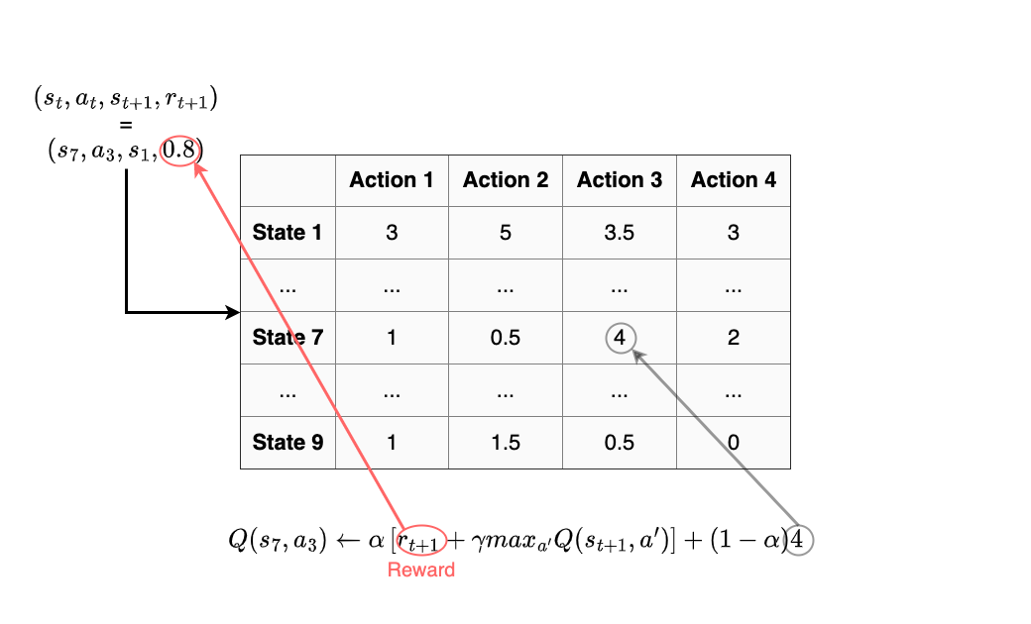
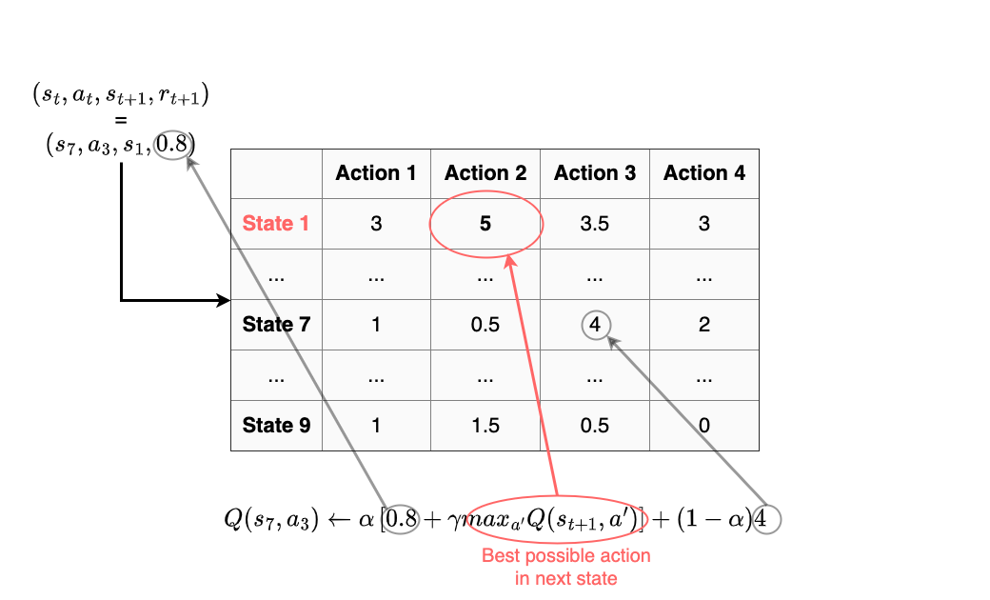
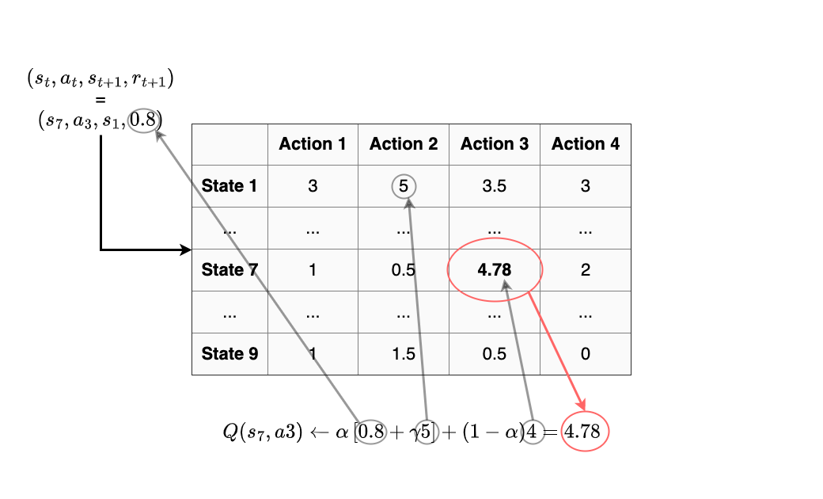
Q-(D)SOM : The Q-Table
(Watkins et al., 1992)

Slide 12
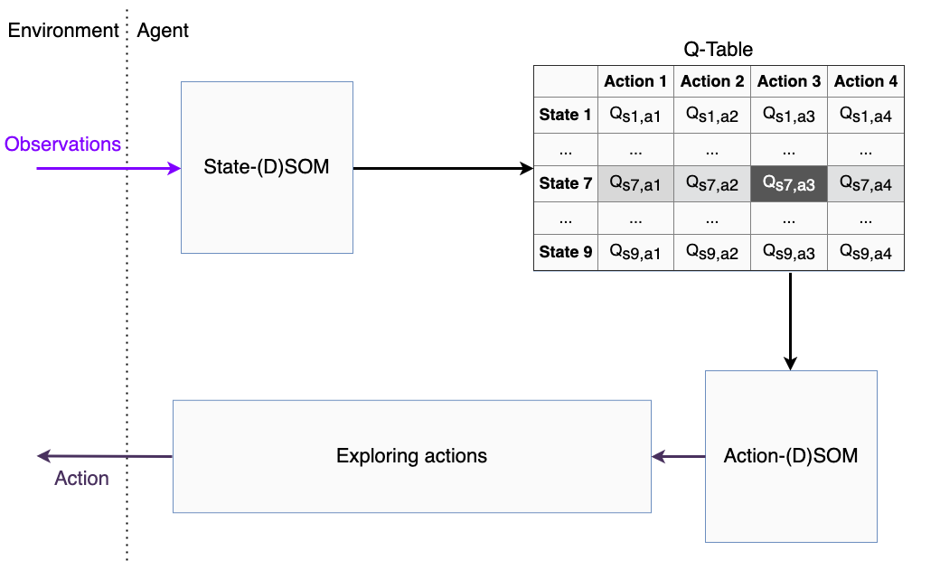
Q-(D)SOM : Combining Q-Table and (D)SOMs

Slide 13
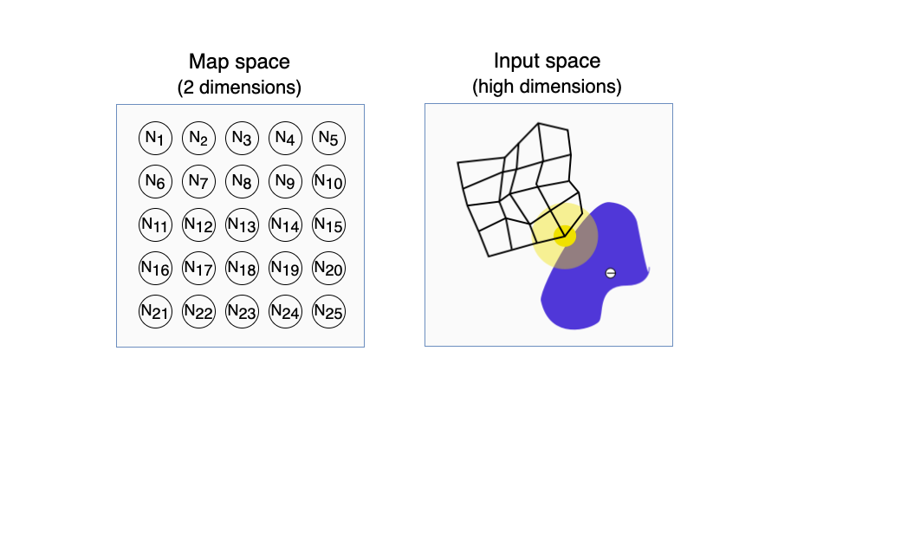
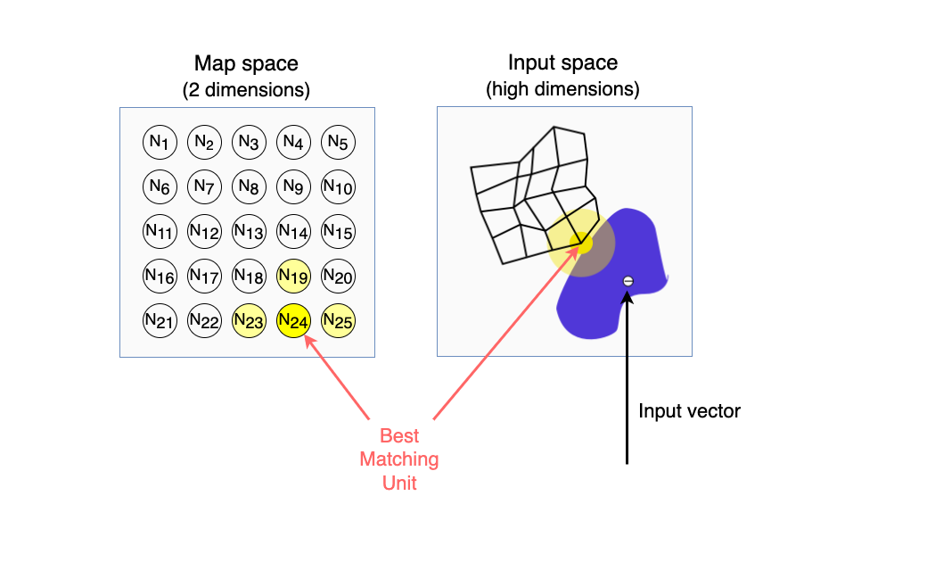
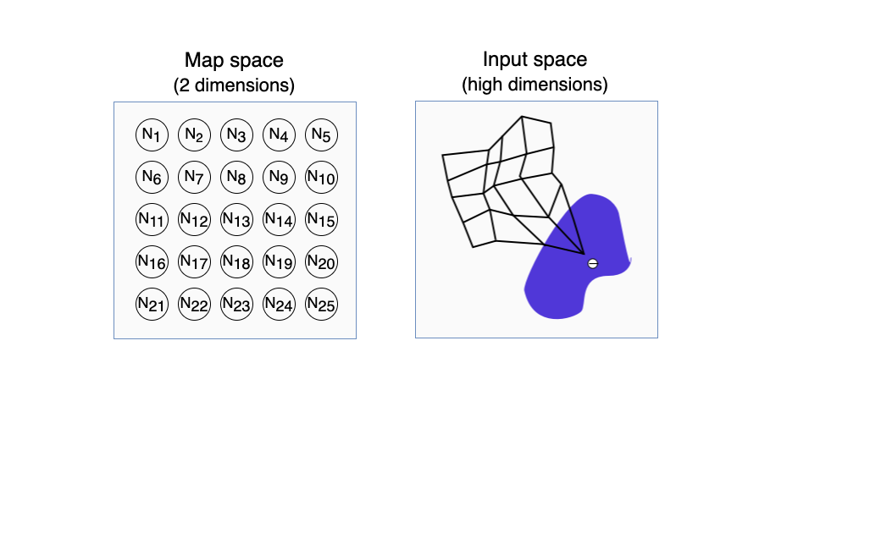
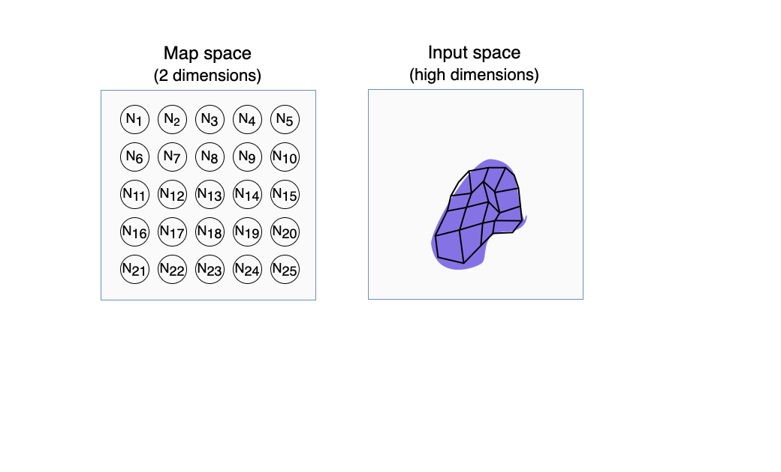
Q-(D)SOM : The Self-Organizing Map
(Kohonen, 1990)

Slide 14
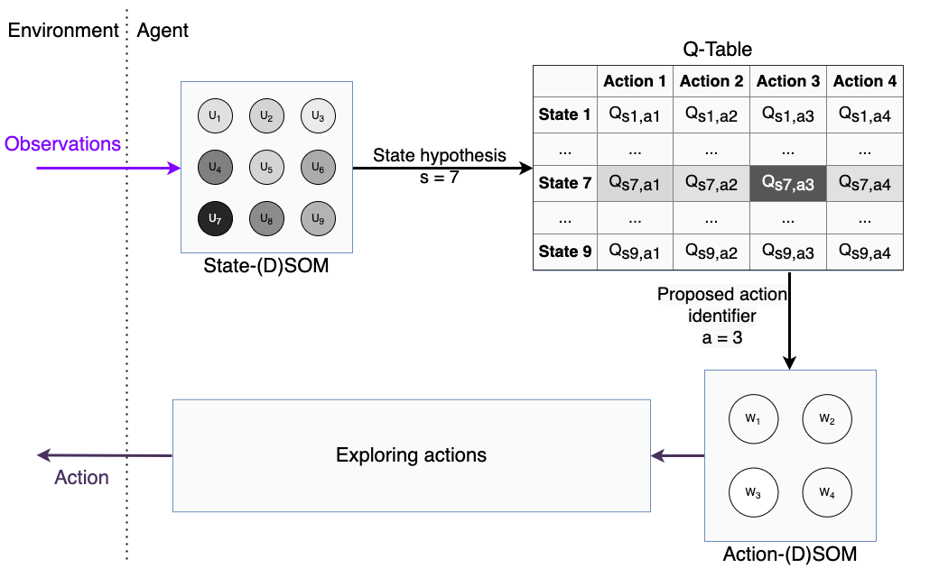
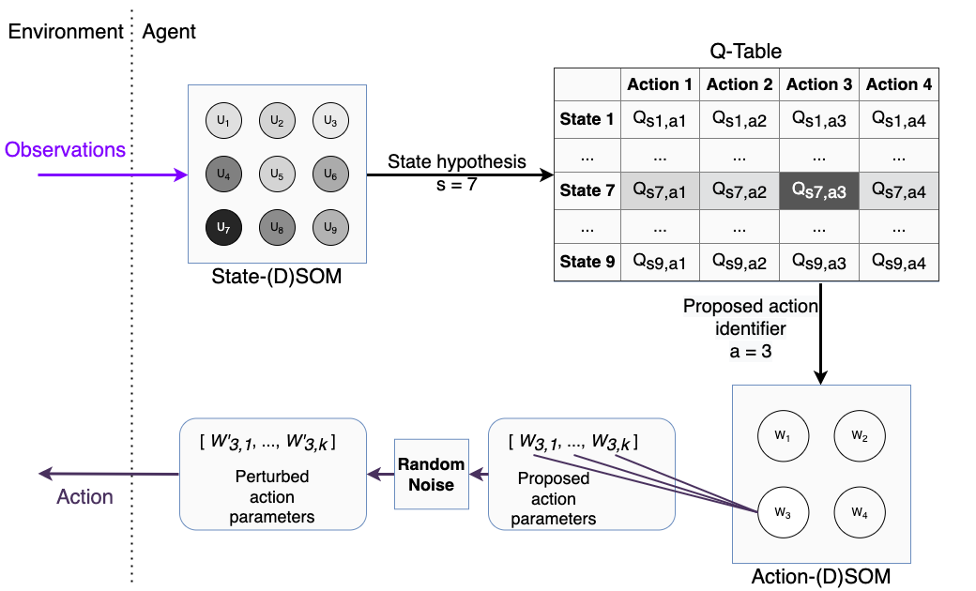
Q-(D)SOM : Combining Q-Table and (D)SOMs
Notes:
Modularity

Slide 15
What we have achieved
Objective | Mechanism
Handle complex environments – Multiple persons | Multi-agents Individual observations
Handle complex environments – Multiple values
Handle complex environments – Multiple situations | (D)SOMs
Adapt to shifting ethical consensus | Non-convergence DSOMs
Learn behaviours with non-dilemma situations | Learning algorithms
Specify desired behaviour
Learn behaviours with dilemma situations

Slide 16
What we still lack
Correctly designing the reward function
Adding, removing, or updating multiple moral values
Allowing domain experts to participate
Readability by non-AI experts

Slide 17
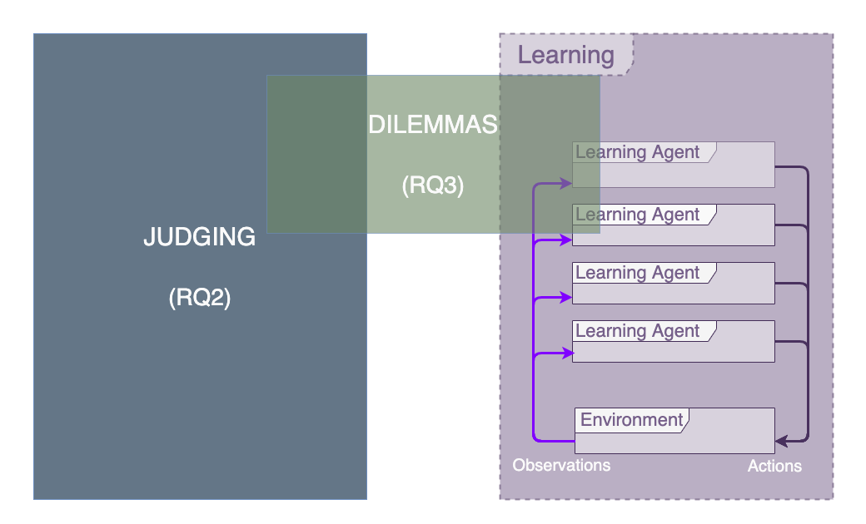
Notes:
15min

Slide 18
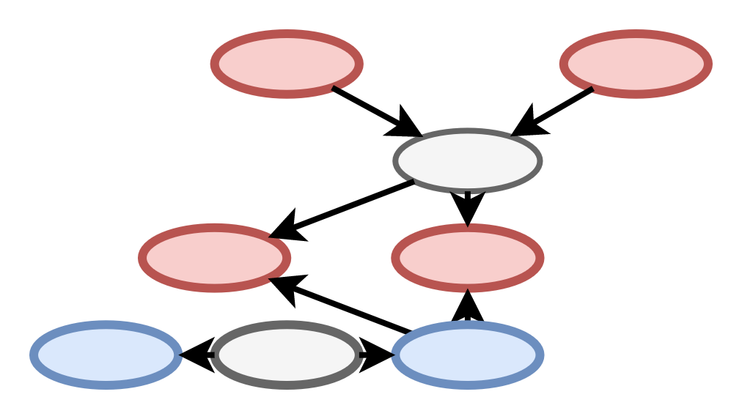
Advantages of symbolic reward functions
Numeric reward functions
Symbolic judgments for reward functions
R = 1 - distance
R =
(-) Difficult to integrate expert knowledge
(-) Can be difficult to read or understand for human users
(+) Easier to integrate expert knowledge
(+) Easier to understand or justify rewards
(+) Agentification for complex mechanisms

Slide 19
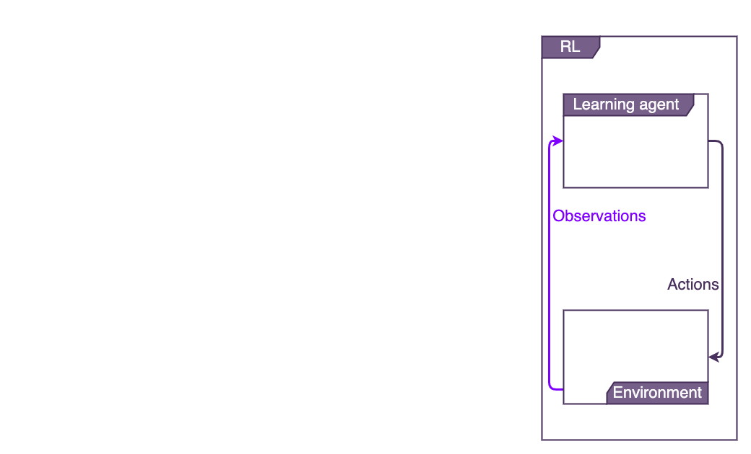
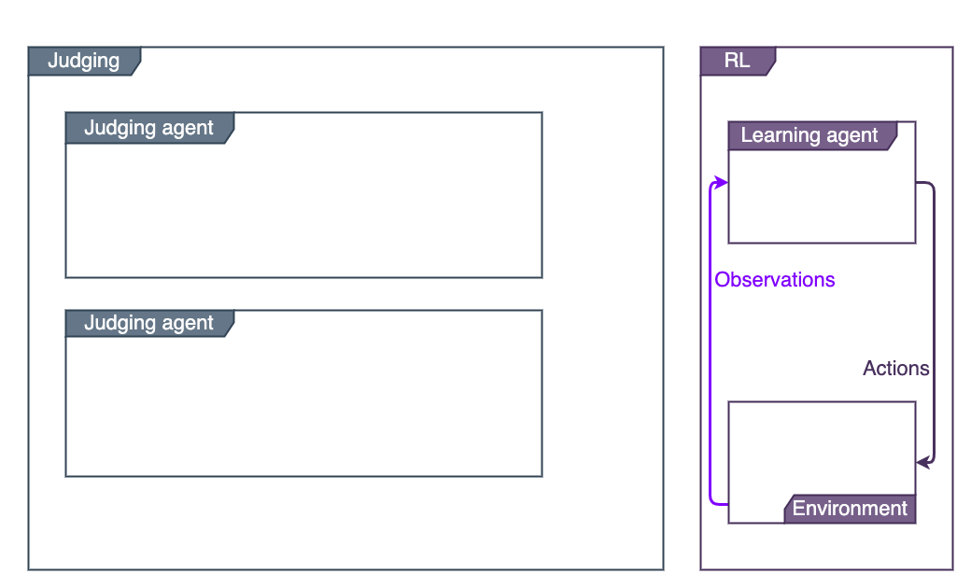
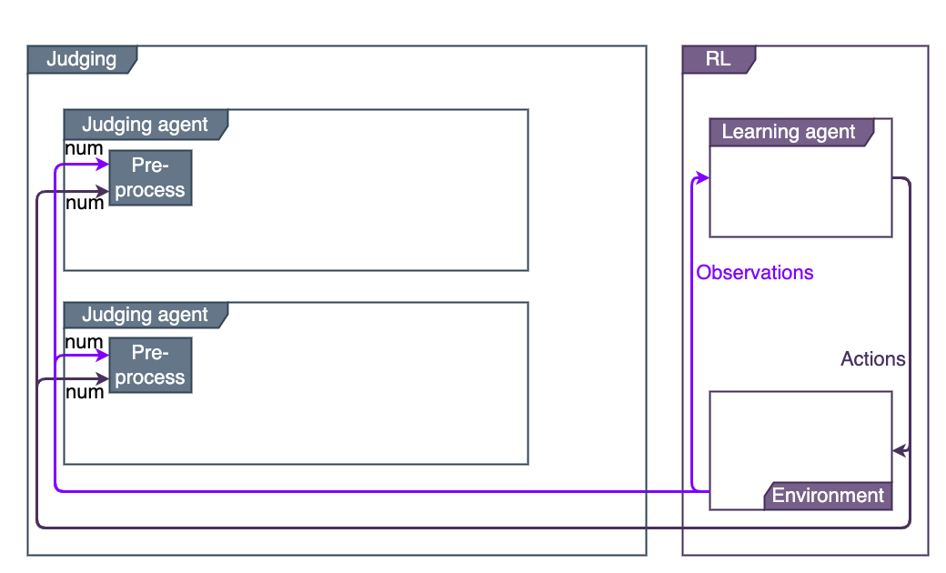
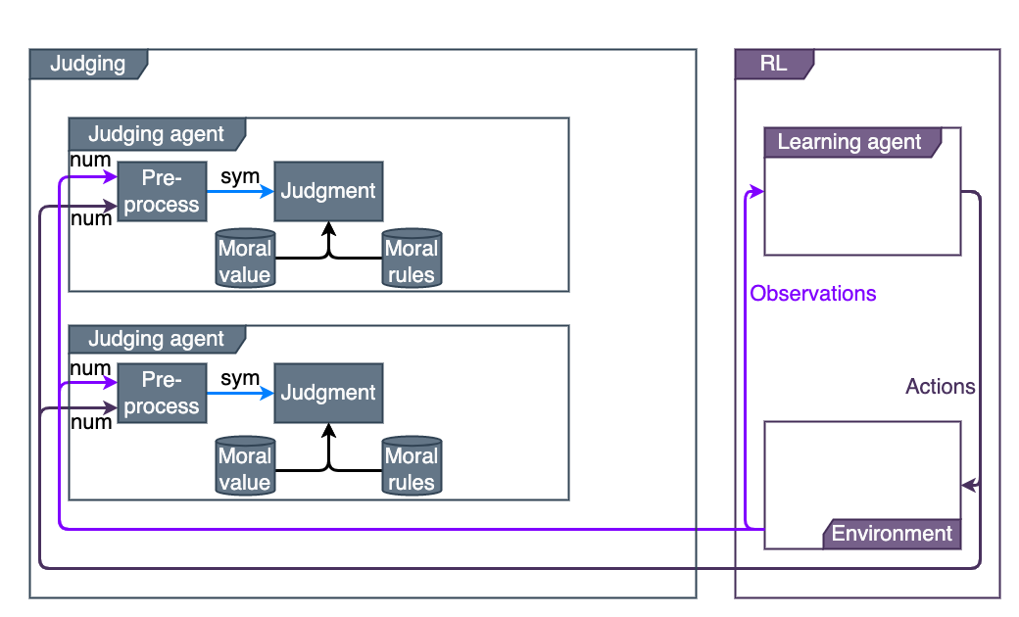
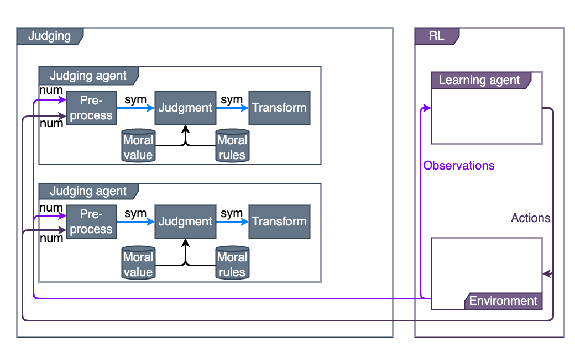
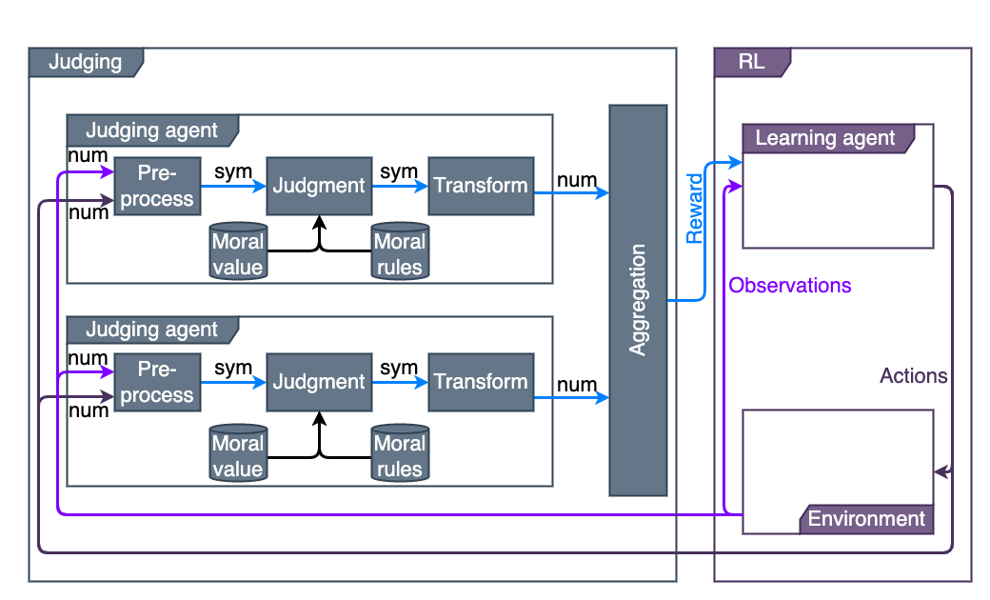
Judgment architecture

Slide 20
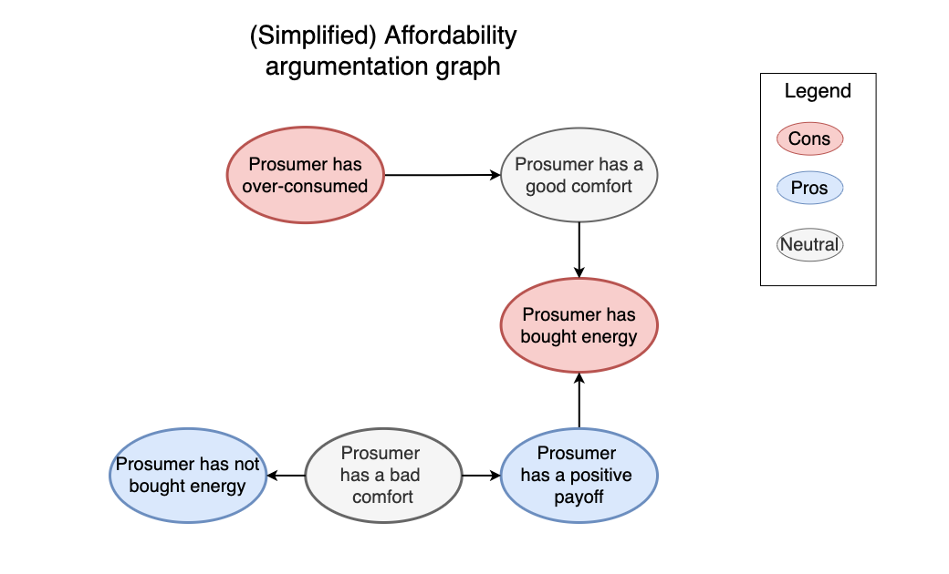
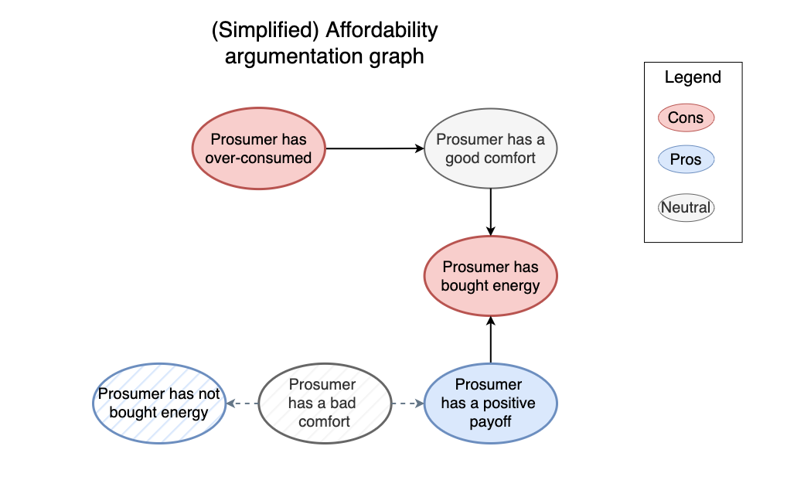
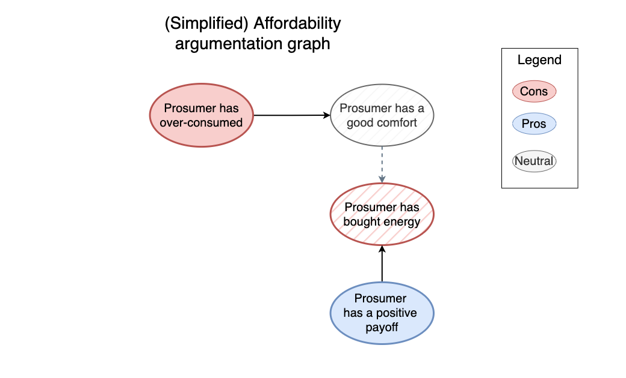
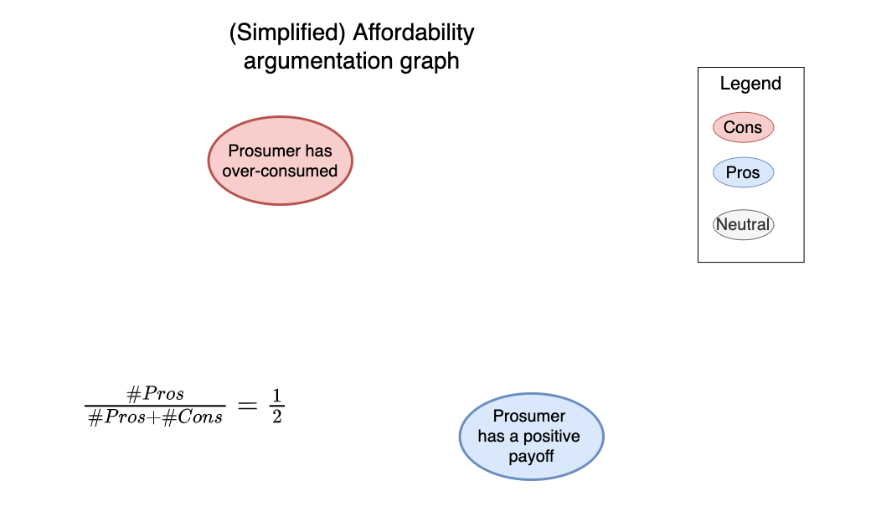
Argumentation-based Judgment
(Amgoud et al., 2009)
Notes:
POV of Judges
Judging a learner (prosumer)

Slide 21
What we have achieved
Objective | Mechanism
Handle complex environments – Multiple persons | Multi-agents Individual observations
Handle complex environments – Multiple values | Multiple judging agents
Handle complex environments – Multiple situations | (D)SOMs
Adapt to shifting ethical consensus | Non-convergence DSOMs Agentified reward functions
Learn behaviours with non-dilemma situations | Learning algorithms
Specify desired behaviour | Symbolic judgments
Learn behaviours with dilemma situations
Notes:
Agentified => adding, removing, ...

Slide 22
What we still lack
Explicit dilemmas
Hidden dilemmas because of aggregation
average(1, 1, 1, 0.2) = 0.8
Human preferences
Favouring a moral value
Notes:
Human prefs = different persons / different situations

Slide 23
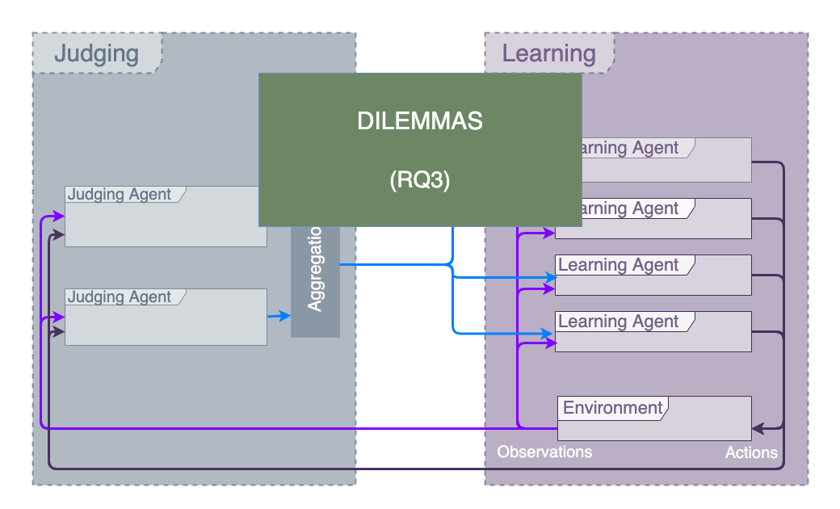
Notes:
21-22min

Slide 24
Desired properties for multi-objective RL
Explicit identification of dilemmas
Take human preferences into account
Human-actionable preferences
“Manageable” for humans

Slide 25
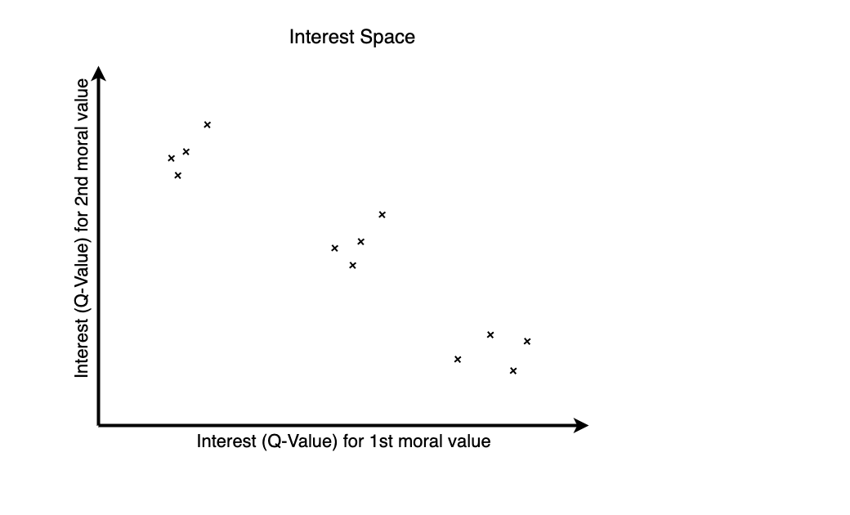
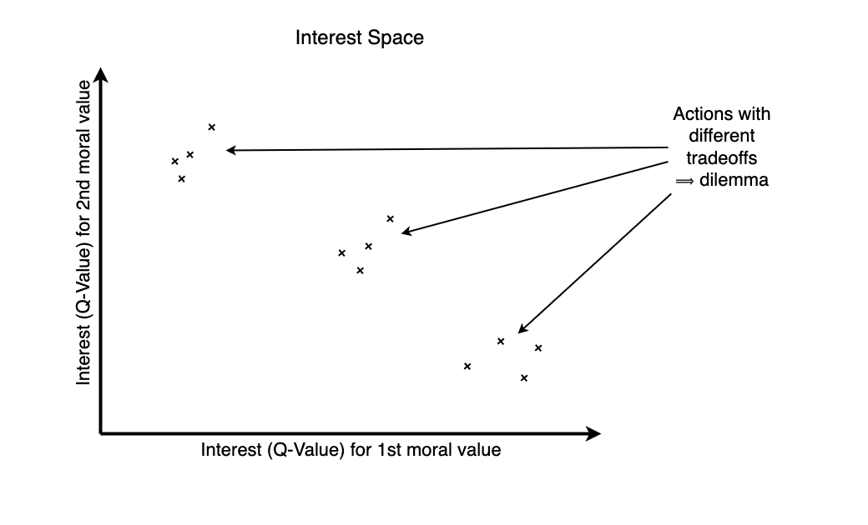
Dilemmas in multi-objective space

Slide 26
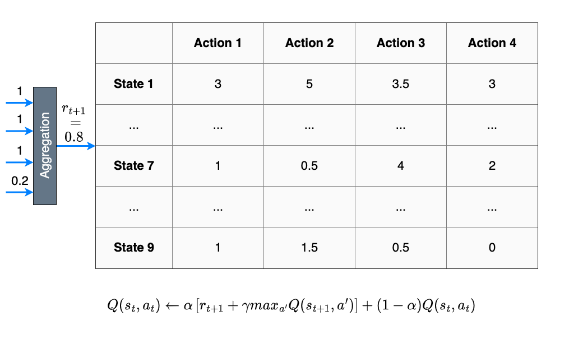
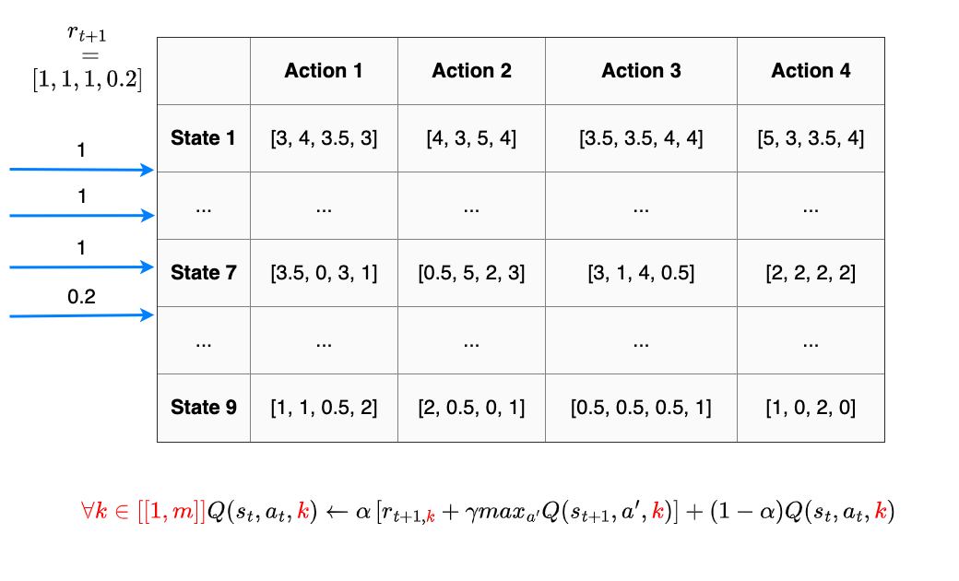
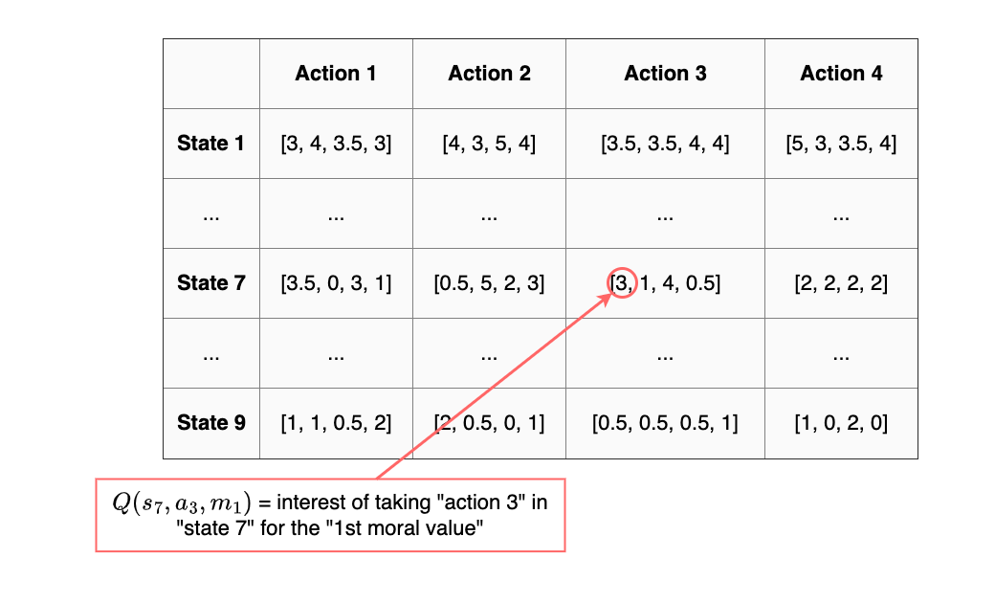
The multi-objective Q-Table

Slide 27
Our algorithm in 3 steps
Step 1
Step 2
Step 3
Learning interesting actions
Identifying dilemmas
Learning human preferences

Slide 28
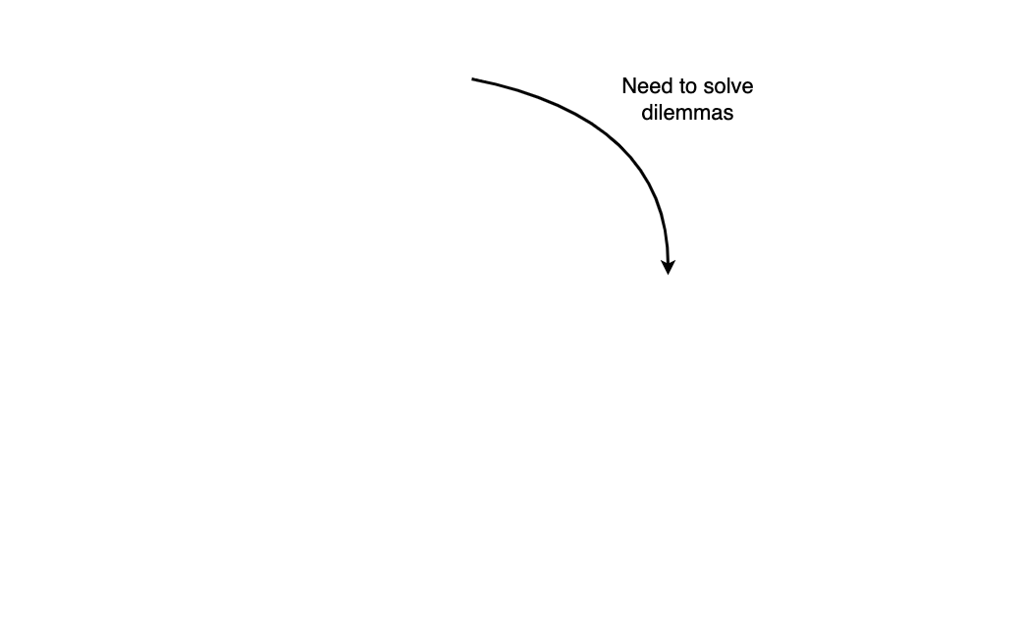
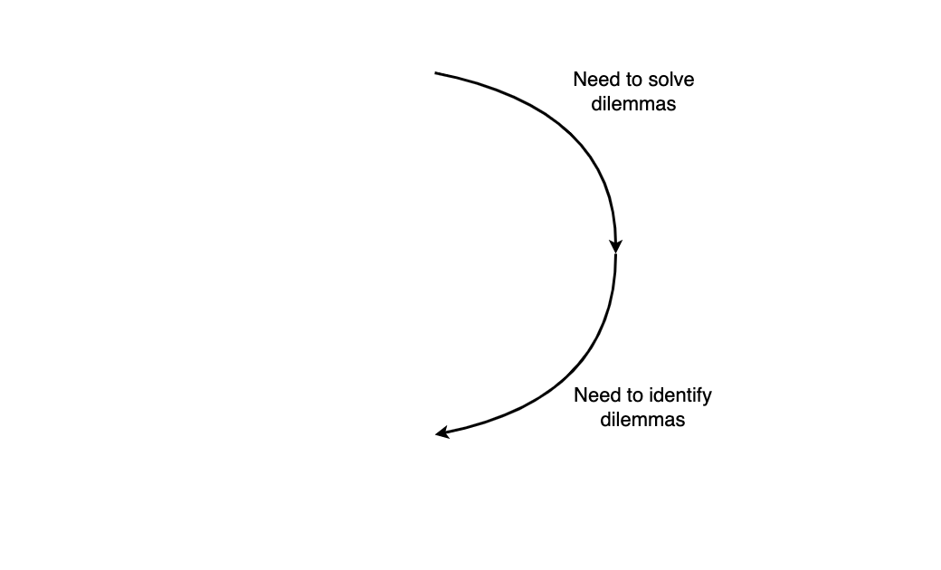
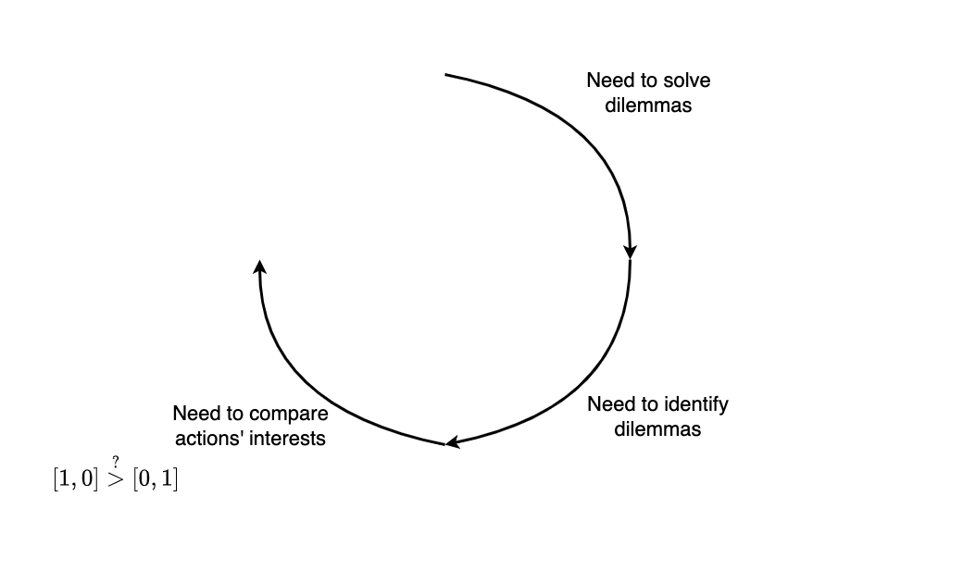
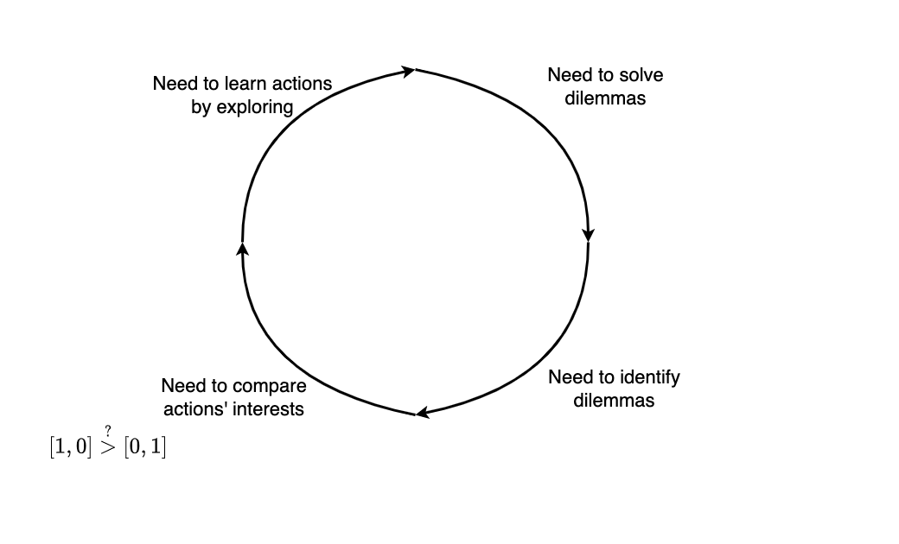
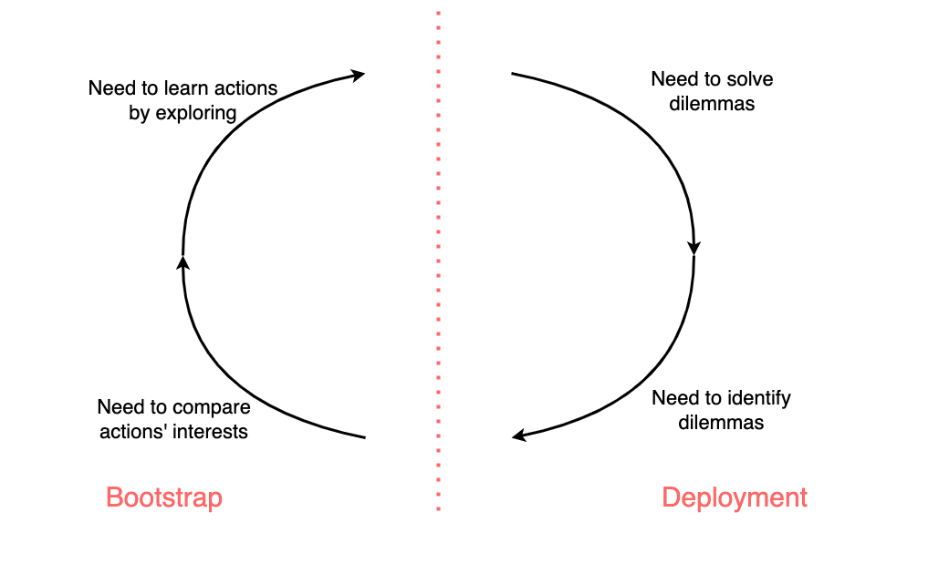




Step 1. Learning interesting actions
Notes:
We want to propose all alternatives => find them
Explo profiles => by designers

Slide 29










Step 2. Identifying dilemmas

Slide 30






Step 3. Learning human preferences

Slide 31



Human user interface

Slide 32
What we have achieved
Objective | Mechanism
Handle complex environments – Multiple persons | Multi-agents Individual observations
Handle complex environments – Multiple values | Multiple judging agents
Handle complex environments – Multiple situations | (D)SOMs
Adapt to shifting ethical consensus | Non-convergence DSOMs Agentified reward functions
Learn behaviours with non-dilemma situations | Learning algorithms
Specify desired behaviour | Symbolic judgments
Learn behaviours with dilemma situations | Explicit identification Grouping into similar contexts
Notes:
Identification + grouping = automatic but relies on human eye (definitions)
Reduced number of interactions

Slide 33
What we still lack
Impaired adaptability (ethical consensus shifting)
Because of separation into bootstrap + deployment
Few leads, e.g., re-bootstrapping regularly
Potentially more intelligent mechanisms?

Slide 34

Notes:
32min
We have put the user back in the loop

Slide 35
Experiments

Slide 36

Smart Grid as a use-case
Notes:
Implement˚ of simulator in Python
Researched literature for values
Realistic datasets

Slide 37




Different types of agents
Household
Battery capacity: 500Wh
Action range: 2,500Wh
Office
Battery capacity: 2,500Wh
Action range: 14,100Wh
School
Battery capacity: 10,000Wh
Action range: 205,000Wh

Slide 38
Number of agents
Scenario “Small”
  20 Households
  5 Offices
  1 School
Scenario “Medium”
  80 Households
  19 Offices
  1 School

Slide 39


Datasets for simulating needs
Scenario “Annual”
Scenario “Daily”

Slide 40

Learning – Q-SOM statistically outperforms others

Slide 41

Judging – Agents adapt to multiple moral values

Slide 42

Dilemmas – Number of proposed actions is manageable

Slide 43

Number of unresolved dilemmas diminishes with time
42 interactions
10,000 dilemmas

Slide 44
Conclusion
Notes:
40min

Slide 45
Synthesis
Reinforcement Learning algorithms to learn behaviours, using continuous representations, able to adapt
Hybrid learning through symbolic judgments in specific agents to make learning agents integrate ethical considerations
Putting the user back in the loop, with a focus on dilemmas and contextualized preferences
Validation on a Smart Grid simulator, with real datasets

Slide 46
A few limitations
Learning could be improved
  Multi-agent => joint-actions
  Interesting actions => automatic partitioning of interest space
Human preferences
  Different definitions of preferences
  Experiments with users
Notes:
43min

Slide 47

Perspective - Explainability

Slide 48
Perspective - Co-construction
Human users learning from agents
  e.g., change in preferences => which impact on society?
Judging agents with long-term reasoning over learning agents
  e.g., purposefully returning a lower reward because they know they
  could have done better
Meta-judge selecting which moral values to take into account
  e.g., automated curriculum learning

Slide 49
Thank you for your attention

Slide 50
References
Amgoud, Leila, and Henri Prade. “Using Arguments for Making and Explaining Decisions.” Artificial Intelligence 173, no. 3 (2009): 413–36.
Anderson, Michael, and Susan Leigh Anderson. Machine Ethics. Cambridge University Press, 2011.
Anderson, Michael, Susan Leigh Anderson, and Vincent Berenz. “A Value-Driven Eldercare Robot: Virtual and Physical Instantiations of a Case-Supported Principle-Based Behavior Paradigm.” Proceedings of the IEEE 107, no. 3 (2019): 526–40.
Bernstein, Daniel S., Robert Givan, Neil Immerman, and Shlomo Zilberstein. “The Complexity of Decentralized Control of Markov Decision Processes.” Mathematics of Operations Research 27, no. 4 (2002): 819–40.
Bremner, Paul, Louise A. Dennis, Michael Fisher, and Alan F. Winfield. “On Proactive, Transparent, and Verifiable Ethical Reasoning for Robots.” Proceedings of the IEEE 107, no. 3 (2019): 541–61.

Slide 51
References
Cointe, Nicolas, Grégory Bonnet, and Olivier Boissier. “Ethical Judgment of Agents’ Behaviors in Multi-Agent Systems.” In Proceedings of the 2016 International Conference on Autonomous Agents & Multiagent Systems, 1106–14. AAMAS ’16. Singapore, Singapore: International Foundation for Autonomous Agents and Multiagent Systems, 2016.
Dignum, Virginia. Responsible Artificial Intelligence: How to Develop and Use AI in a Responsible Way, Artificial Intelligence: Foundations, Theory, and Algorithms (Springer International Publishing, 2019).
Kohonen, Teuvo. “The Self-Organizing Map.” Proceedings of the IEEE 78, no. 9 (1990): 1464–80.
Sutton, Richard S, and Andrew G Barto. Reinforcement Learning: An Introduction. 2nd ed. MIT Press, 2018.
Watkins, Christopher J. C. H., and Peter Dayan. “Q-Learning.” Machine Learning 8, no. 3 (1992): 279–92.

Slide 52
References
Wu, Yueh-Hua, and Shou-De Lin. “A Low-Cost Ethics Shaping Approach for Designing Reinforcement Learning Agents.” ArXiv:1712.04172 [Cs], 2017.

