Slide 1
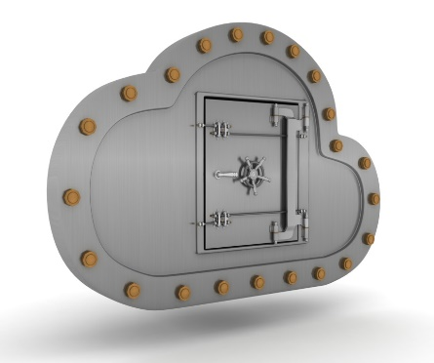

pASSWORD tYPOS and
How to Correct Them Securely
Project Silver
Rahul Chatterjee, Anish Athayle, Devdatta Akhawe, Ari Juels, Thomas Ristenpart
rahul@cs.cornell.edu
Introduction
Typo Correction
Typos are annoying.
Websites reject a login attempt even if a legitimate user makes small typographical mistakes when typing password. This hampers user experience and discourages users from choosing long passwords.
We analyze the usability benefits and security loss of tolerating small typographical errors in submitted passwords.
Correctors: A set of simple transformation functions that corrects easily correctable typos. e.g., swc-all, switches the case of all the letters in a password.
Correcting typos on the fly:
Allow login if either the entered password or any of the corrected versions of it matches the stored password.
Compatible with existing password stores, and:
Offline attack remains unchanged.
Online attack can be throttled by the website if the website sees a lot of failed login attempts.
Our free corrections theorem proves that one can correct typos without any security loss, in theory
We provide practical typo tolerant password checkers based on the theory
Usability | Security
Fraction of login attempts results in successful login. | Success probability of an attacker in guessing a randomly sampled password within q tries.
Typo Rates
Collected typo data using studies conducted at:
Amazon Mechanical Turk, and
Dropbox login infrastructure
Dropbox results:
9% of all the logins fail due to 3 typos, such as accidental pressing caps-lock key.
fixing these simple typos can increase total login by 3% in Dropbox.
delay in login can be saved by 100 seconds for 20% of the users.
Security
Security Degradation
Only entered password
Try all typo correctors
Fix typos except to blacklisted PWs
Fix typos except for heavy balls
Figure: (Left) Fraction of failed logins due to some easily correctable typos. (Right) Fraction of logins delayed due to those easily correctable typos.
Conclusion
Typo correction in passwords is possible with negligible degradation in security.
http://silver.web.unc.edu Cloud Security Horizons Summit, March 2016

