Slide 1
Fraudulent Claim Detection Case Study
Batch : DS_C72
Richa Chaturvedi
Madhav Jindal
Abhishek Guleria

Slide 2
Summary
Problem Statement
Business Objective
Approach
Results

Slide 3
Problem Statement
Global Insure, a leading insurance company, processes thousands of claims annually. However, a significant percentage of these claims turn out to be fraudulent, resulting in considerable financial losses.
The company’s current process for identifying fraudulent claims involves manual inspections, which is time-consuming and inefficient.
Fraudulent claims are often detected too late in the process, after the company has already paid out significant amounts.
Global Insure wants to improve its fraud detection process using data-driven insights to classify claims as fraudulent or legitimate early in the approval process.
This would minimize financial losses and optimize the overall claims handling process.

Slide 4
Business Objectives
Global Insure wants to build a model to classify insurance claims as either fraudulent or legitimate based on historical claim details and customer profiles. By using features like claim amounts, customer profiles and claim types, the company aims to predict which claims are likely to be fraudulent before they are approved.
Based on this assignment, you have to answer the following questions:
How can we analyze historical claim data to detect patterns that indicate fraudulent claims?
Which features are most predictive of fraudulent behavior?
Can we predict the likelihood of fraud for an incoming claim, based on past data?
What insights can be drawn from the model that can help in improving the fraud detection process?

Slide 5
Approach

Slide 6
Approach
We have followed the below mentioned steps for completing this assignment:
Data Preparation
Data Cleaning
Train Validation Split 70-30
EDA on Training Data
EDA on Validation Data (optional)
Feature Engineering
Model Building
Predicting and Model Evaluation

Slide 7
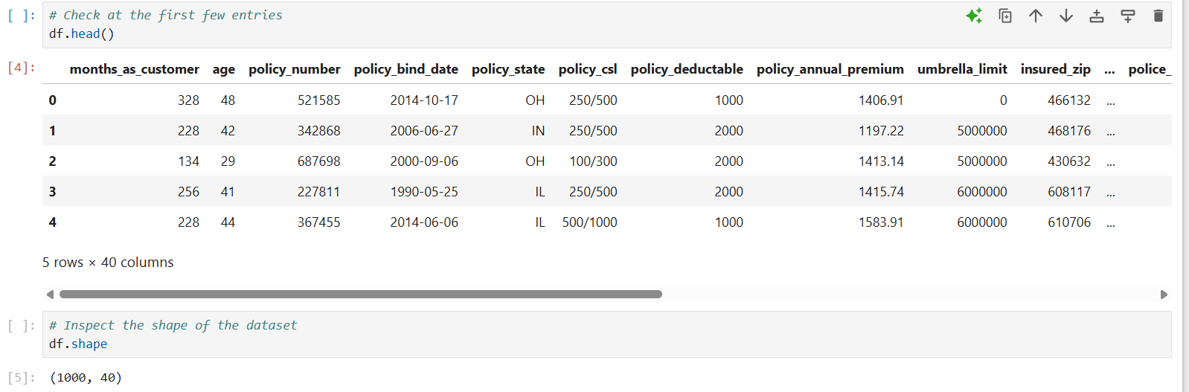
Results – Data Preparation
1.1 Load the Data

Slide 8
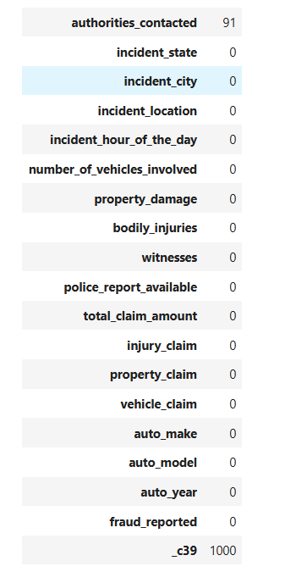
Results – Data Cleaning
2.1.1 Handle null values
From above we can see entire column with name "_c39" has null values while column named "authorities_contacted" have 91 null values.

Slide 9
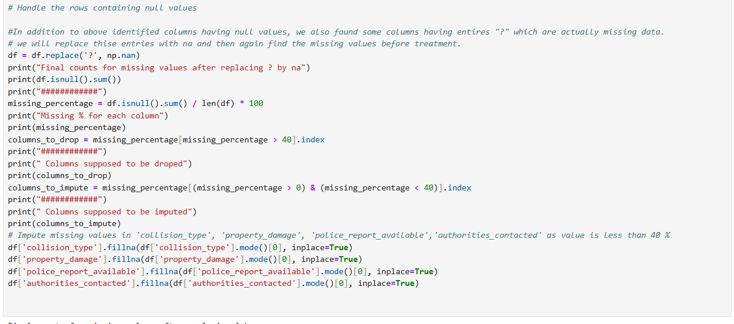
Results – Data Cleaning
2.1.2 Handle rows containing null values
Thus after analysis it is found that 5 columns have missing data among which "_c39" is completely missing while rest four columns have missing data lesser than 35-36%.
Thus we will drop _c39 while retain other columns with proper imputation (by mode as these are categorical).

Slide 10
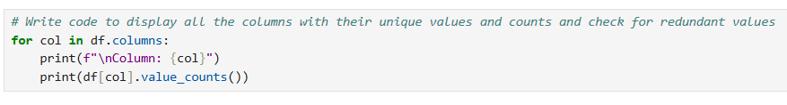
Results – Data Cleaning
2.2.4 Identify and handle redundant values and columns
Checking for Redundant Columns:
Column 'policy_number' is having >90% unique counts. High variability. Thus is a redundant feature.
Column 'policy_bind_date' is having >90% unique counts. High variability. Thus is a redundant feature.
Column 'policy_annual_premium' is having >90% unique counts. High variability. Thus is a redundant feature.
Column 'insured_zip' is having >90% unique counts. High variability. Thus is a redundant feature.
Column 'incident_location' is having >90% unique counts. High variability. Thus is a redundant feature.
Column '_c39' is completely empty. Should be dropped

Slide 11
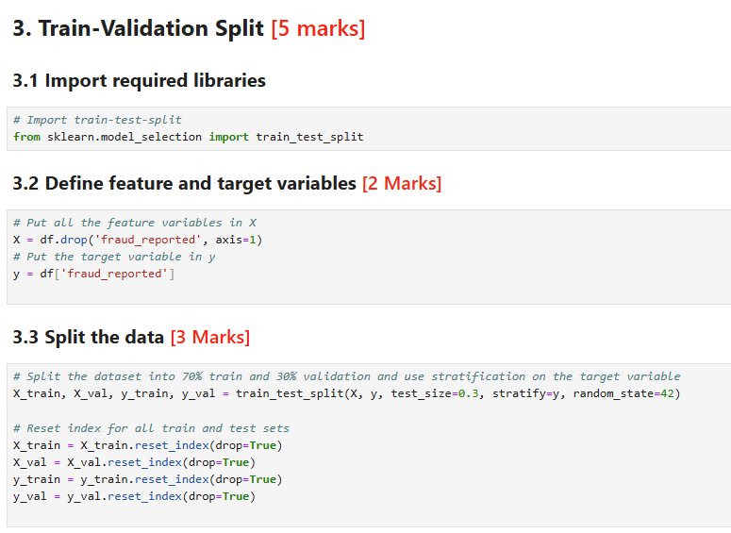
Results – Train-Validation Split
3.1,3.2 & 3.2
Train-Validation Split helps to define the target variable & Independent Variables
70% of data is used as test and 30% of data is used as validation purpose

Slide 12
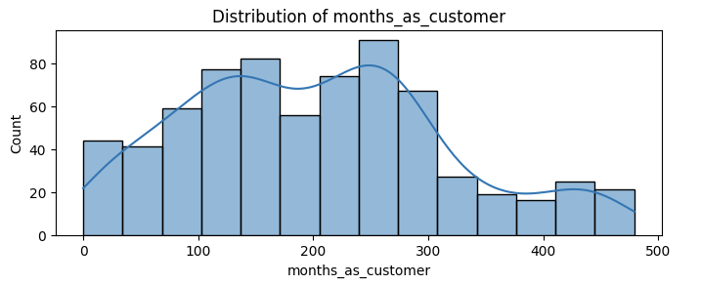
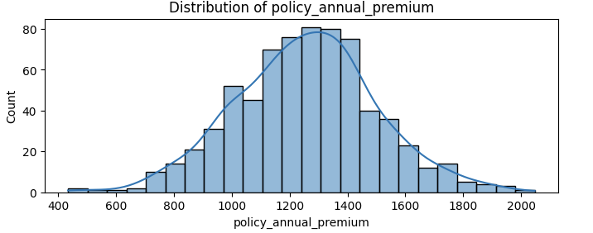
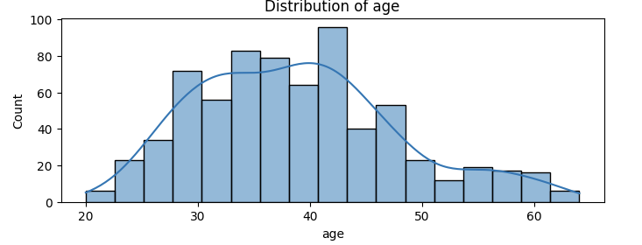
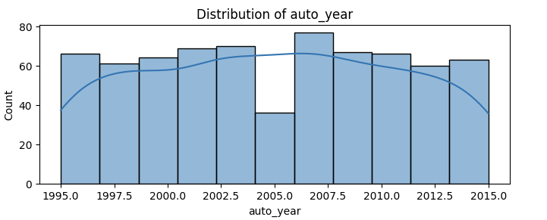
Results – EDA on Training Data

Slide 13
Results – EDA on Training Data
4.1 Analysis of Histogram
months_as_customer Distribution: near normal
age Distribution: Near-normal.
policy_deductable Distribution: Discrete with only a few levels (500, 1000, 2000).
policy_annual_premium Distribution: Approximately normal.
umbrella_limit Distribution: Highly skewed with most values at zero and a few very large outliers.
capital-gains Distribution: Right-skewed with many zeros and few large values.
capital-loss Distribution: Left-skewed with many zeros, negative values (illogical).
incident_hour_of_the_day Distribution: Fairly uniform.
number_of_vehicles_involved Distribution: Mostly 1 vehicle.

Slide 14
Results – EDA on Training Data
bodily_injuries Distribution: Only 0, 1, or 2.
witnesses Distribution: 0–3, discrete.
total_claim_amount Distribution: Right-skewed.
injury_claim Distribution: Right-skewed.
property_claim Same as above.
vehicle_claim Same as above.
auto_year Distribution: Uniform across recent years.
Capital loss Contains invalid negative values we can drop column umbrella_limit dominated by zeros injury_claim/property_claim/vehicle_claim Consider dropping two out of three due to redundancy with total_claim_amount( we will check multicollinearity among these and than decide

Slide 15
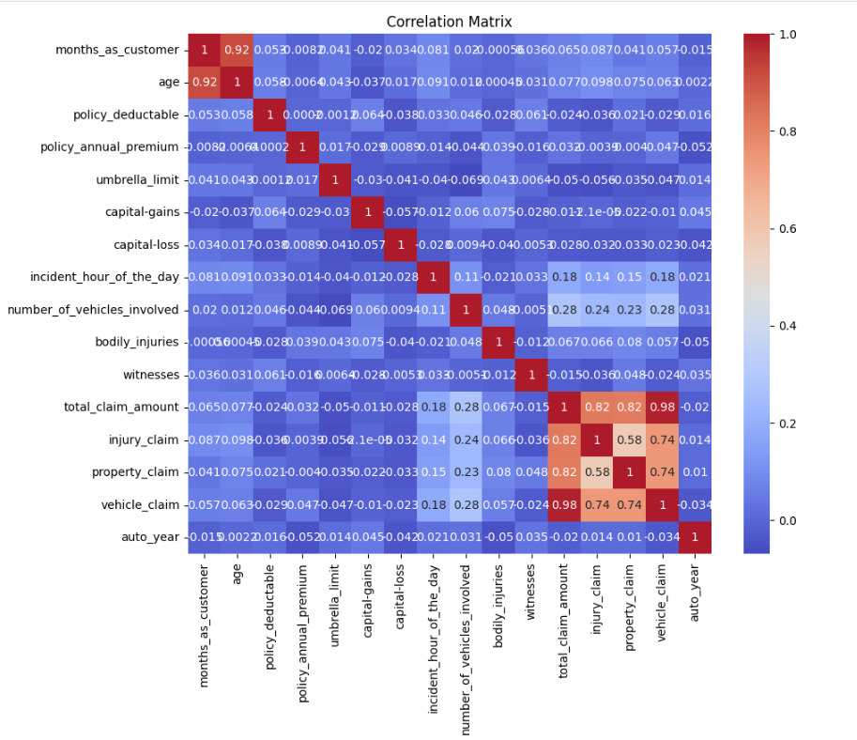
Results – EDA on Training Data
4.2 Correlation Analysis
We can see that there is high correlation between age and months_as_customer.We will drop the "Age" column. Also there is high correlation between total_clam_amount, injury_claim, property_claim, vehicle_claim as total claim is the sum of all others. So we will drop the total claim column.
Age and the total claim column shall be removed as are highly correlated with other.

Slide 16
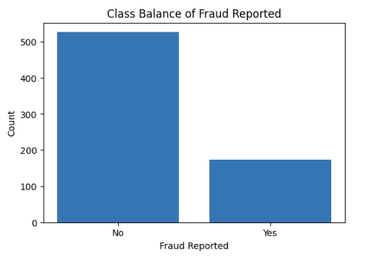
Results – EDA on Training Data
4.3 Check Class Balance
Target variable is highly imbalanced.

Slide 17
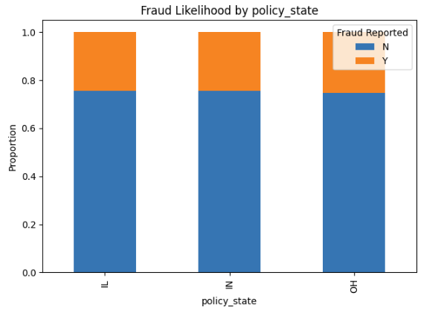
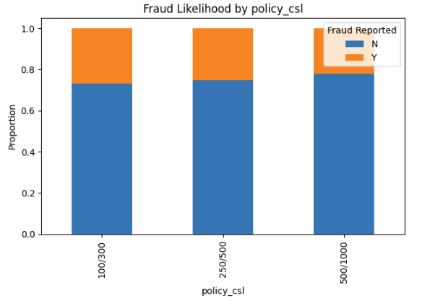
Results – EDA on Training Data
Bivariate Analysis :Target Likelihood

Slide 18
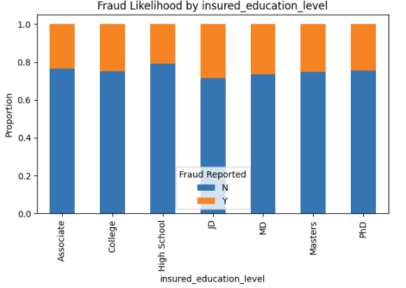
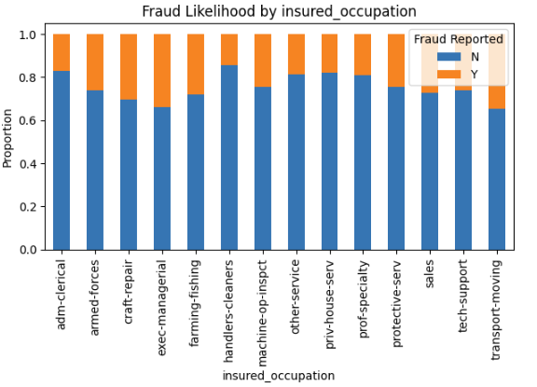
Results – EDA on Training Data
Bivariate Analysis :Target Likelihood

Slide 19
Results – EDA on Training Data
Summary of Target Likelihood Analysis:
policy_state: Not significant (p-value = 0.9684). Categories with higher-than-baseline fraud rate: [2].
policy_csl: Not significant (p-value = 0.4788). Categories with higher-than-baseline fraud rate: [0, 1].
insured_sex: Not significant (p-value = 0.9742). Categories with higher-than-baseline fraud rate: [0].
insured_education_level: Not significant (p-value = 0.9294). Categories with higher-than-baseline fraud rate: [3, 4, 5].
insured_occupation: Not significant (p-value = 0.4016). Categories with higher-than-baseline fraud rate: [1, 2, 3, 4, 11, 12, 13].
insured_hobbies: Significant (p-value = 0.0000). Categories with higher-than-baseline fraud rate: [5, 6, 10, 13, 14, 19].
insured_relationship: Not significant (p-value = 0.1671). Categories with higher-than-baseline fraud rate: [2, 4, 5].
incident_type: Significant (p-value = 0.0001). Categories with higher-than-baseline fraud rate: [0, 2].
collision_type: Not significant (p-value = 0.1963). Categories with higher-than-baseline fraud rate: [0, 2].
incident_severity: Significant (p-value = 0.0000). Categories with higher-than-baseline fraud rate: [0]. - authorities_contacted: Significant (p-value = 0.0039).

Slide 20
Results – EDA on Training Data
Summary of Target Likelihood Analysis:
uthorities_contacted: Significant (p-value = 0.0039). Categories with higher-than-baseline fraud rate: [0, 1, 2].
- incident_state: Significant (p-value = 0.0098). Categories with higher-than-baseline fraud rate: [0, 2, 3, 4, 5].
- incident_city: Not significant (p-value = 0.5827). Categories with higher-than-baseline fraud rate: [0, 1, 2, 6].
- property_damage: Not significant (p-value = 0.2289). Categories with higher-than-baseline fraud rate: [1].
- police_report_available: Not significant (p-value = 0.5368). Categories with higher-than-baseline fraud rate: [0].
- auto_make: Not significant (p-value = 0.6983). Categories with higher-than-baseline fraud rate: [1, 2, 3, 5, 6, 7, 8, 13].
- auto_model: Not significant (p-value = 0.1969). Categories with higher-than-baseline fraud rate: [1, 2, 4, 5, 7, 10, 12, 14, 15, 16, 17, 18, 20, 22, 24, 26, 28, 32, 34, 37, 38].
** Target liklihood analysis**
Insured_hobbies,incident_type,incident_severity,authorities_contacted,incident_state found to be significant as per target liklihood analysis.

Slide 21
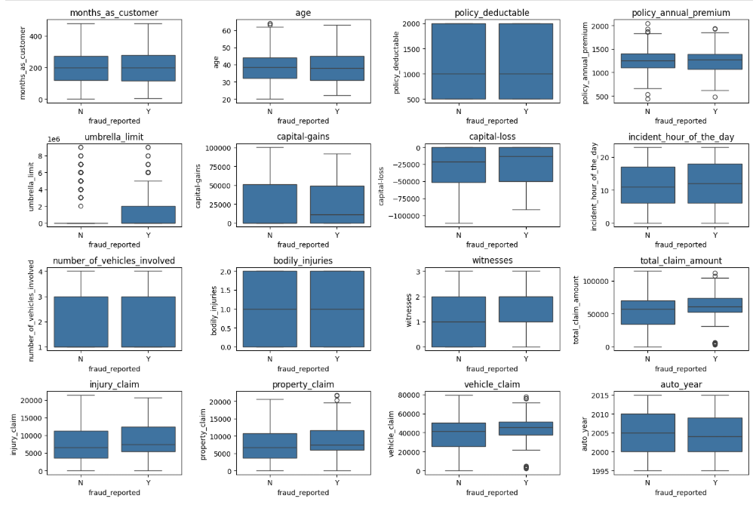
Results – EDA on Training Data
4.4.2 Relationship between Numerical Features and the target variable

Slide 22
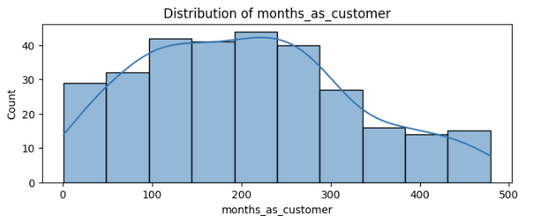
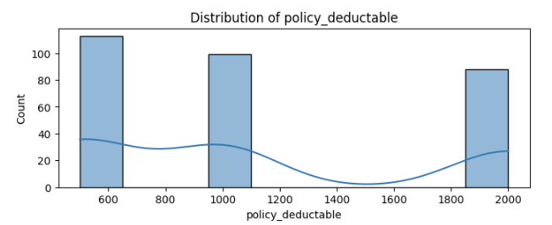
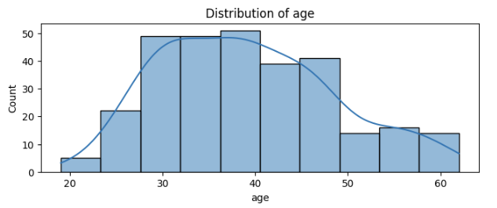
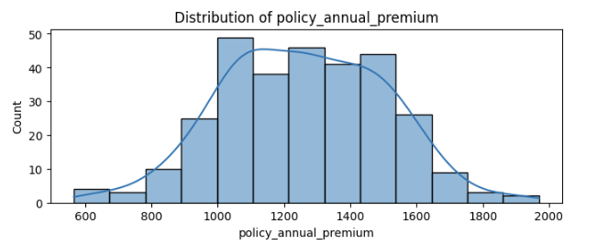
Results – EDA on Validation Data
Univariate Analysis

Slide 23
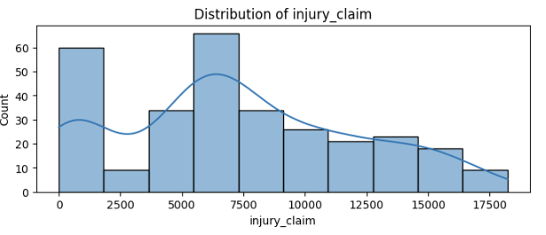
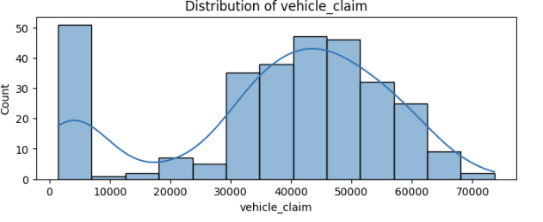
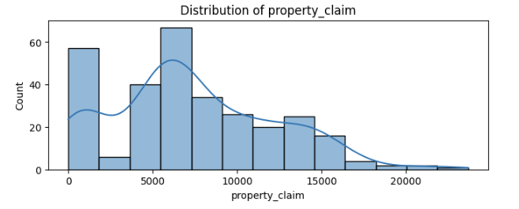
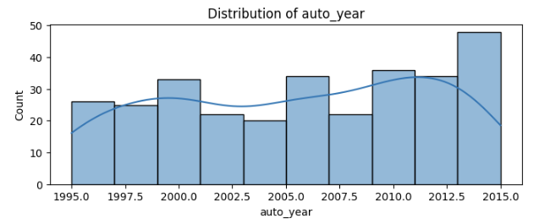
Results – EDA on Validation Data
Univariate Analysis

Slide 24
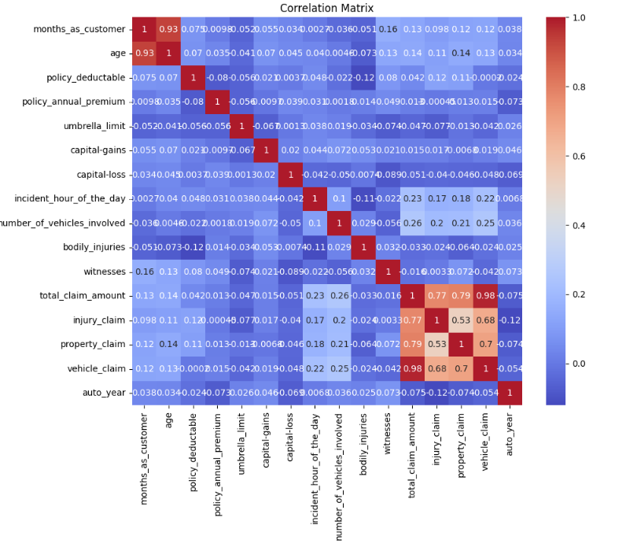
Results – EDA on Validation Data
Correlation Analysis

Slide 25
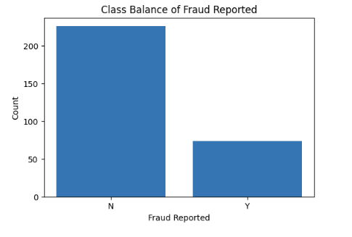
Results – EDA on Validation Data
5.3 Check Class Balance

Slide 26
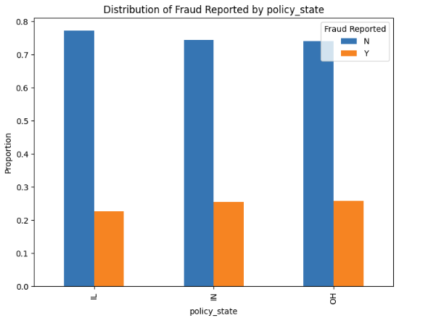
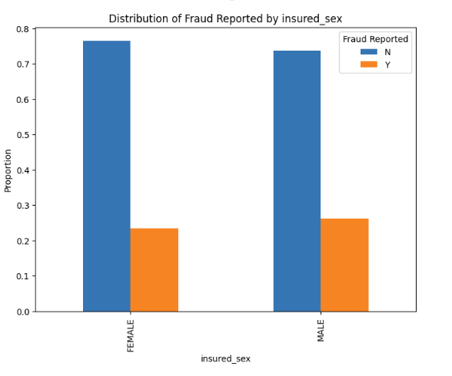
Results – EDA on Validation Data
Bivariate Analysis :Target Likelihood

Slide 27
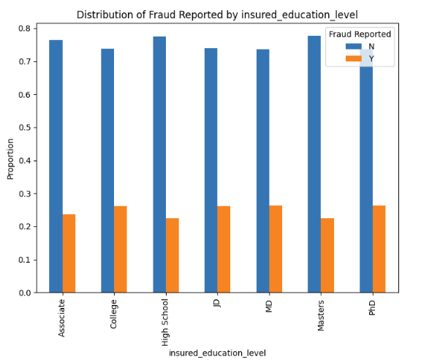
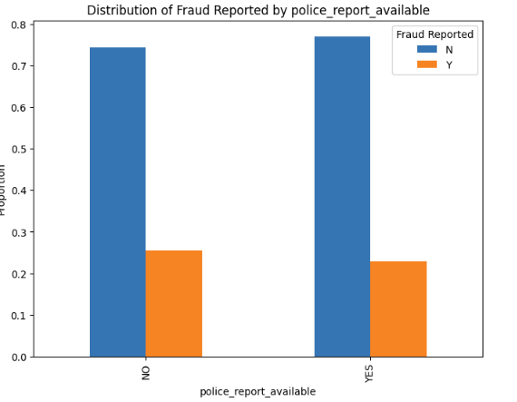
Results – EDA on Validation Data
Bivariate Analysis :Target Likelihood

Slide 28
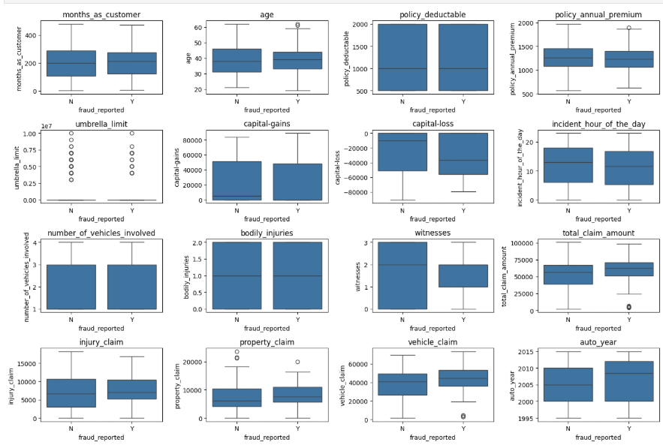
Results – EDA on Validation Data
5.4.2 Relationship between Numerical Features and the target variable

Slide 29
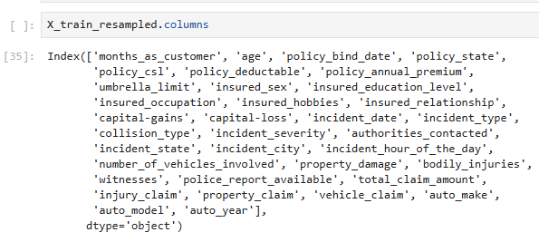
Results – Feature Engineering
6.1 Resampling : RandomOverSampler

Slide 30
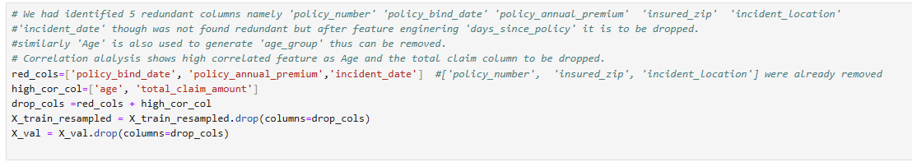
Results – Feature Engineering
6.3 Handle redundant columns

Slide 31
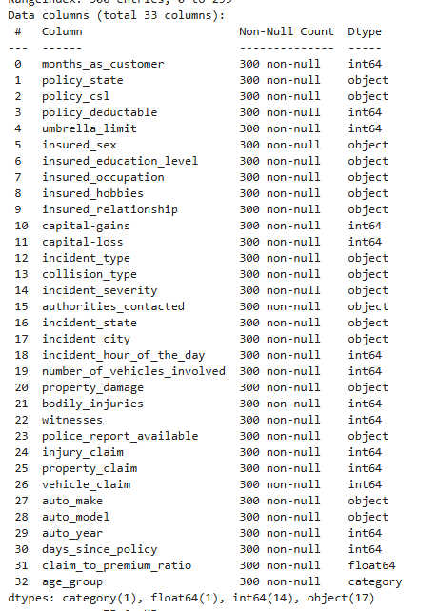
Results – Feature Engineering
6.3 Handle redundant columns

Slide 32
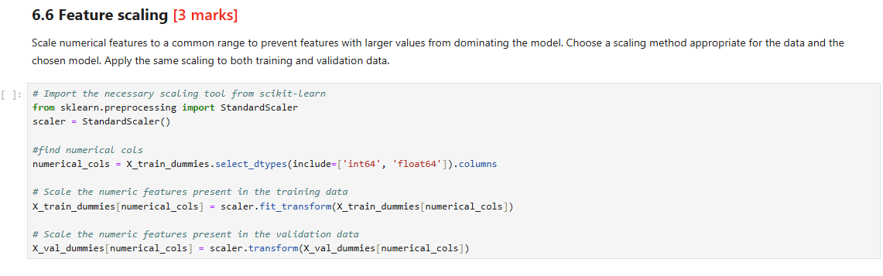
Results – Feature Engineering
6.6 Feature Scaling

Slide 33
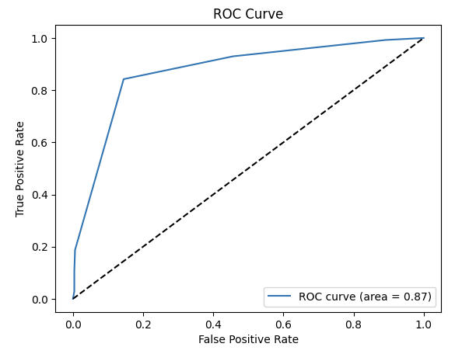
Results – Model Building
7.3 Optimal Cut-off and ROC Curve

Slide 34
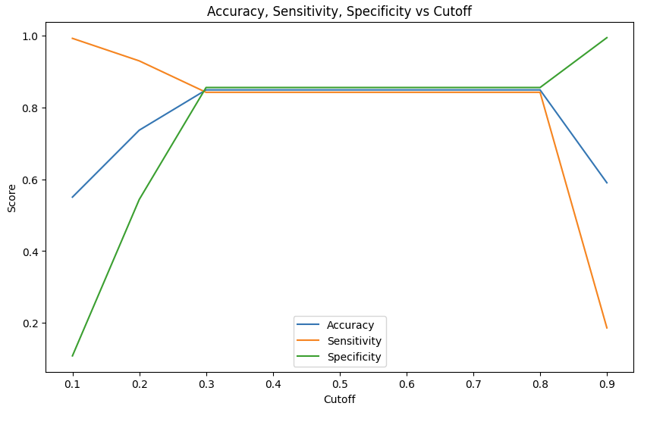
Results – Model Building
7.3.3 Accuracy, Sensitivity, Specificity at different values of cutoffs

Slide 35
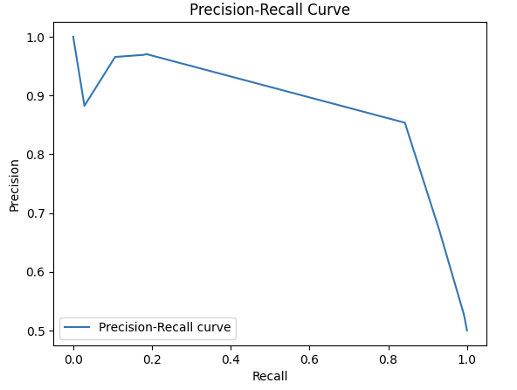
Results – Model Building
7.3.9 Precision-Recall Curve

Slide 36
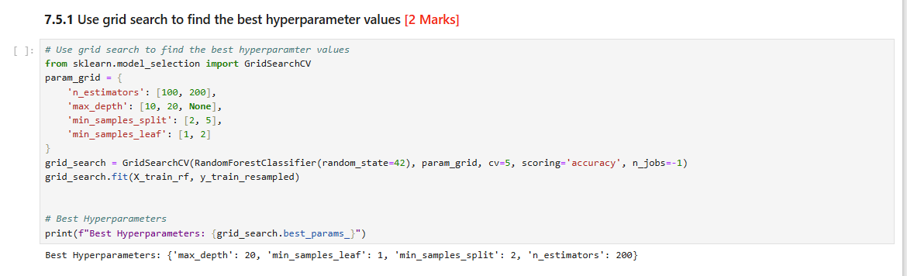
Results – Hyperparameter Tuning
7.5.1 Grid Search

Slide 37
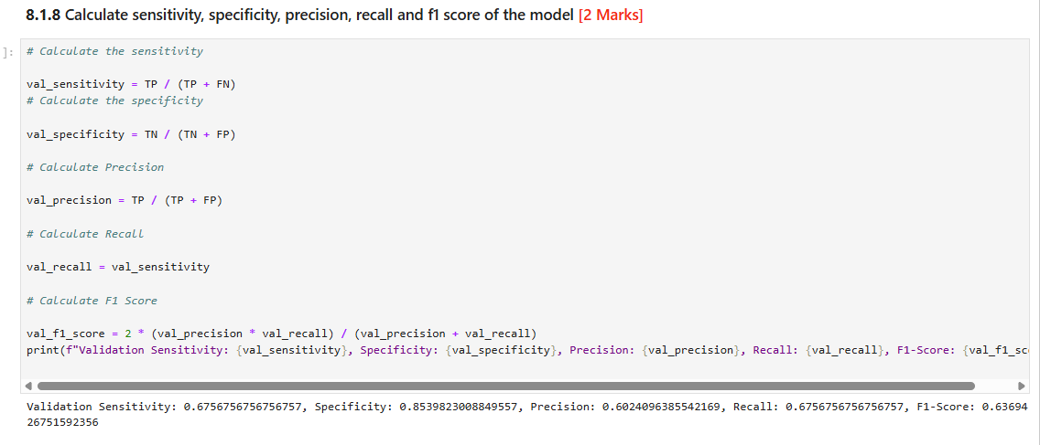
Results – Predictions and Model Evaluation
8.1 Predictions over validation data using logistic regression model

Slide 38
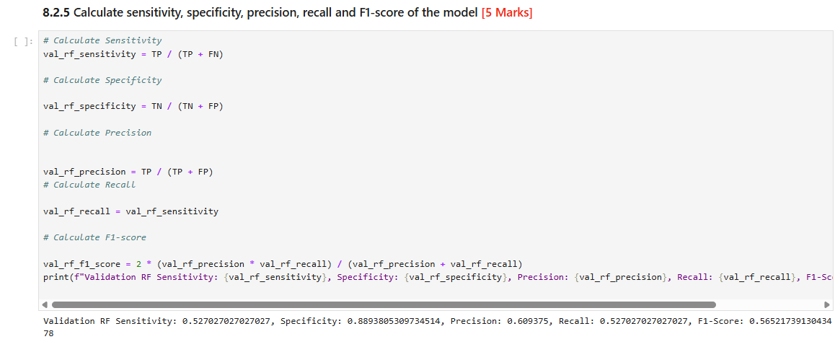
Results – Predictions and Model Evaluation
8.2 Predictions over validation data using random forest model

Slide 39
Results – Evaluation and Conclusion
The fraud detection models developed using Logistic Regression and Random Forest provide effective tools for identifying fraudulent insurance claims.
The Logistic Regression model, after feature selection with RFECV and optimal cutoff tuning, achieved balanced performance with good sensitivity and specificity, making it interpretable and suitable for scenarios where understanding feature impacts is crucial.
The Random Forest model demonstrated strong predictive power, particularly in handling complex interactions, though it showed signs of overfitting. Both models were evaluated on validation data, with the Logistic Regression generally outperforming Random Forest in accuracy and F1-score, suggesting it may be preferred for deployment.
Key features like claim amounts, incident severity, and customer tenure were highly predictive of fraud. To improve the fraud detection process, Global Insure should prioritize these features in their screening process, implement the Logistic Regression model for initial claim screening, and continuously monitor model performance to adapt to evolving fraud patterns.

Slide 40
Thanks !

