Slide 1




Home Credit Default Risk
Group 23(Phase -3)
Tanay Kulkarni
tankulk@iu.edu
Shefali Luley
sluley@iu.edu
Sanket Bailmare
sbailmar@iu.edu
Raj Chavan
rchavan@iu.edu

Slide 2
Outline
Project Description
Summary of Previous phases
Phase 3 plan
Approach
Visual Representation of TensorBoard
Accuracy of Neural Network.
Leakage and Cardinal Sins
Results and discussion
Conclusion and Future Scope

Slide 3
Project Description
Home credit utilizes several alternative data and methods to predict their client’s repayment abilities.
We will be using machine learning and statistical methods to determine these predictions.
We have finalized Logistic Regression and Random forest classifier for prediction.
We performed Feature Engineering, did hyperparameter training and train model using best parameters and setting.
In this phase we use a Multi Layer Perceptron (MLP) Model using Pytorch for loan default classification and use Tensorboard to visualize the results of training and modeling

Slide 4
Summary of Previous Phases
We cleaned the data and picked only the features which were important to the target variable and prediction.
We featured the data performing OHE and applied imputing methods to fix the data before feeding it to the model.
We were able to create the baseline pipeline and could experimentally understand the accuracies of the models like logistic regression, naive bayes and Random forest. Based on the results of the models we saw that there might be underfitting in naive bayes and overfitting in Random Forest.
The best model that we could get for Phase 0 was Logistic Regression which gave a training accuracy of 91.9% and the Kaggle submission accuracy of 73.6%
In Phase 2 we did feature engineering by adding our custom features and performed hyperparamter tuning to achieve the best features from the model using GridSearchCV , we got training accuracy of 72.93 and testing accuracy of 72.841

Slide 5
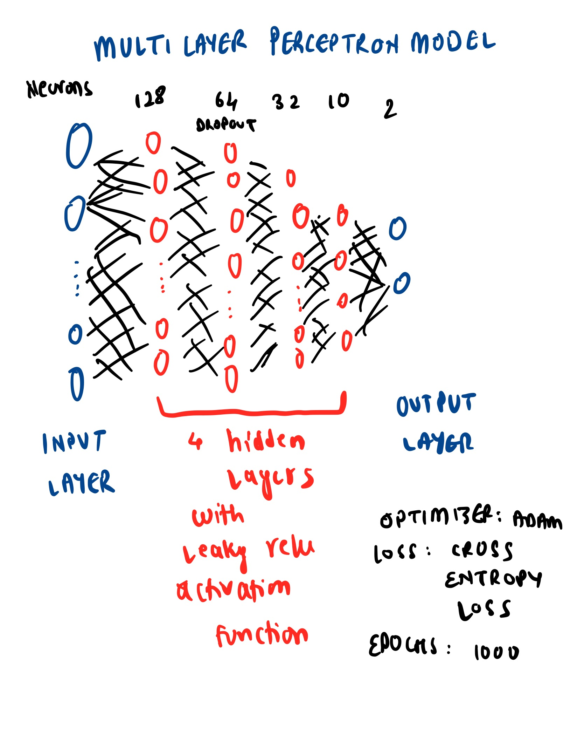
Phase 3 Plan
* Use a Multi Layer Perceptron (MLP) Model using Pytorch for loan default classification
* Use Tensor board to visualize the results of training and modeling

Slide 6
Approach
We used Pytorch to build a MLP model and built an Artificial Neural Network with 4 hidden layers consisting of 128, 64, 32, 10 neurons in each layer respectively with an output layer having 2 neurons
The activation function that we used was the leaky relu activation function which is an upgrade on the relu activation function having more resilience to the vanishing gradient problem
The loss function that we used for this model is the cross entropy loss and the optimizer (after experimenting different optimizers) we used for modeling is the Adam optimizer
The learning rate (after trying different learning rates) that we decided for this particular model was 0.001 and a dropout layer with dropout rate of 0.5 was added in the network to regularize the overfitting of model
Lastly, the neural network model was trained for 1000 epochs and a softmax function was applied on the final predictions to get the final answer in the form of probabilities

Slide 7
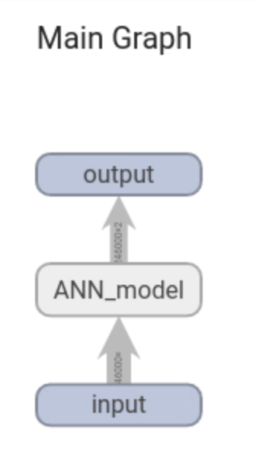
Tensorboard Visual Representation

Slide 8
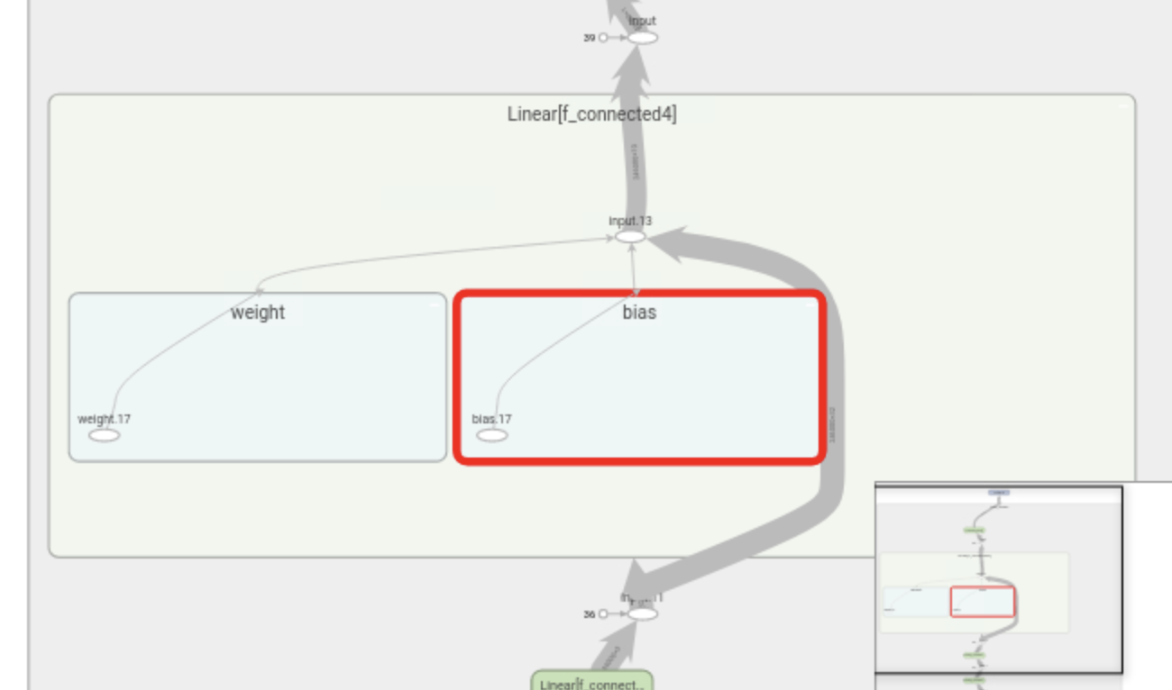
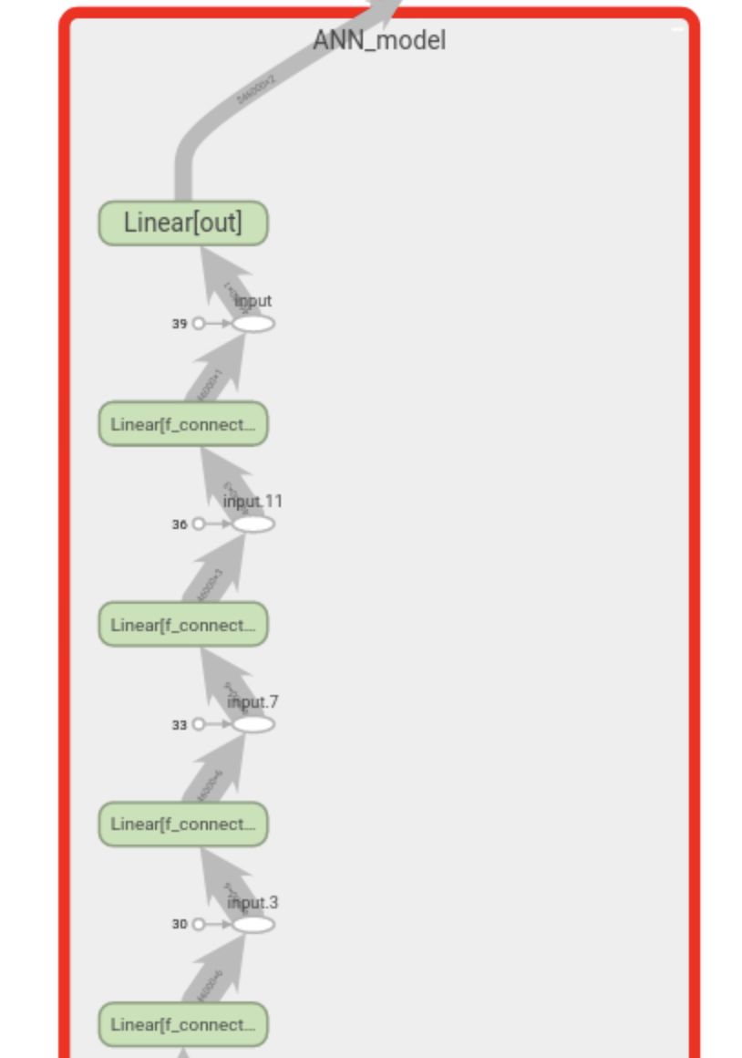
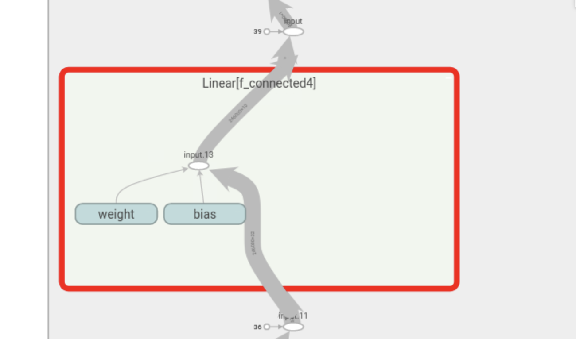

Slide 9
Results and discussion of results

Slide 10
Accuracies and Losses
On implementation of Neural Network for modeling the HCDR dataset we got a training accuracy of 91.95% and a test roc score of 0.71225.
Here, we used the features that we created in the previous phase of the project and selected features just with high correlation as strong predictors that we would train our neural network with.
After trying different combinations of hidden layers and the number of neurons in them we found that 4 hidden layers with 128,64,32,10 neurons respectively worked the best with an output layer having 2 neurons.
We tried out 3 optimizers namely AdaDelta, Adam and RMSprop where we found that the Adam optimizer worked the best for us. Since we did not want to overtrain and overfit the model we limited the epochs to 1000 after which we did not find any significant difference for the increase in accuracy.

Slide 11
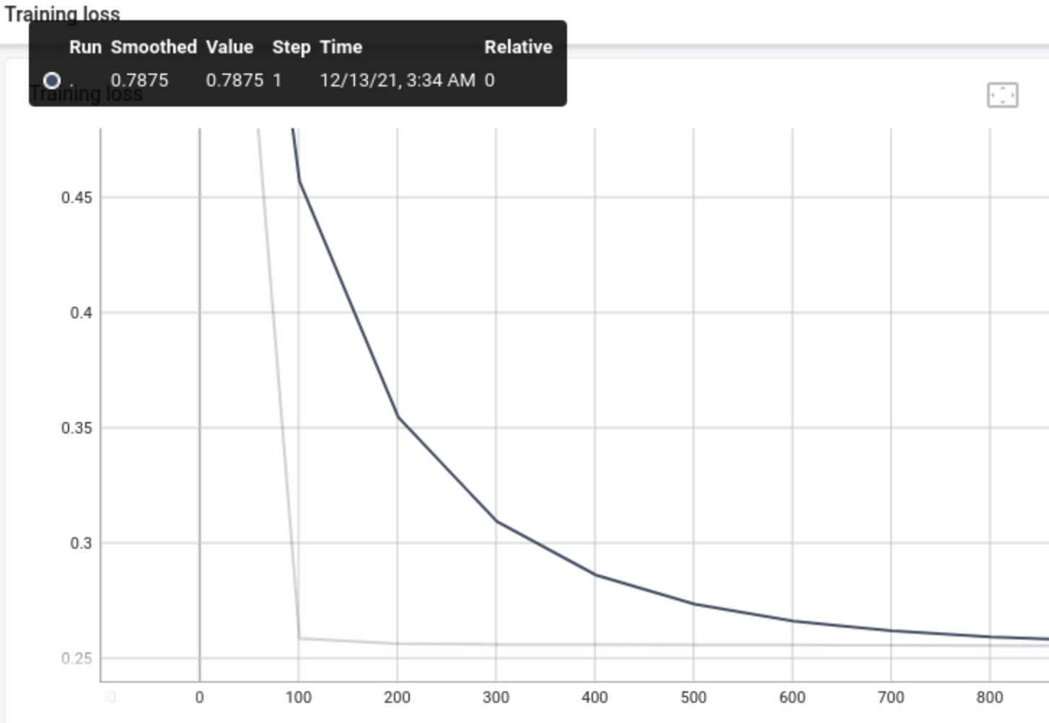
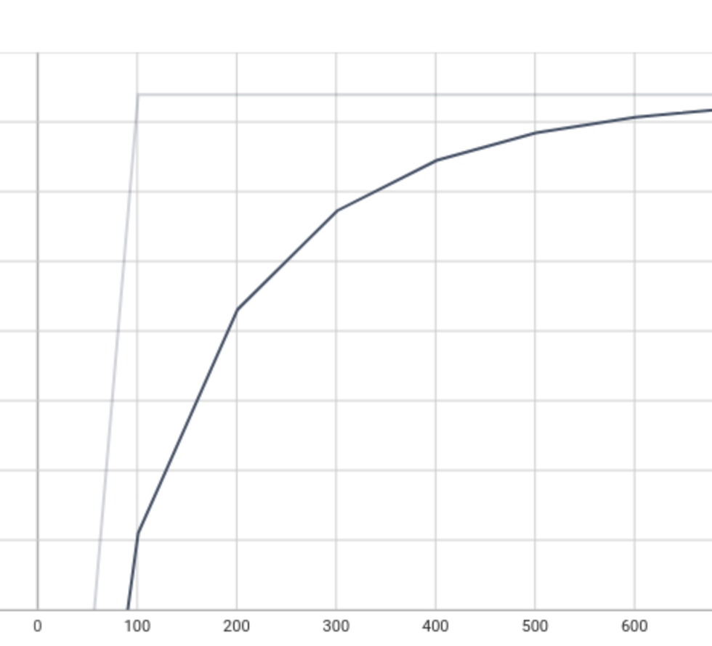
TRAINING LOSS
ACCURACY

Slide 12
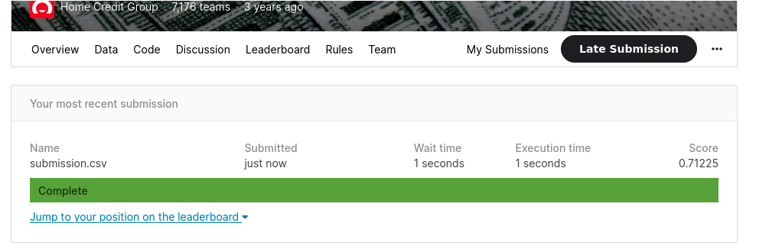
Kaggle Submission

Slide 13
Leakage
Data leakage in Machine Learning modeling pipelines usually occurs when the data that is available during training or feature engineering is unavailable on the time of inference or testing the accuracy of model for untested/unseen data.
For the pipeline that we have used, we see that there is no data leakage as we have dealt with all NaN values appropriately, and the data type has been set uniform across columns.
We have also ensured that the new features that we have generated during feature engineering have been used appropriately during training and is available at the time of inference.

Slide 14
ML Cardinal Sins
The most common cardinal sins that could map to this project that we understood were:
Data and Model abuse: where there is no split for training and testing, also there is a high possibility of overfitting. Here we have sufficiently dealt with the above point by splitting the data and training it for best fit.
Bad Data: We have checked appropriately for bad data and have removed that if any.
Cross-validation chaos: we have used less number of cross-validations in our grid search to get the best average and not the overrated one.
Overinterpretation of results: We have stuck to the evidence that we found through results and did not attempt to overmap tp pollute the understanding of results.
Sticking to one score metric: We did not stick to just one score metric to understand our results but used additional metrics like roc score and confusion matrix to interpret the results.
Thus we believe that we have not committed any cardinal sins of Machine Learning in this project.

Slide 15
Conclusion and Future Scope
In this last phase we implemented a Multilayer Perceptron(MLP)model using Pytorch for loan default classification.
We found out the accuracy for the MLP model to be 91.95% and a test roc score of 0.71225 which is pretty close to our previous non deep learning models.
Deep Learning models require huge amount of data to train itself and thus on a longer run Deep Learning models would work best for HCDR classification as compared to usual supervised models.
The future scope for this project can include using embeddings in deep learning models or using some advanced classification models like lightGBM/other boosting models that can produce better results.

