Slide 1
Introducción Git
Control de versiones

Slide 2
Control de versiones
Uno de los mayores cambios en cómo colaboran entre sí los desarrolladores se ha producido en el control de versiones de código fuente.
La adopción de Git ha cambiado los patrones de desarrollo de software., mejorando la agilidad y la comunicación de los equipos

Slide 3
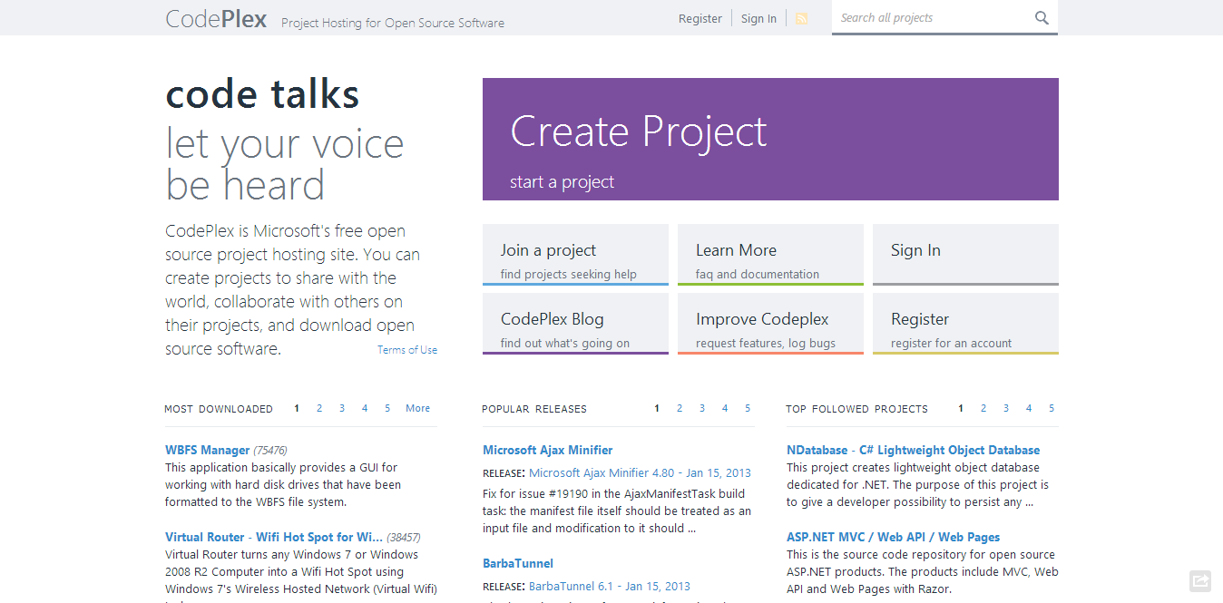
Notes:
On CodePlex. I’m pretty sure this audience is familiar with CodePlex. Before working on CodePlex, I worked on several parts of the Visual Studio product, including the UML and architectural discovery features. And in VS 2012 I worked on the Code Review and the My work Features.
So developer productivity has been something that has been close to my heart for several years.

Slide 4
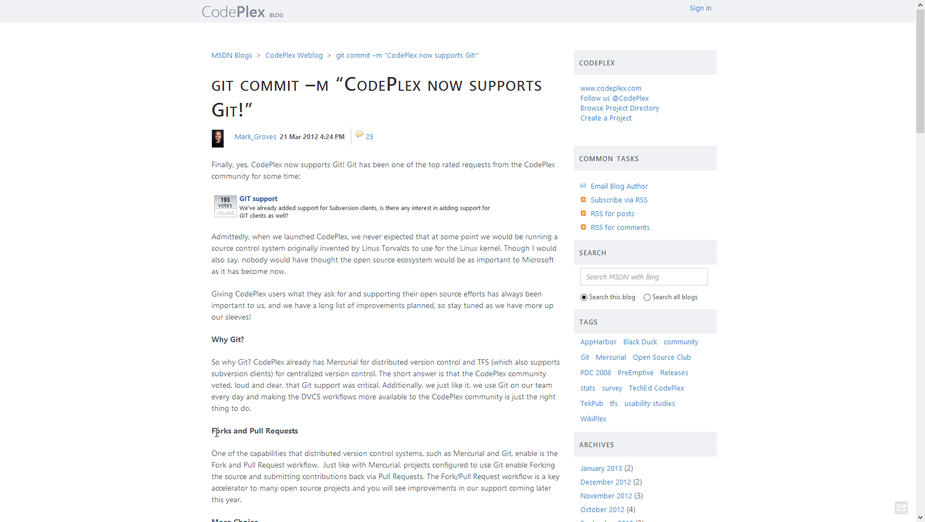
Notes:
By in March of last year, CodePlex added Git Support. You may have heard about announcement.
We now have several teams within the company using git on a daily basis. The ASP.Net Web Stack team, Entity Framework, the Typescript team, and several others. Including the CodePlex team.
I had been playing with Git on personal projects for about a year, but this was the first time I had to chance to work with a development team on a real project.

Slide 5





Historia
Creado Linus Torvalds para el proyecto de Linux kernel ~2005
Usan git para su control de versiones:
Notes:
Git was originally created by Linus for work on the Linux kernel right around 2005.
Although git has its origins in the Open source community, git is being used within close source projects also.
This is just some of the many companies that are using git for both oss and closed sourced projects.

Slide 6
Git es
Distributed
Version Control System
Notes:
Git is a distributed version control system.

Slide 7
Git es
Directory
Content Management System
Notes:
A directory content management system

Slide 8
Git es
Tree
history storage system
Notes:
A tree based history storage system

Slide 9
Git es
Content
tracker
Notes:
Or How git is described on the Git Man page a Stupid content tracker.

Slide 10
Control de versiones distribuido
Todo el equipo tiene la historia completa del código que se esta desarrollando.
Se puede trabajar fuera de línea, excepto cuando se comunica con el servidor para actualizar la versión para el equipo.
No se basa en una autoridad centralizada.
Los cambios también se pueden compartir punto apunto en caso de que el servidor este fuera de línea.
Notes:
Given Git’s nature you can even share changes in a peer-to –peer nature.
This does not happen often but Git does enable this ability. If your server is offline for some reason your team can still work.

Slide 11
Centralized VC vs. Distributed VC
Central Server
Remote Server
Notes:
This is over simplifying the story, but the basics are that centralized version control system define a central authority.
I am not saying one system is better that the other, it is just that each model that its benefits.
In the distributed model by definition everything is expected to be off line. To have a system that expects everything to be offline, you have to build in several local capabilities that are not required in a centralized model.
Such as local branching. And to make branching fast and lightweight you better make merging great also.
I won’t go into the guts of git that enables some of this capability in this talk, but if you are interested I will highlight some resources at the end of the talk where you can go deeper.

Slide 12

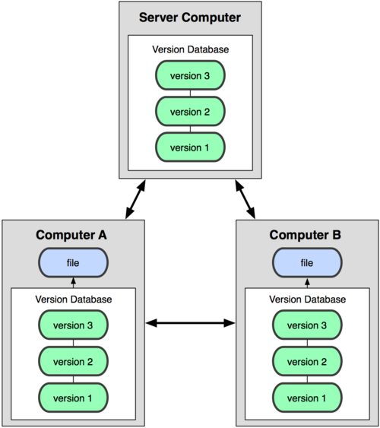
Modelo distribuído de GIT
Centralized Model
Distributed Model
(CVS, Subversion, Perforce)
(Git, Mercurial)
Result: Many operations are local
Notes:
http://git-scm.com/book/en/Getting-Started-About-Version-Control

Slide 13
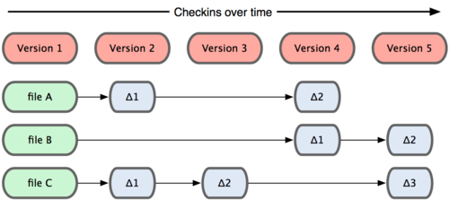
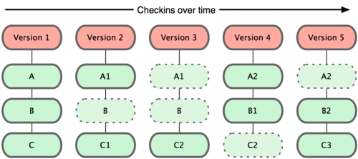
Git toma “snapshots”
Subversion
Git

Slide 14
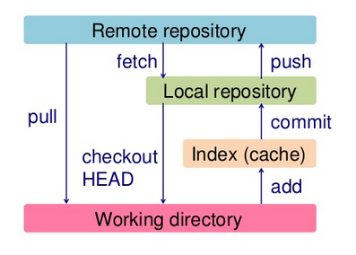
Control de versiones distribuido

Slide 15
Branching
Es diferente CVC ( control de versiones centralizado)
Un “branch work” es como tener “Sticky Note” en un gráfico de nodos que representan las versiones.
Cada “branch work” está asociado a una carpeta del sistema de archivos.
Cambiar de branch equivale a cambiar de ubicación al “Sticky Note”.
Notes:
Switching between branches is just moving the sticky note around.

Slide 16
Inicialización
C:\> mkdir CoolProject
C:\> cd CoolProject
C:\CoolProject > git init
Initialized empty Git repository in C:/CoolProject/.git
C:\CoolProject > notepad README.txt
C:\CoolProject > git add .
C:\CoolProject > git commit -m 'my first commit'
[master (root-commit) 7106a52] my first commit
1 file changed, 1 insertion(+)
create mode 100644 README.txt
Notes:
After you install git on your machine to get started you will need to initialize a repository.
You can do this by going into your file system, creating a folder and doing git init within the folder.
All the magic happens in the Dot Git folder. This folder IS GIT. You can copy this folder to another machine and it will work.
When I first started playing with git, I had setup a new machine, and was having a hell of a time trying to figure out how I should move my git projects over to the new machine. It was kind of embarrassing. Eventually I just tried to copy it over and it worked.
At this point you really don’t have much. You need to do your first commit to make this light up.
You create a file. When then stage it, but telling git the track this file. In this case I told git to add all files.
Then I was able to commit with a message say this is my first commit.

Slide 17
Branching
master
A
> git commit –m ‘my first commit’
Notes:
Now lets see what this visually looks like.
On my first commit I have A.
The default branch that gets created with git is a branch names Master.
This is just a default name. As I mentioned before, most everything in git is done by convention. Master does not mean anything special to git.

Slide 18
Branches Illustrated
master
A
B
C
> git commit (x2)
Notes:
We make a set of commits, moving master and our current pointer (*) along

Slide 19
Branches Illustrated
master
A
B
C
bug123
> git checkout –b bug123
Notes:
Suppose we want to work on a bug. We start by creating a local “story branch” for this work.
Notice that the new branch is really just a pointer to the same commit (C) but our current pointer (*) is moved.

Slide 20
Branches Illustrated
master
A
B
C
D
E
bug123
> git commit (x2)
Notes:
Now we make commits and they move along, with the branch and current pointer following along.

Slide 21
Branches Illustrated
master
A
B
C
D
E
bug123
> git checkout master
Notes:
We can “checkout” to go back to the master branch.
This is where I was freaked out the first time I did this. My IDE removed the changes I just made. It can be pretty startling, but don’t worry you didn’t lose anything.

Slide 22
Branches Illustrated
master
A
B
C
D
E
bug123
> git merge bug123
Notes:
And then merge from the story branch, bringing those change histories together.

Slide 23
Branches Illustrated
master
A
B
C
D
E
> git branch -d bug123
Notes:
And since we’re done with the story branch, we can delete it. This all happened locally, without affecting anyone upstream.

Slide 24
Branches Illustrated
master
A
B
C
D
E
F
G
bug456
Notes:
Let’s consider another scenario. Here we created our bug story branch back off of (C). But some changes have happened in master (bug 123 which we just merged) since then.
And we made a couple of commits in bug 456.

Slide 25
Branches Illustrated
master
A
B
C
D
E
F
G
bug456
> git checkout master
Notes:
Again, to merge, we checkout back to master which moves our (*) pointer.

Slide 26
Branches Illustrated
master
A
B
C
D
E
H
F
G
bug456
> git merge bug456
Notes:
And now we merge, connecting the new (H) to both (E) and (G). Note that this merge, especially if there are conflicts, can be unpleasant to perform.

Slide 27
Branches Illustrated
master
A
B
C
D
E
H
F
G
> git branch -d bug456
Notes:
Now we delete the branch pointer.
But notice the structure we have now. This is very non-linear. That will make it challenging to see the changes independently. And it can get very messy over time.

Slide 28
Branches Illustrated
master
A
B
C
D
E
F
G
bug456
Notes:
Rebase flow - Let’s go back in time and look at another approach that git enables. So here we are ready to merge.

Slide 29
Branches Illustrated
master
A
B
C
D
E
F’
G’
bug456
> git rebase master
Notes:
Instead of merging, we “rebase”.
What this means is something like this:
1. Take the changes we had made against (C) and undo them, but remember what they were
2. Re-apply them on (E) instead

Slide 30
Branches Illustrated
master
A
B
C
D
E
F’
G’
bug456
> git checkout master
> git merge bug456
Notes:
Now when we merge them, we get a nice linear flow.
Also, the actual changeset ordering in the repository mirrors what actually happened. (F’) and (G’) come after E rather than in parallel to it. Also, there is one fewer snapshots in the repository.

Slide 31
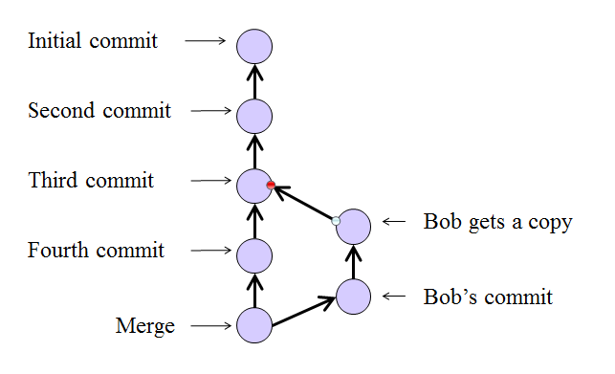

Slide 32
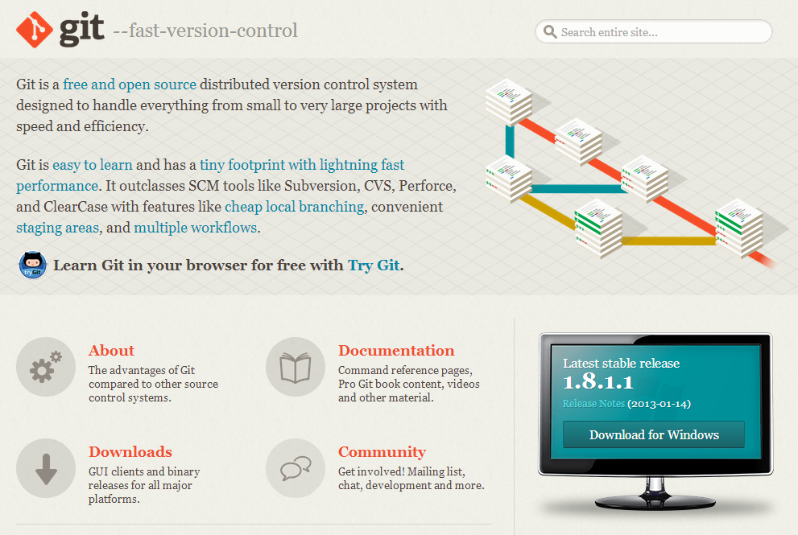
http://Git-SCM.com

Slide 33
Tools / Resources
Pro Git (Book) http://www.git-scm.com/book
TortoiseGit (with TortoiseMerge) http://code.google.com/p/tortoisegit
Msysgit (includes git-bash) http://code.google.com/p/msysgit
Posh-Git (for PowerShell users) http://github.com/dahlbyk/posh-git
GitScc (Visual Studio integration) http://gitscc.codeplex.com/
Windows Git Credential Store http://gitcredentialstore.codeplex.com/
GitHub for Windows http://windows.github.com/

