Slide 1
Lecture 3
Modeling Gene Regulation and Bistability

Slide 2

Cell Information Processing
Cell
Input
Signal Nutrient Repellent Antibiotic DNA damage
Protein misfolding
Output
Movement
Sporulation
Toxin expression
Induce its own death (apoptosis)
DNA repair
Conjugation (DNA sharing)
•
•
Virus
Other cell
• Division
3

Slide 3
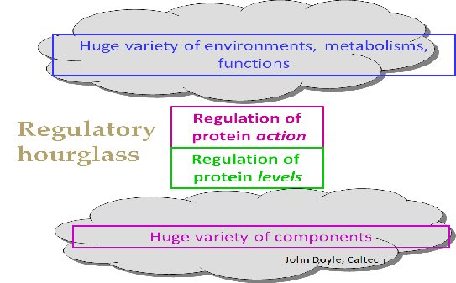
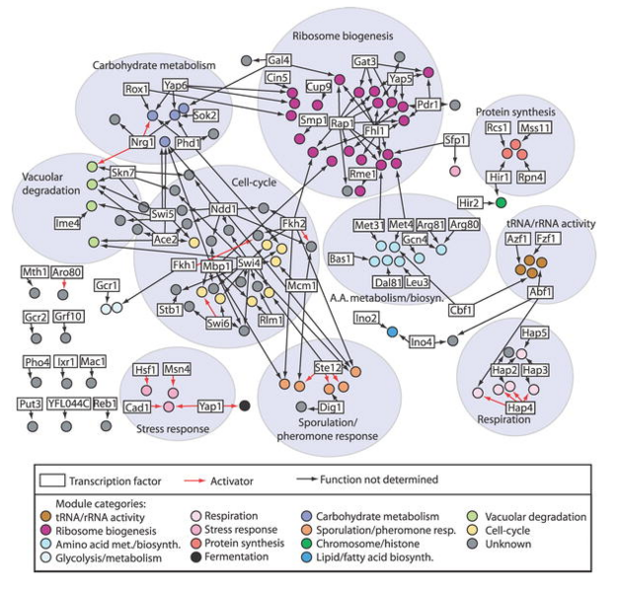
How cells make decisions?
Biochemical reaction inside the cells:
Metabolism (inputs&otputs = metabolites/fluxes)
Signaling networks (input – extracellular lignand, output – rate of a cellular process or activity of protein
Gene regulatory networks (input – concentration of transcription factors, output – gene expression rate)
Regulation of protein level is often regulated on the level of transcription
Complexity of higher organisms in many ways associated with complexity of transcriptional networks
Transcriptional regulators often regulate genes encoding other transcriptional regulators
Transcriptional networks control most of biocomplexity

Slide 4
Outline
Basics in gene expression and regulation
Principal players in gene expression: transcription, translation, regulation
Activation and repression of gene expression: Lac operon example
Modeling gene regulation - cooperativity
Feedbacks and bistability
Positive and negative feedbacks
Bistability
Engineering a biostable circuit: Gardner et al 2000.

Slide 5
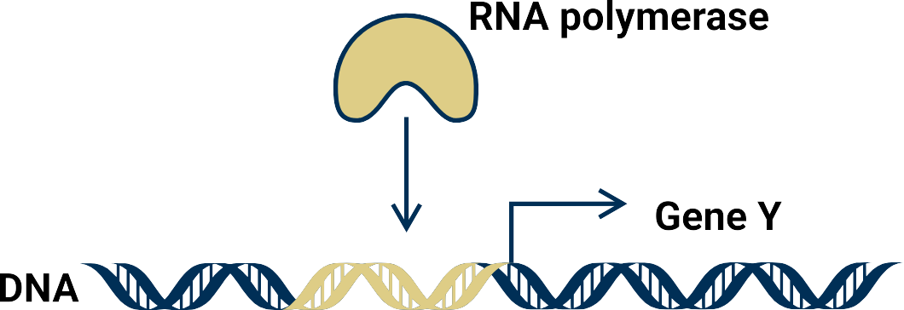




Basics processes and players
Players in gene expression
Transciption - RNAP binds the promoter region to produce mRNA
Translation – ribosomes produce
proteins from mRNA
Transcription
Translation
Y

Slide 6
Timescales
Fast
~0.1 sec
Transcription
Slow ~1-2 min
Translation
Slow ~1-2 min
Y
Protein turnover
Very slow ~1 hr

Slide 7
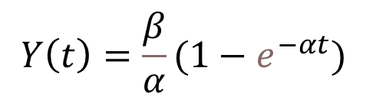
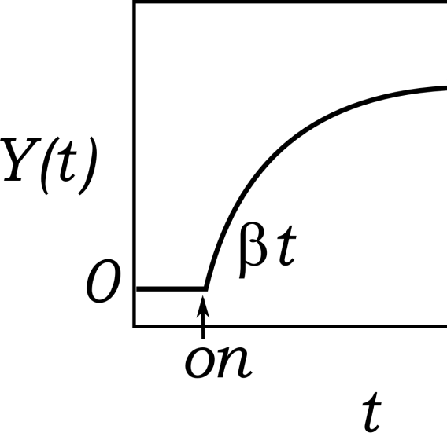

Basics in gene expression
Focus on the slowest processes:
Constant rate of expression:
production
degradation
ⅆ𝑌 𝑡
= 𝛽 − 𝛼𝑌 𝑡
ⅆ𝑡
Transcription
Translation
Y

Slide 8
Challenge problem 1:
ⅆ𝑌 𝑡
= 𝛽 − 𝛼𝑌 𝑡
Simulate numerically the equation for
Y(0)=1 α=0.1h⁻¹ β=0.5 h⁻¹μM⁻¹
Compare with analytical solution
ⅆ𝑡
Notes:
t,y]=ode45(@(t,y) 0.5-0.1*y, [0 10],0);
plot(t,y,'o’)
hold on
plot(t, 0.5/0.1*(1-exp(-0.1*t)),'r')

Slide 9
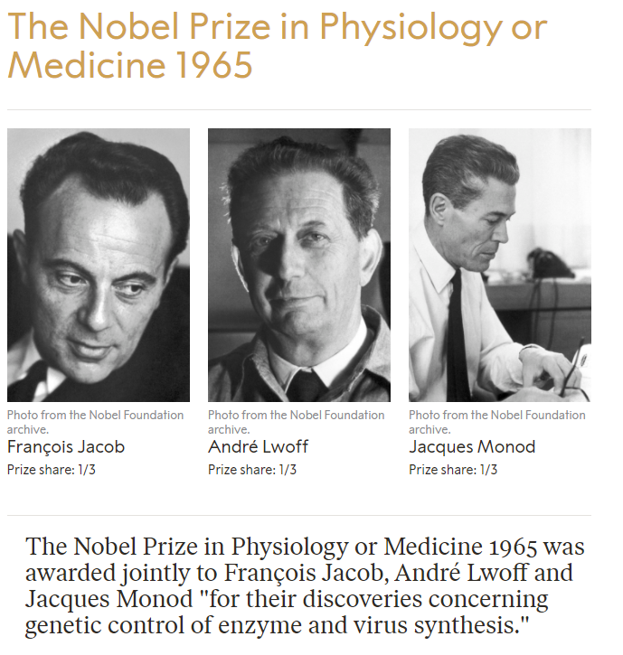
Classic Example: Lac Operon

Slide 10
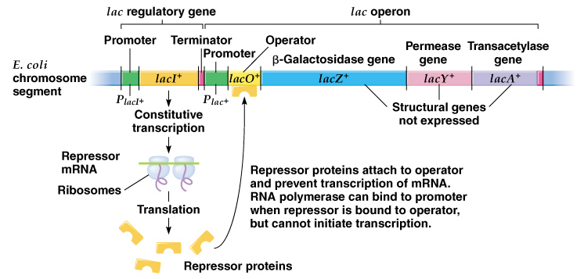
In the absence of lactose:

Slide 11
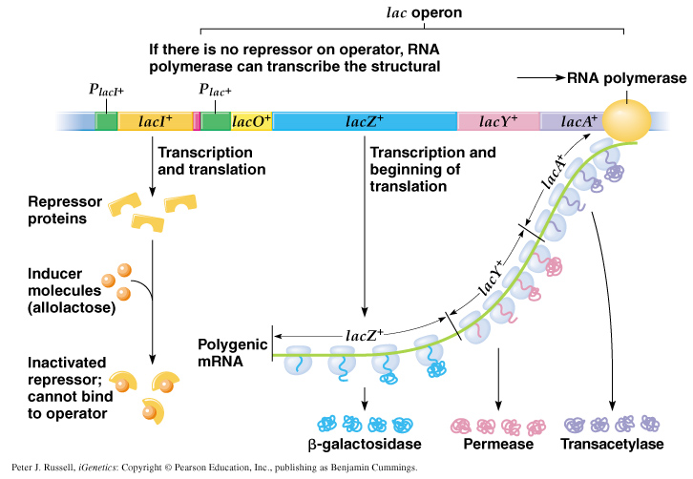
Growing on lactose:

Slide 12
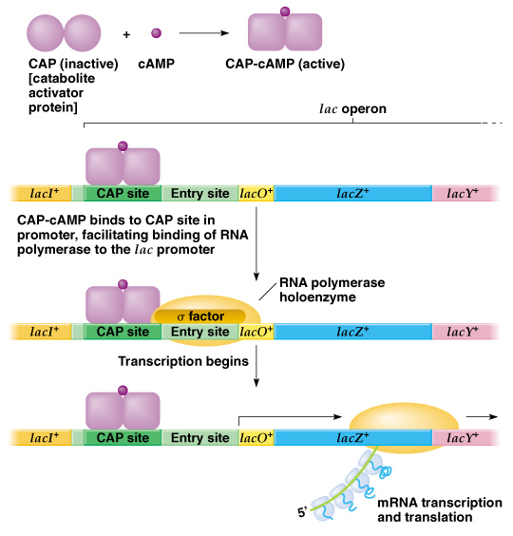
Lac-Operon Logic
-Negative control is removed when inducer (alloalactose) is present
-For full expression we also need activator cyclic AMP receptor protein;
This protein is required cAMP to be active and cAMP levels decrease when glucose is imported
+glucose
-glucose
Lac Digital Logic:
+lactose
0
1
-lactose
0
0

Slide 13





Regulation of gene expression
X
Y
X regulates the expression of Y:
production
degradation
Transciption factor
X
ⅆ𝑌(𝑡)
= F(x) - αY
ⅆ𝑡
𝐹 𝑥 ?
Y
Regulation – Transcription factors (are other proteins that) modulate the transcription of genes in response of stimuli

Slide 14










Activation of gene expression
X unbinds the promoter
X
𝐹 𝑥 −
Linear combination of rates given the occupancy of binding sites
rate unoccupied
rate occupied
𝛽₀
basal production of Y
𝐹(𝑥) = … + …
Y
X binds to the promoter
X
𝛽₁
Y
increase in expression of Y

Slide 15
Activation of gene expression
X unbinds the promoter
X
𝐹 𝑥 −
Linear combination of rates given the occupancy of binding sites
rate unoccupied
rate occupied
𝛽₀
basal production of Y
𝐹(𝑥) =
𝑐
0
𝛽 +
𝑐
1
𝛽
Y
𝑐_{𝑇}
0
𝑐_{𝑇}
1
X binds to the promoter
X
𝛽₁
Y
increase in expression of Y

Slide 16
Activation of gene expression
X unbinds the promoter
X
𝐹 𝑥 −
Linear combination of rates given the occupancy of binding sites
rate unoccupied
rate occupied
𝛽₀
basal production of Y
𝐹(𝑥) =
𝑐
0
𝛽 +
𝑐
1
𝛽
Y
𝑐_{𝑇}
0
𝑐_{𝑇}
1
X binds to the promoter
X
probability unoccupied
probability occupied
𝐹(𝑥) = 𝑝₀𝛽₀ + 𝑝₁𝛽₁
𝛽
1
Y

Slide 17


Activation of gene expression
Dynamics of occupancy: X activates expression of Y
^{𝑘}𝑜𝑓𝑓
ⅆ𝑐₁
𝑐₀ + 𝑥 ⇆ 𝑐₁ ⇨
= 𝑘_{on} 𝑐₀ 𝑥 − 𝑘_{off} 𝑐₁
ⅆ𝑡
X
𝑘
𝑜𝑓𝑓
unoccupied
^{𝑘𝑜𝑛} occupied
𝑘
𝑜𝑛
Doing a bit of algebra:
𝑐₁ = 𝑐_{𝑇} − 𝑐₀
solutions@eq
𝑐 =
𝑐_{𝑇}
0
₁ ₊ ^{𝑘}𝑜𝑛
𝑥
1
unoccupied occupied
𝐹(𝑥) = 𝑝₀𝛽₀ + 𝑝₁𝛽₁ =δ+
^{𝑘}off
𝛽𝑥
𝑝 = ^{𝑐0} =
0
𝑐_{𝑇}
₁ ₊ ^{𝑘}𝑜𝑛
𝑥
𝐾_{𝐷}+ 𝑥
^{𝑘}off
𝑝₁ = 1 − 𝑝₀ =
𝑥
Michaelis Menten equation
^{𝑘}𝑜𝑓𝑓
+ 𝑥
^{𝑘}o𝑛
𝐾_{𝐷}

Slide 18
Repression of gene expression
Dynamics of occupancy: X represses the expression of Y
^{𝑘}𝑜𝑓𝑓
ⅆ𝑐₁
X
𝑐₀ + 𝑥 ⇆ 𝑐₁ ⇨
= 𝑘_{on} 𝑐₀ 𝑥 − 𝑘_{off} 𝑐₁
ⅆ𝑡
𝑘
𝑜𝑓𝑓
unoccupied
^{𝑘𝑜𝑛} occupied
𝑘
𝑜𝑛
Doing a bit of algebra:
𝑐₁ = 𝑐_{𝑇} − 𝑐₀
solutions@eq
𝑐 =
𝑐_{𝑇}
0
₁ ₊ ^{𝑘}𝑜𝑛
𝑥
1
We assume when X is bond there is no expression of Y
^{𝑘}off
unoccupied occupied
𝐹(𝑥) = 𝑝₀𝛽₀ + 𝑝₁𝛽₁ =
𝑝 = ^{𝑐0} =
𝛽
0
𝑐_{𝑇}
₁ ₊ ^{𝑘}𝑜𝑛
𝑥
^{𝑘}off
𝐾_{𝐷}+ 𝑥
𝑥
𝑝₁ = 1 − 𝑝₀ =
^{𝑘}𝑜𝑓𝑓
+ 𝑥
^{𝑘}o𝑛
𝐾_{𝐷}

Slide 19

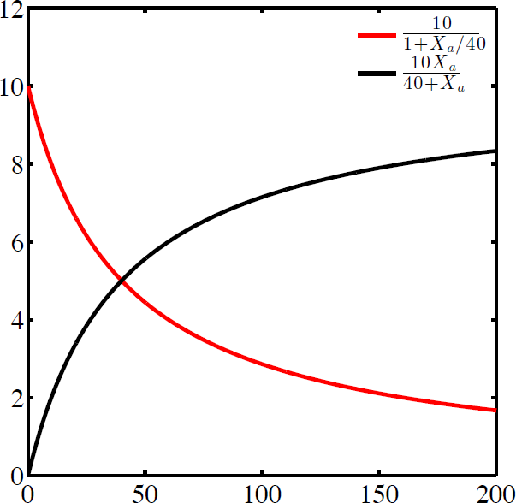
Regulation of gene expression
Gene regulation is sub-linear
Activation:
X Y
Repression:
X Y
Repression Activation
F(x) (nM/h)
𝛽𝑥
𝐾_{𝐷} + 𝑥
𝛽
𝐹(𝑥) =
𝐹(𝑥) =
𝐾_{𝐷} + 𝑥
(Michaelis-Menten function) K_{D}= half-saturation constant
𝐾_{𝐷}
x (nM)

Slide 20
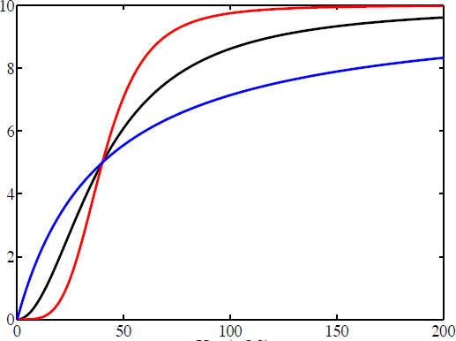




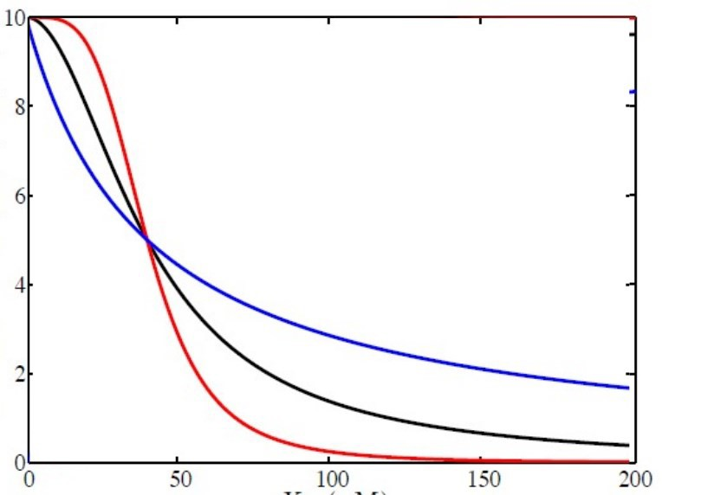




Effect of cooperativity: multimeric TFs
• Cooperative repression:
X Y
𝛽
𝐹(𝑥) =
𝐾_{𝐷} ^{𝑛} + 𝑥^{𝑛}
F(x) (nM/h)
𝛽𝑥^{𝑛}
𝐹(𝑥) =
𝐾
𝑛 _{+ 𝑥}𝑛
𝐷
(Hill function)
K_{D}= half-saturation constant
x (nM)
Smaller change in x lead to larger change in F(x) – high sensitivity
n = Hill coefficient
x

Slide 21




Positive self-regulation: TF activates itself
Positive auto-regulation: X activates its own expression
production
X
degradation
ⅆ 𝑥(𝑡)
= … - …
ⅆ𝑡
Dynamics auto-activation:
Hill function
ⅆ 𝑥(𝑡) _{= δ +}
𝛽𝑥^{𝑛}
- 𝛼𝑥
X
𝐾
𝑛_{+𝑥}𝑛
ⅆ𝑡
𝐷
Basal expression

Slide 22

Feedbacks+ cooperativity can lead to bistability
Positive auto-regulation: X activates its own expression
ⅆ 𝑥(𝑡)
𝛽𝑥^{𝑛}
= 0;
_{𝑛+𝑥𝑛} = 𝛼𝑥
production = degradation
ⅆ𝑡
𝐾
𝐷
Cooperativity
No Cooperativity
Hill function
ⅆ 𝑥(𝑡)
ⅆ 𝑥(𝑡)
ⅆ𝑡
ⅆ𝑡
MM function
𝑥(𝑡)

Slide 23
Challenge problem 2:
Production
Degradation
ⅆ 𝑥(𝑡) _{= δ +}
𝛽𝑥^{𝑛}
- 𝛼𝑥
𝐾
𝑛_{+𝑥}𝑛
ⅆ𝑡
𝐷
Plot production and degradation functions on the same graph for
0<x<4 δ=0.01h⁻¹μM⁻¹ β=0.5 h⁻¹μM⁻¹
n=2 KD=1 μM for α=0.1h⁻¹ α=0.3h⁻¹ α=0.5h⁻¹
Any of the values result in bistability?
Use fzero to find a steady state
Notes:
x=linspace(0,4,100);
Pr=0.05+0.5*x.^2./(x.^2+1^2);
Deg=0.3*x;
plot(x,[Pr;Deg])
dxdt=@(x) 0.05+0.5*x.^2./(x.^2+1^2)-0.3*x;
fzero(dxdt, 0.1) fzero(dxdt, 1) fzero(dxdt, [0.34,0.99])

Slide 24
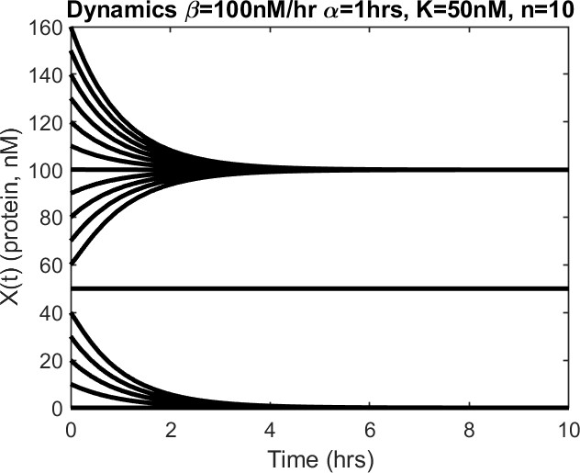
Memory (hysteresis)
Positive auto-regulation: X activates its own expression
STABLE
Molecular memory: cells with low activator levels remain low and vice versa
high
𝑥∗ ~ 𝛽/𝛼
3
UNSTABLE
_{𝑥}∗
~ 𝐾
2
𝐷
STABLE
low
_{𝑥}∗
~ 0
1

Slide 25

What about Negative Feedback?
Negative auto-regulation: X represses its own
expression
production
degradation
ⅆ 𝑥(𝑡)
𝛽
= _{𝑛+𝑥𝑛} - 𝛼𝑥
a
ⅆ𝑡 𝐾
𝐷
ⅆ 𝑥(𝑡)
Dynamics auto-repression:
Hill function
ⅆ𝑡
ⅆ 𝑥(𝑡) _{= 0;} 𝛽
= 𝛼𝑥
ⅆ𝑡
𝐾
𝑛_{+𝑥}𝑛
𝐷
𝐾_{𝐷}
𝑥(𝑡)

Slide 26
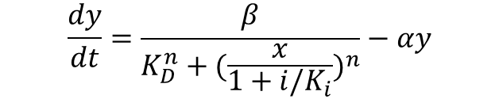

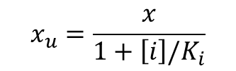
Regulation of TF activity with inducers
LacI is a repressor that only binds to DNA when NOT bound to the inducer
𝑘_{b}
Assume equilibrium
i + 𝑥_{u} ⇆ 𝑥_{b} ⇨
0 = 𝑘_{b} 𝑥_{u} i − 𝑘_{d} 𝑥_{b}
𝑥 = 𝑥_{u+} 𝑥_{b}
𝑘_{d}
Total concentration of repressor
$$x_{u}=\frac{x}{1+\left[i\right]/K_{i}}$$
$$K_{i}=k_{d}/k_{b}$$
production
degradation
$$\frac{dy}{dt}=\frac{β}{K_{D}^{n}+{(\frac{x}{1+i/K_{i}})}^{n}}−αy$$
Lac-operon production

Slide 27
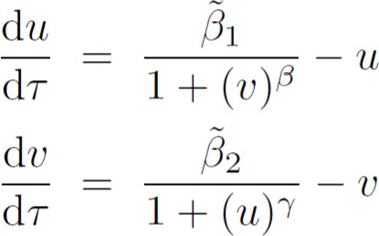
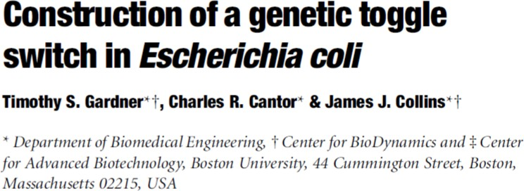

Building synthetic bistable switch
Bistability enables cell memory
IPTG (inducer)
Visible reporter
u
v
GFP
(Gardner et al. 2000)
aTC (inducer)

Slide 28
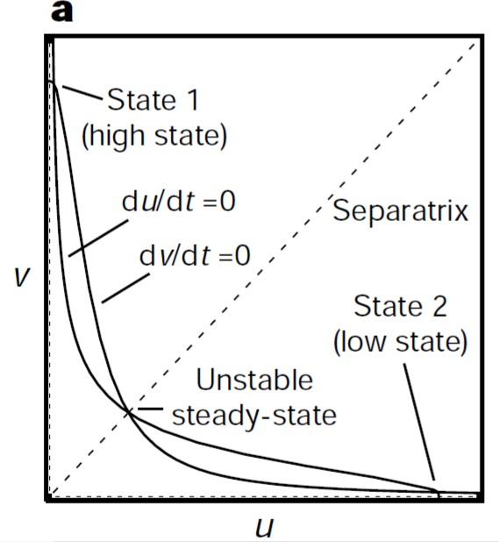
Model predicts two stable states: high u/low v and hing v/low u
IPTG (inducer)
Visible reporter
u
v
GFP
(Gardner et al. 2000)
Theory says:
aTC (inducer)
Bistability

Slide 29
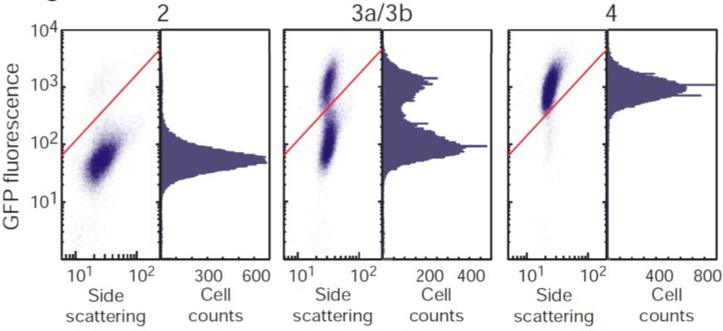
Experiments show two stable states
Bistability enables cell memory
IPTG (inducer)
Visible reporter
u
v
GFP
(Gardner et al. 2000)
Theory says:
What they see:
aTC (inducer)
1 . High and low states exist
Bistability

Slide 30
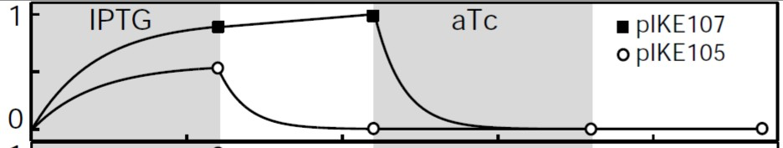
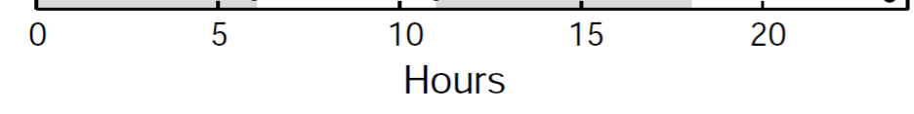
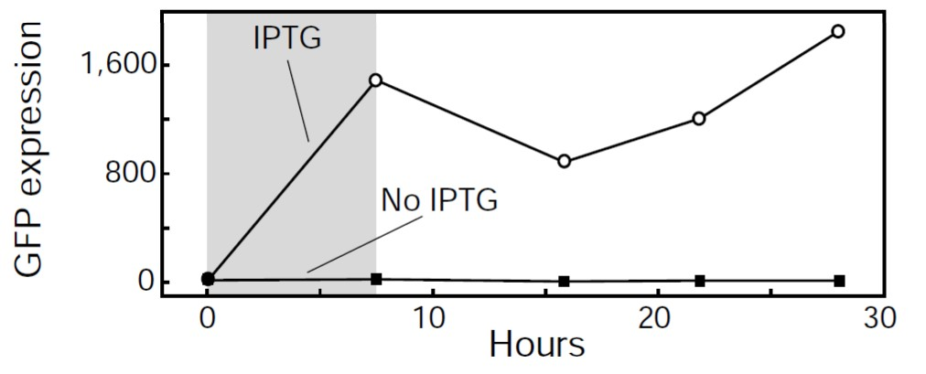
Small molecules regulating TF can flip the switch
Bistability enables cell memory
IPTG (inducer)
Visible reporter
u
v
GFP
(Gardner et al. 2000)
Theory says:
What they see:
aTC (inducer)
2. Bistability enables memory
1. High and low states exist
Bistability
Adriana Lucia-Sanz agarcia337@gatech.edu
54

Slide 31
Summary – basics in gene regulation
Regulation of gene expression enables cells to respond to internal and
external stimuli.
Gene regulation is fundamentally nonlinear.
Nonlinear gene regulation is the basis for bistability, i.e., in which vastly
different outcomes can arise given small differences in input.
Stimulus can induce a change in gene expression that is retained over time (memory).
Memory and bistability in cells is the basis for differentiation in single- and
multi-cellular organisms.

