Slide 1
Oscillators and Clocks
Lecture 4

Slide 2
Why we need to keep time.
Development. When should which cells turn into what? What order should things happen? How do they know when to differentiate? What about life events? (Maturity, etc).
2. Normal, daily life involves cycles. Cell division, metabolism, sleep, hibernation, heart beats, regeneration of cells.

Slide 3
Simplest Oscillator model?
dC/dt=Pr(C)-Deg(C)
Oscillations not possible!
Oscillations imply that at different times but at the same concentration C first decreses then increases.
Increase imply Pr(C)>Deg(C). Decrease imply Pr(C)<Deg(C) can’t have it both ways
No oscillations in 1D biochemical system

Slide 4
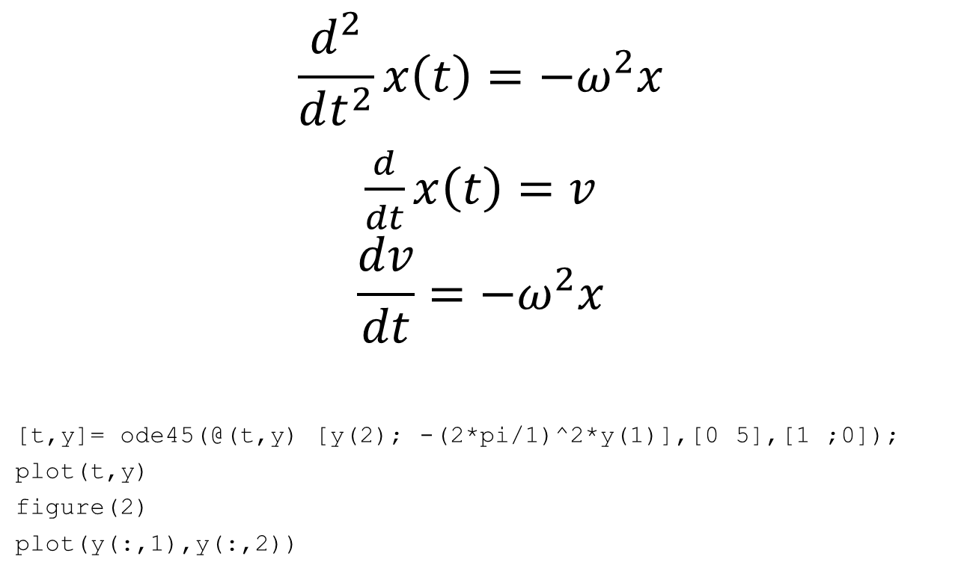
Harmonic Oscillator
$$\frac{d^{2}}{dt^{2}}x\left(t\right)=−ω^{2}x$$
$\frac{d}{dt}x\left(t\right)=v$
$$\frac{dv}{dt}=−ω^{2}x$$
[t,y]= ode45(@(t,y) [y(2); -(2*pi/1)^2*y(1)],[0 5],[1 ;0]);
plot(t,y)
figure(2)
plot(y(:,1),y(:,2))
Need at least two variables!

Slide 7
Notes:
Here and below slideas are from http://homepages.ulb.ac.be/~dgonze/TEACHING/osc_design.pdf

Slide 8
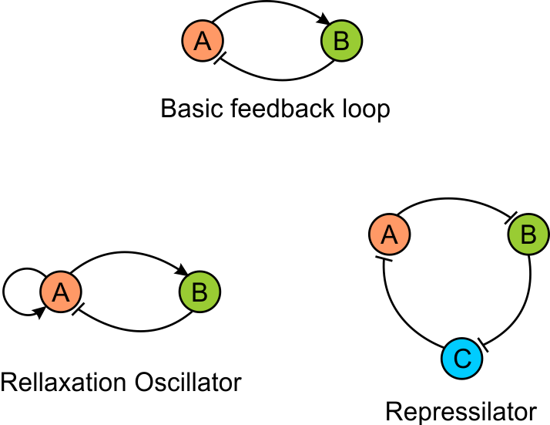
Basic oscillator architectures

Slide 11
The Circadian Clock
Defined By:
1. Period of ~24 hours
2. synchronized by the environment
3. temperature independent
4. self-sustained (--- therefore inherent)

Slide 12
Circadian genes
Most studied (sleep disorder implications, etc)
WC, frq in Neurospora
clk, bmal, per, cry in mammals
per, tim, cyc, clk in Drosophila
These genes are similar, and form similar feedback loops. Several of them are related.

Slide 13
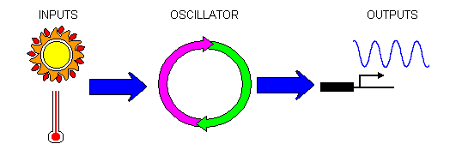
Key elements:
Feedback: something that inhibits itself either directly or indirectly
Delay [can result from indirect interactions]
Degradation or some other “reset” cue
In most cases, the ability to reset to external conditions but to keep functioning without external impetus
Outputs that regulate other cell functions

Slide 14
Feedbacks
Can be transcriptional (direct or indirect) or emergent from network architecture and conservation laws
The best way to see if it is there is to look at the network jacobian

Slide 15
Delays
Transcription/translation/translocation delays
Multi-step cascades
Accumulation to a threshold or degradation below threshold
repressor
Production
Production
Δ
Ro
Δ
Ro
repressor
time
time

Slide 17
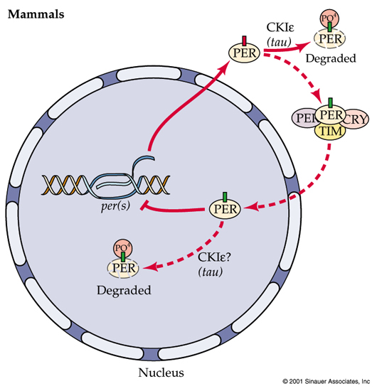
Model of mammalian circadian clock
The key player is PER –transcription factor that represses its own transcription
✓ Negative feedback
✓ Delay? –transcription/translation/translocation
??? Nonlinearity

Slide 18
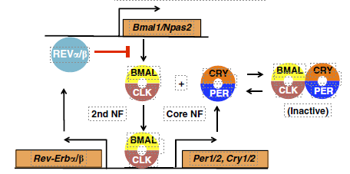
Mechanism of autorepression
PER sequesters the activator of transcription BMAIL-CLK
Does sequestration produce non-linearity?

Slide 19
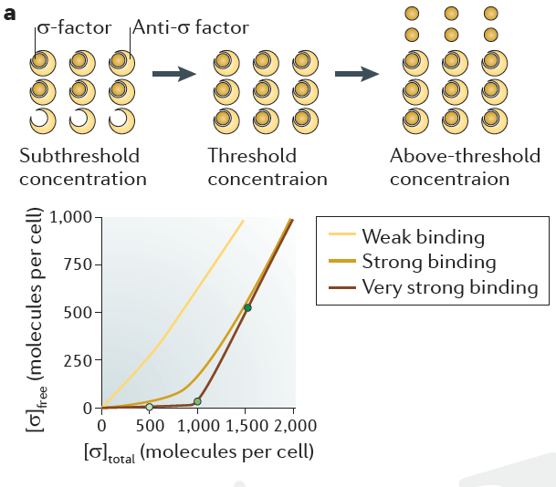
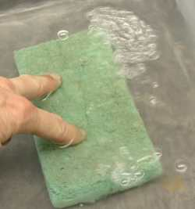
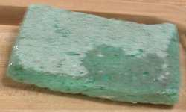
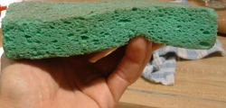
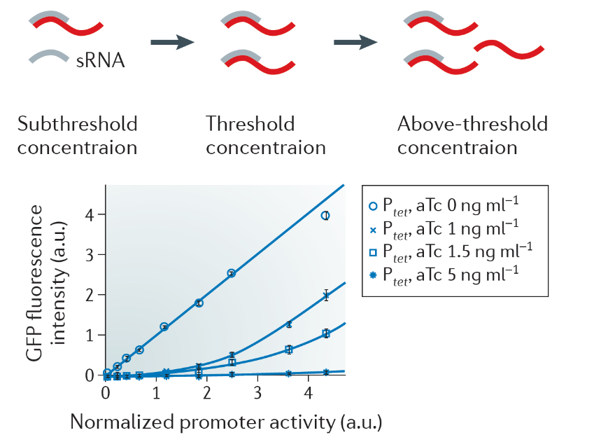
Sponge-like saturation leads to ultrasensitivity
Free Water
Total Water
Ray, Tabor &Igoshin
9(2011) 817
After the mRNA concentration exceeds a threshold determined by the sRNA concentration (owing to a sufficient level of stress signal), translation of unsequestered mRNA proceeds

Slide 20
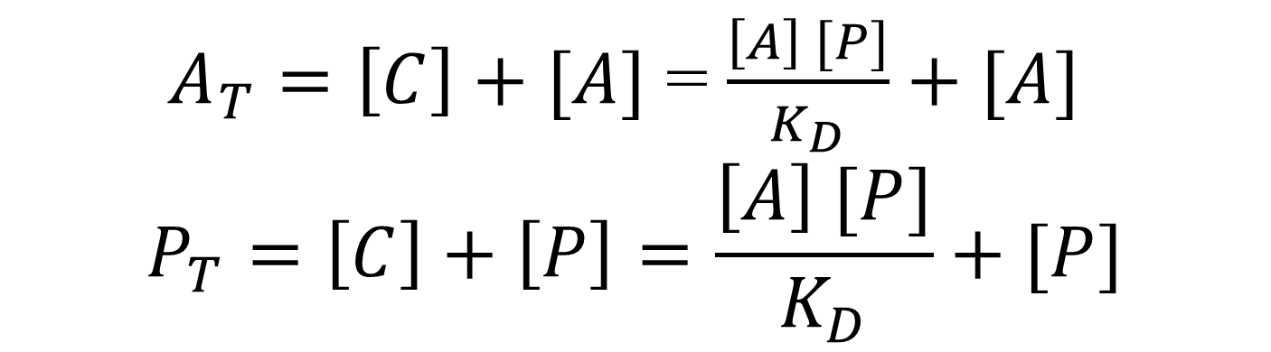

Sequestration of activator
$$A+P ↔C$$
$$[C]=\frac{\left[A\right] [P]}{K_{D}}$$
$A_{T}=\left[C\right]+[A]$ = $\frac{\left[A\right] [P]}{K_{D}}+[A]$
$$P_{T}=\left[C\right]+\left[P\right]=\frac{\left[A\right] [P]}{K_{D}}+[P]$$
$A_{T}=\left(\frac{ \left[P\right]}{K_{D}}+1\right)\left[A\right]=$ $\left(\frac{ P_{T}}{{(1+[A]/K_{D})K}_{D}}+1\right)\left[A\right]=\frac{{\left[A\right](\left[A\right]+K_{D}+P}_{T})}{\left[A\right]+K_{D}}$

Slide 21
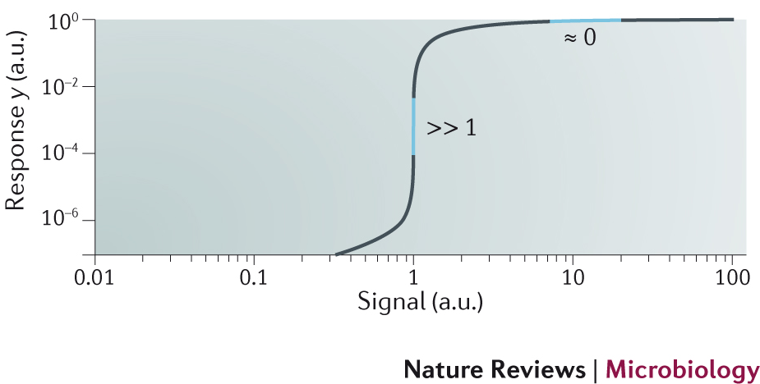

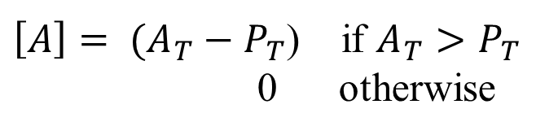

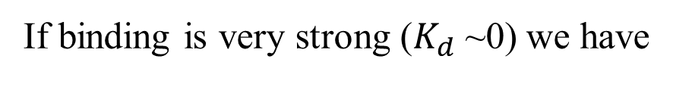
Sequestration function
$\left[A\right]=\frac{1}{2}(A_{T}−P_{T}−K_{d}+\sqrt{{\left(A_{T}−P_{T}−K_{d}\right)}^{2}+4A_{T}K_{d}}$)
If binding is very strong ($K_{d}$~0) we have
$$\left[A\right]$$
$\left[A\right]= (A_{T}−P_{T}$) if $A_{T}>P_{T}$
0 otherwise
$$P_{T}$$
Around $A_{T}\sim P_{T}$ small % changes $P_{T}$ in lead to large changes in$\left[A\right]$
Ultrasensitivity:

Slide 22
Mechanism of the clock
✓ Negative feedback
✓ Delay –transcription/translation/ translocation
✓ Nonlinearity - sequestration
Notably transcription of BMAIL is also autoregulated – second negative feedback (faster/no delay) –WHY?

