Slide 1
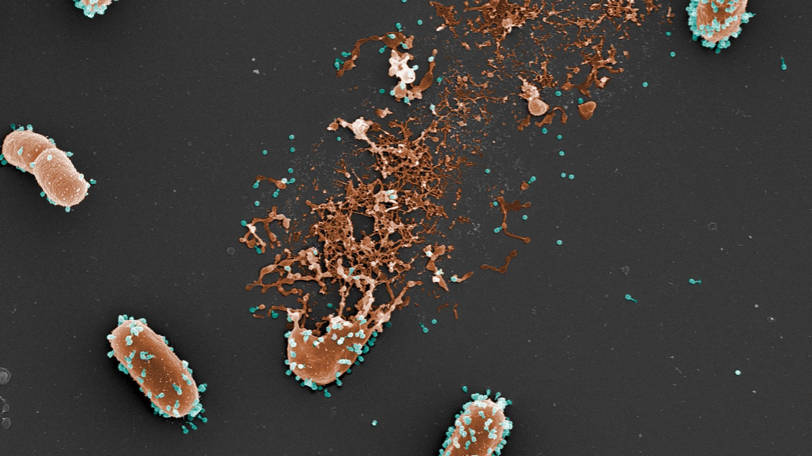
Analysis of
Fluctuations I Luria-Delbrück
experiment
Image from Laurent Debarbieux

Slide 2
The nature of inheritance
Selection is…?
“a process in which environmental or genetic influences determine which types of organisms thrive better than others, regarded as a factor in evolution.”

Slide 3
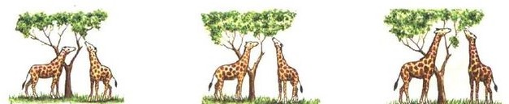
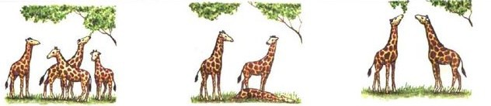
Heritable traits are dependent on selection ( also called acquired inheritance)
Lamarck
Selected traits during the lifetime are inherited
Heritable traits are independent of selection
Darwin
Survival of the fitest
Variability on traits

Slide 4
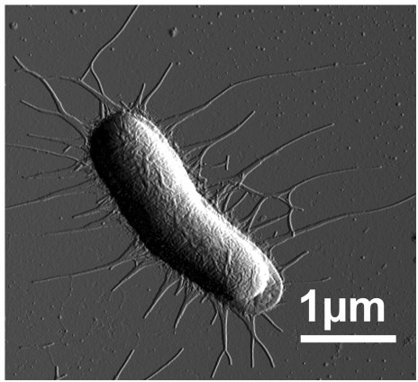
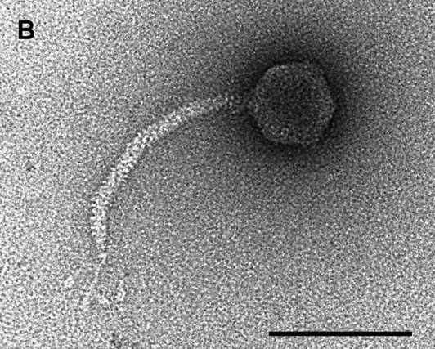
Luria-Delbruck experiment
Phages – viruses that attack and kill bacteria
Certain bacteria are resistant (immune) to certain phages
Is immunity induced or preexisting in a small subpopulation?
Relevant in many systems, e.g. is cancer resistance to chemotherapy is due to acquired or preexistent mutations?
100nm
https://doi.org/10.1128/JB.188.4.1419-1436.2006
4
https://doi.org/10.1371/journal.pone.0038548

Slide 5
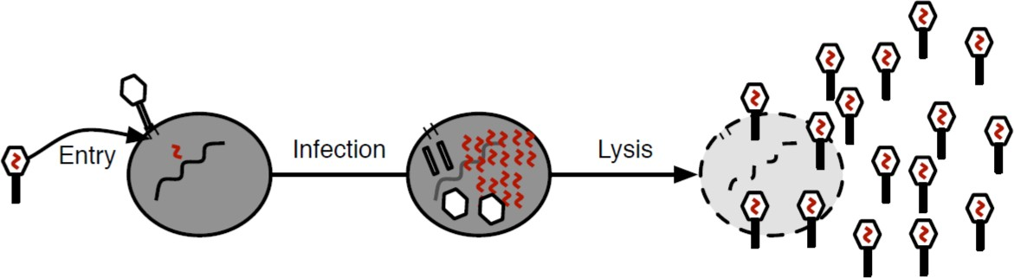
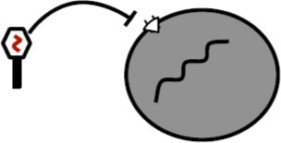
The setup
Phage-sensitive bacteria get infected. The virus replicates inside the bacteria and exits by killing (lysis) the host cell. Sensitive bacteria die.
Resistant bacteria are immune to phage infection and survive.

Slide 6
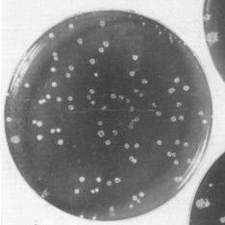
We can count the resistant cells
Petri dish with T1 phage + E.coli
Every resistant bacterium form a colony of resistant clones
Lederber and Lederberg, J Bacteriol.
1952 Mar; 63(3): 399–406.

Slide 7
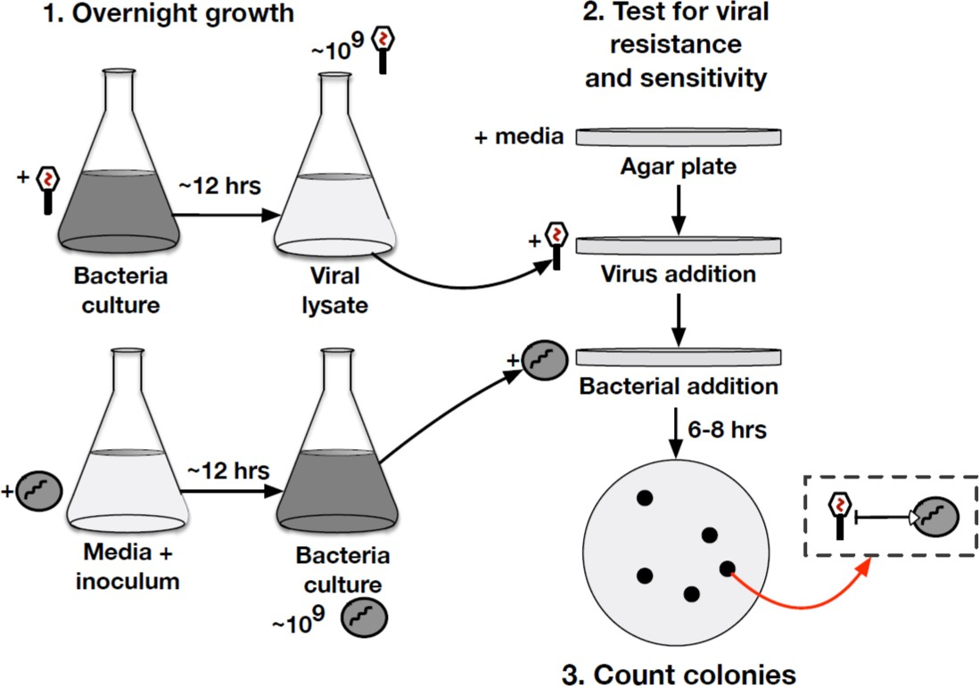
Luria-Delbrück experiment
Grow phage
Grow bacteria
Selection of resistant!

Slide 8
Are the acquired mutations come about because of the phages?
Scenario 1: All bacteria are initially sensitive to the virus. There is a finite chance to survive the infection. Post-survival cells are immune. Not biologically crazy (our immunity, lysogenic phages, CRISPR)
Scenario 2: The bacteria has a chance to develop resistance randomly without the phage. The decedents of resistant mutants with be resistant.
How to distinguish the two?

Slide 9
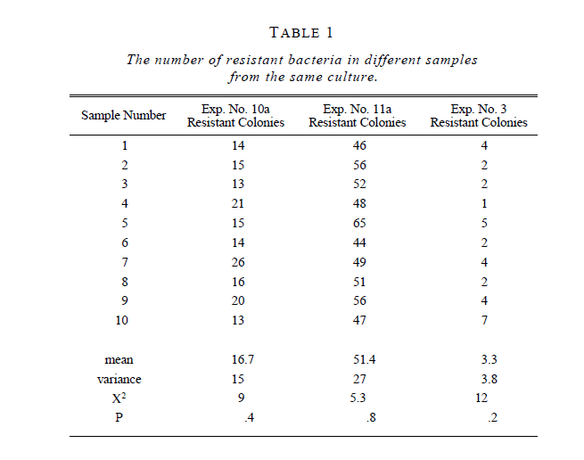
How do you distinguish the two?
Naïve approach: let’s look at the fraction of resistant cells? If you start without virus randomly then the longer you wait (the larger the population) the more resistant cells there be. Otherwise – constant fraction.
The problem – too much noise! Why?

Slide 10
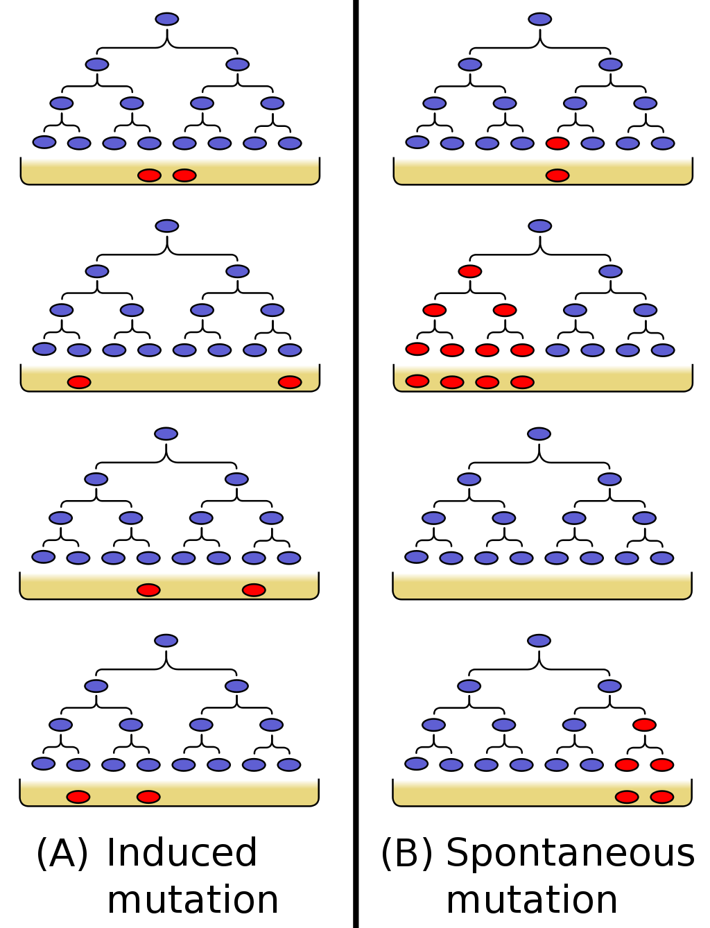
What was the LD plan?
The answer is in the fluctuations! Compare the variance to the mean for the number of resistant bacteria arising from single populations started from one or a few cells.
For this case, the variance will be large compared to the mean because of “jackpots”, i.e. early mutation events that result in much of an entire population being mutant.
In contrast, if these populations are mixed together and sampled, the distribution will be Poisson, i.e. variance = mean.

Slide 11
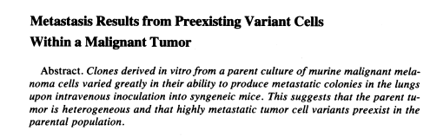
Same idea for cancer
Fidler IJ, Kripke ML. 1977. Science 197: 893-5.
Like Luria and Delbruck – variance between different clones much higher than variance within each clone. Distribution for cells directly injected from parent tumor line has much less variability than the variability among clones.

Slide 12
Let’s get some simple math to work for us… 1. Dependent selection
There is small probability μ_{a} for each bacterium to survive an attack of phage.
What is the mean number mutants across replicas?
What is the probability of observing m resistant bacteria “a.k.a mutants” in an N bacteria population?
Hint: What is the probability to observe 0 resistant bacteria? What is the probability to observe 1 resistant bacteria?

Slide 13
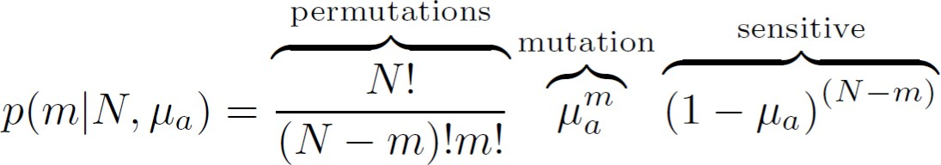
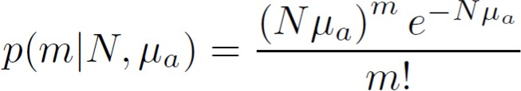
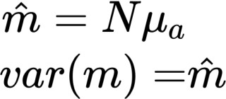
Dependent selection hypothesis
(Acquire immunity)
There is small probability μ_{a} for each bacterium to survive an attack of phage.
What is the probability of observing m resistant bacteria “a.k.a mutants” in an N bacteria population? or in other words, how is the distribution of mutants across replicas?
Binomial distribution:
(Poisson limit theorem)
Poisson distribution:
Poisson distribution properties:
If I repeat the experiment with many replicas, the average number of mutants predicted by acquired

Slide 14
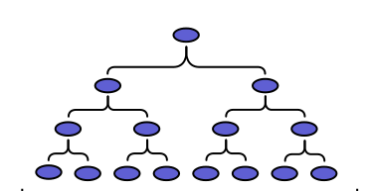
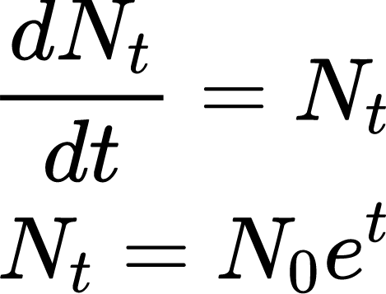
Independent selection hypothesis (Spontaneous mutation)
Mathematical expression on how the population grows?
g=0
g=1 g=2 g=3
N₀=1
2N₀
4N₀
8N₀
𝑁_{𝑔} = 𝑁₀2^{𝑔}
𝑡 = 𝑔 log 2
𝑁_{𝑡} = 𝑁₀e^{𝑡}

Slide 15
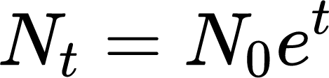
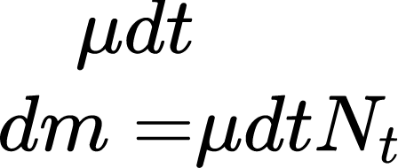

Number of mutants generated
Mutation per unit time
[2]
Mutants per unit time
[3]
Number of new mutants
[4]
However: need to account for mutant growth!
When was the first mutant generated? How long did it have to grow?

Slide 16
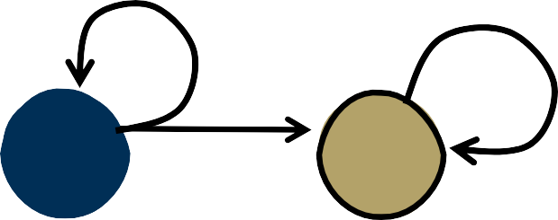

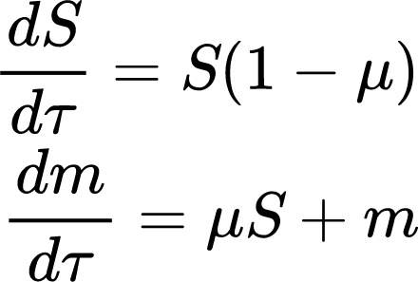

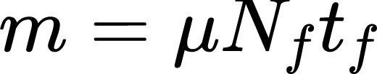
Continuous model of mutation
A population of susceptible bacteria, S, grows at rate r. During replication, mutants appear at a rate μ . We assume new mutants grow at the same rate than susceptible bacteria.
r
r
N
f
S
m
Normalized eq system:
N_{t}
N₀
Total population
Susceptible: 𝑁₀e^{𝑟 1−𝜇 𝑡}
mutant
t
The fraction of resistant bacteria increases poportianlly to time
the fraction of resistant bacteria increases proportionally to the experiment time

Slide 17
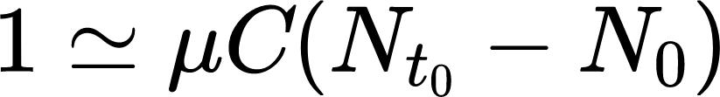
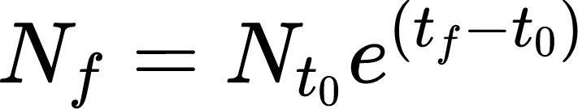
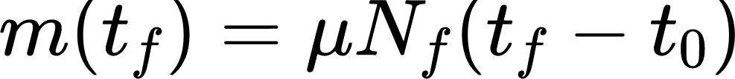
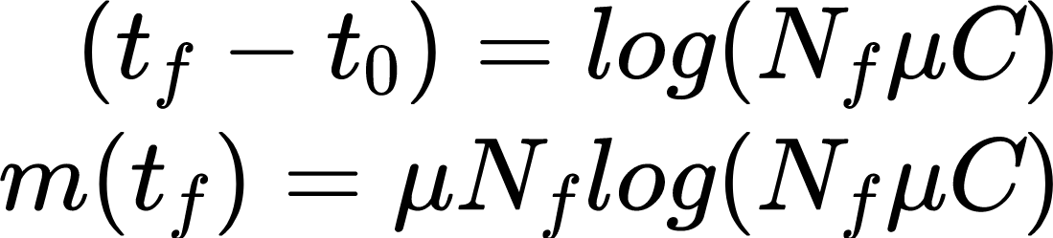
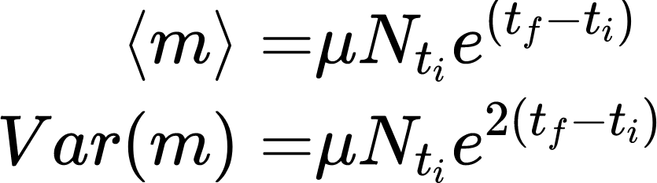
Discrete model of mutation
On average there is μN_{t} new resistant bacteria in every generation and e^{(t-ti)} from previous generations... But not in all generations we have the same measurement sensitivity
When the 1st mutant appears
N_{f}
N_{t} C
1st mutant
in C cultures
How much t₀ mutant grow until t_{f}
Remember, the predicted average number of mutants from this clone is
t
t
f
0

Slide 18
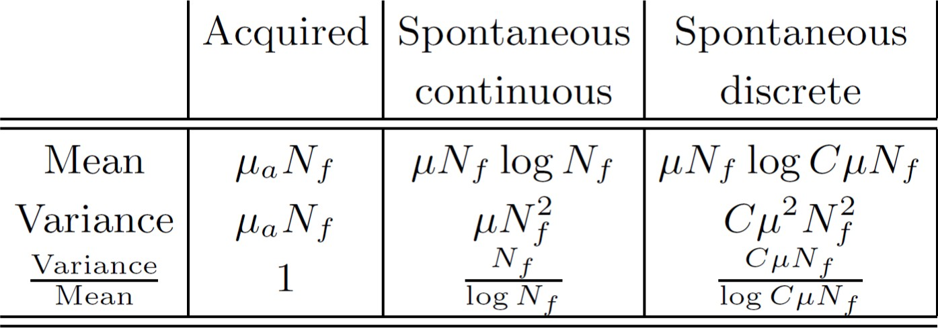
Summary
Mutations are the generative driver of variation in the evolutionary process.
Prior to the work of Luria and Delbrück, there was a major unanswered question: are mutations independent of or dependent on selection? Afterwards, the consensus shifted: mutations are independent of selection.
Large variation, i.e., a lack of reproducibility, was a key hallmark of the independent mutation
hypothesis, and counter to predictions of the acquired mutation hypothesis.

Slide 19
Can we learn mutation rate?
𝜇𝑁
0_{e}−𝑁𝜇
𝑃 0, 𝜇, 𝑁 =
_{= e}−𝑁𝜇
𝑂!
We observe a fraction of cultures with no mutants, f₀ . Then, we can calculate the mutation rate as:
− log 𝑓₀
𝜇 =
𝑁

Slide 20
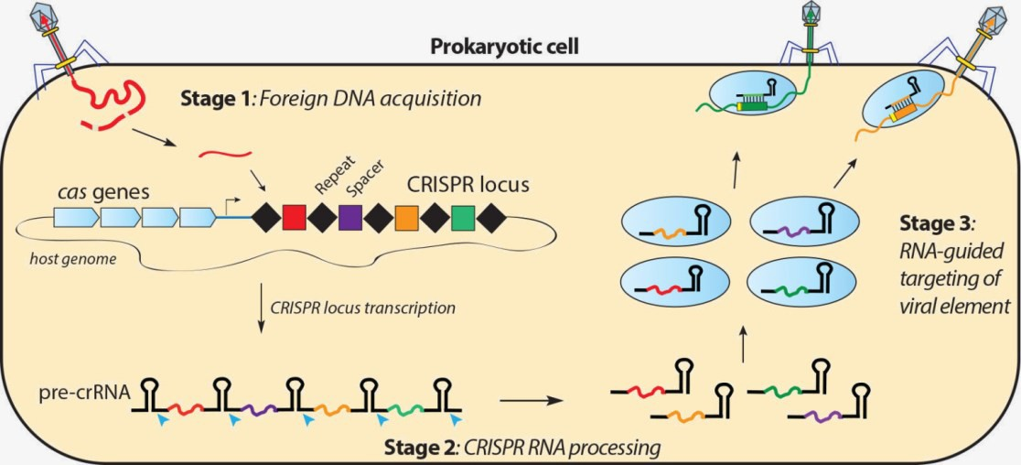
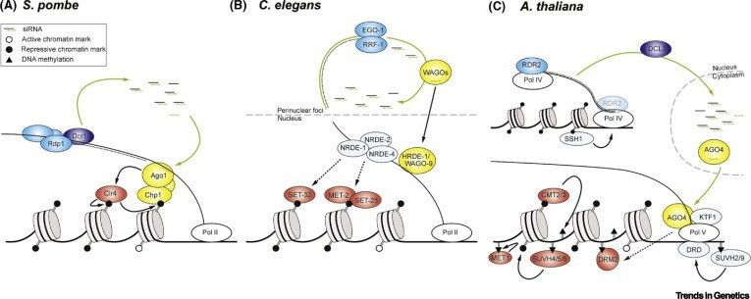
Exceptions to the rule
The concept of the independent mutation remains the paradigm in biology however there are instances of acquired inheritance.
CRISPR Systems
Defense mechanism in bacteria against phage (and other foreign DNAs) attack. Short sequences of this foreign DNA are incorporated to the bacterial chromosome and inherited. Upon a second encounter, this short sequences target against the foreign DNA.
https://doudnalab.org/research_areas/crispr-systems/
Epigenetic inheritance
Epigenetics is the study of phenotype changes that do not involve alterations in the DNA sequence, but in the DNA chemistry.
DNA methylation is a hereditable epigenetic mechanism that shuts down the expression of genes.

