Slide 1
Modeling Evolution and Selection
Stochastic and deterministic population dynamics at constant population sizes

Slide 2
Last Time
Exponentially growing population
Stochasticity in the mutation arrival plus their amplification in exponential growth leads to huge variability in the outcomes
No selection till the end – mutants had no benefits and paid no price for resistance before seeing the virus
Today
Constant population (balanced growth/death)
Fitness of mutations may be different
Combination of randomness of population dynamics and selection determines the outcome

Slide 3
Motivation: cancer as evolutionary process
Lifetime risk of cancer in human populations is around 1 out of 3
Each year 10 million cases are diagnosed
Very little in-common between different cancers except…
Cancer dynamics is evolutionary dynamics!

Slide 4
Tumor Progression by Clonal Evolution
Cancer cells have a short term evolutionary advantage over wild type cells, because they grow and proliferate at a greater rate
Thus, selection leads to a preponderance of cancer cells over healthy cells
Some mutations are “driver” and some are “passengers”
As more mutations accumulate in cancer cells, the greater the competitive edge
In other words, cancer cells evolve towards higher virulence within the body
However, at the whole organismal level there is a cost

Slide 5
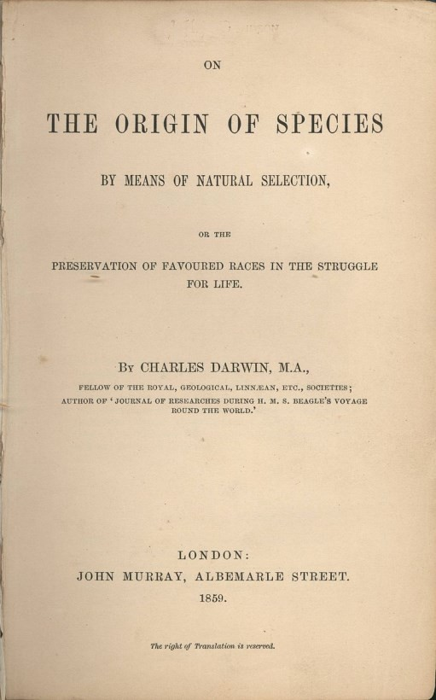
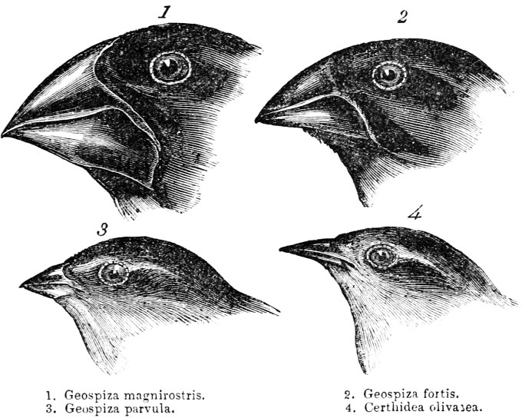
Origins of Evolutionary Theory
Natural selection: 1859 – “It’s not the strongest species that survive but the
most responsive to change”
Darwin's finches by John Gould
Variation+ Selection
“Darwin was presumably the greatest naturalist that has ever lived, a highly talented
observer, and a genius in intuition. He was certainly not a fan of mathematics and his
centennial treatise of evolution does not contain a single formula.”
The mathematics of Darwin’s theory of evolution: 1859 and 150 years later
Peter Schuster (on Canvas)

Slide 6
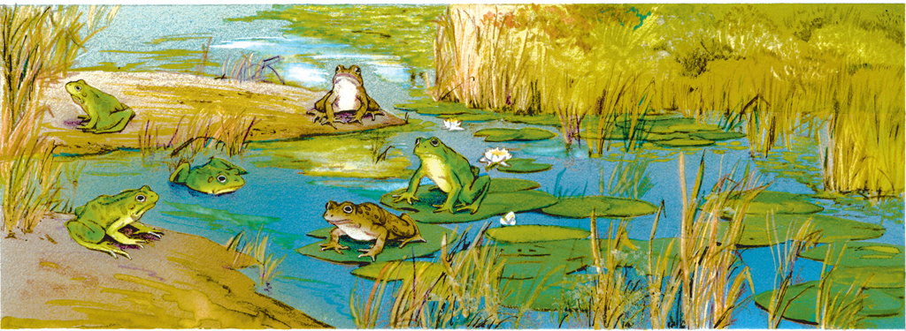
Genetic variation in a population increases the chance that some individuals will survive.
Genetic variation leads to phenotypic variation.
Phenotypic variation is necessary for natural selection.
Genetic variation is stored in a population’s gene pool.
made up of all alleles in a population
allele combinations form when organisms have offspring

Slide 7
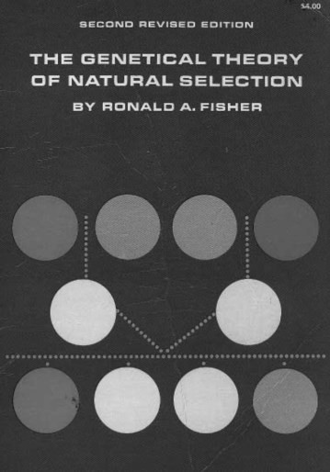
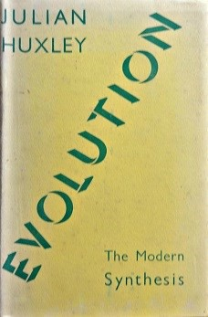
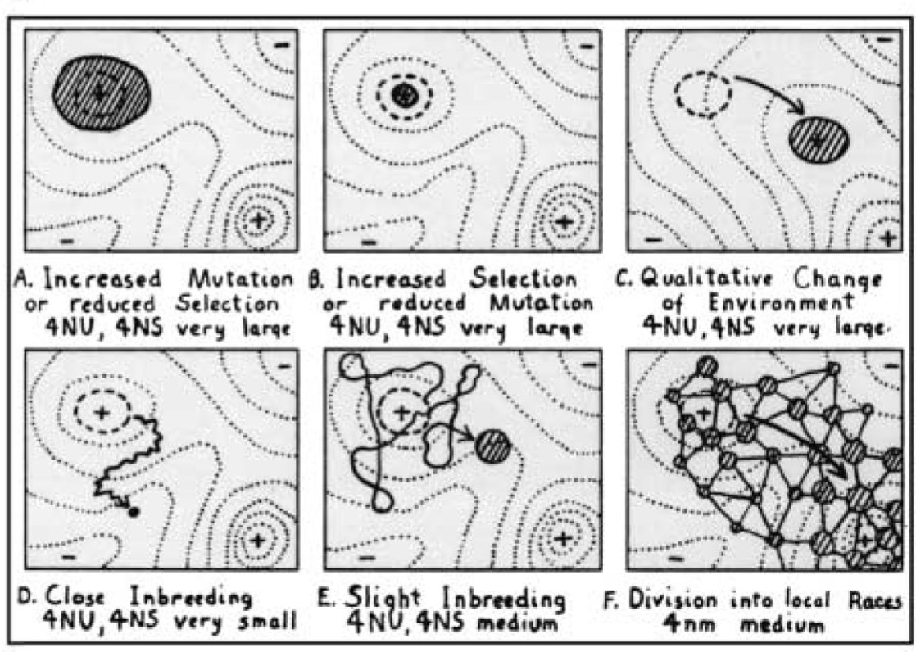
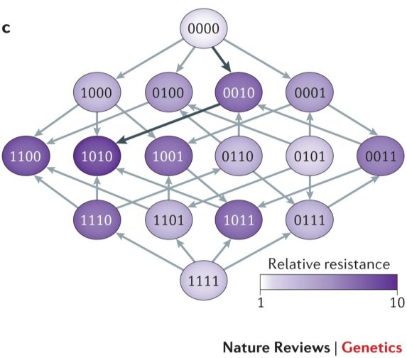
Evolutionary Theory becomes mathematical
Modern evolutionary synthesis – 20th century: coalescent theory of genetic
variation, natural selection, and discrete (mendelian) inheritance.
Sewall Wright’s (1932) fitness landscape
Fisher (1930)
J. Huxley (1942)
Wright, Haldane, Fisher and others developed the core of the mathematics of population
genetics. Key driving factors include population size, mutation rate, and selection…

Slide 8
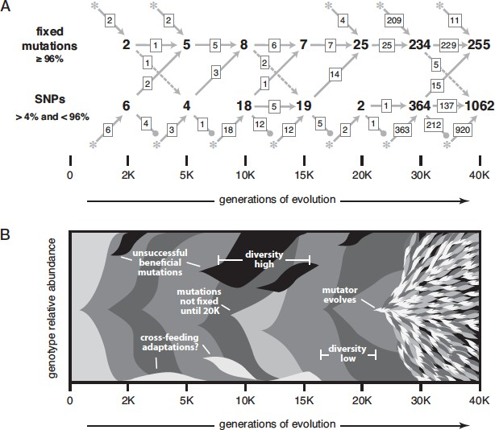
Evolutionary Theory – now
Experiments with rapid evolving populations of model organisms (E. coli, S. cerevisiae, viruses, etc) help to test previous and novel hypotheses and theories in evolution.
Barrick and Lenski, 1989
Richard Lenski’s long-term evolution experiment (LTEE) with E. coli, now passing 60,000 generations (see-left for sense of scale) reveals how evolution is repeatable.

Slide 9
Useful Population genetics terms
Drift: The process by which allele frequencies are changing through generations
Mutation: The process by which new alleles are being introduced
Recombination: the process by which multi-allelic genomes are mixed
Natural Selection: the effect of fitness on the dynamics of allele drift
Epistasis: the drift effects of fitness dependencies among different alleles
“Organismal” effects: Ecology, Geography, Behavior

Slide 10
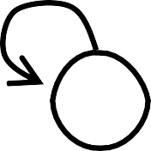

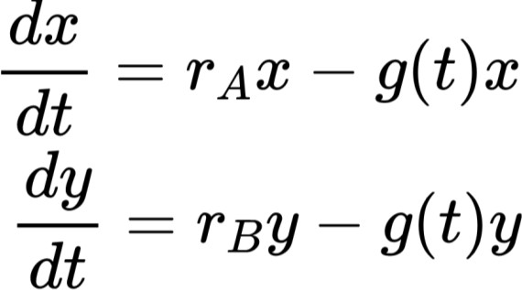
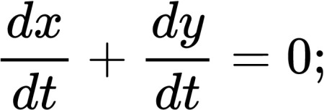


Evolutionary Theory: natural selection
Models of selection: imagine a population with two variants (alleles A, and B) growing exponentially until a maximum capacity given by a time-
exponential
dependent loss function g(t).
r_{B}
growth
limitation
r_{A}
growth
A B
n_{A}/N y= n_{B} /N
x =
= 0
average fitness

Slide 11
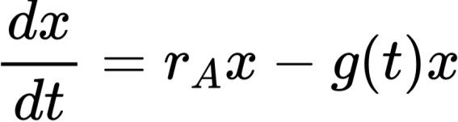
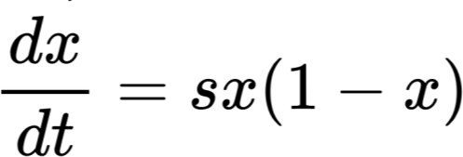
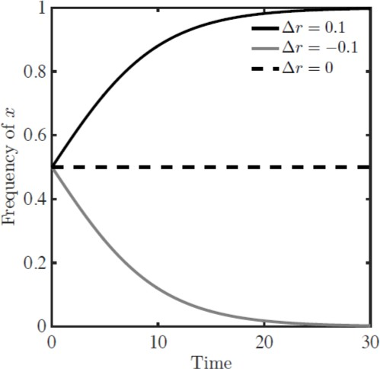
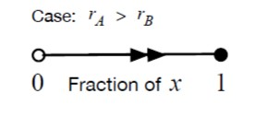

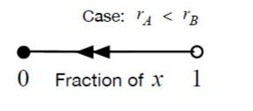
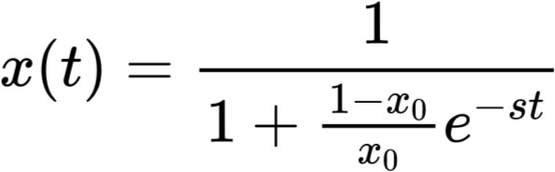
Result: Survival of the fitter
average fitness
being s the selection coefficient

Slide 12
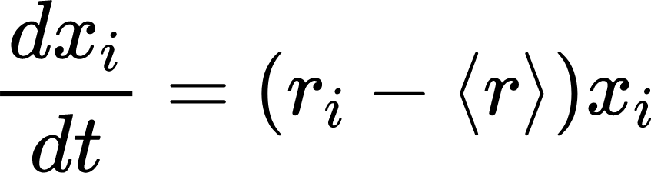

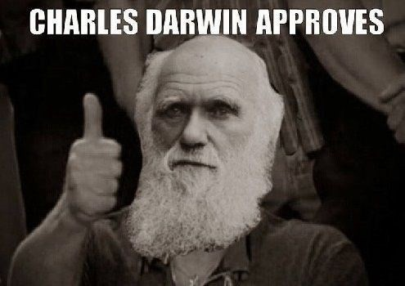
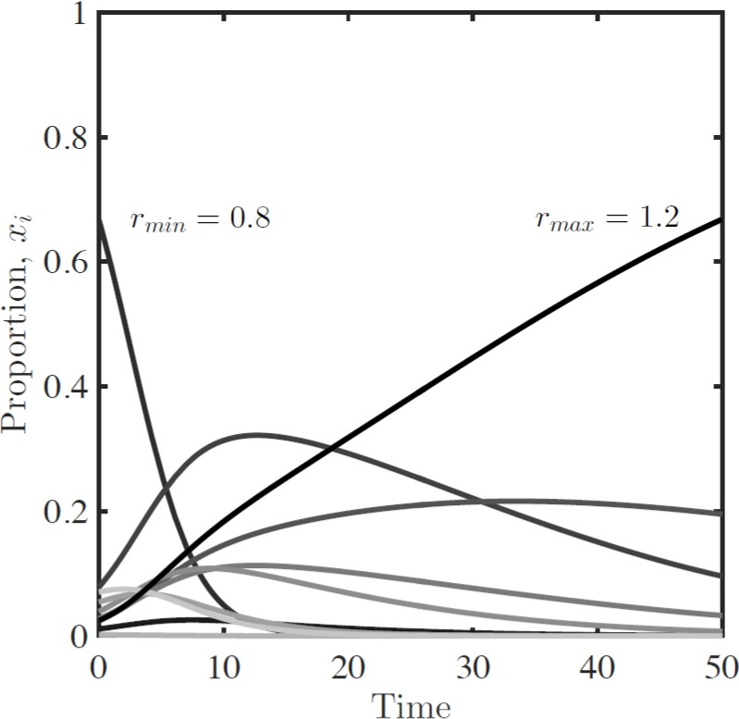
In general: survival of the fittest
Replicator dynamics: Generalization to a population with s variants. The relative frequencies are given by x₁, x₂,…x_{s} and the respective replication rates r₁, r₂,…, r_{s}
r_{i} | > | survives; x_{i} ➔1
r_{i} | < | dies; x_{i} ➔0
Survival of the fittest!
Major caveat:
Natural selection eliminates diversity!

Slide 13


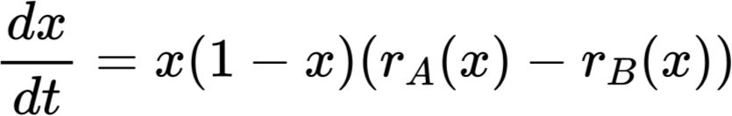
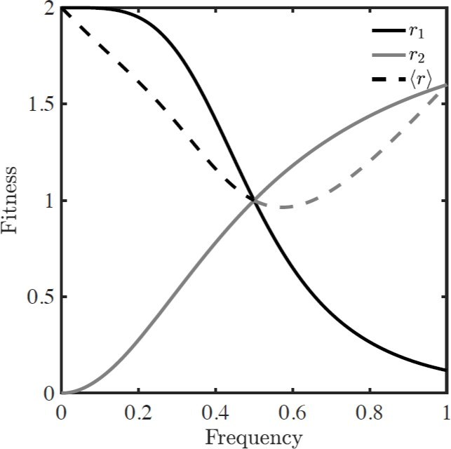

Cooperation can lead to coexistence
(i) Frequency - dependent selection model: the fitness of variants A and B depends on their frequencies r_{A}(x) and r_{B}(x) respectively.
r_{A}(x) r_{B}(x)
A
x
B
y = 1-x
There is a value of x_{c} that satisfies:
r_{A} (x_{c})=r_{B} (x_{c})
r_{A}(x)
r(x)
Negative frequency dependent selection
+
0
x_{c} 1
r_{B}(x)
-
x

Slide 14

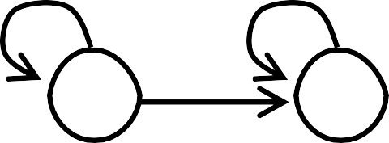
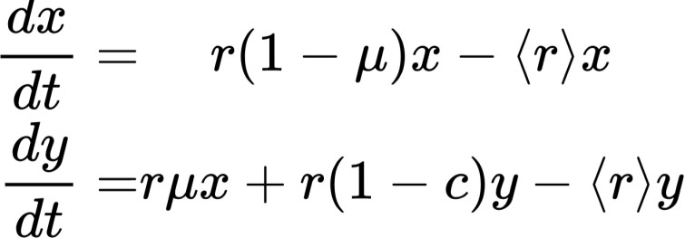
Mutations also restore diversity
(ii) Mutation - selection model: Mutants arise at a rate μ and replicate with a
lower fitness (cost of mutation) than the wild-type.
r r(1-c)
average fitness
μ
A
x
B
y = 1-x
mutant
wild-type
average fitness:
rescale: t = r t , dt = rdt
Rescaled average fitness:

Slide 15
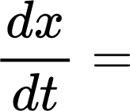
Different outcomes possible:
(ii) Mutation - selection model: Mutants arise at a rate μ and replicate with a
lower fitness (cost of mutation) than the wild-type.
r r(1-c)
Rescaled equation:
μ
A
x
B
y = 1-x
mutant
At equilibrium:
0
wild-type
= 0
x*= 1- μ /c
if c >> μ ; x* ➔1 wild-type gets fixed
if c <= μ ; x* ➔ 0 wild-type gets extinct

Slide 16
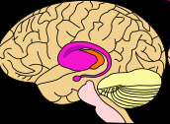
Mutation-Selection balance: Huntington disease
a neurological genetic disease appearing after age 35
Resulting from a dominant mutation – how does this disease survive in the human population?
Although it may be fatal, the fitness is not very low due to the late age of onset (estimated w12=0.81)
Genotype
Fitness
Frequency
Human population: 70 per million (Europe) to 1 per million (Africa)
h>0, and we can estimate the mutation rate at the Huntington locus, as hsq’ = 10⁻⁶ (1-0.81) = 1.9x10⁻⁷ to 70x10⁻⁶ (1-0.81) = 1.3x10⁻⁶

Slide 17
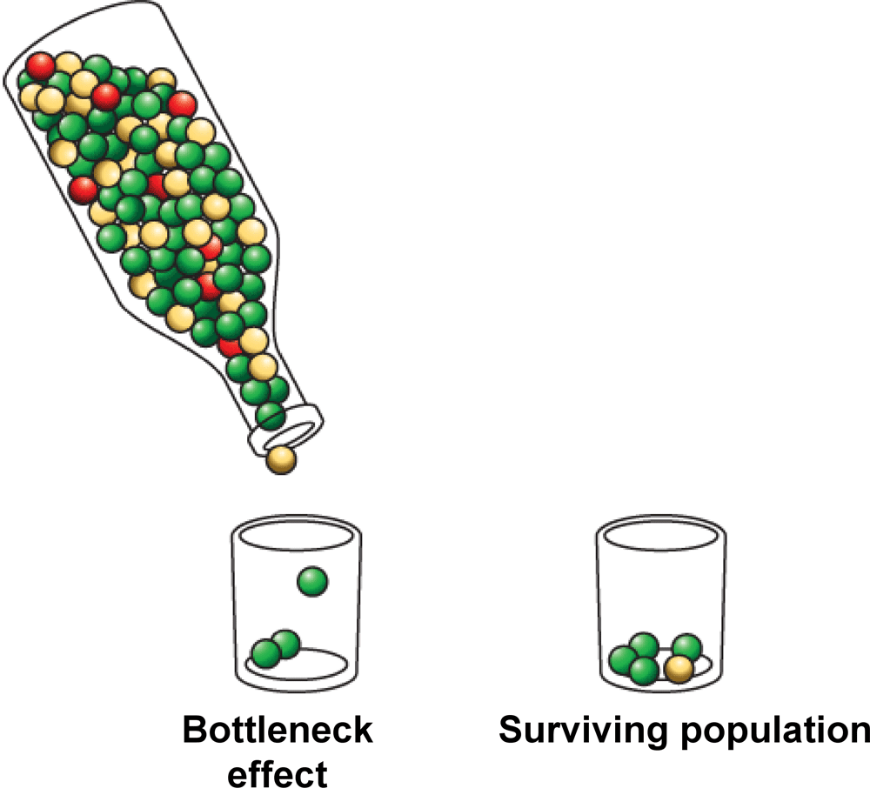
Genetic drift is a change in allele frequencies due to chance.
Genetic drift causes a loss of genetic diversity.
It is most common in small populations.
A population bottleneck can lead to genetic drift.
It occurs when an event drastically reduces population size.
The bottleneck effect is genetic drift that occurs after a bottleneck event.
In small populations genetic drift also allows for the accumulation of neutral and slightly deleterious mutations

Slide 18
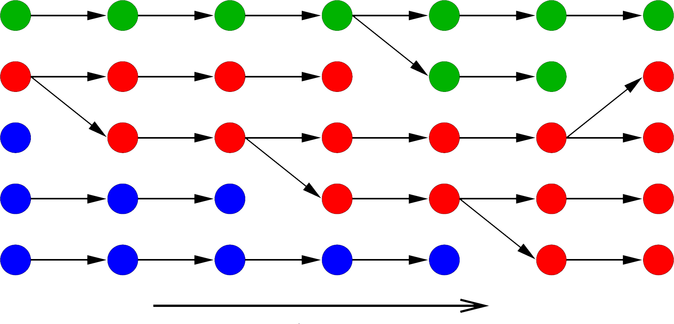
Evolutionary theory & population genetics
Moran process:
μ
μ
μ
μ
Time
Change in color: mutation
Colors: different traits / genotype / allele
Diversity: first increases and later decresases
There is extinction! – Limitation on resources that maintains population sizes
Image modified from J. Krug: Population Genetics and Evolution

Slide 19
The Moran model
Instead of working with discrete generation, we replace at most one individual at each time step
A
A
A
Replace by
sampling from
the current
population
a
a
X
A
A
A
a
a
a
A
A
A
A
A
A

Slide 20


The Moran model
A
A
A
Replace by
sampling from
the current
population
a
a
X
A
A
A
a
a
a
A
A
A
A
A
A
Random-walks in the population space (Markov Chain):
Loss
0
1
i-1
i
i+1
N-1
N
Fixation
$$b_{i}=(N−i)⋅\frac{i}{N}$$
“Birth”
Rates:
$$d_{i}=i⋅\frac{N−i}{N}$$
“Death”

Slide 21
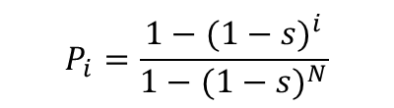
Fixation probability: selection in the Moran model
When population is finite, we should consider the effect of selection more carefully
Loss
0
1
i-1
i
i+1
N-1
N
Fixation
The models assume the fitness is the probability of the offspring to be viable. If it is not, then there will not be any replacement
“Birth”
Rates:
“Death”
Fixation probability, i.e. probability to reach number of mutants N starting from i
$$P_{i}=\frac{1−(1−s)^{i}}{1−(1−s)^{N}}$$
N,s
N,s
Bonus: +5pt on the lab – can you apply this to problems 1 and 2?

Slide 22
Lab Overview
Demo: two ways to simulate Moran Model:
“individual-based”; each cell is a binary variable 0/1, the population is a vector. Each time-step we update cell identity by finding cells to replicate and kill
Markov-Process-based: System is fully characterized by the number of mutants. Each tiem steps it remains the same or change by 1.
2. Moran Model with selection:
Adapt Markov-Process-based formalism as it is more efficient. Different transition matrix form accounts for difference in replication probability of mutants.
3. Moran Model with selection + spatial structure (1D):
Assume only neighbors can replace dead cells (makes sense for cancer – speed and local nutrients, oxygen etc is limited)
Adopt individual-based models formulation for this.

