Slide 1
Infectious dynamics modeling
Lecture 13

Slide 2
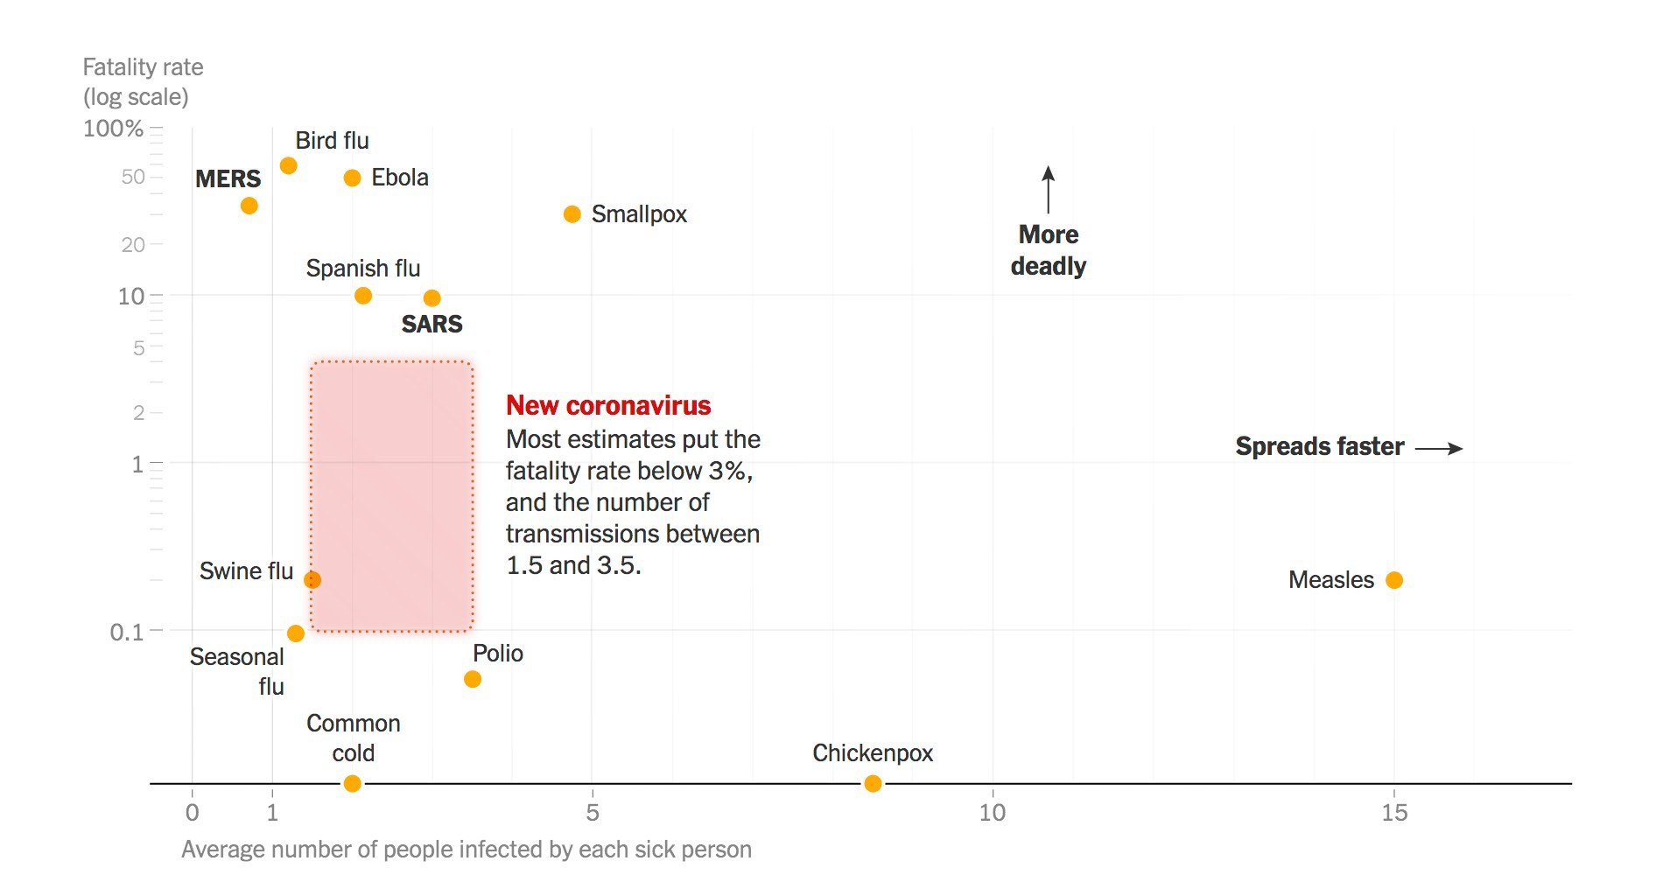
Central modeling questions: How to use models to project the value of responses?
Case fatality rate (directly measured) Infection fatality rate (indirectly measured)
(R0)
Basic reproductive number, “R₀”
Equal to the average number of new infections per sick person Indirectly measured
Source: NY Times, Feb 7, 2020 and approximate updates noted

Slide 3


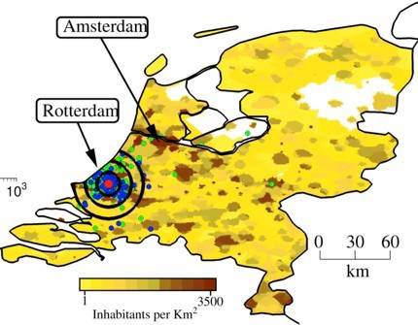



How to model the spread?
Non-spatial ODEs
Discrete space Network models
Continuous Space PDE + Networks
More complicated models fit data better but are harder to parametrize and analyze
Merler et al.BMC Medicine 2013

Slide 4



Transmission rate
S
T_{I}
R
I
Recovery time
Additional compartments can be added: Exposed but not yet infectious, dead, vaccinated, etc

Slide 5
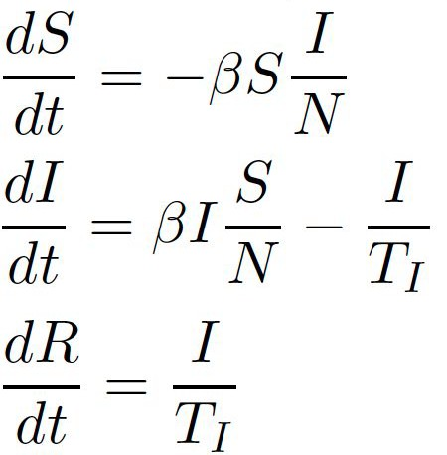
Transmission rate
S
T_{I}
R
I
Recovery time
Number of contacts * probability of transmission if contact is infected*
probability of contact infected

Slide 6
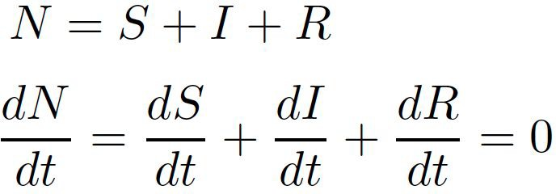
Transmission rate
S
T_{I}
R
I
Recovery time

Slide 7
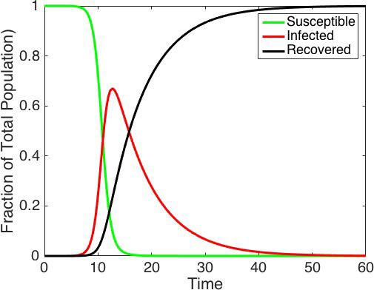
S
T_{I}
R
I

Slide 8


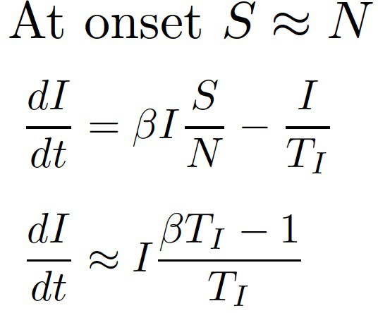
Infected population changes exponentially at onset
of an epidemic
𝛽
S
TI
R
I

Slide 9
Infected population changes exponentially at onset
of an epidemic
𝛽
S
TI
R
I
R0: # of infections due to a single infectious individual in an otherwise susceptible population.

Slide 10
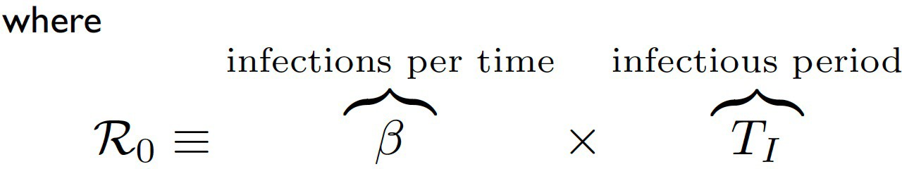
Initial Dynamics depend on R0
The expected number of cases,initially changes like:
I˙ = ^{I} (R - 1)
TI
0
Speed of the epidemic (r) is the population level rate of spread. It can often be inferred from case incidence data by fitting an exponential function: 𝑖 𝑡
𝑖(t)=i(0)exp(𝑟𝑡)

Slide 11
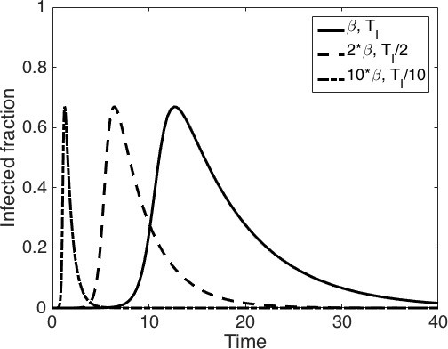
Infected population changes exponentially at onset
of an epidemic
𝛽
S
TI
R
I
Same R0 different TI
Speed

Slide 12
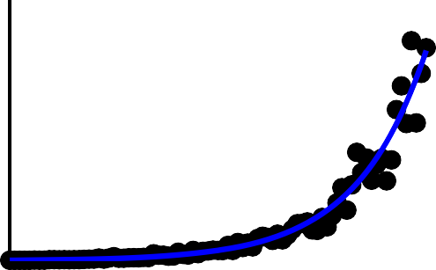
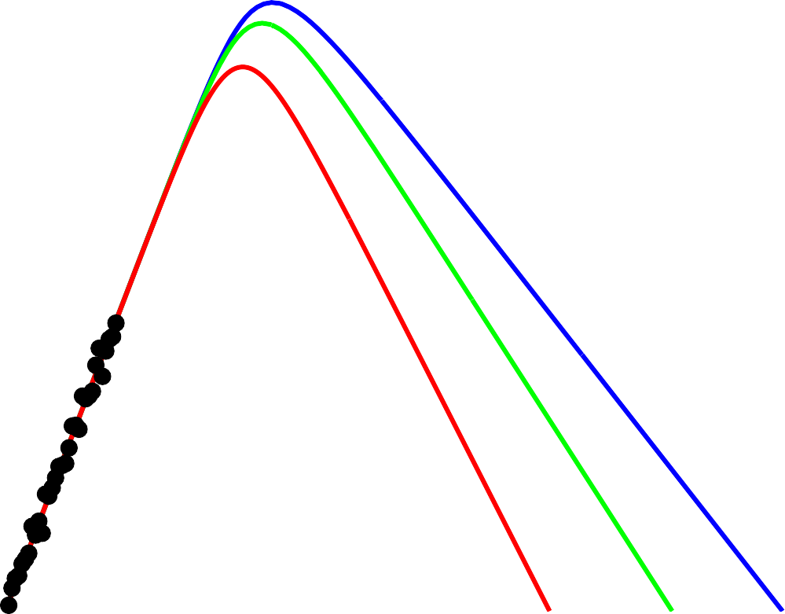
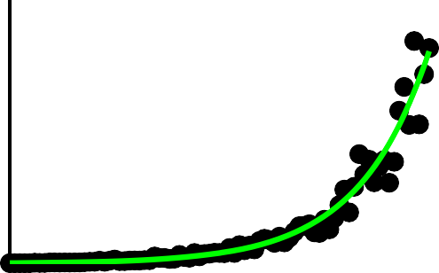
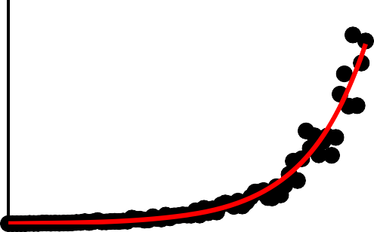
R0 is a key feature of epidemic dynamics
400
300
200
100
0
400
300
200
100
0
400
300
200
100
R ₀ = 2.5
Size
R 0
R 0
= 2.5 10⁶
= 2.0
R 0 = 1.5
I (t )
Strength ₁₀⁵
10⁴
I (t )
R 0 = 2.0
I (t )
3
Infected,
10
10
2
R 0
= 1.5
Speed
I (t )
10¹
0
0
50
100
Days, t
150
0
200
400
600
Days, t
800
1000
10⁰
1200
However Many values of R0 can be compatible with the same observed rate of increase in cases – even if projected outbreak sizes are different.

Slide 13
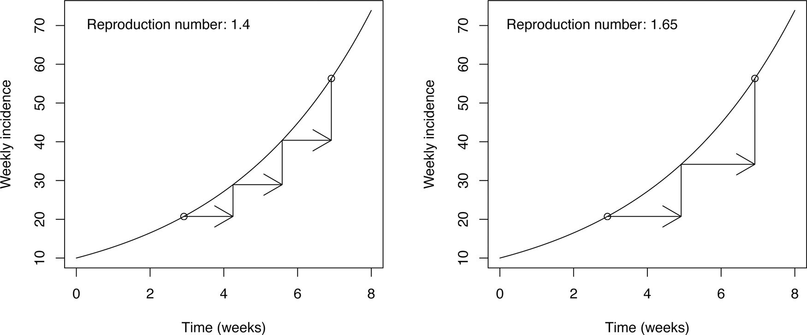
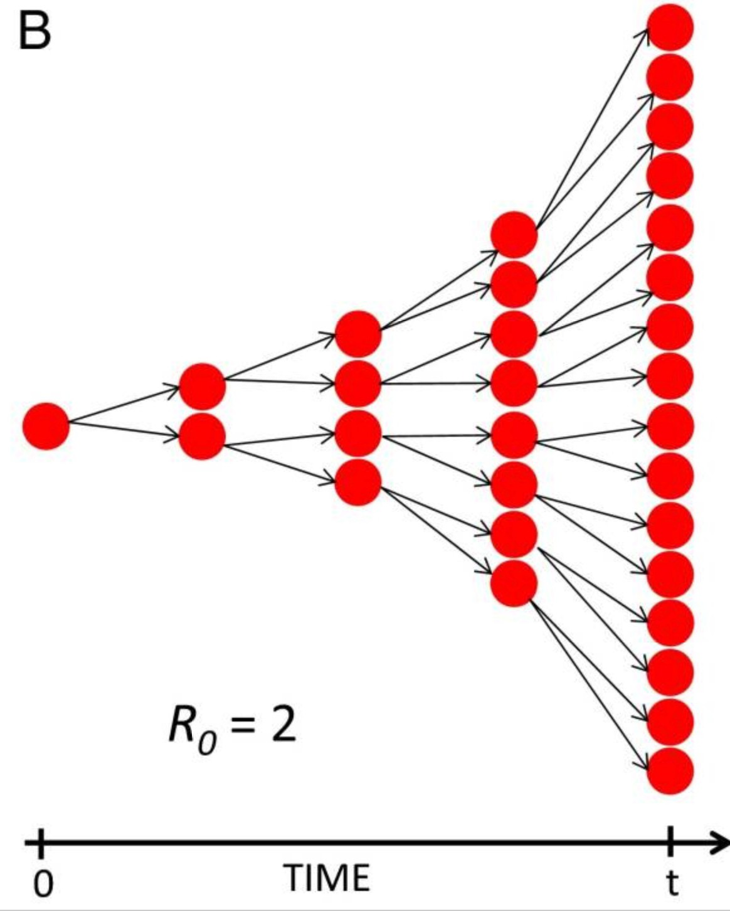
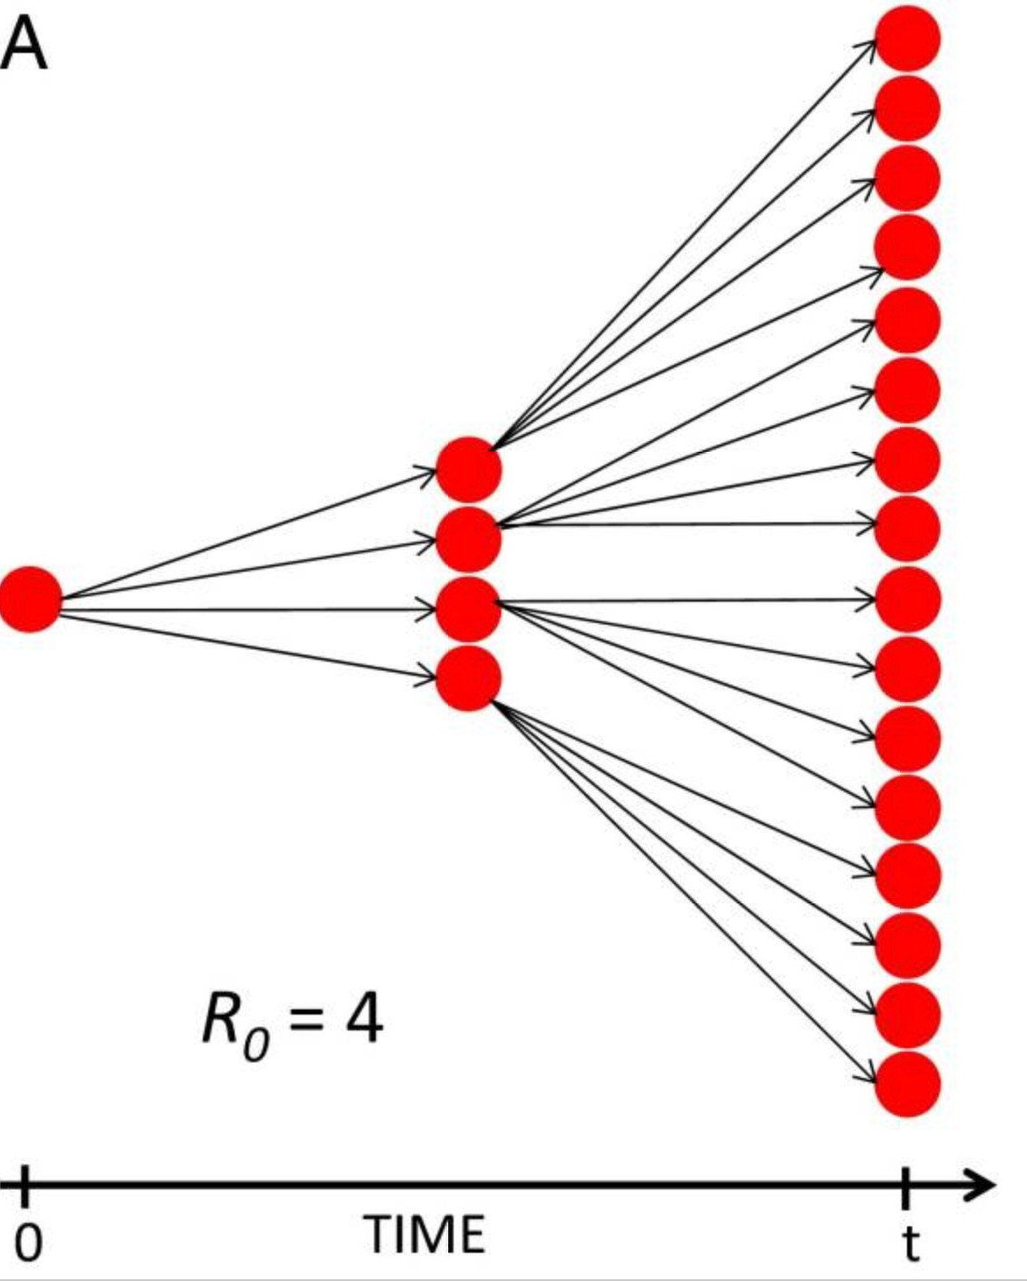
The implicit link between speed and strength
𝑟 = 0.25/𝑤𝑒𝑒𝑘
Shorter generation intervals
𝑟 = 0.25/𝑤𝑒𝑒𝑘
Longer generation intervals
Fast transmission
Slow transmission
at the individual
at the individual
level
level
ℛ0 = 1.4
ℛ0 = 1.65
𝑃𝑜𝑤𝑒𝑟𝑠 𝑒𝑡 𝑎𝑙. 𝑃𝑁𝐴𝑆 2014

Slide 14
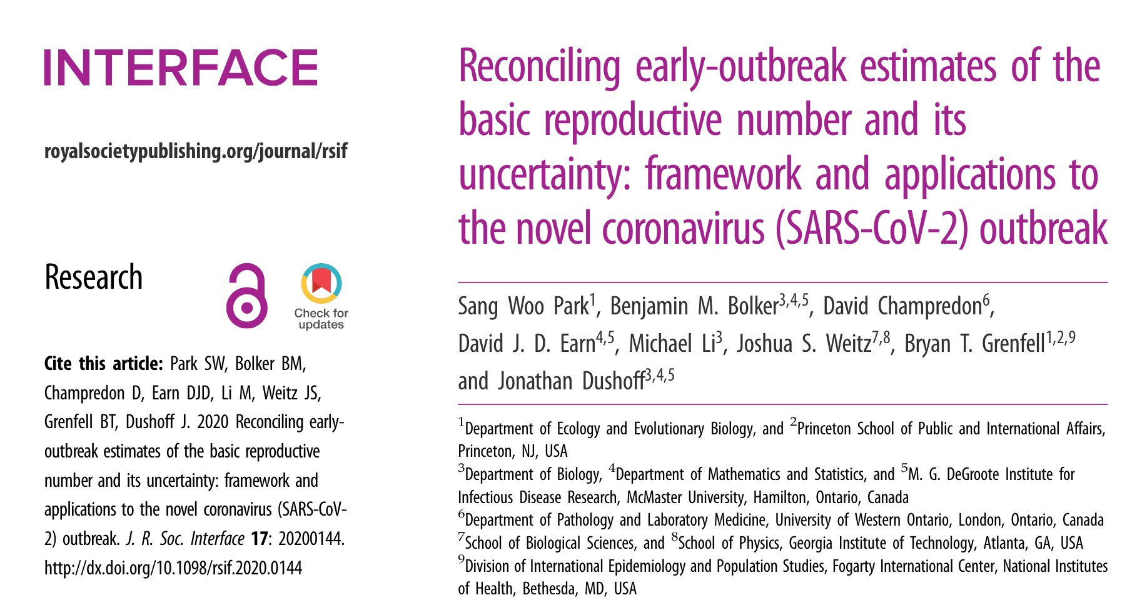
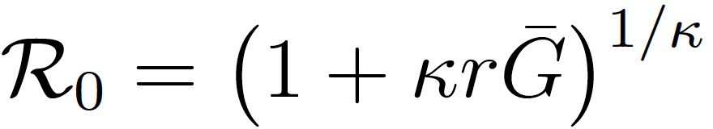

This link helps to estimate 𝓡0 through epidemic
data (but assumptions matter)
Estimating 𝓡0 for covid-19
Step 1: estimate latent uncertainty in ‘parameters’.
Study 1
●
Study 1
●
Study 1
●
Study 2
●
Study 2
●
Study 2
Study 3
●
Study 3
●
Study 3
●
Study 4
●
Study 4
●
Study 4
●
Study 5
●
Study 5
Study 5
●
Study 6
●
Study 6
Study 6
●
Study 7
●
Study 7
Study 7 ●
Step 2: incorporate different types of uncertainty into R0 estimates by study or as part of a‘pooled’ estimate (using a Bayesian multi-level model)
dispersion of g
growth
Pooled estimate
●
Pooled estimate
●
Pooled estimate
●
0.0 0.1 0.2
Exponential growth rate (days⁻¹)
0.3
6 8 10 12 14
Mean generation interval (days)
growth rate GI mean
0.00 0.25 0.50 0.75 1.00
Squared coefficient of variation
● base
GI variation
all
8
Take-home: R0 of 2.9 (95% CI 2.1-4.5)
despite much larger point estimates.
Basic reproductive number
6
●
( )_{1/}
R ₀ = 1+ rG¯
4
●
Gamma distribution
Mean of g
●
●
approximation linking r and
ℛ0
2
●
Pooled estimate Study 1
Study 2
Study 3
Study 4
Study 5
Study 6
Study 7

Slide 15
Pandemic-to-endemic
Wading immunity or pathogen mutations makes recovered susceptible again
How do you modify SIR?

Slide 16
Epidemics Beyond SIR
In your teams, choose a scriber and brainstorm the max number of possible complications to real-world infection spread that makes simple
SIR-models fail
Stochasticity/superspreaders
Compartments/networks of contacts
Feedback, e.g. awareness changes behavior

Slide 17
Stochasticity
SIR can be run with Gillespie algorithm
S + I -> 2I
I -> R
Demo next lab (Thu)

Slide 18
Overdispersion
For stochastic SIR the number of contacts (infections) per individual would follow Poisson distribution
However Pareto principle states that for many outcomes, roughly 80% of consequences come (80/20 rule). In COVID-19, superspreading is common and almost 90% of infections come from 10% of infected individuals

Slide 19
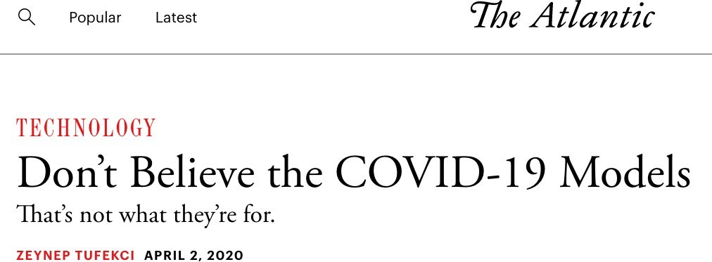
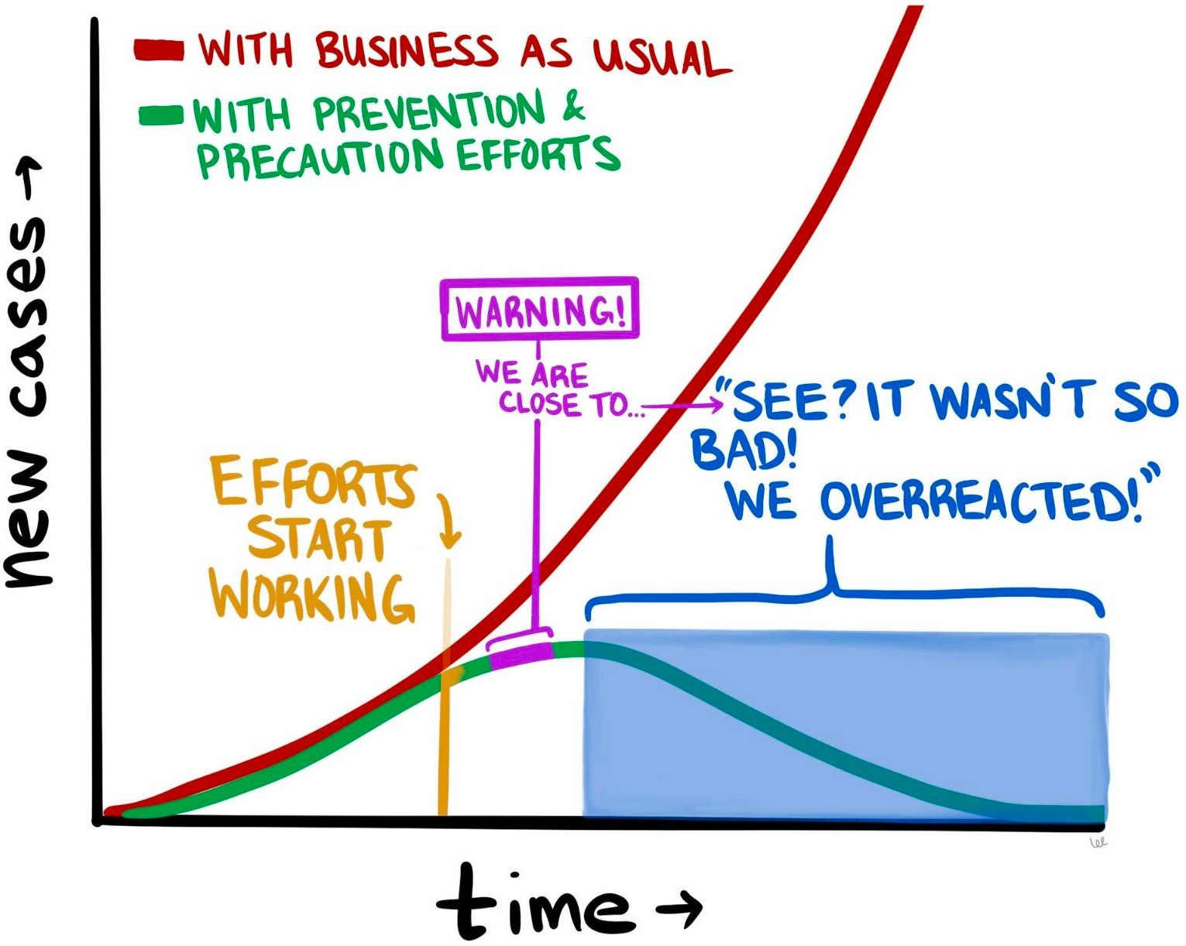
Usefulness of model predictions in managing outbreaks?

Slide 20
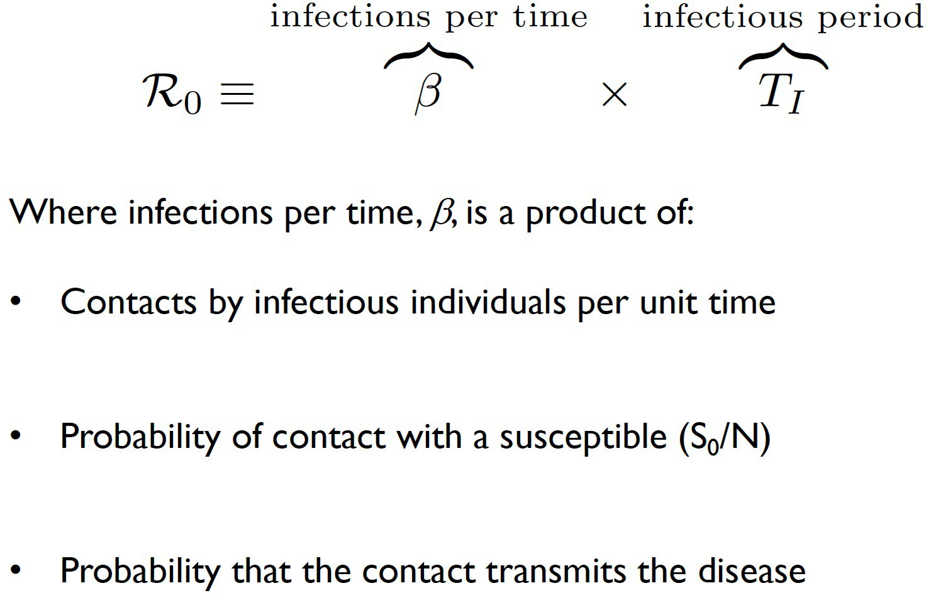
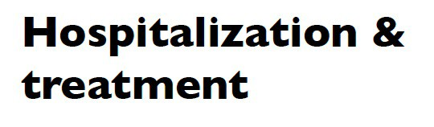
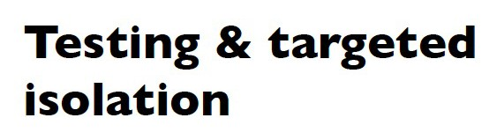
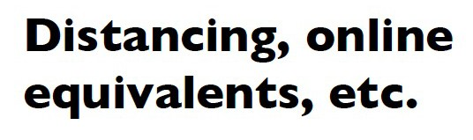
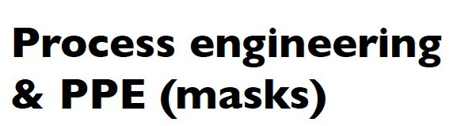
Models in action
Recall: Conditions for epidemic growth

Slide 21
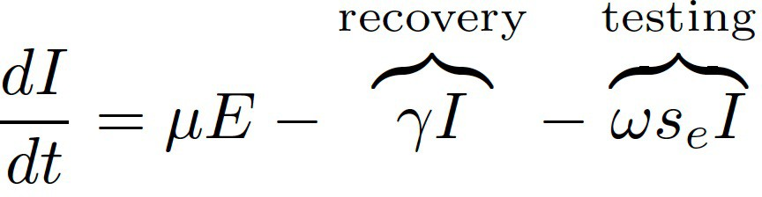
Value of viral testing as a mitigation
Principles of testing as mitigation
S
Infection
Incubation
Recovery
E
I
R
‘Removal’ via Testing

Slide 22
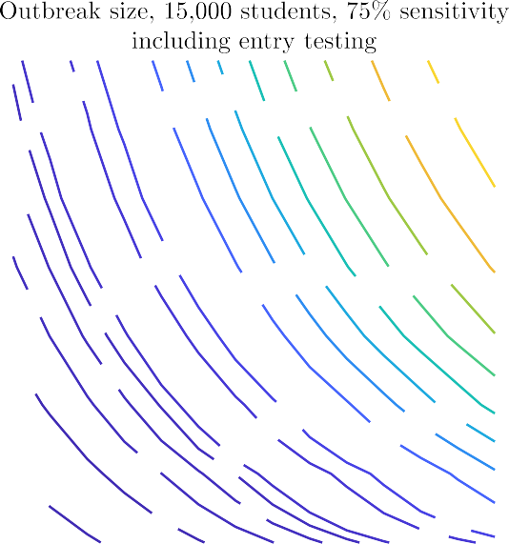
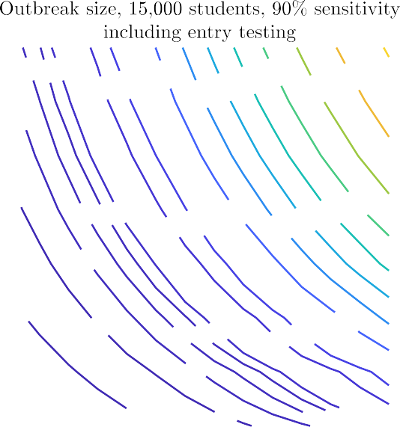
Value of viral testing as a mitigation
Principles of testing as mitigation
S
Infection
Incubation
Recovery
E
I
R
Test frequency is key. Being able to retest
<7 days is essential.
on-Pharmaceutical Intervention
General NPIs are
key: Keeping R0<1.5
essential to avoid >1000s of cases (wear masks!).
Test sensitivity matters, but speed matters more.
Entry testing helps to reduce case load.
‘Removal’ via Testing
N
10
10
750
2000
3000
4000
6000
7000
9000
400
450
500
750
1000
2000
4000
5000
6000
7000
8000
9
500
5000
8000
9
3000
450
350
8
400
8
7
750
1000
4000
7000
7
300
400
450
500
2000
5000
6000
350
500
2000
3000
5000
6000
750
1000
3000
4000
6
450
6
350
5
300
400
5
250
750
1000
2000
3000
4000
300
400
450
500
750
1000
2000
4
350
500
4
250
450
350
300
400
1000
250
500
3
1.25 1.5 1.75
2
750
3
1.25 1.5 1.75
300
₄₀₀ 450
2.25 2.5
2
2.25 2.5

Slide 23
Awareness-driven feedback

