Slide 1
Lecture 1
Class Summary and Numerical Methods Matlab refresher

Slide 2
Instructor: Oleg Igoshin
B.Sc. In Chemical Physics, Novosibirsk, Russia
M. Sc. In Chemistry, Weizmann Institute, Israel
Ph.D. In Physics (Biophysics), UC Berkeley, 2004
Postdoc UC DAVIS BME 2004-2006
@ Rice since 2007

Slide 3

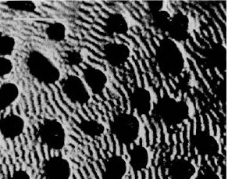
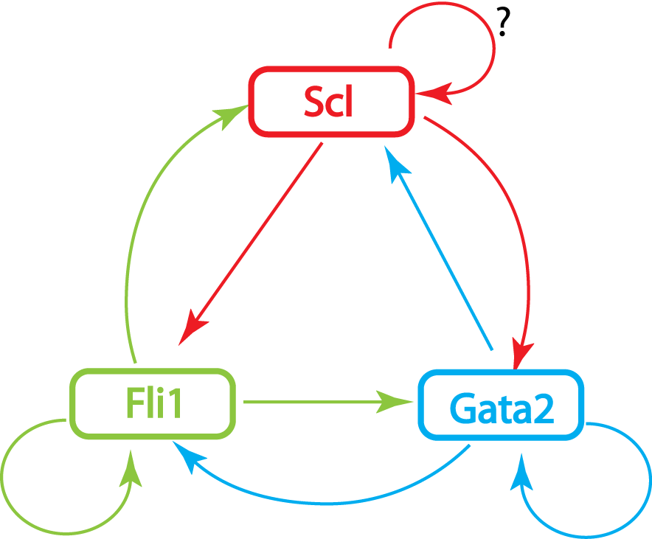
Research in my group:
Engineering approaches for computational systems biology:
Reverse engineering of multicellular self-organization
Pharmacokinetics
Evolutionary Design principles of biochemical networks
Intracellular scale
Intercellular scale
Organismal/ Physilogy
Scale

Slide 4
General Info
Grading:
No curve grading – everyone can get an A
Assignments:
~weekly reading (prior to class). Lecture/discussion followed by hands lab
Slightly more open-ended final lab (2 classes plus report due exam week). Teams of 2 students can submit one report for that.
All course materials will be posted on canvas

Slide 5
Biology revolutions of the last 20 years
Molecular Evolution (80s)
Genome Evolution (90s)
Systems Biology (-omics) (ongoing)
Tools, knowledge and mechanisms uncovered as a result change the landscape of biology and bring about new possibilities for bioengineering

Slide 6
Bioengineering “revolution”
From engineering FOR biology towards engineering WITH biology

Slide 7
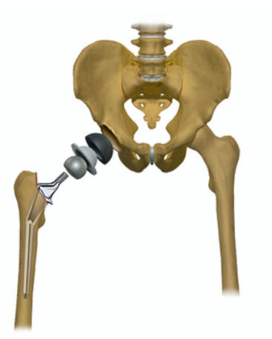
Example: hip replacement
Traditional Bioengineering
Modern Bioengineering
Hip bone – mechanical object with given material properties and shape
Bone is a living tissue containing cells and extracellular matrix
It’s dynamic with constant recycling of material
Can we program cells to re grow new hip?

Slide 8
New interface of biology and engineering
Better understanding of mechanisms
Parts are identified at accelerated rate
Synthesis and quantitative approaches are inherent tools
Better manipulation techniques on molecular and cellular level
Biology need engineering approaches
Engineering can aim to predictively manipulate biology

Slide 9
What is Computational Biology?
Using computational tools and algorithms to deal with biological data to achieve mechanistic and predictive understanding of biological systems

Slide 10
Course Philosophy
The class is organized around the understanding of key advances in the biosciences that depended critically on quantitative models and reasoning.
Each week, students will learn:
logic how to apply quantitate/engineering things at different scales [aka theory]
computational skills to implement stochastic and dynamic modeling
methods for developing and analyzing quantitative models

Slide 11
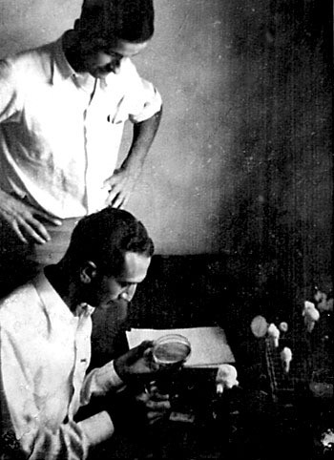
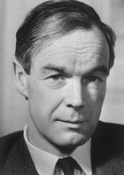
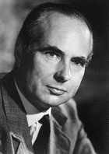
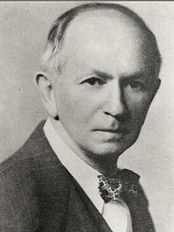
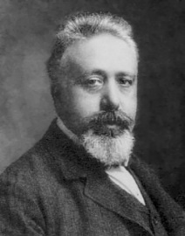
Where will we go?
Max Delbrück and Salvador Luria at CSHL ca 1941. US Natl.
Library Medicine
A.L. Hodgkin A.F. Huxley
Signaling and Behavior
Molecules and Genes
Synthetic Biology
Quantitative Physiology
Populations and Ecosystems
Alfred J. Lotka Vito Volterra

Slide 12
How will we get there?
Reading
Discussing
Analyzing data
Simulating models
Comparing results to data

Slide 13
MATLAB – where to get
Rice University has signed an agreement with MathWorks to provide all our students, faculty, and staff with campus-wide access to MATLAB
License Includes toolboxes – bioinformatics, simbiology, image processing
Go to kb.rice.edu and search for Matlab for installation instructions

Slide 14
MATLAB refresher
M-files
Programming structures
Specific Matlab operations for engineering computations
A few examples

Slide 15
Matlab key facts
High-level language for numerical computation and visualization
Provides an interactive environment for exploration and programming interface for the ease of quality coding
Excellent library fo efficient commands for matrix and array manipulation and common engineering computation
Excellent data visualization capabilities

Slide 16
M-files
Scrips (list of commands) or functions (inputs and outputs)
Function name should be a file name
Subfunction (after teh “end” of a function) can be called from within a function
Comments “%” and indentation for ease of reading/debuging

Slide 17
MATLAB build-in functions for engineering computations
Roots and optimization:
fzero %1-d root finding
fsolve %solve systems of nonlinear equations
fminbnd %minimum of single-variable function on fixed interval fminsearch(A) %minimum of a function (with vector argument)
fmincon(A) %minimum of a function subject to equality/inequality constraints

Slide 18
Finding roots
Sample biological problem:
Transcription factor (with a concentration X) is able to activate it’s own expression with the rate given by Hill function: P(X)=1+18X²/(X²+1)
The degradation is linear: D(X)=10X
Find the steady state concentration(s) of X, i.e. the concentration(s) for which production is equal to degradation
Notes:
X=0:0.1:5; P=1+18*X.^2./(X.^2+1); D=10*X; plot(X,P,'r',X,D,'g'); plox(X,P-D); roots([10,-19,10,-1])

Slide 19
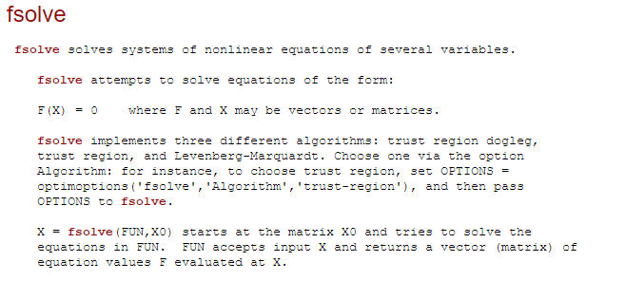
Roots in 2(+)D
function F = myfun(x,c)
F = [ 2*x(1) - x(2) - exp(c*x(1))
-x(1) + 2*x(2) - exp(c*x(2))];
To solve the system of equations for a specific value of c, first
assign the value to c. Then create a one-argument anonymous function
that captures that value of c and calls myfun with two arguments.
Finally, pass this anonymous function to fsolve:
c = -1; % define parameter first
x = fsolve(@(x) myfun(x,c),[-5;-5])

Slide 20
fminbnd Function
MATLAB has a built-in function, fminbnd, which combines the golden-section search and the parabolic interpolation.
[xmin, fval] = fminbnd(function, x1, x2)
[xmin, fval] = fminbnd(function, x1, x2, options)
fminbnd is a one-dimensional minimizer that finds a minimum for a problem specified by

Slide 21
fminsearch Function
MATLAB has a built-in function, fminsearch, that can be used to determine the minimum of a multidimensional function.
[xmin, fval] = fminsearch(function, x0)
xmin in this case will be a row vector containing the location of the minimum, while x0 is an initial guess. Note that x0 must contain as many entries as the function expects.
The function must be written in terms of a single variable (e.g. x_{i}), where different dimensions are represented by different indices of that variable (such as x₁, x₂, ect).

Slide 22
fminsearch Function
To minimize f(x,y)=2+x-y+2x²+2xy+y² rewrite as f(x₁, x₂)=2+x₁-x₂+2(x₁)²+2x₁x₂+(x₂)²
f=@(x) 2+x(1)-x(2)+2*x(1)^2+2*x(1)*x(2)+x(2)^2 [x, fval] = fminsearch(f, [-0.5, 0.5])
Note that x0 has two entries & f is expecting it to contain two values.
MATLAB reports the minimum value is 0.7500 at a location [-1.000 1.5000]

Slide 23
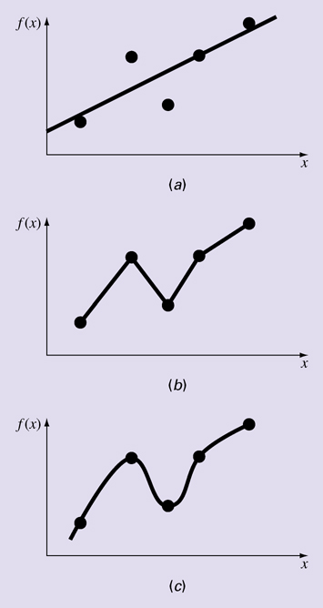
Curve fitting:
Helps estimate for continuous values between discrete data points
(a) Least-squares regression
Follows overall data pattern
(b) Interpolation
Fits to individual points
(c) Curvilinear fits
Very relevant in instrumentation, signal, and image analysis
Figure PT4.1

Slide 24
Polynomial regression in MATLAB
Given x and y data in columns, solve for the coefficients of the best fit line for y=a₀+a₁x+a₂x² Z = [x.^2 x ones(size(x))] a = (Z’*Z)\(Z’*y)
Note also that MATLAB’s left-divide will automatically include the [Z]^{T} terms if the matrix is not square, so a = Z\y would work as well
To calculate measures of fit: St = sum((y-mean(y)).^2) Sr = sum((y-Z*a).^2) r2 = 1-Sr/St syx = sqrt(Sr/(length(x)-length(a)))
Alternatively polyfit command
a = polyfit(x,y,2)

Slide 25
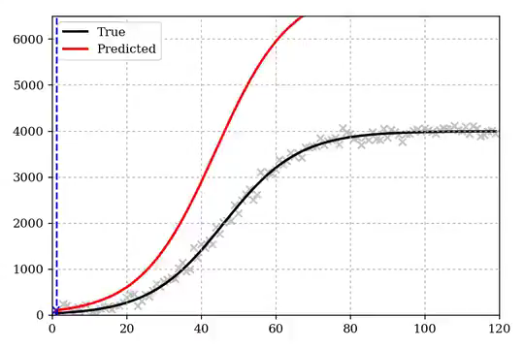
Regression models are rarely expected to extrapolate beyond the data range
c/(1+a*exp(-b*t))
https://twitter.com/clcrozier/status/1251148890595708938?s=03)
Sigmoidal (s-curves) are common for “saturating” processes, e.g. epidemics

Slide 26
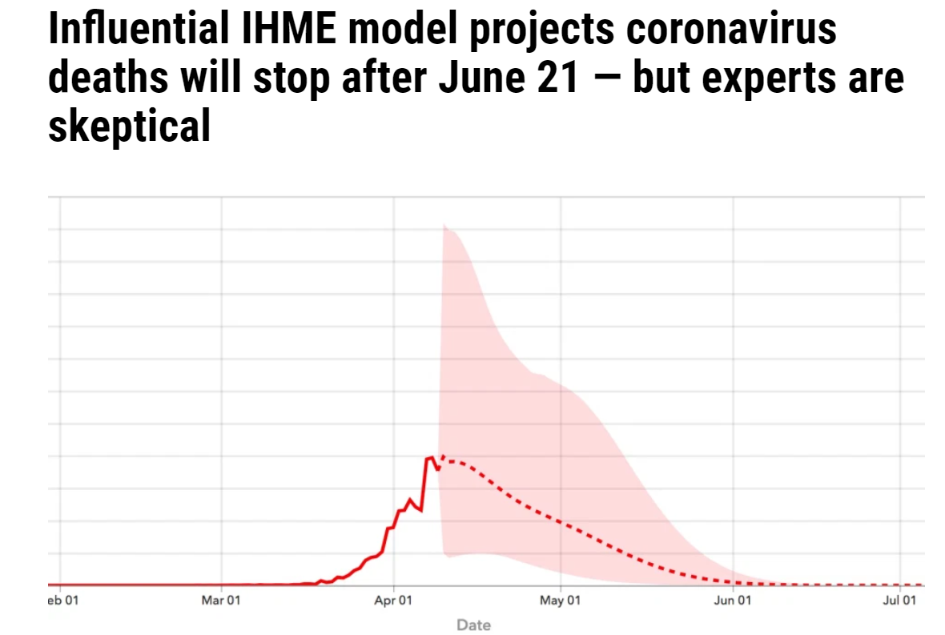
IMHE Model of COVID spread
https://ktla.com/news/nationworld/influential-ihme-model-projects-coronavirus-deaths-will-stop-after-june-21-but-experts-are-skeptical/

Slide 27
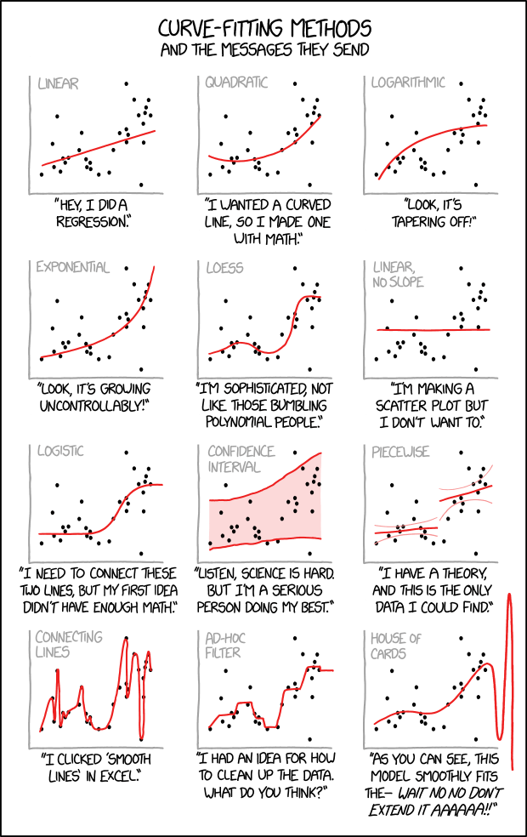
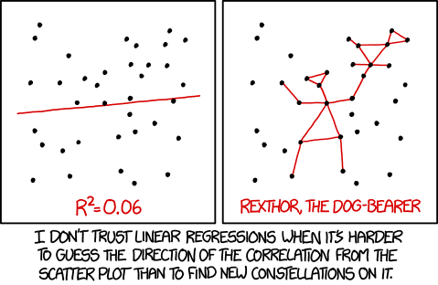
https://xkcd.com/1725/
https://xkcd.com/2048/

Slide 28
Nonlinear Regression in MATLAB
To perform nonlinear regression in MATLAB
write a function that returns the sum of the squares of the estimate residuals for a fit
then use MATLAB’s fminsearch function to find the values of the coefficients where a minimum occurs
The arguments to the function to compute S_{r} should be the coefficients, the independent variables, and the dependent variables

Slide 29
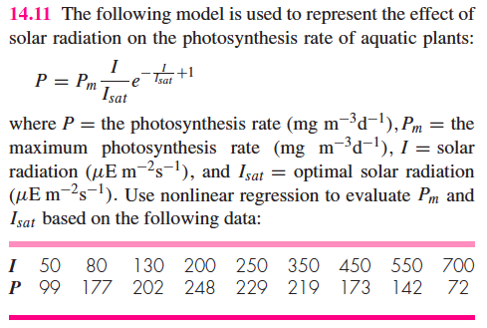

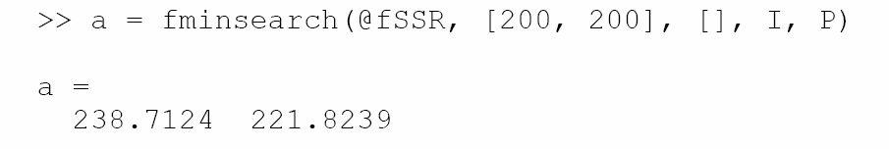
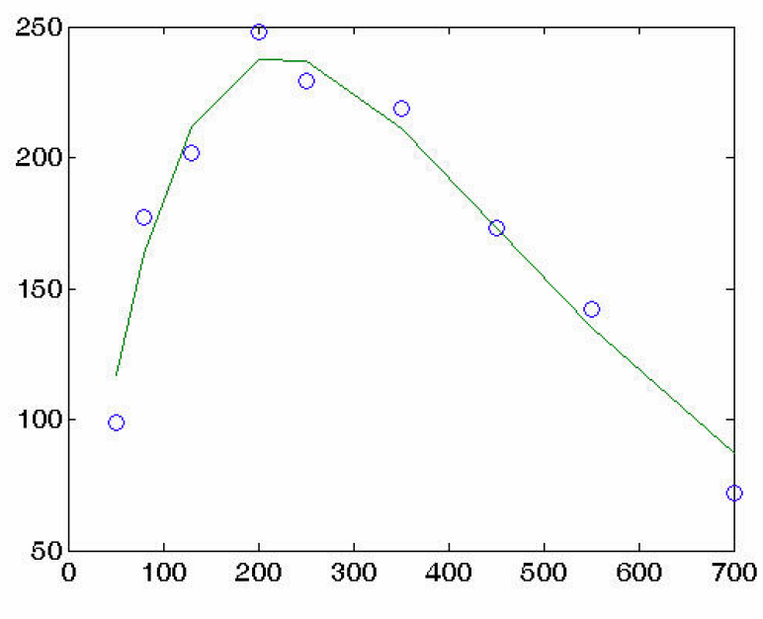
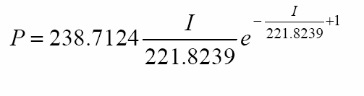
Example:
function f = fSSR(a, I, P)
Pp = a(1)•I/a(2)•exp(-I/a(2) + 1);
f = sum ((P-Pp)²);
Vectorized, coefficients in one vector!

Slide 30
Ordinary Differential Equations (ODEs)
Differential Equations (DEs) involve unknown functions and their derivatives
ODEs involve functions of 1 independent variable, such as y(x)
Order = highest order of derivative
Many ODEs are 2nd order or higher
Can be converted/reduced to a system of 1st order ODEs

Slide 31
MATLAB Functions
MATLAB’s ode23 function uses second- and third-order R-K functions to solve the ODE and adjust step sizes
MATLAB’s ode45 function uses fourth- and fifth-order R-K functions to solve the ODE and adjust step sizes. This is recommended as the first function to use to solve a problem

Slide 32
How to Use ODE Solvers
[t,y]=ode45(odefun, tspan, y0, options, p₁, p₂,…)
t = time array
y = array of unknown function
odefun = function handle computing dy/dt
tspan = integration interval
can be endpoints or specific times (in order)
y0 = initial conditions vector p₁, p₂ parameters required for the odefunc
Without output variable MATLAB usually automatically creates a plot of the solution
[t,x]=ode45(@vdp1,[0,150],[5 2]);

Slide 33
ODE Solver Options
Options to ODE solvers may be passed as an optional fourth argument, and are generally created using the odeset function: options=odeset(‘par₁’, ‘val₁’, ‘par₂’, ‘val₂’,…)
Commonly used parameters are:
‘RelTol’: adjusts relative tolerance
‘AbsTol’: adjusts absolute tolerance
‘InitialStep’: sets initial step size
‘MaxStep’: sets maximum step size (default: one tenth of tspan interval)

Slide 34
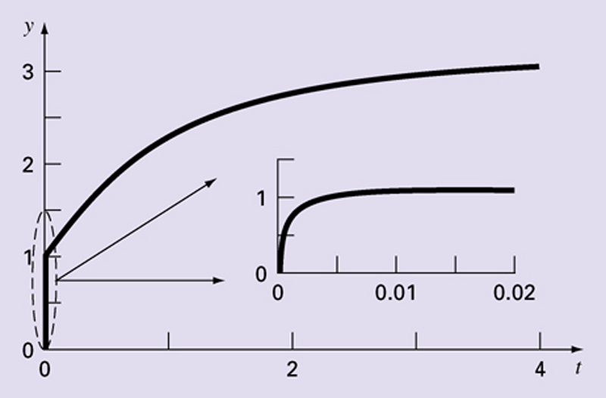
Stiff ODE Systems
Contain rapidly changing components and slowly changing components
Can be individual ODE or a system of ODEs
Viscoelasticity, spring and damping systems, control systems, chemical kinetics
Example:
dy/dt = -1000y + 3000 – 2000e^{-t}, y(0)=0
Soln: y = 3 – 0.998e^{-1000t} – 2.002e^{-t}
initially dominates later dominates
Figure 21.7

Slide 35
MATLAB Solvers for Stiff ODEs
ode15s
Multistep solver based on numerical differentiation formulas
Low to medium accuracy
ode23s
One step solver, may be better than ode15s
ode23t
Version of trapezoidal rule, low accuracy
ode23tb
Version of Runge-Kutta w/backwards diff, also may be better than ode15s

Slide 36
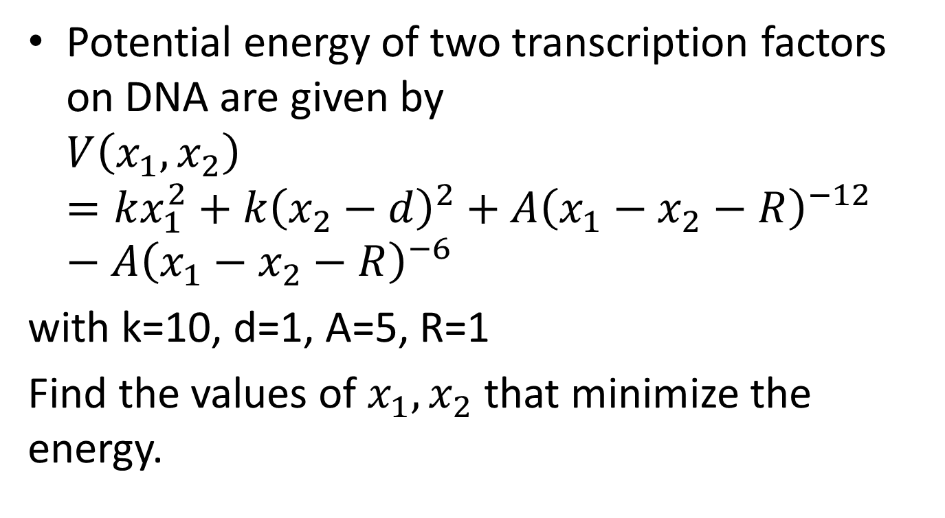
Challenge Problem 1
Potential energy of two transcription factors on DNA are given by $V\left(x_{1},x_{2}\right)=kx_{1}^{2}+k{\left(x_{2}−d\right)}^{2}+A{\left(x_{1}−x_{2}−R\right)}^{−12}−A{\left(x_{1}−x_{2}−R\right)}^{−6}$
with k=10, d=1, A=5, R=1
Find the values of $x_{1},x_{2}$ that minimize the energy.

Slide 37
Solution
k=10;
d=1;
A=5;
R=1;
f=@(x) k*x(1)^2+k*(x(2)-d)^2+A*(x(1)-x(2)-R)^(-12)-A*(x(1)-x(2)-R)^(-6);
[x, fval] = fminsearch(f, [-0.5, 0.5])

Slide 38
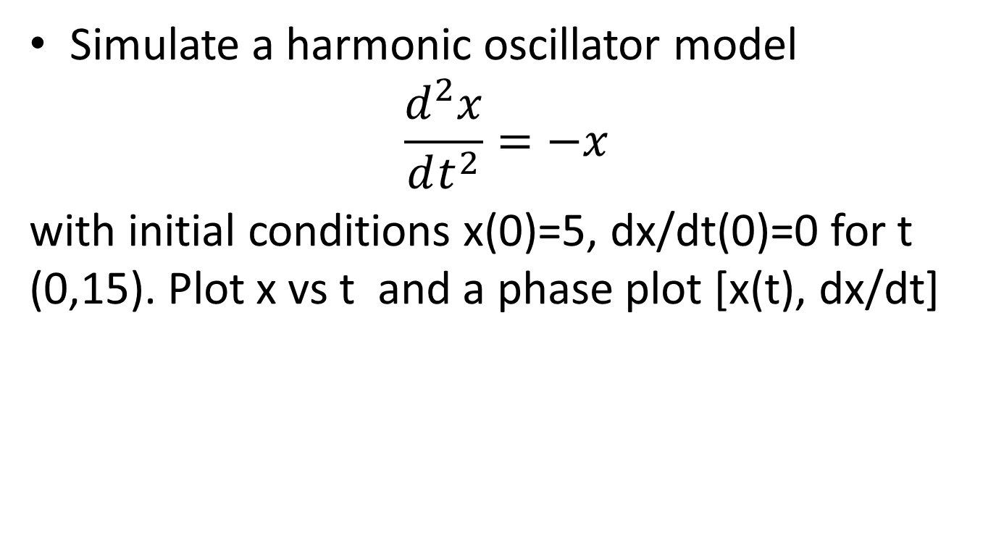
Challenge Problem 2
Simulate a harmonic oscillator model $\frac{d^{2}x}{dt^{2}}=−x$
with initial conditions x(0)=5, dx/dt(0)=0 for t (0,15). Plot x vs t and a phase plot [x(t), dx/dt]

Slide 39
Solution
%dx1/dt=x2
%dx2/dt=-x1
rhs1= @(t,x) [x(2); -x(1)];
[t,x]=ode45(rhs1,[0,15],[5 0]);
plot(x(:,1), x(:,2));
xlabel('x')
ylabel('dx/dt')

