Slide 1
Pharmacokinetic and Pharmacodynamic Modeling
BioE 446
09/01/2022

Slide 2
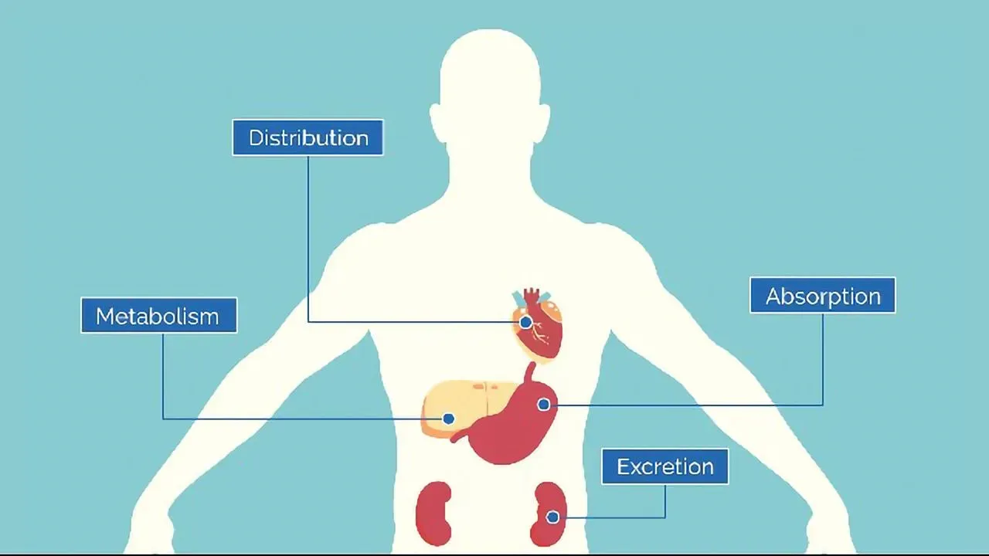
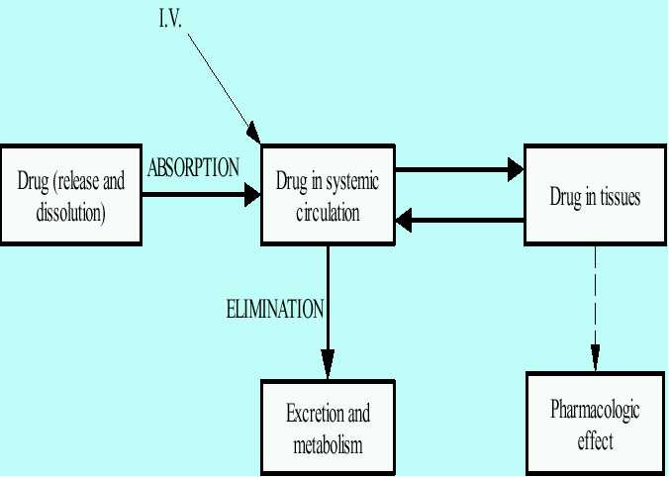
What Happens to a Drug in the Body?
ADME
Absorption: How does the drug enter the body?
Digestion, inhalation, absorption through skin, injection into blood/other compartments
Distribution: Where does the drug go?
Blood, peripheral tissue, lymphatic system, other organs
Metabolism: How does your body process the drug?
Biochemical transformations in digestive system, liver, kidney, etc.
Excretion: How does the drug leave your body?
Urine, feces, sweat, expiration
https://www.technologynetworks.com/drug-discovery/articles/what-is-adme-336683

Slide 3
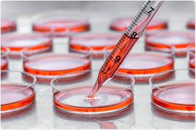
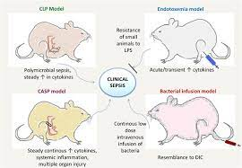
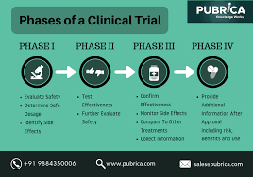
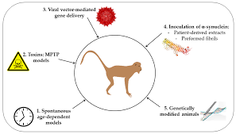
Typical Drug Development Process
Before a therapeutic can be tested in humans, we need to have a general idea of how it will behave. The typical drug development process looks like this:
In Vitro Experiments
Small Animal Models
Large Animal Models
Clinical Trials
Before arriving at clinical trials, how can we predict how a therapeutic will behave in humans?
Notes:
FDA requires justification for dose amounts.

Slide 4

Pharmacokinetic and Pharmacodynamic Models
Dose
Compartment 1
C1(t)
Transport
Compartment 2
C2(t)
Clearance
Pharmacokinetic (PK) and pharmacodynamic (PD) models are ultimately used to predict how a therapeutic will behave in humans.
Data from preclinical experiments and prior clinical trials are used to estimate drug-specific parameters and target behaviors.
$$\frac{dC1}{dt}= …$$
$$\frac{dC2}{dt}= …$$
$$\frac{dE}{dt}=…$$
E = f(C2,t,…)
Notes:
PK – drug distributions
PD – effects in body

Slide 5
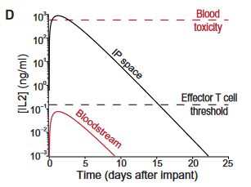
What do we predict with PK/PD models?
Broadly speaking, we want to make sure a therapeutic will be both safe and effective before entering clinical trials.
From a PK perspective, concentrations of the delivery therapeutic are related to safety and efficacy based on exposure levels.
Predicting safety and efficacy using PD is more detailed, but requires more complex models which may come with more uncertainty.

Slide 6
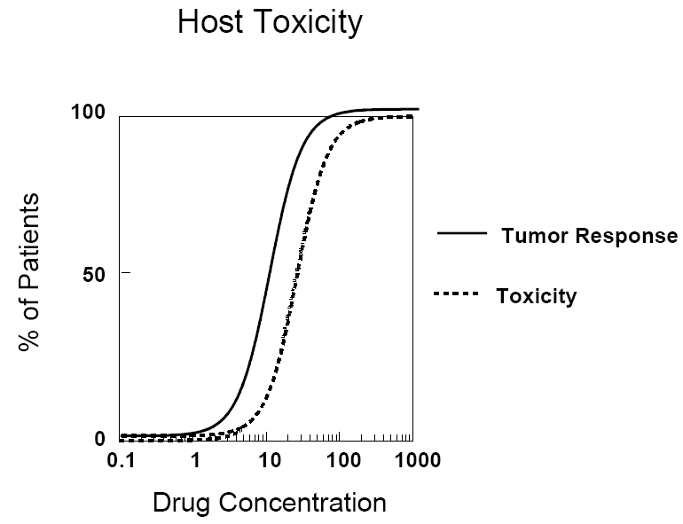
Therapeutic Index
A useful measure of a drug’s performance is its therapeutic index.
Basically, a drug’s therapeutic index it’s a measure of the separation between its toxic and efficacious dose.
Many drugs fail to be approved due to a narrow therapeutic index.

Slide 7
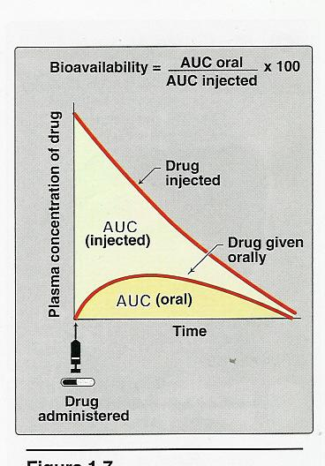
Bioavailability
Bioavailability (F) refers to the % of administered drug that reaches systemic circulation.
I.V. administration of a therapeutic is defined to have a bioavailability of 100%.
Bioavailability of other routes of administration (oral, s.c., i.p., etc.) can often be very low which can be a major obstacle for drug development.

Slide 8
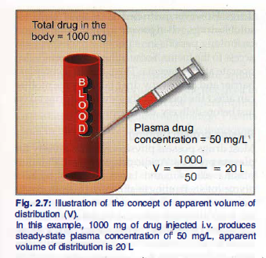
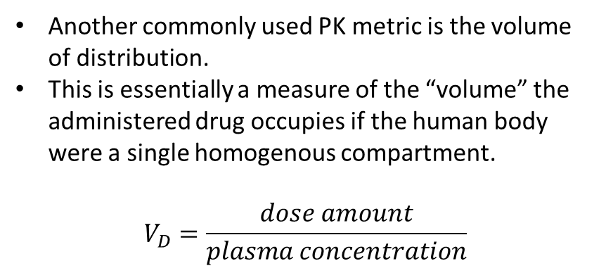
Volume of Distribution
Another commonly used PK metric is the volume of distribution.
This is essentially a measure of the “volume” the administered drug occupies if the human body were a single homogenous compartment.
$$V_{D}=\frac{dose amount}{plasma concentration}$$

Slide 9
Types of PK Models

Slide 10
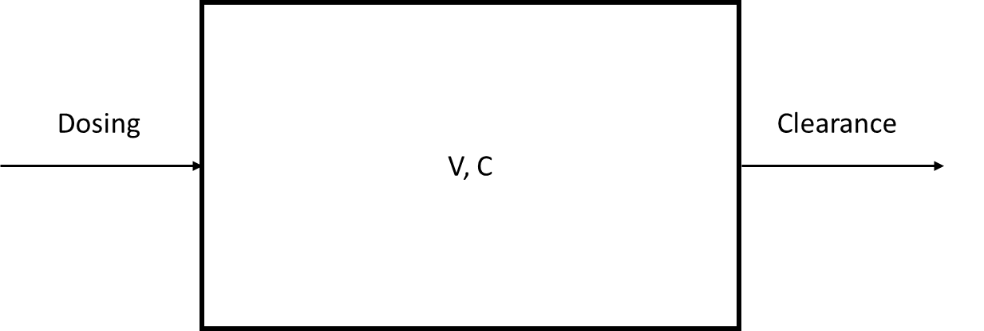

One Compartment PK Model
One compartment models can be used for i.v. administration of therapeutics without any complex PK trends.
Small molecules
Biologics without strong binding or peripheral tissue penetration.
Only a single equation is needed to describe the system, and an analytical solution is easily obtained.
$$C_{0}=\frac{D}{V}$$
$$\frac{dC}{dt}= −k_{CL}C$$
$$C\left(t\right)=\frac{D}{V}\exp\left\{−k_{CL}t\right\}$$

Slide 11
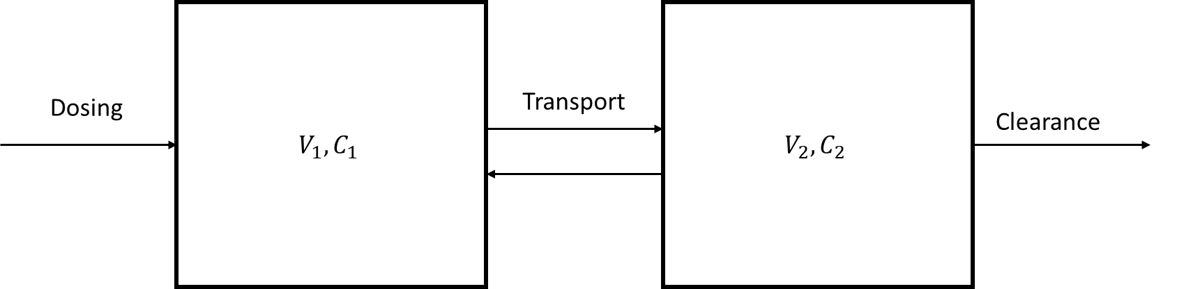
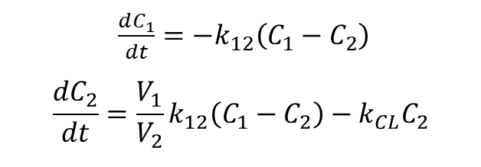
Two Compartment PK Models
Two compartment models are used when a therapeutic is not delivered directly to the blood (e.g. subcutaneous or intraperitoneal administration).
These models consist of two equations governing the concentration of therapeutic in each compartment.
Depending on the system, only one or both concentration predictions may be of interest.
$\frac{dC_{1}}{dt}={−k}_{12}\left(C_{1}−C_{2}\right)$
$$\frac{dC_{2}}{dt}=\frac{V_{1}}{V_{2}}k_{12}\left(C_{1}−C_{2}\right)−k_{CL}C_{2}$$

Slide 12
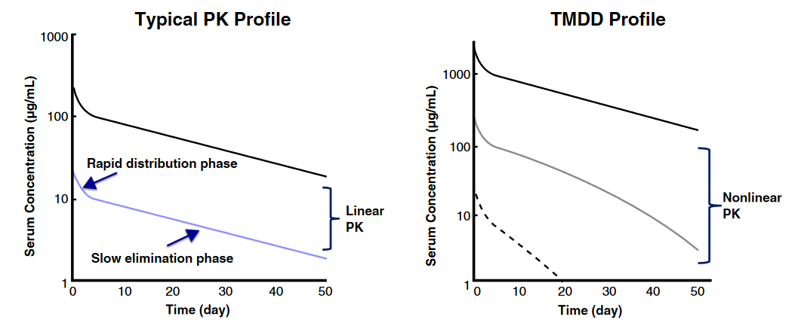
Linear v. Nonlinear PK Models
The models we have discussed so far are all linear PK models, i.e. doubling dose amounts leads to 2x predicted concentrations of therapeutic.
PK Profiles of Monoclonal Antibodies:
Typically saturable processes lead to non-linear PK, including:
Target binding
Enzyme saturation
Feedback loops

Slide 13

Challenge Problem: Modeling I.V. Bolus Injection with PK Models
Time (hours) | Blood Concentration (ug/mL)
0.5 | 0.197
1 | 0.194
1.5 | 0.192
2 | 0.189
2.5 | 0.186
3 | 0.183
6 | 0.168
8 | 0.159
12 | 0.141
16 | 0.126
24 | 0.100
36 | 0.070
54 | 0.050
72 | 0.025
The following data was taken after a patient was given a dose of 1 mg of therapeutic A. Using the data, estimate the half life of the therapeutic. Assume a human blood volume of 5000 mL.
$$C\left(t\right)=\frac{D}{V}\exp\left\{−k_{CL}t\right\}$$
$$t_{1/2}=\frac{ln\left(2\right)}{k_{CL}}$$

Slide 14
PK Modeling of IL-12 Cell Therapy

Slide 15
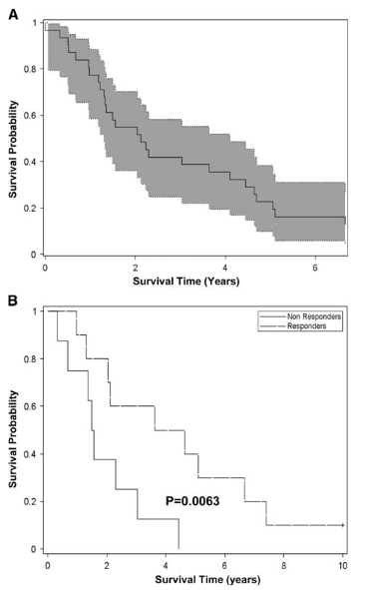
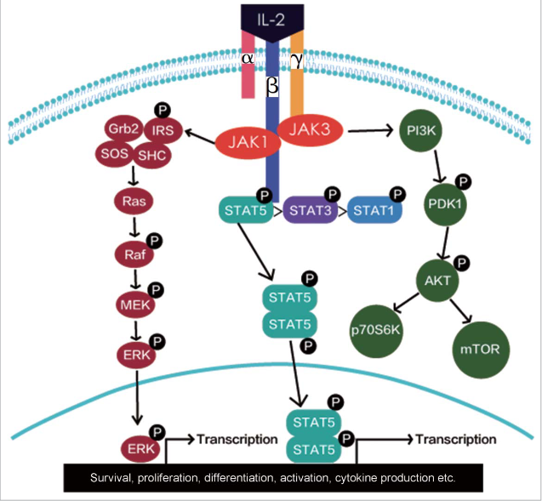
Interleukin-2 (IL-2) as a Cancer Immunotherapy
Local delivery of IL-12 via i.p. infusions has shown efficacy in patients with advanced ovarian cancer.
Maintaining high local concentrations of IL-2 leads to tumor suppression; however systemic exposure leads to toxicity.
Novel engineering strategies are in development for maintaining local concentrations while limiting systemic exposure
Jiang et al., OncoImmunology, 2016.
Vlad et al., Cancer Immunology, Immunotherapy, 2010.

Slide 16
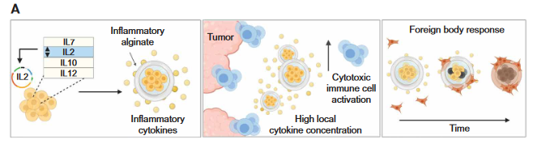
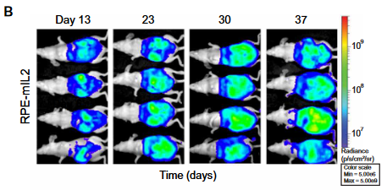
Intraperitoneal IL-2 Cell Therapy
Efficacy and safety in mouse and NHP models are well characterized, how can we use a PK model to justify translation to humans?
Nash et al., Sci. Adv., 2022

Slide 17
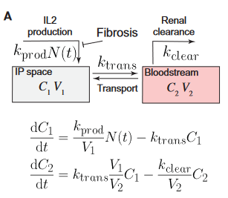
PK Model of IP Cytokine Cell Therapy
A simple model of i.p. implantation of cytokine producing cell capsules was created.
To use this model for predictions of cell therapy behavior in humans, two steps were taken:
Validation of model structure via fitness to animal model experiments.
Estimation of human transport and clearance parameters.
If clinical trials of the therapeutic of interest exist, parameters can be estimated with these datasets.
Allometric scaling must be used otherwise.
Nash et al., Sci. Adv., 2022

Slide 18
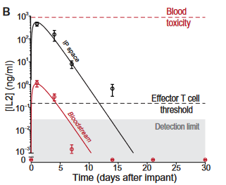
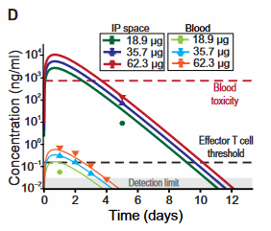
Validation of Model Structure
Fit to Mouse Data:
Fit to NHP Data:
Nash et al., Sci. Adv., 2022

Slide 19
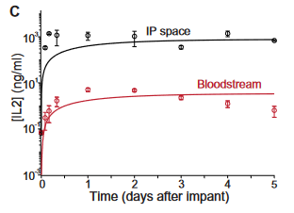
Estimation of Human Parameters and Cell Therapy Behavior
Here, detailed human clinical trial data was available. In the absence of clinical trial data allometric scaling methods can be used to determine parameters instead.
Nash et al., Sci. Adv., 2022
Vlad et al., Cancer Immunology, Immunotherapy, 2010

Slide 20
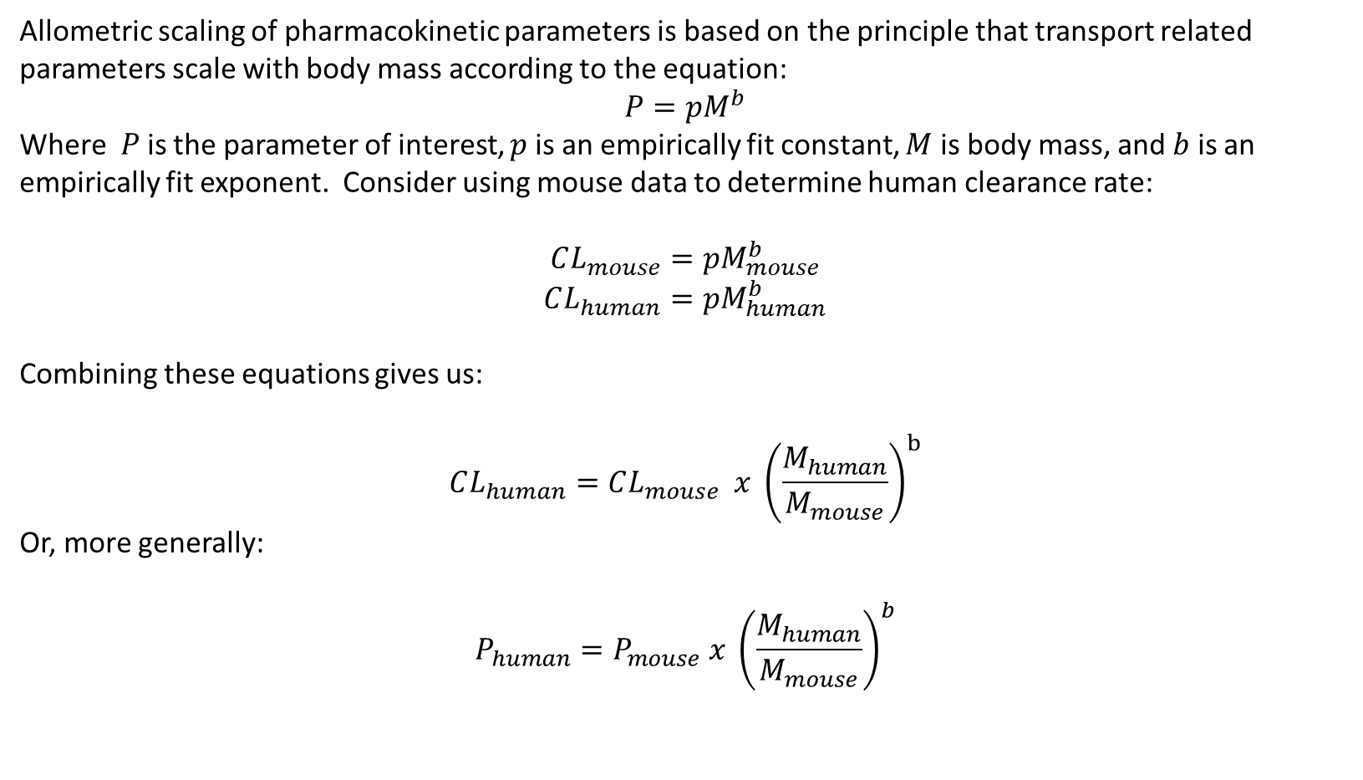
Allometric Scaling
Allometric scaling of pharmacokinetic parameters is based on the principle that transport related parameters scale with body mass according to the equation:
$$P=pM^{b}$$
Where $P$is the parameter of interest, $p$ is an empirically fit constant, $M$ is body mass, and $b$ is an empirically fit exponent. Consider using mouse data to determine human clearance rate:
$$CL_{mouse}=pM_{mouse}^{b}$$
$$CL_{human}=pM_{human}^{b}$$
Combining these equations gives us:
$$CL_{human}=CL_{mouse} x {\left(\frac{M_{human}}{M_{mouse}}\right)}^{b}$$
Or, more generally:
$$P_{human}=P_{mouse} x {\left(\frac{M_{human}}{M_{mouse}}\right)}^{b}$$
Trevakis et al., Frontiers in Physiology, 2020
Huh et al., Xenobiotica, 2011

Slide 21
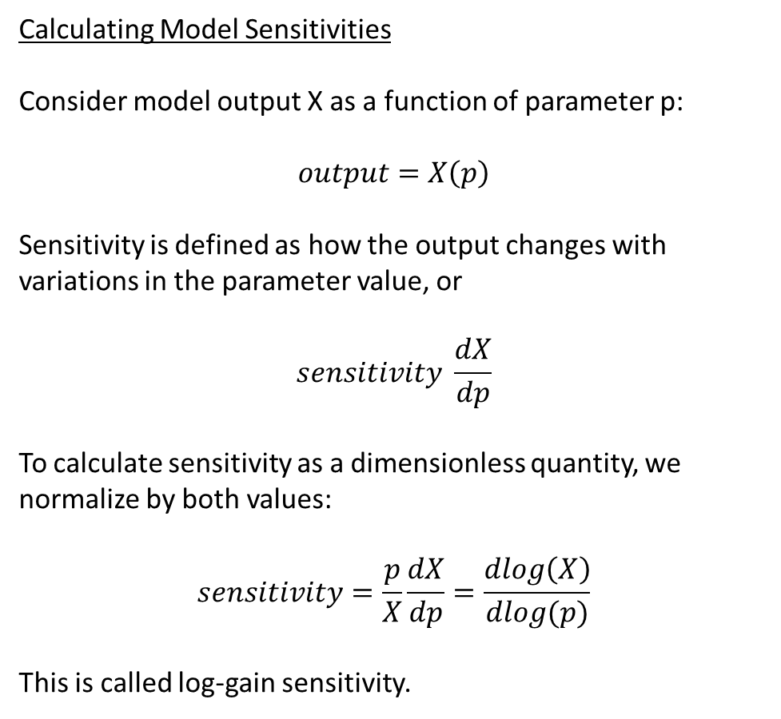
Sensitivity Analyses
Calculating Model Sensitivities
Consider model output X as a function of parameter p:
$$output=X\left(p\right)$$
Sensitivity is defined as how the output changes with variations in the parameter value, or
$$sensitivity \frac{dX}{dp}$$
To calculate sensitivity as a dimensionless quantity, we normalize by both values:
$$sensitivity=\frac{p}{X}\frac{dX}{dp}=\frac{dlog\left(X\right)}{dlog(p)}$$
This is called log-gain sensitivity.
Sensitivity analyses are a useful tool for any kind of modeling to determine how important assumptions are on model output.
In the case of PK/PD modeling, this can tell us how significant errors in parameter estimations influence our human predictions.

