Slide 1
Lecture 5
Stochastic Chemical Kinetics & Gene expression noise

Slide 2
Today
Stochasticity in Chemistry and Biology
Stochastic simulation algorithm
Stochastic production and degradation – Poisson process
Stochastic gene expression: transcriptional and translational bursting
Stochastic cell differentiation

Slide 3
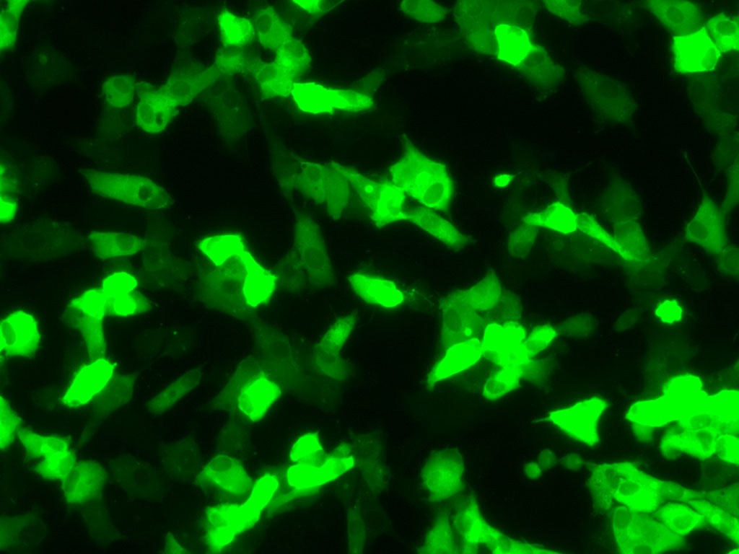
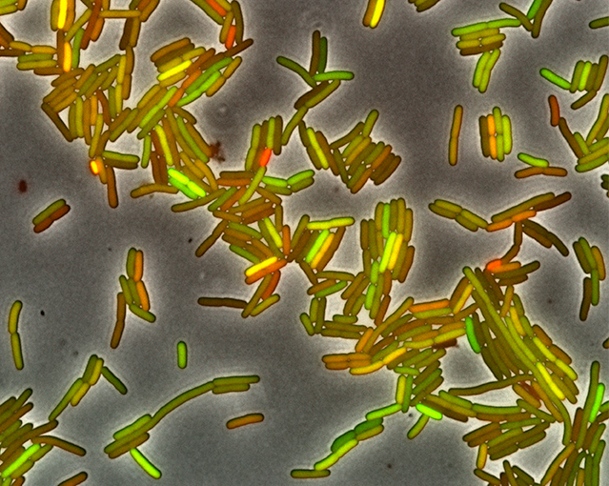
Why genetically cells look different from one-another?
How many reasons can you come up with?

Slide 4
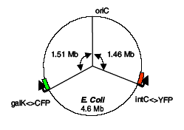
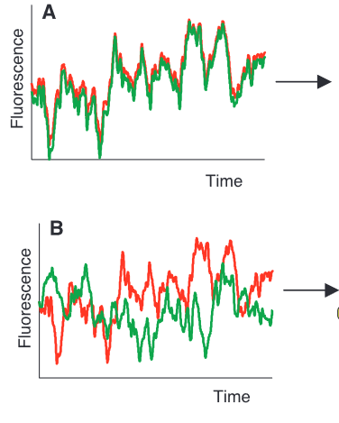
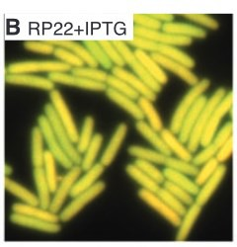
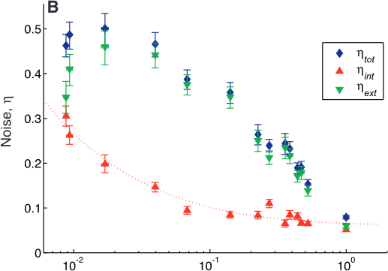
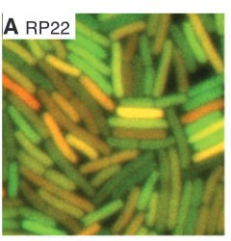
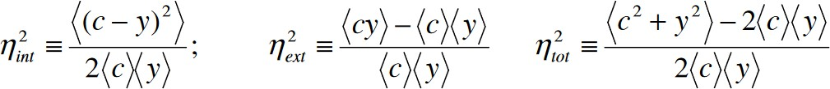
Sources of noise
Intrinsic vs. Extrinsic noise
Elowitz et al., 2002
Low expression
High expression
total
Relative fluorescence
Measures of noise:
Noisy gene expression generates heterogenity in genotypically identical cells

Slide 5
Introduction
Genetically identical cells exposed to the same environmental conditions can show significant variation in molecular content and marked differences in phenotypic characteristics.
This variability is linked to stochasticity in gene expression, which is generally viewed as having detrimental effects on cellular function with potential implications for disease.
However, stochasticity in gene expression can also be advantageous.
It can provide the flexibility needed by cells to adapt to fluctuating environments or respond to sudden stresses, and a mechanism by which population heterogeneity can be established during cellular differentiation and development.

Slide 6
Where does stochasticity arise in biology?
All chemical reactions are fundamentally random – modulated by solvent or sometimes quantum mechanics
Average description ( concentrations) fails for small copy-numbers and volumes. Some bio-molecules are present 1-2 copies per cell, e.g. DNA
May not be too important for metabolism (more molecules/faster reaction) but often crucial for gene expression (fewer molecules/slower reactions)

Slide 7
Rate vs Probability
(QUIZZ) If the rate of a process is r = 3hr ⁻¹ i) How many events happen in ΔT=1hr? ii) How many in ΔT=1 min?
Average number of events is rΔT , i.e.
rΔT = 3h ⁻¹ 1h= 3 events
rΔT=3h ⁻¹ (1h/60min) 1min= 1/20 event
Number <1 means that 1 reaction has occur a chance to occur with probability p=rΔT

Slide 8
Rate constants define probability of reaction per unit time
Constant production (zeroth order): -> X, rate k0 the probability that reaction occurs in dt is k0*dt
First order degradation: X-> , rate k1 the probability that reaction occurs in dt is k1*Nx*dt (the probability is k1*dt for each molecule)
Second order binding: X+Y->.. , rate k2 the probability that reaction occurs in dt is k1*Nx*Ny*dt (the probability is k2*dt for each pair)
X+X->.. , rate k2 the probability that reaction occurs in dt is k2*Nx*(Nx-1)/2*dt (the probability is k2*dt for each pair)

Slide 9
Simulating stochastic process Simplest (but not the smartest) way – Monte-Carlo
Divide time interval to small increments dt so that no more then 1 reaction occurs
Calculate probabilities of each reaction to occur in the next dt
Draw a random number(s) whether a reaction will occur and which reaction to occur
R1: A+ B → C ; A→ D
Suppose that you know that probability (at this time step) of the R1 is 0.03 and R2 0.04. How will you use MATLAB random number generator to simulate this?

Slide 10
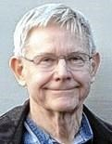

The Gillespie algorithm(SSA)*: Simulation of the reaction probability density function
Equivalent to the chemical master equation
Basic idea: when will the next reaction occur, what kind of reaction is it?
Described by the reaction probability density function P(τ,μ)
P(τ,μ) dτ := prob. that, given the state (X₁,…,X_{N}) at time t, the next reaction will occur in (t+τ,t+τ+dτ) and will be an R_{μ} reaction
Dan Gillespie, B.S. Physics @Rice 1960 Sid Richardson

Slide 11
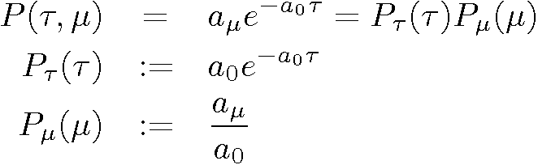
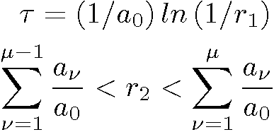
Simulation of P(τ,μ)
Generate a random pair (τ,μ) according to
Generate r₁,r₂ two uniformly distributed (0,1) randon numbers and compute

Slide 12
The Algorithm
Step 0 (Initialization): set the reaction rates c₁,…,c_{M} and the initial molecular population numbers X₁,…,X_{N}
Step 1: calculate the reaction probabilities per unit time a₁=h₁c₁, …, a_{M}=h_{M}c_{M} and the total probability a₀
Step 2: generate random numbers τ and μ according to P(τ,μ)
Step 3: increase time t by τ and update molecule numbers according to reaction μ
if t < t_{int} goto Step 1

Slide 13
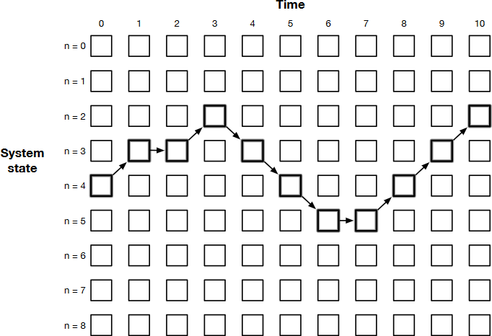
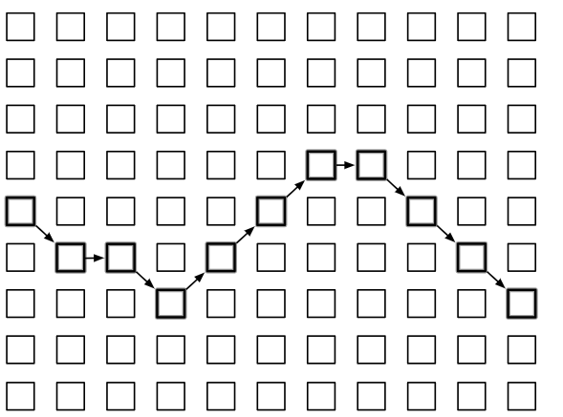
Gillespie algorithm for simulating
stochastic gene expression
Consider a system (a cell) with N+1 posible states (number of mRNA, n)
Inside a cell we have a discrete and finite number 𝑛 of mRNA that increases and decreases one molecule at a time
p p
𝑛 − 1 𝑛 𝑛 + 1
d
Cell 1: p+p+d+p
Cell 2: p+d+p+p
Cell 3: p+p+p+d
d
each cell has its unique trayectory of events of production and degradation. All the ensemble of stochastic trajectories give a probability distribution of 𝑛
Adriana Lucia-Sanz agarcia337@gatech.edu

Slide 14
For constant rate of gene expression
Transcription rate 𝛽
mRNA degradation rate 𝛼
Assume we have n molecules of mRNA
Probability of mRNA production
Independent of n, 𝛽ΔT
Probability of mRNA degradation
Linear in n, 𝛼nΔT
n=3, 𝛽 =2 min^-1, 𝛼=1 min^-1
a1=Pr(3->4 )=2 min^-1
a2=Pr(3->2 )=3 min^-1
a0=a1+a0=5min^-1
Notes:
Tnext=1/5*log(1/rand)
Rind=rand;
Nnext=(N+1)*(Rind<2/5)+(N-1)

Slide 15
A simple example: birth-death process
k
P
γ
γ=ln(2)/τ
τ: half-life
Master equation
Time evolution: mean
Time evolution: variance
Time evolution: noise
CV = Coefficient of Variation
f = Fano factor
What distribution will it be?

Slide 16


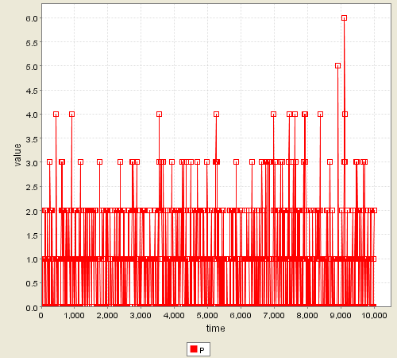
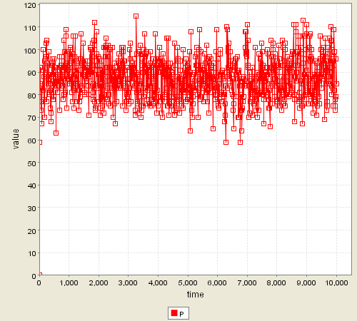
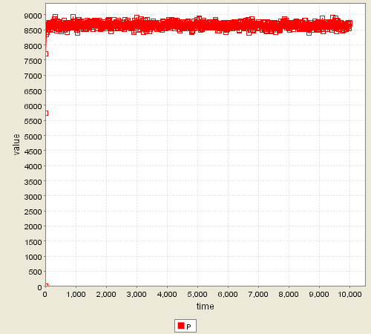
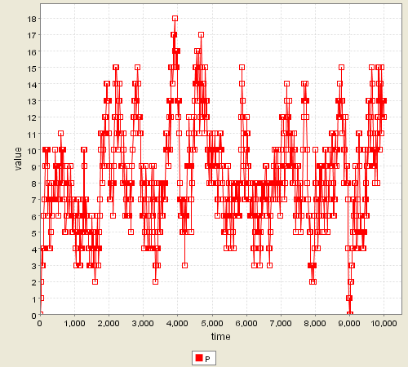
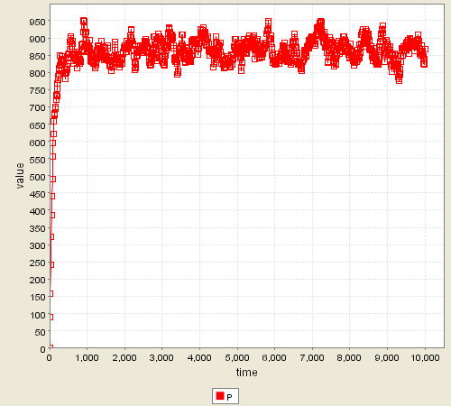
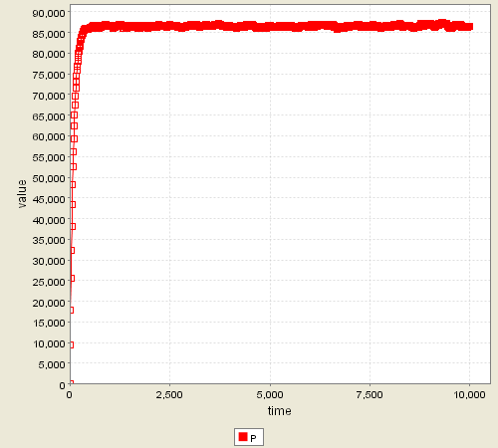
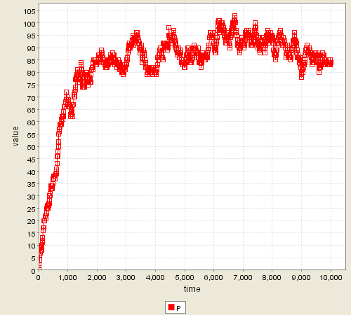
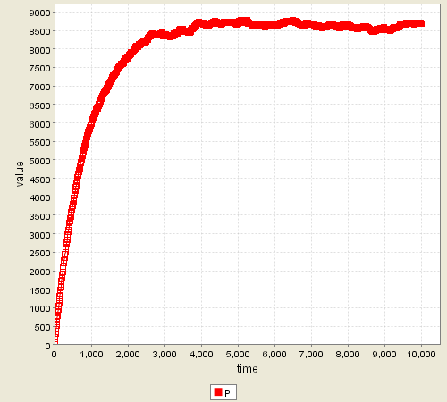
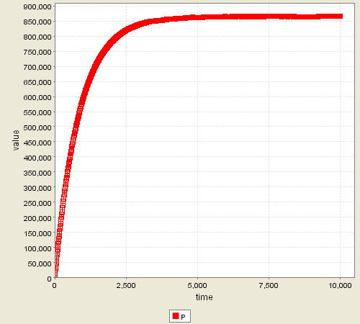
Stochastic simulation: flipping a gene “ON”
synthesis
k=0.1
k=10
k=1000
γ=ln(2)/6
γ=ln(2)/60
γ=ln(2)/600
degradation
D. T. Gillespie, J. Comp. Phys. 22(4), 403-433 (1976); D. T. Gillespie, J. Phys. Chem. 81, 2340-2360 (1977)

Slide 17
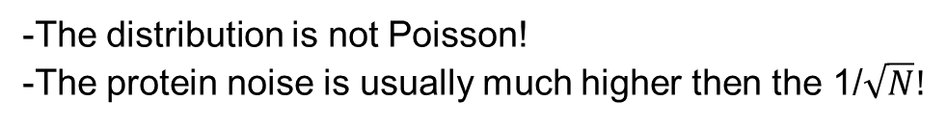
Gene expression is not a simple birth-death process…
-The distribution is not Poisson!
-The protein noise is usually much higher then the 1/$\sqrt{N}!$

Slide 18
Major Sources of Noise
Stochastic effects are especially important when the number of molecules is small and the reactions are slow
DNA replication – gene dosage effects
Transcriptional bursting- ON<>OFF transitions in transcription activation
Translational bursting – each mRNA produces many proteins, variability of mRNA leads to large variability of proteins

Slide 19
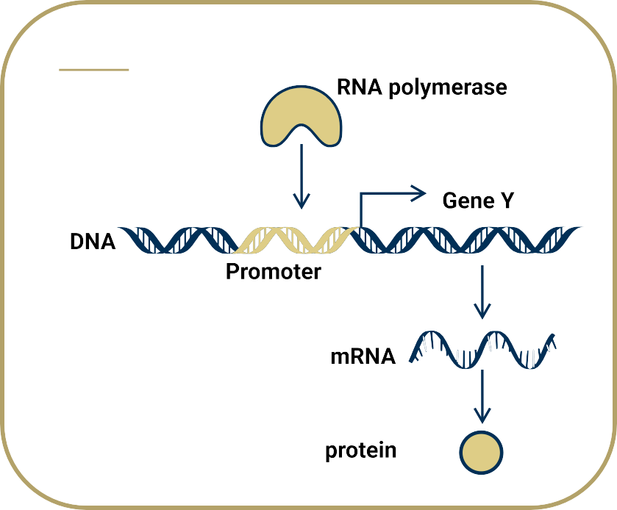
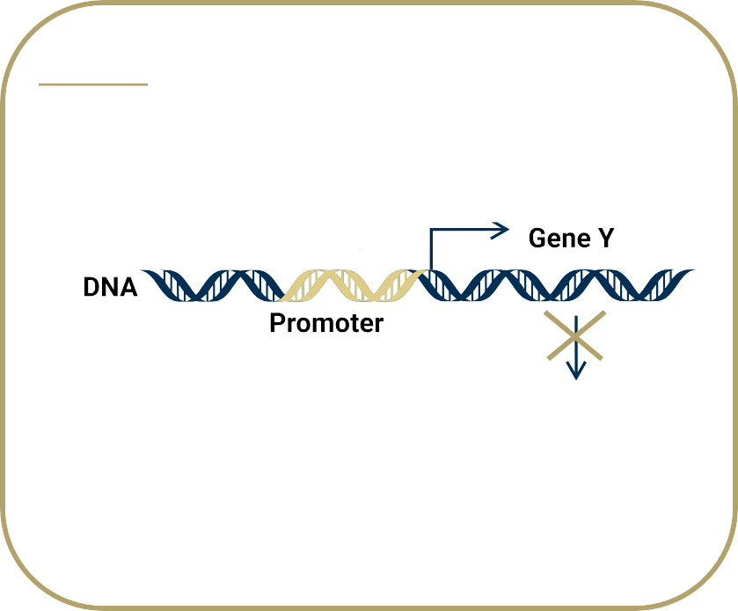

Bursty gene expression
Active and inactive states of the gene
ON
OFF
^{𝑘}𝑜𝑓𝑓
^{𝑘}𝑜𝑛
In deterministic model we can say these are in equilibrium and probabilities
of each state can eb computed
$P_{ON}=\frac{k_{on}}{k_{on}+k_{off}}$; $P_{OFF}=\frac{k_{off}}{k_{on}+k_{off}}$

Slide 20
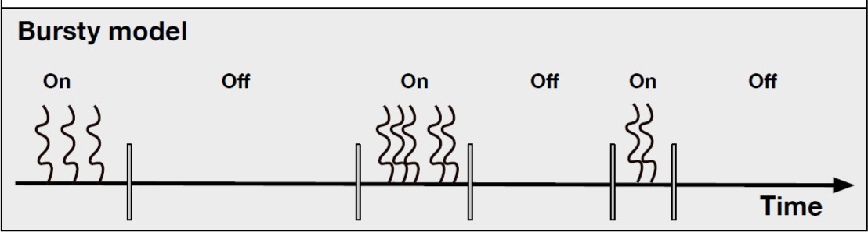
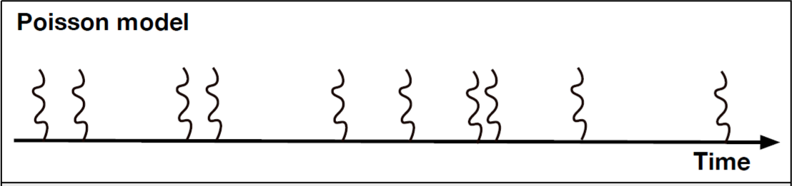
Bursty gene expression
Active and inactive states of the gene
Transition between states:
^{𝑘}𝑜𝑓𝑓
ON OFF
^{𝑘}𝑜𝑛
When the gene is in an active state its expressed at a rate
Even with no transcriptional bursting we get multiples proteins per mRNA
That is called translational bursting

Slide 21
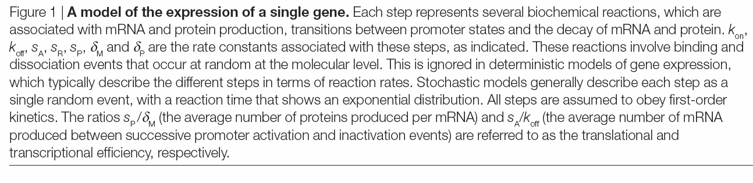
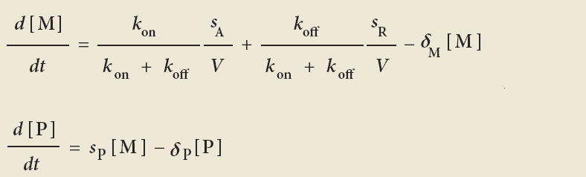
Modeling a Single Gene
Deterministic model

Slide 22
Finite Number Effect
System size is an important factor contributing to stochasticity in gene expression.
FIGS 2a,b: volume and average rate of transcription were decreased 100-fold → same protein concentration
noise tends to increase when the size of the system is decreased.
Finite number effect: characteristic 1/√N scaling of the noise (η ~1/√N)

Slide 23
Translational Bursting
FIG 2a,c: 100-fold decrease in transcription rate, 100-fold increase in translation rate.
‘translational bursting’ mechanism: the amplitude of fluctuations in protein abundance depends on the number of proteins produced per mRNA (burst parameter or translational efficiency)
higher translational efficiency and lower mRNA abundance is predicted to display greater fluctuations in protein concentration and a broader population distribution than the gene with the lower translational efficiency and higher mRNA abundance.

Slide 24
Noise Strength
Noise strength= Fano factor: variance divided by the mean (ϕ = σ²/N).
Because of its ability to discriminate between these situations, the noise-strength measure has proved useful as a tool to interpret experimental data.
It is important, however, to note that increased noise strength does not imply that the relative variability (the coefficient of variation η) is also increased.

Slide 25
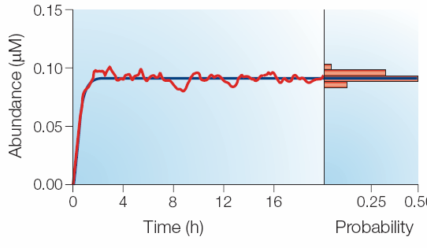
Transcriptional Bursting
Simulation results with reduced promoter transition rates.
Here, the promoter is in the active state for longer, allowing an increased number of mRNAs to be synthesized in rapid succession.
The size of these ‘bursts’ in transcription depends on the average number of transcripts produced between promoter activation and deactivation: transcriptional efficiency.
The transition rates are so slow that the protein abundance (and that of mRNA) tracks the state of the promoter → random transitions between high and low expression states and a bimodal distribution of intracellular protein concentration.

Slide 26
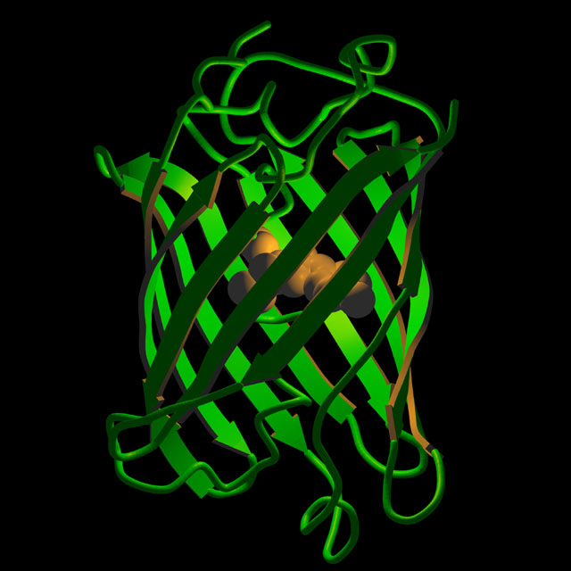
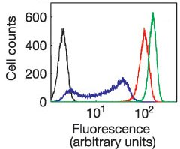
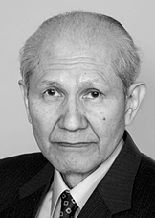
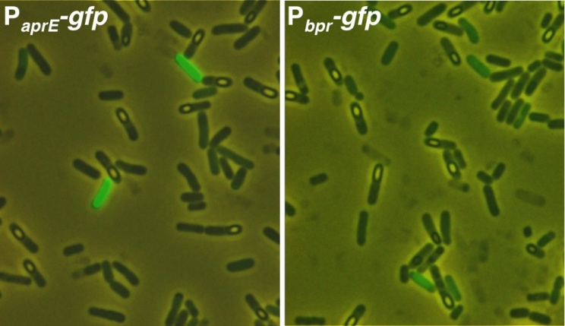
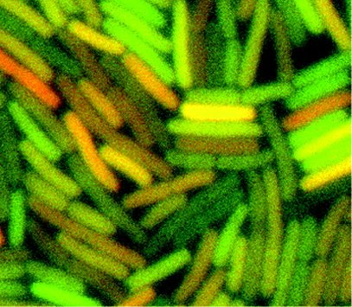
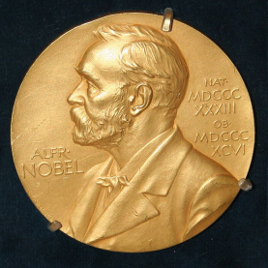
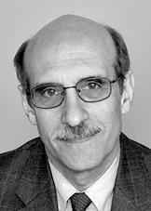
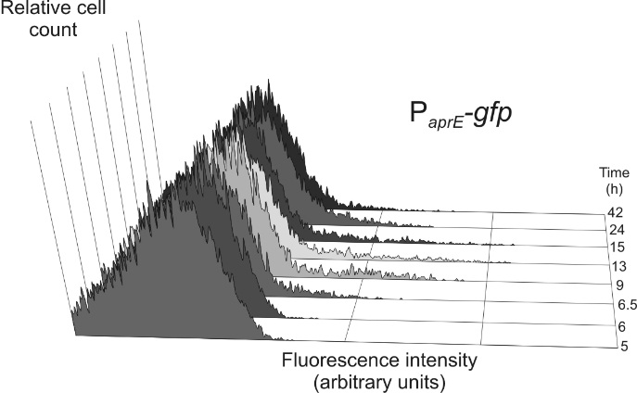
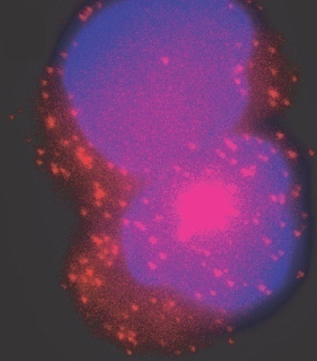
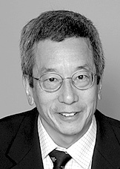
Measuring noise
Green Fluorescent Protein (GFP)
Flow
cytometry
Blake et al., Nature 422, 633 (2003).
Fluorescent reporters or fusions
of the gene of interests
std =
standard
deviation
mean
O. Shimomura
Confocal
microscopy
Elowitz, et al., Science 297, 1183 (2002).
Microscopy
Nobel Prize
Chemistry 2008
M. Chalfie
FISH
Raj et al., PLoS Biol. 4, e309 (2006).
R. Y. Tsien
Flow cytometry

Slide 27
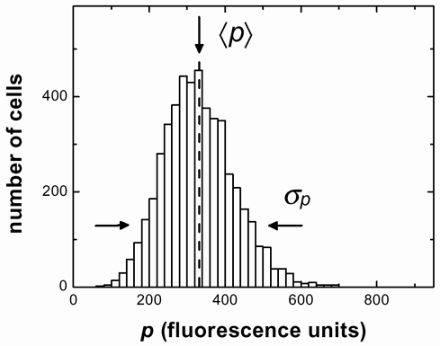
Quantifying noise
Noise =
Coeff. of variation =
CV =STD/mean
Elowitz et al., Science 297, 1183 (2002)
Becskei et al., Nat. Gen. 37, 937 (2005)
Colman-Lerner et al., Nature 437, 699 (2005)
Noise strength =
Fano factor =
f =Var/mean
Ozbudak et al., Nat. Gen. 31, 69 (2002)
Blake et al., Nature 422, 633 (2003)
Raser & O’Shea, Science 304, 1811 (2004)

Slide 28
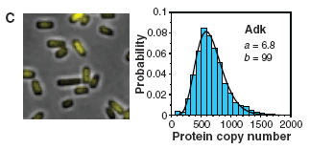
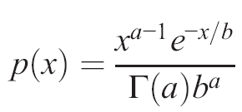
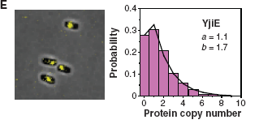
Bursty gene expression leads to Gamma distribution of proteins
a = mean no. of bursts per protein lifetime
b = mean burst size
Gamma Distribution
Distribution of most proteins in bacteria is well described by the gamma distribution

Slide 29
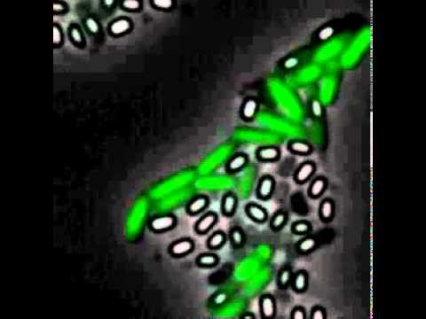
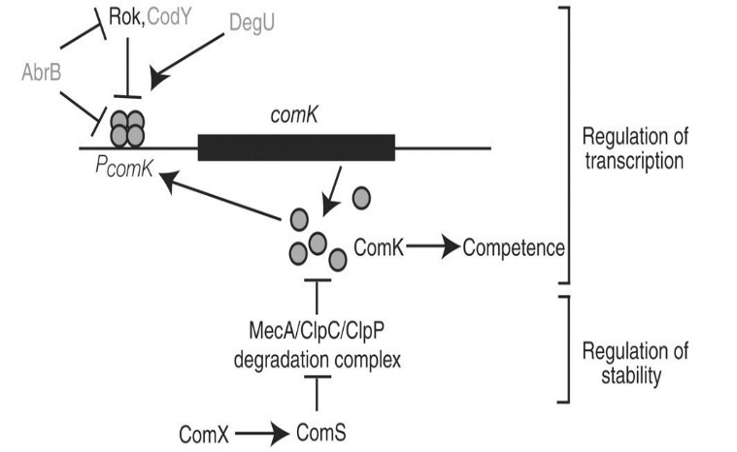
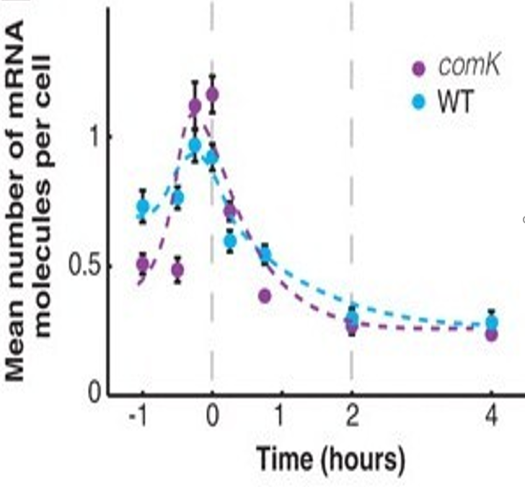
Physiological consequence of gene expression noise – stochastic differentiation
Controlling network:
Pos. feedback+cooperativity=bistability
At the onset of stationary phase the basal transcription rate of ComK increased and protein degradation decreased.
That is insufficient for deterministic switching. Low ComK is still a stable state.
However high-fluctuation burst in gene expression can lead to stochastic activation

Slide 30
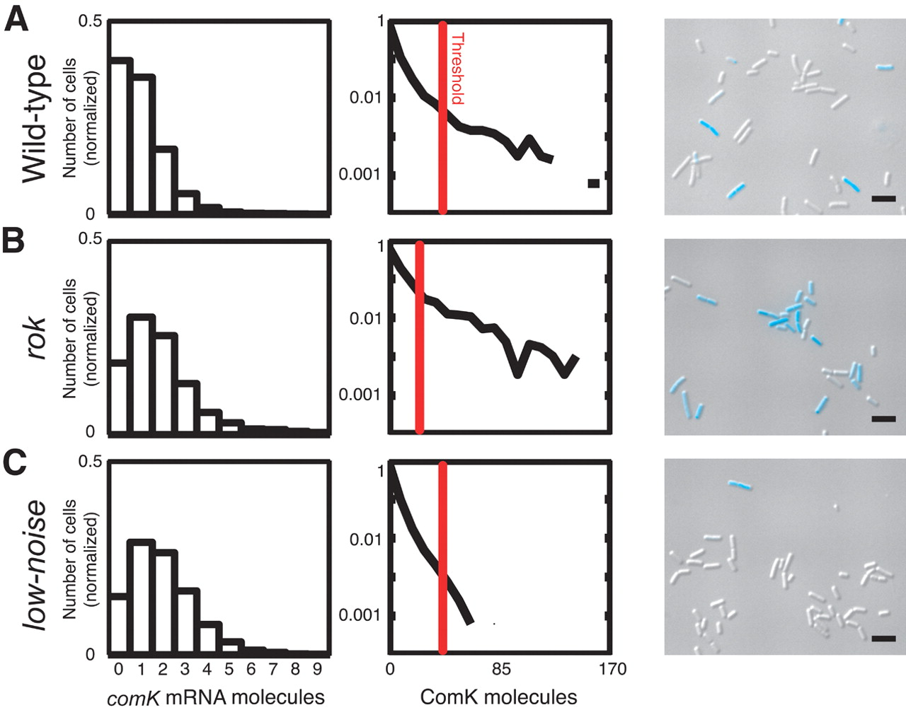
Noise controls switching fraction!
Fraction competent cells
15%
25%
Decreased translation 2x but increased transcription 2x
<1%

Slide 31
Take-home messages
All cell chemistry is stochastic; stochasticity matters when not enough averaging – slow reactions, small copy-numbers
Noise propagates to protein copy-numbers from switches at the promoter and from mRNA
Therefore even with large number of proteins stochastic effect play a big role
Noise can lead to stochastic switching in a bistable switch

Slide 32
The goals of the lab
Practice stochastic simulations with direct coding of Gillespie algorithm and with Simbiology
Understand the effects of transcriptional and translational bursting on noise
Understant the effects of positive and negative autoregulation on noise

