Slide 1
ENGI 301 Etch-A-Sketch PCB
12/12/2023
Robert Heeter

Slide 2
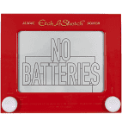
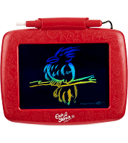
Background Information
PCB for an “Etch-a-Sketch”
Hardware
PocketBeagle
SPI screen
Potentiometer x2
Left, Right
Button x2
1 - reset the game
2 - change color
LED x3
Red, Green, Blue
USB host

Slide 3
System Block Diagram
5V
3.3V
USB host
PocketBeagle
VCC
SPI screen
USB
SPI
SPI
VCC
USB
SPI
GPIO
GPIO
GPIO
GND
3.3V
GND
GND
1k
Button (1)
1.8V
Potentiometer (right)
3.3V
GPIO
1k
Button (2)
AIN
GPIO
AGND
LED (blue)
GPIO
1.8V
Potentiometer (left)
GPIO
AIN
LED (green)
AGND
GPIO
LED (red)

Slide 4
Mechanical Drawing
4.2”
SPI screen (2.8”)
0.8”
PocketBeagle
1.45”
R
1.2”
0.6”
USB host
G
0.6”
3.2”
B
1.2”
LEDs
Pot. left
But.
2
Pot. right
But.
1
0.4”
1.0”
2.2”
1.85”
0.4”
3.1”
3.8”
FRONT
BACK

