Slide 1
SNUBH Sepsis
w/ Korean Sepsis Alliance S Y Lim

Slide 2
Antibiotics

Slide 3
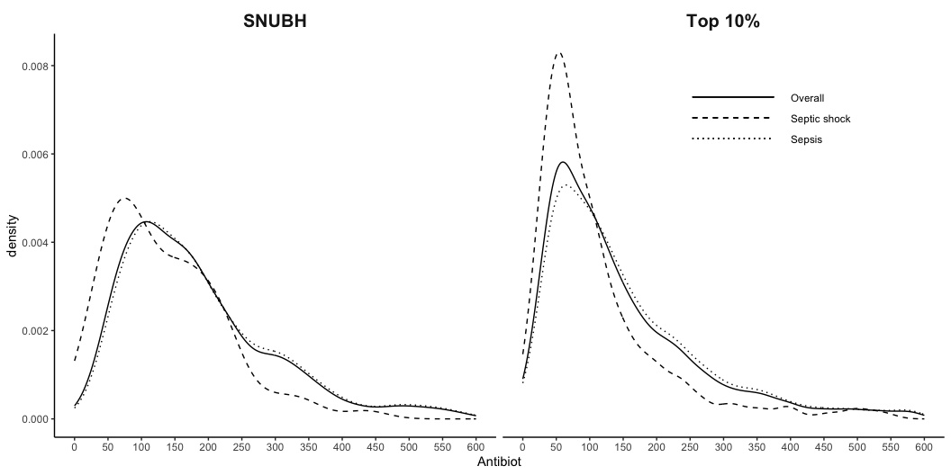
TZ ~ Antibiotics: SNUBH vs Top 10

Slide 4
TZ ~ Antibiotics: SNUBH vs Top 10
Variable | SNUBH |  |  |  | Top 10%
 | Overall N = 690 | Septic shock N = 68 | Sepsis N = 622 | p-value | Overall N = 3,955 | Septic shock N = 714 | Sepsis N = 3,241 | p-value
Antibiot | 158 [101-235] | 113 [65-176] | 161 [105-243] | <0.001 | 110 [61-192] | 78 [49-133] | 120 [68-204] | <0.001

Slide 5
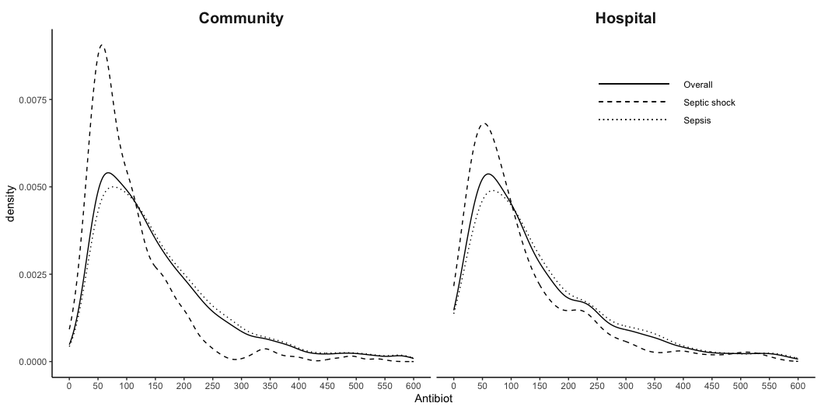
TZ ~ Antibiotics: Community vs Hospital

Slide 6
TZ ~ Antibiotics: Community vs Hospital
Variable | Community |  |  |  | Hospital
 | Overall N = 2,764 | Septic shock N = 359 | Sepsis N = 2,405 | p-value | Overall N = 1,881 | Septic shock N = 423 | Sepsis N = 1,458 | p-value
Antibiot | 122 [72-200] | 79 [53-126] | 130 [79-210] | <0.001 | 108 [59-200] | 83 [47-154] | 118 [62-214] | <0.001

Slide 7
Blood culture

Slide 8
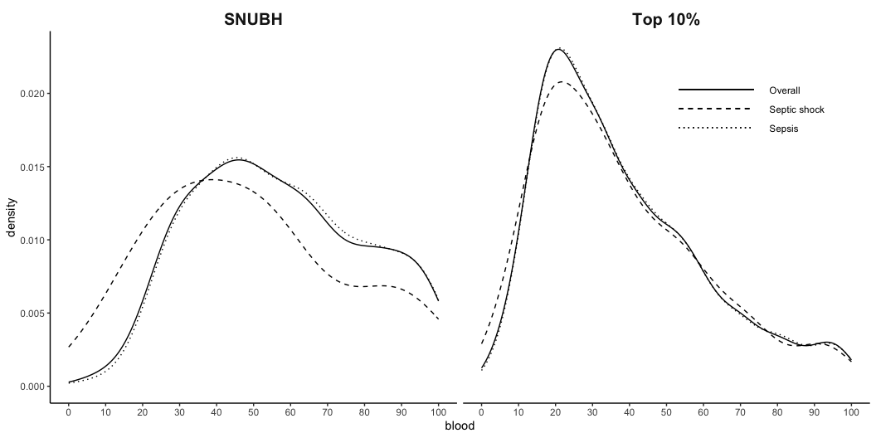
TZ ~ Blood culture: SNUBH vs Top 10%

Slide 9
TZ ~ Blood culture: SNUBH vs Top 10%
Variable | SNUBH |  |  | Top 10%
 | Overall N = 264 | Septic shock N = 19 | Sepsis N = 245 | Overall N = 2,847 | Septic shock N = 485 | Sepsis N = 2,362
blood | 54 [40-76] | 49 [29-62] | 56 [40-76] | 33 [21-51] | 32 [20-51] | 33 [21-51]

Slide 10
Bundle compliance

Slide 11
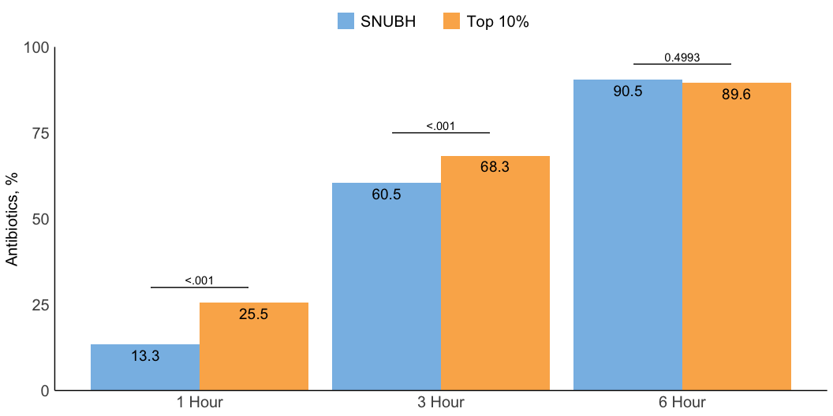
Antibiotics 1~6h

Slide 12
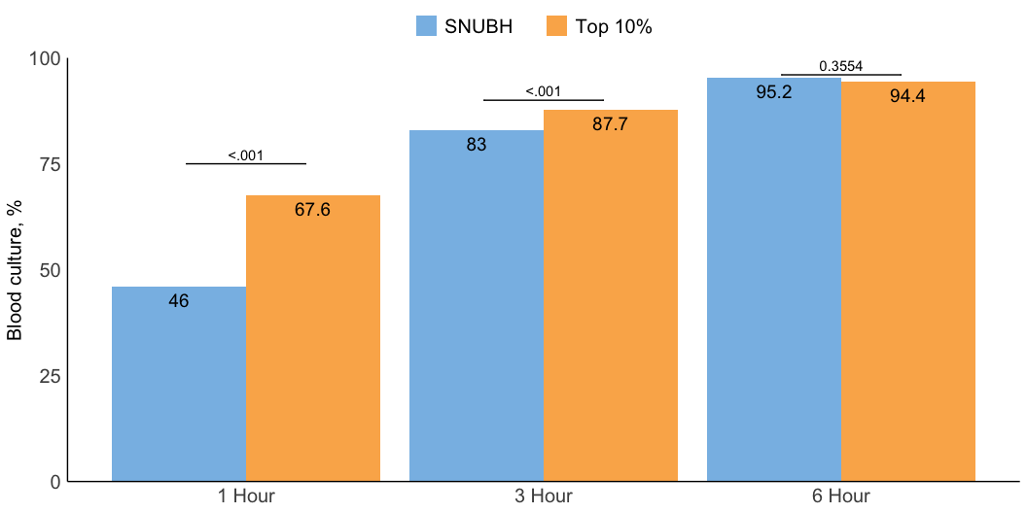
Blood culture 1~6h

