Slide 1

Streamlining your life, one note at a time

Slide 2

A Common Issue
Picture this: you want to play piano music on the clarinet. Just play the piano sheet music. Easy right?
Well...
The piano is in the key of C whereas the clarinet is in the key of Bb. So now you have to transpose every note on the music two half steps up!

Slide 3
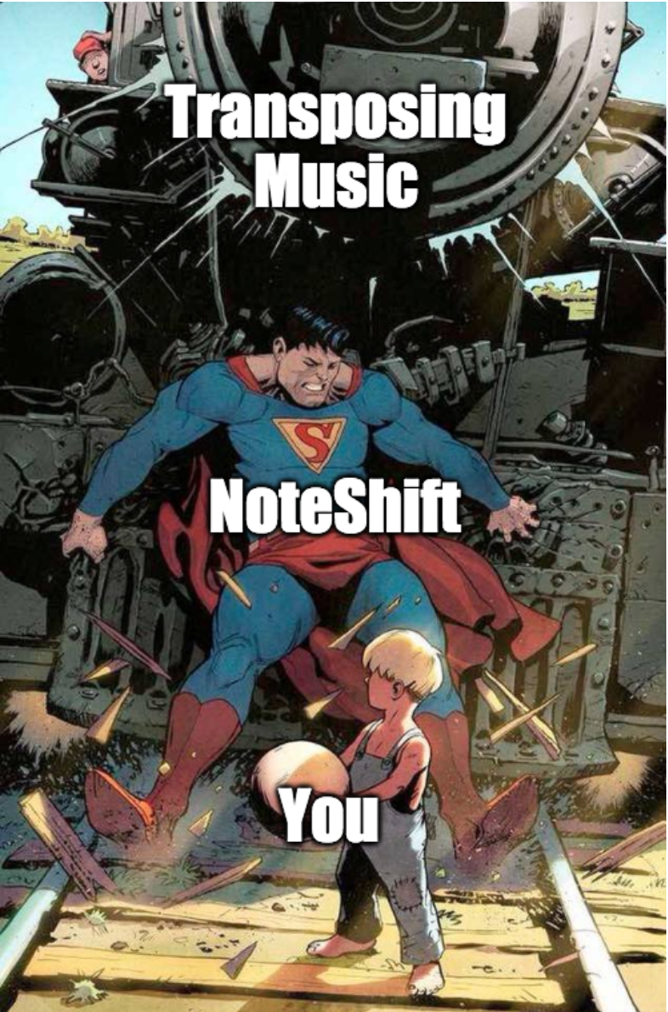
A Convenient Solution
That’s where NoteShift comes into play. With its simple UI, anyone can easily go to our website, upload an image of their sheet music, and get their music transposed!

Slide 4

How Does NoteShift Work?
Scans your document, automatically crops out edges of the paper, and applies perspective correction
Converts your .jpg/.pdf file into music data
Gathers user input from the UI
Transposes music based off the user input
Displays transposed music in a downloadable .pdf file

Slide 5

Where can NoteShift be used?
Anywhere with internet! All the user needs to do is take a picture of their music and upload it to our website.
Singers/Vocalists who want to sing in a lower/higher register can transpose the music up/down with ease
When you want to learn song from a different instrument
When you get new music and don’t want to transpose by hand for an hour
Teachers can transpose music to a nicer key for beginning students
And much much more!

Slide 6
Future Goals/Features

Slide 7
Sources/Libraries
[1] https://docs.opencv.org/trunk/da/d54/group__imgproc__transform.html
[2] https://github.com/Audiveris/audiveris
[3] https://www.musicxml.com/tutorial/the-midi-compatible-part/pitch/
[4] https://musescore.org/en/handbook/3/command-line-options

Slide 8
Now onto the demo...

