Slide 1
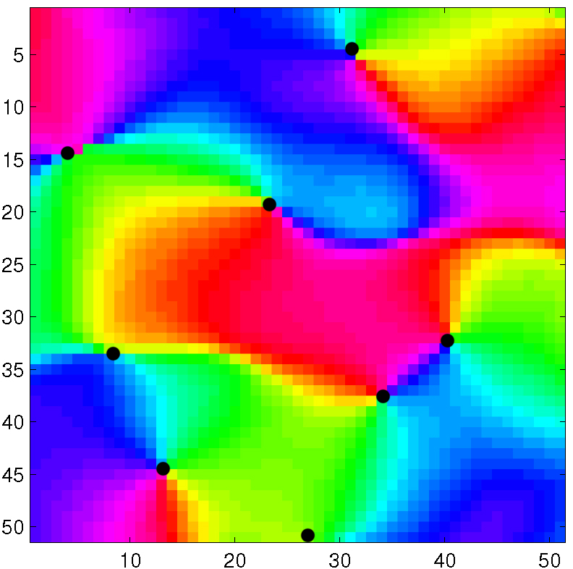
513x513: 375-425; 200-250

Slide 2
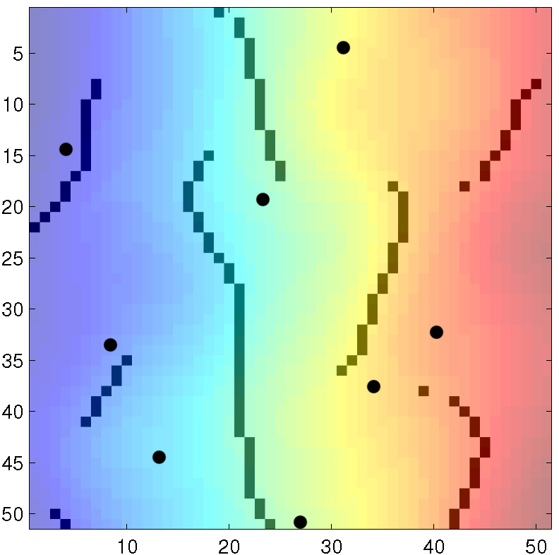
Azimuth

Slide 3
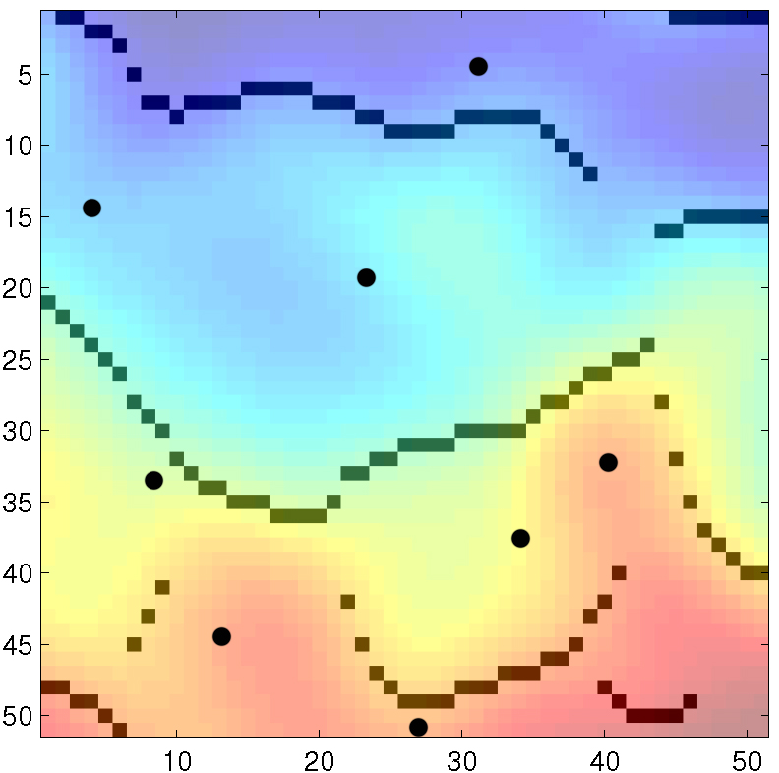
Elevation

Slide 4
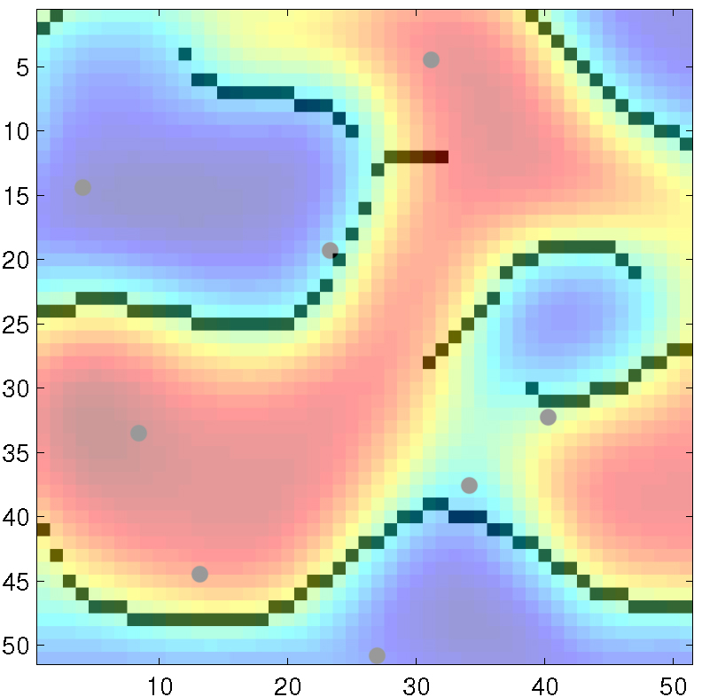
Spatial Frequency

Slide 5
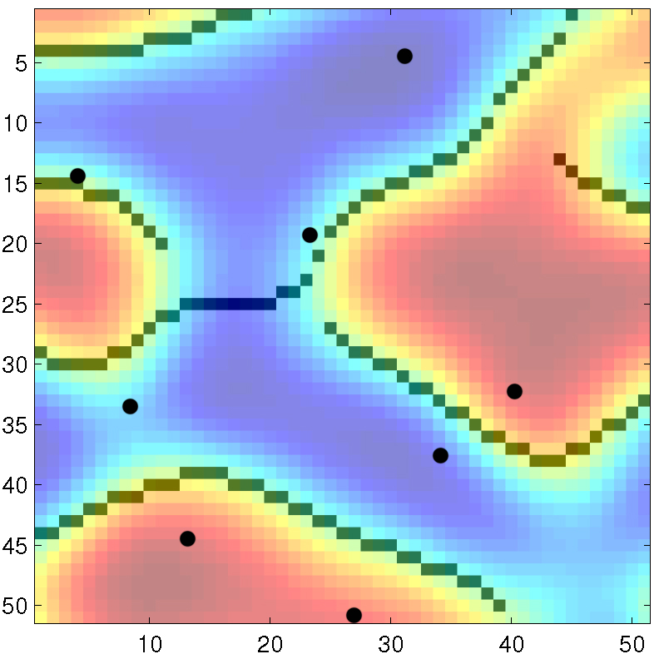
Ocular Dominance

Slide 6
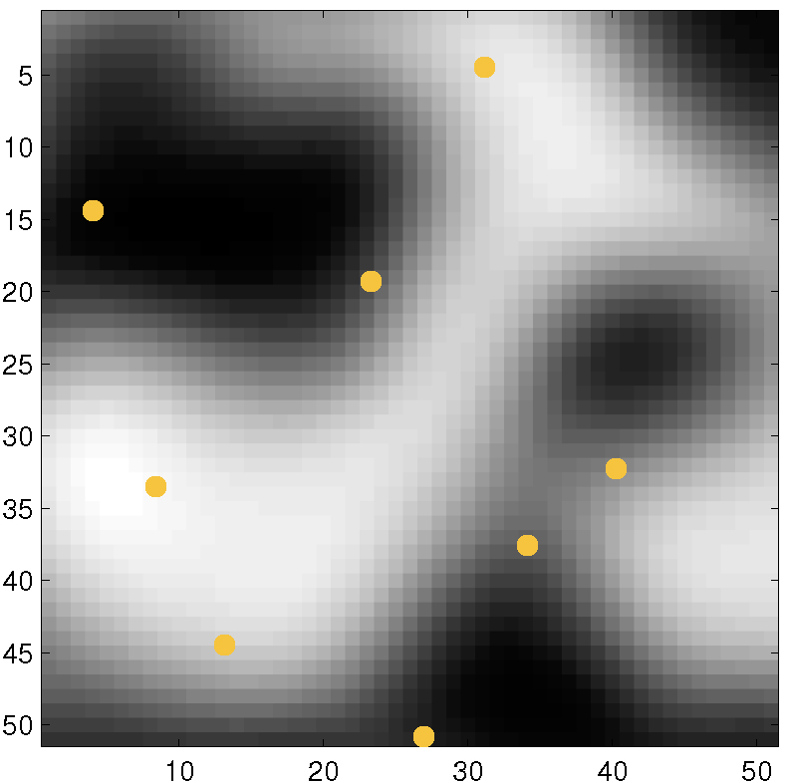
Spatial Freq - gray

Slide 7
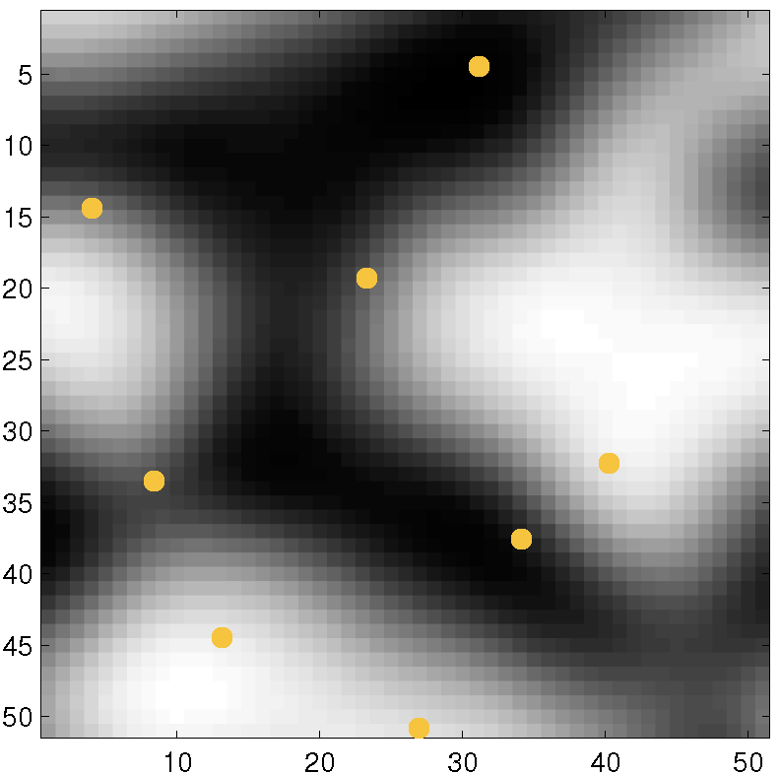
Oc Dom - gray

