Slide 1
central biological question: Are the odds of death significantly different between treatments?
Mortality <=? Treatment

Slide 2
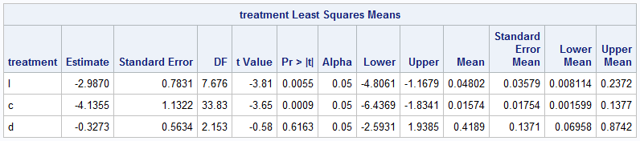
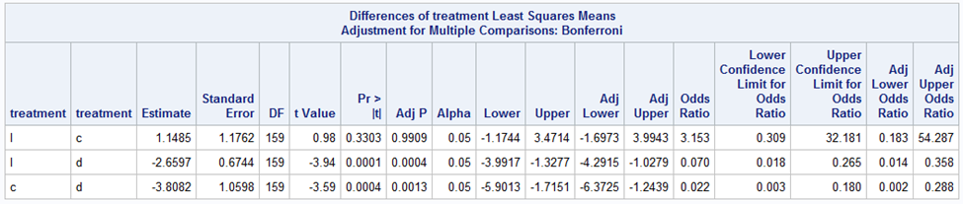
Red: natural log odds (NLO) (how likely death is / how likely life is) (negative => odds are small) ORANGE: p value (whether differences in NLO between treatments are significant)

Slide 3
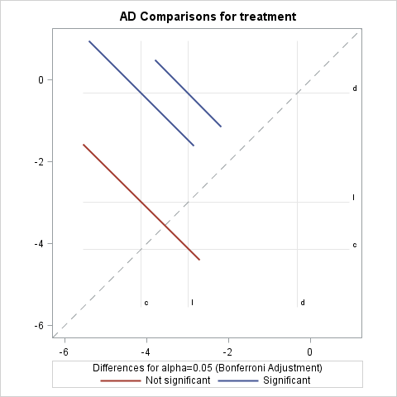
Are the odds of death significantly different between treatments?
Diffogram
NLO comparison of direct and indirect treatments
Axes: NLO
Center of the line: NLO comparisons
Line: confidence interval
direct vs control
indirect vs control

Slide 4
BIOLOGICAL QUESTION:
What are the odds of death for each treatment?
PROS:
Shows how different the NLO are
CONS:
Line has no meaning and distracts
Doesn’t show significance
Doesn’t show confidence interval

