Slide 1
Forecasting Avocado Prices
Avocado King can use data to optimize profits
Renel Chesak, MSc Data Science
Winter 2020

Slide 2
The problem
Company
Context
Problem statement
Avocado King , a major distributor of avocados across the USA
Avocado prices fluctuate based on a variety of factors
Avocado King stores historical sales and price data
Google provides historical search data
There is a need to forecast avocado prices to enable company-wide financial planning

Slide 3
Challenges deep-dive
Understand data
Prepare data
Model prices
Through data visualization, we can better see relationships in the data and develop analytical approach
The data given has a unique key: [date, region, type]
Data must be cleaned and normalized carefully with key in mind
Utilize sound statistical analyses and machine learning to model prices
Random forest regression
Linear regression

Slide 4
Solution
On average, the selected model predicts avocado prices within 11 cents of the true value.
Linear Regression
Notes:
Forecasting 1 week ahead
Mean absolute error = 0.11

Slide 5
84%
of variation seen in price is explained by the selected model
Notes:
R-squared = 83.72% (coefficient of determination)

Slide 6
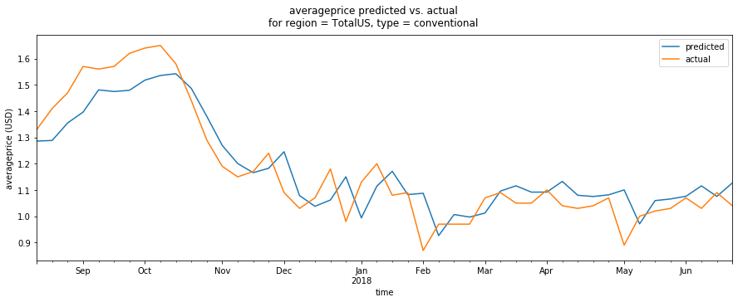
Model performance
Notes:
Validation set

Slide 7
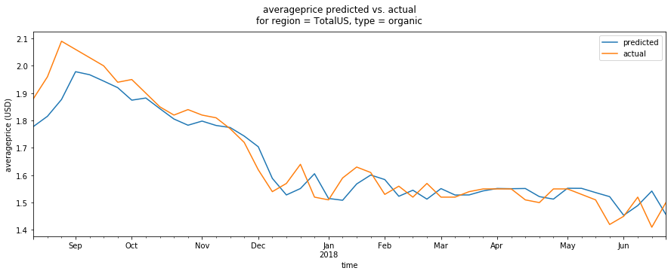
Model performance
Notes:
Validation set

Slide 8
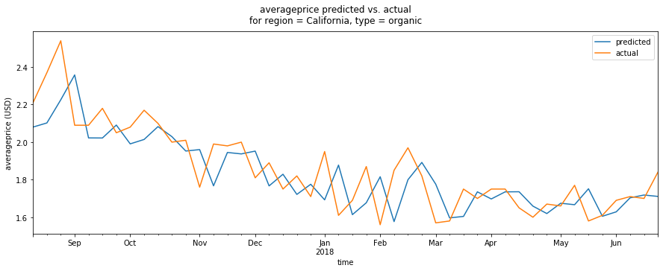
Model performance
Notes:
Validation set

Slide 9
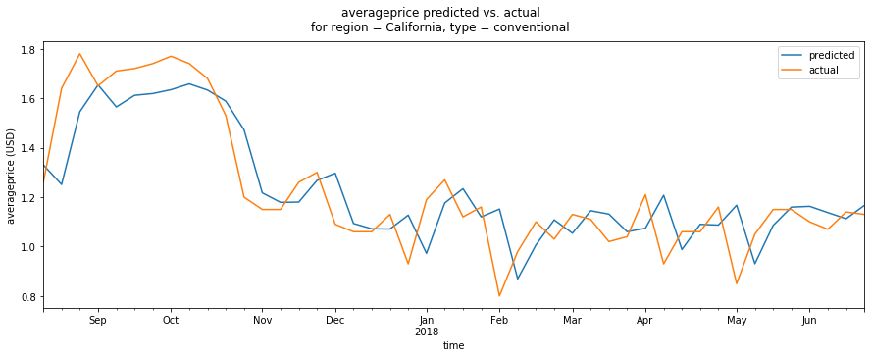
Model performance
Notes:
Validation set

Slide 10
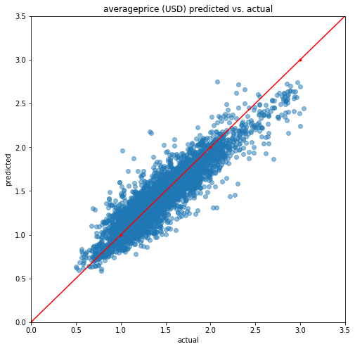
Model performance
Notes:
Validation set

Slide 11
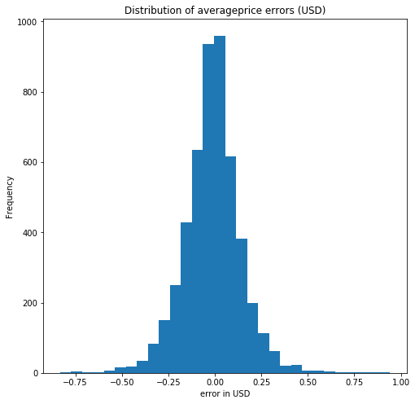
Model performance
Notes:
The errors are approximately normally distributed, meaning the model is low in bias.
Validation set

Slide 12
Impact
max growth
Forecast prices => Plan ahead
=> Optimize profits
=> Maximize growth

Slide 13
Next steps
This proof of concept can be expanded upon:
Higher accuracy
Forecasting weekly, monthly, quarterly, yearly
Forecasting volume sold

Slide 14
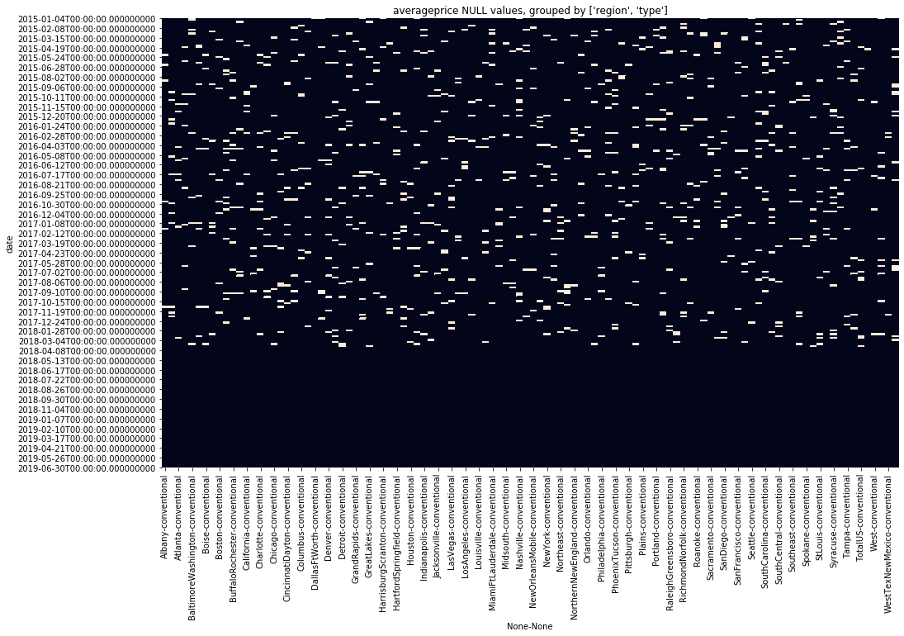
Technical details
Data cleaning
There is a unique key for this dataset: [date, region, type]. We ensured no data was missing:
Check for extra dates (out of expected weekly sequence)
Check for missing dates (based on expected weekly sequence)
Use forwardfill to fill nulls
Use backwardfill to fill remaining nulls
Each unique key combination was visualized:

Slide 15
Technical details
Time shifting
In forecasting, we use values from this week predict next week’s values. So we shifted the data accordingly.
Drop the latest date in x
(since it doesn't have an associated future y at t+1)
Add 7 days to each date in x
Drop the earliest date in y
(since it doesn't have a corresponding past x at t-1)
Join the x (t-1) and y (t) dfs on the unique key [date, region, type]
Predictors
Jan.
Jul.
Dec.
Average price
Jan.
Jul.
Dec.

Slide 16
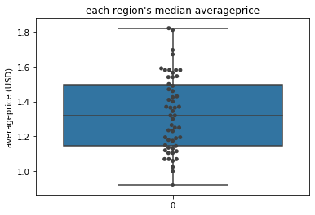
Technical details
The data
All predictive variables were shifted 1 week back to enable forecasting 1 week ahead.
Average price (per avocado, USD)
Region group
Total volume (avocados sold)
Total bags (bags sold)
“Avocado recipe” (google search)
Season (spring, summer, fall, winter)
Type (conventional, organic)
Notes:
Average_price was included because at time t-1, it correlates strongly (r = 0.6) with average_price at time t
Region_group was created to reduce the number of features in the model (reduce overfitting) while preserving the important relationship between geography and price.
Total_volume, total_bags, and “avocado recipe” (google search) were chosen because when grouped by region_group, they correlated weakly (r = 0.2) to moderately (r = 0.5) with average_price.
Season was added because avocados from Mexico come in season in the fall and winter. 70% of avocados sold in the USA are sourced from Mexico.
Type was important to include because in the exploratory visualizations, organic can be seen as almost always more expensive

Slide 17
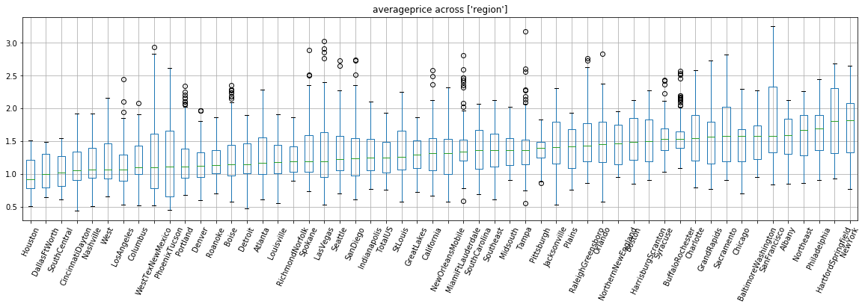
Technical details

Slide 18
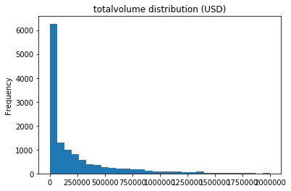
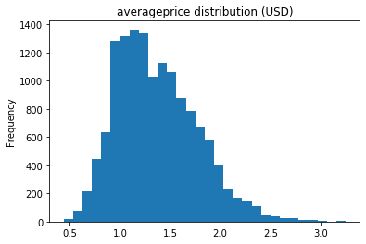
Technical details
Normalization
All numeric predictive variables were tested via several normalization methods, seeking to best preserve the original distribution
Z-score
Methods for preserving skewed distributions (e.g. Pareto):
MinMax
Log + MinMax
Cube Root + MinMax
Z-score normalized:
Total volume
Total bags
“Avocado recipe” (google search)
Left average price on its original scale to preserve distribution. Original was scale not big enough to overpower other predictors.
Notes:
MinMax Normalization seems to preserve the shape of the normally distributed data best, but Z-score Standardization seems to work best in preserving the Pareto-distributed data. However using both will mean that there will be a mix of data centered at zero and data in the range [0, 1]. It is best to have all variables on the same scale. Since `averageprice` is the main target of interest, is normally distributed, and falls in the relatively small range [0.44, 3.25], we will leave it on its original scale and use Z-score normalization on the rest.
Log + MinMax and Cube Root + MinMax normalization don't seem to improve over just MinMax scaling.

Slide 19
Technical details
Train / Validation / Test split
Since this is time series data, we want full years (with all their seasonal variations) to exist in the train, validation, and test set.
training set:
Jan 2015 - July 2017
validation set:
August 2017 - July 2018
test set:
August 2018 - July 2019
training set:
58%
validation set:
21%
test set:
21%

Slide 20
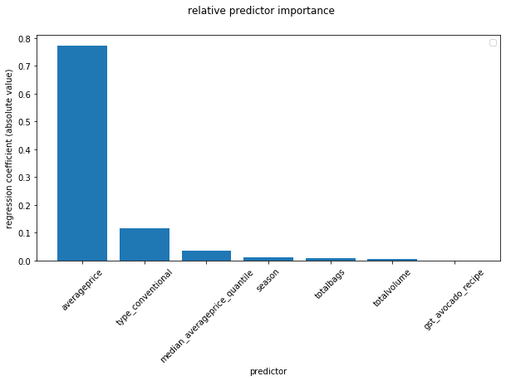
Technical details
Predictor importance
Based on the model, the rank of importance is:
Average price (per avocado, USD)
Type (conventional, organic)
Region group (median_averageprice_quantile)
Season (spring, summer, fall, winter)
Total bags (bags sold)
Total volume (avocados sold)
“Avocado recipe” (google search)

Slide 21
Technical details
Error Metric
Mean absolute error was used when evaluating model performance:
Enables us to intuitively understand how accurate our predictions will be, on average.
MAE = 0.11
“On average, the model predicts avocado prices within 11 cents of the true value.”

