Slide 1
DevOps
Raghuram Chilamakuri(Programmer Analyst)
And
Sandeep battula(Programmer Analyst)
Mentors: Santosh Soni , Subash Meda, Poonam Gupta.
Work Manager: Praneeth Buggaveeti
DevOps Engineer.

Slide 2
Deploying the GoLang Application in GCR
Step 1: Pulling source code and Docker file from git repository.
Step 2: creating the image using the Jenkins pipeline.
Step 3: Tagging the local image with the google cloud image for running a container.
Step 4: Deploying the Golang application in the generated URL.
Step 5: Running the container with the necessary corrections from GitHub.

Slide 3
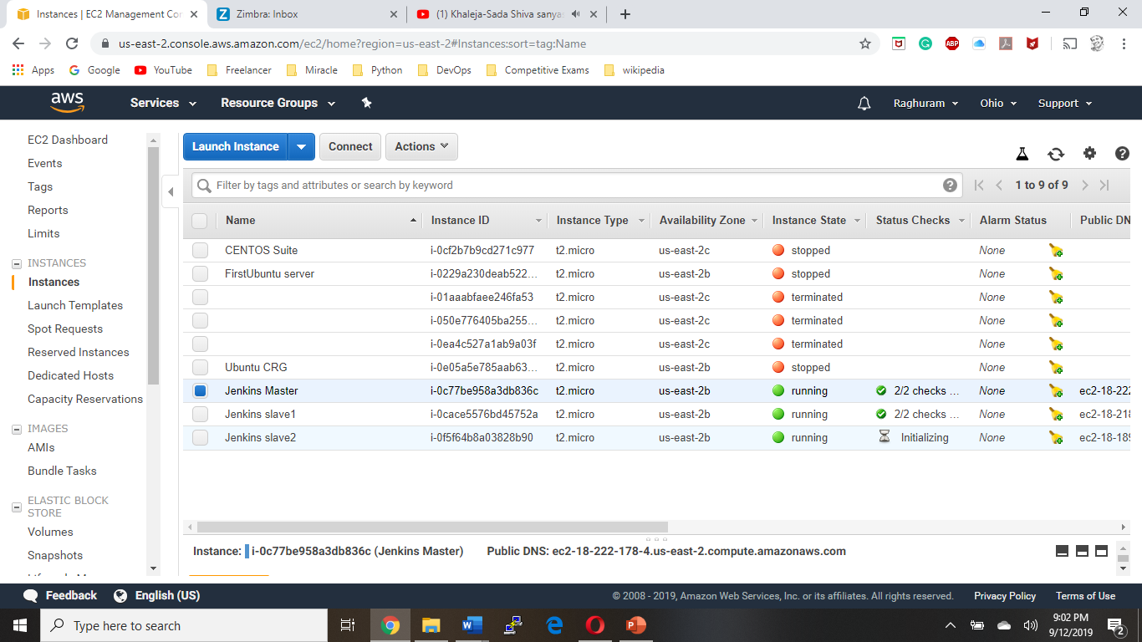
Installing Virtual machines in AWS
Installing ubuntu servers for all three Master, Slave-1, Slave-2.

Slide 4
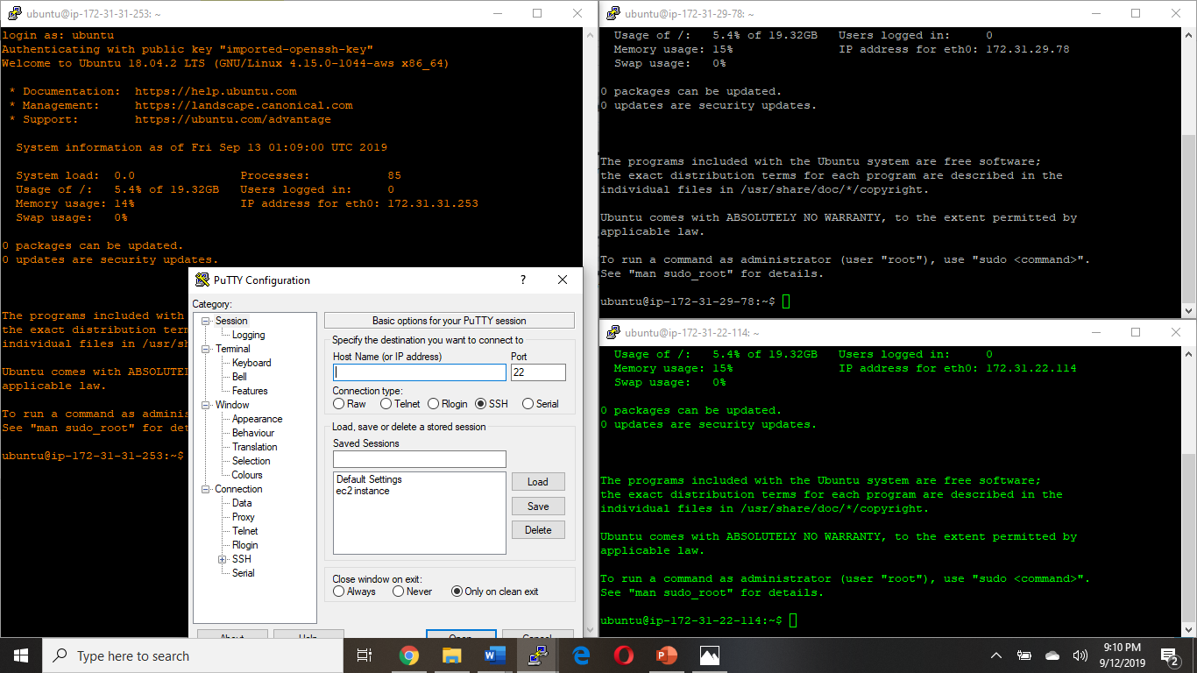
Connecting to Virtual machines using putty

Slide 5
Installing Docker in the Master Jenkins
Following commands are used for installing the Docker in virtual machine.
curl -fsSL https://download.docker.com/linux/ubuntu/gpg | sudo apt-key add –
sudo add-apt-repository "deb [arch=amd64] https://download.docker.com/linux/ubuntu $(lsb_release -cs) stable edge"
apt-cache policy docker-ce
sudo apt-get install -y docker-ce
sudo systemctl status docker

Slide 6
Installing Jenkins in Jenkins master
Following the list of commands to install Jenkins.
sudo apt update
sudo apt install openjdk-8-jdk
wget -q -O - https://pkg.jenkins.io/debian/jenkins.io.key | sudo apt-key add –
sudo sh -c 'echo deb http://pkg.jenkins.io/debian-stable binary/ > /etc/apt/sources.list.d/jenkins.list’
sudo apt update
sudo apt install Jenkins
systemctl status Jenkins

Slide 7
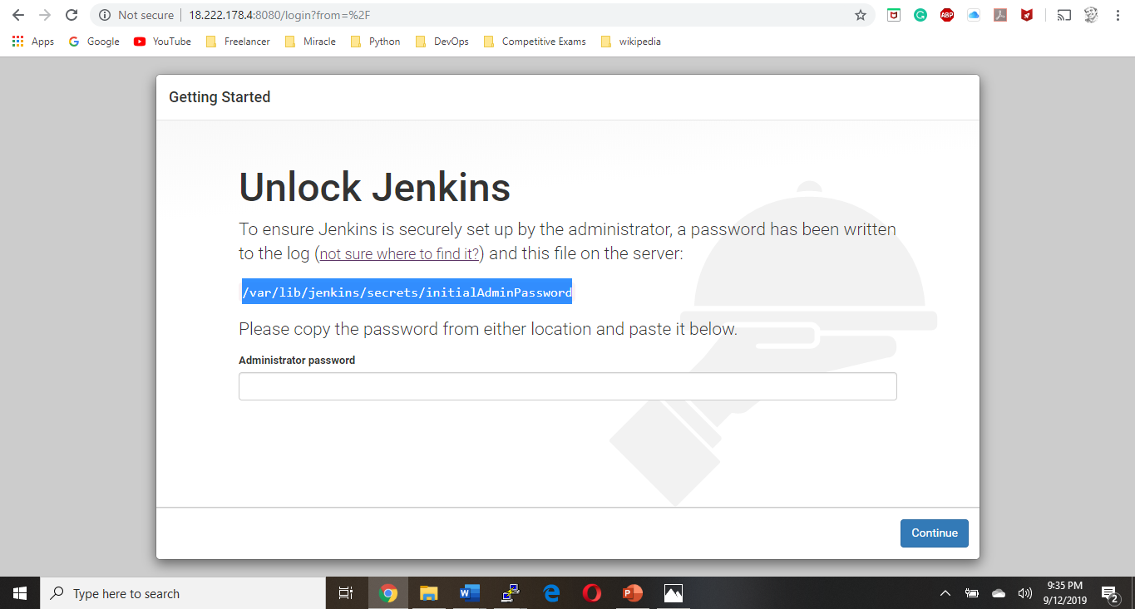
Running Jenkins in Server

Slide 8
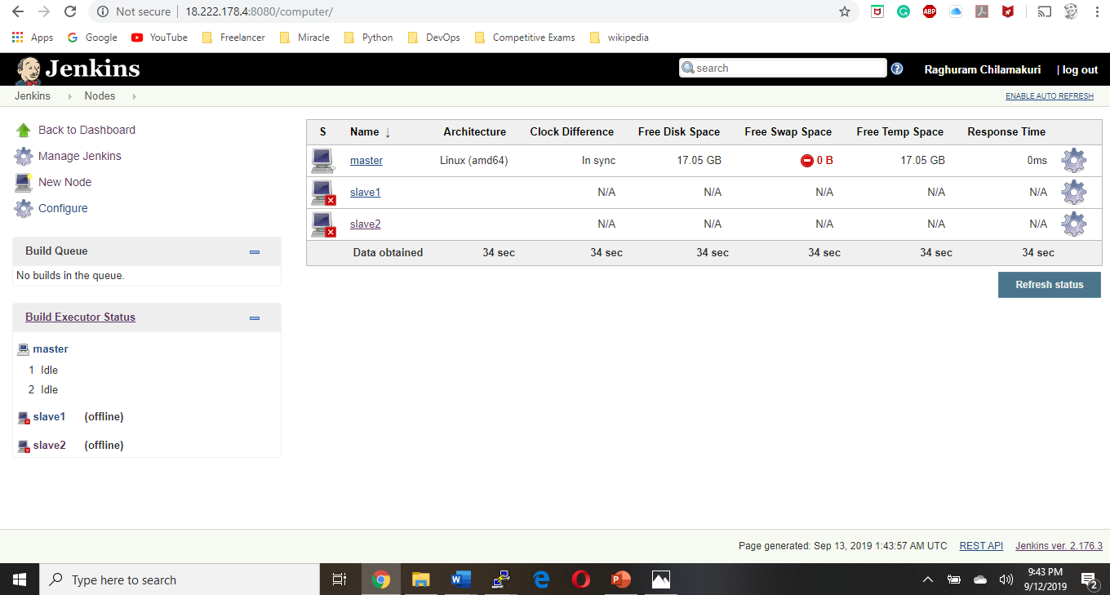
Creating nodes to master Jenkins

Slide 9
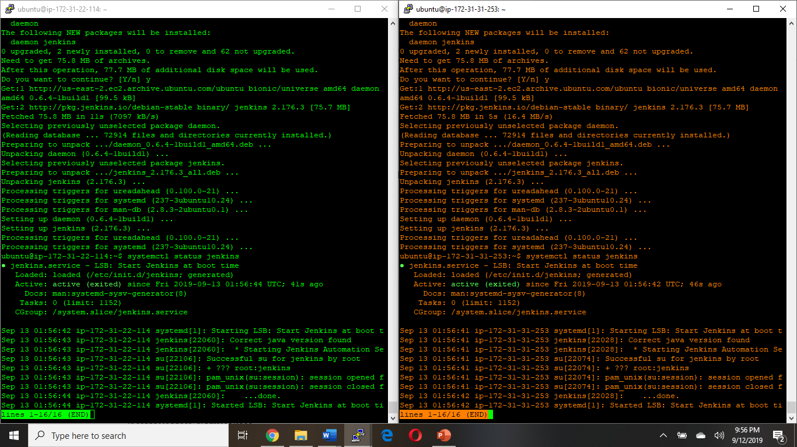
Installing Docker and Jenkins in both slave nodes

Slide 10
Node 1 & 2 Configuration
Build Commands for Node 1
sudo docker rm -f $(sudo docker ps -a -q)
sudo docker build /home/ubuntu/workspace/TestGo -t testimage1
sudo docker run -it -p 82:8080 -d testimage1
Build Commands for Node 2
sudo docker build /home/ubuntu/jenkins/workspace/ProdGo -t testimage2
sudo docker tag testimage2 gcr.io/jenkinsgoapi-project/testimage2:$BUILD_NUMBER
sudo docker push gcr.io/jenkinsgoapi-project/testimage2:$BUILD_NUMBER

Slide 11
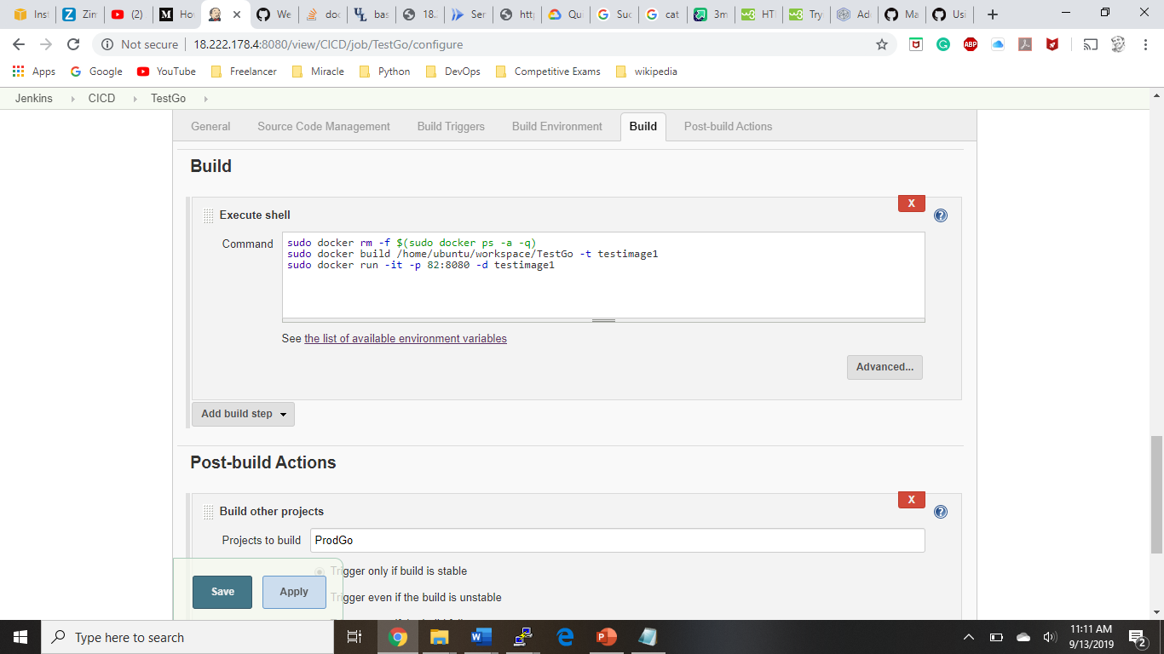
Node Configuration

Slide 12
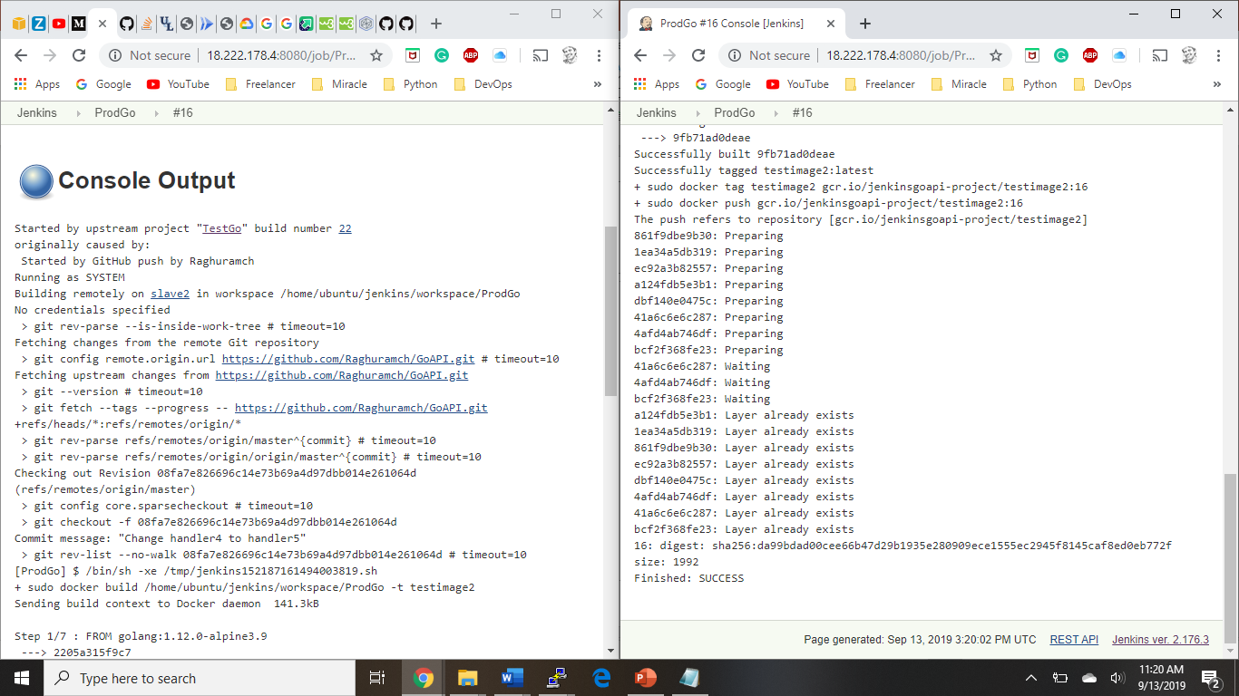
Output for Building Node

Slide 13
Thank You

