Slide 1
Progress Report 3
Raja Chinnakotla

Slide 2
Question
What role does composition of a district play in inter-communal violence?
Motivation:
Gap in literature
Exploit 2001 Census
I’ve been head banging a lot!

Slide 3
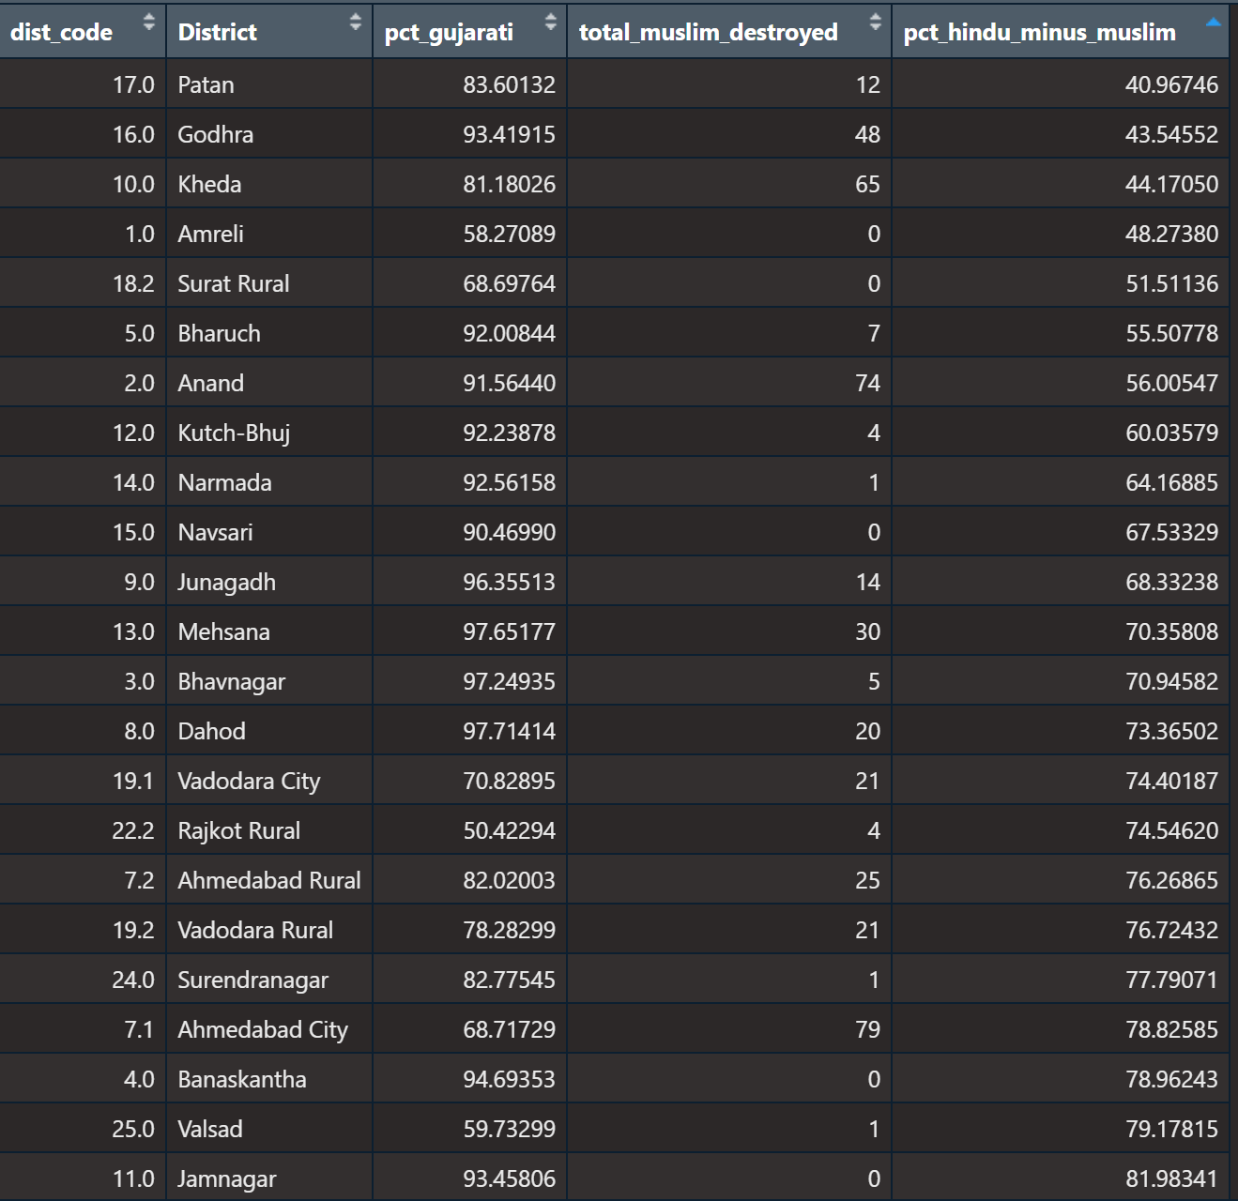
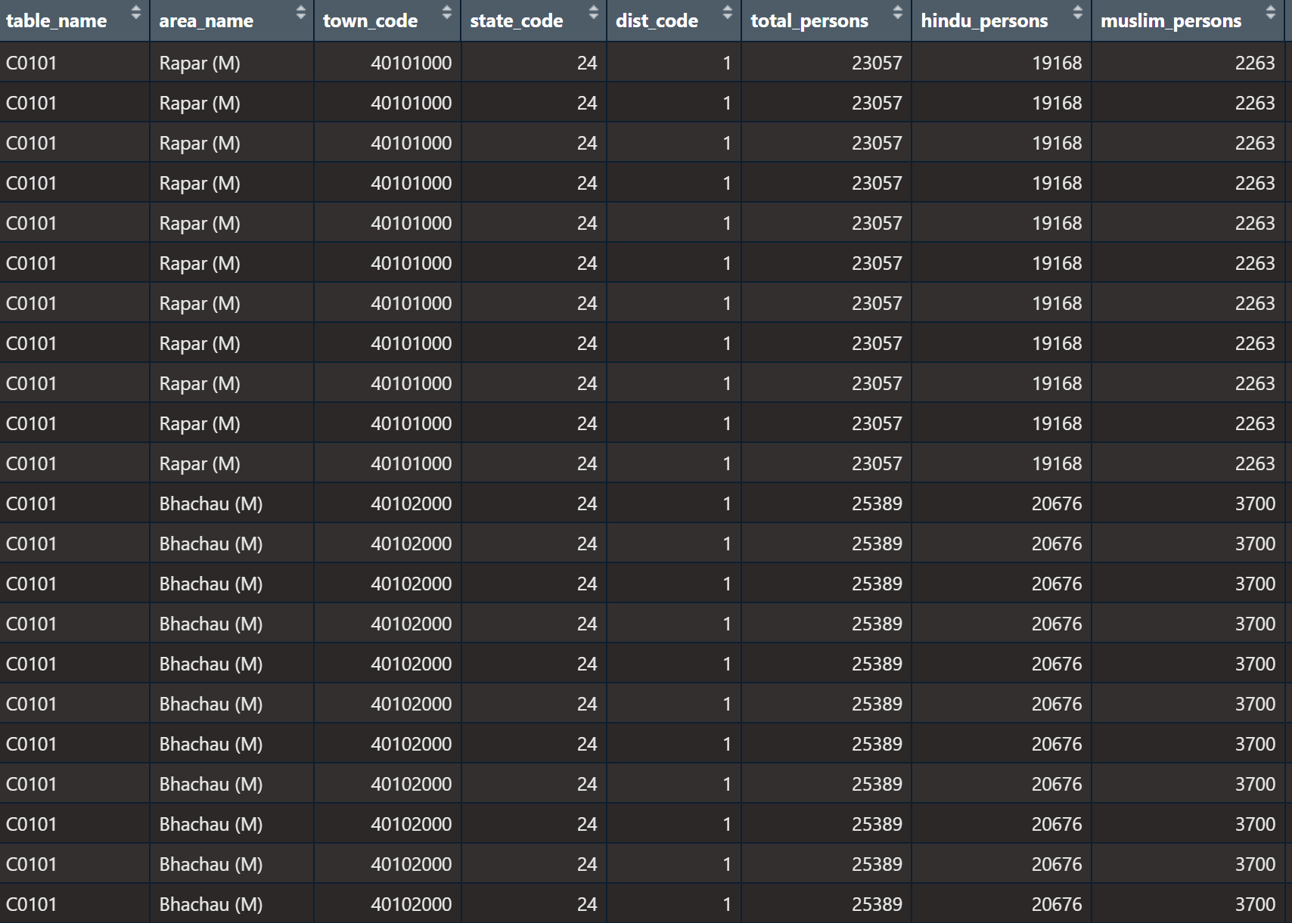
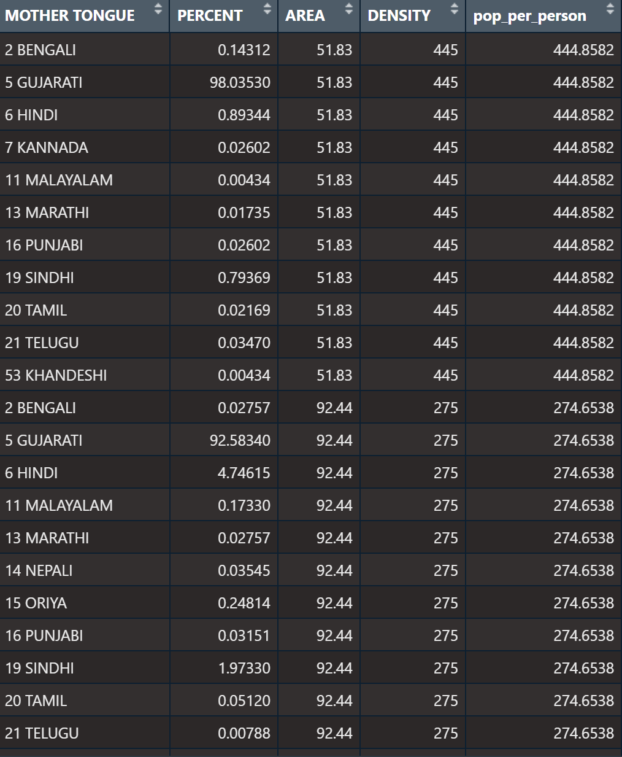
Data

Slide 4
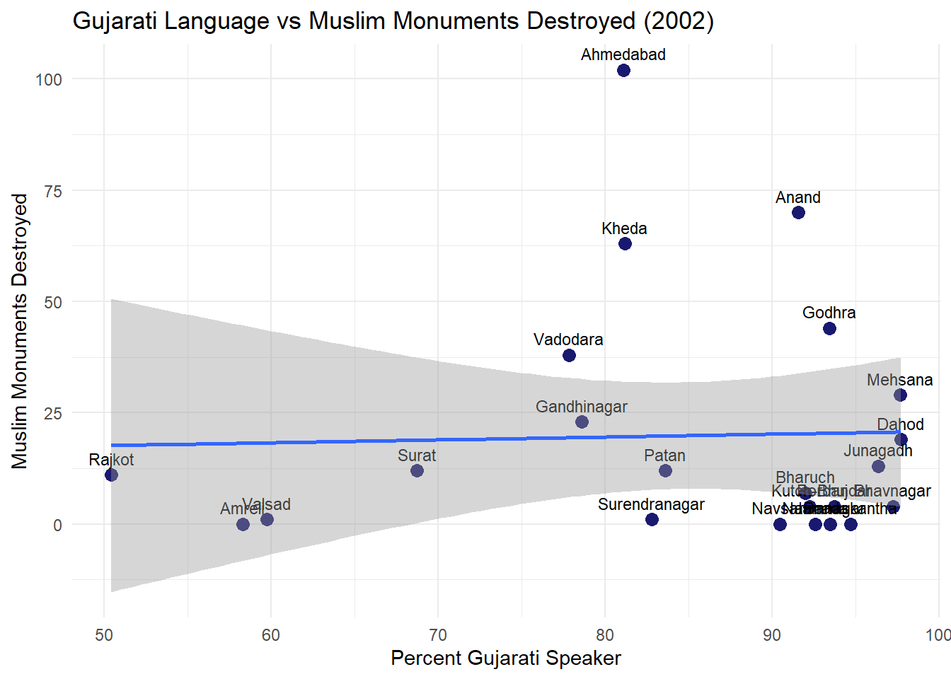

Slide 5

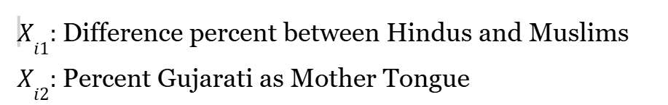
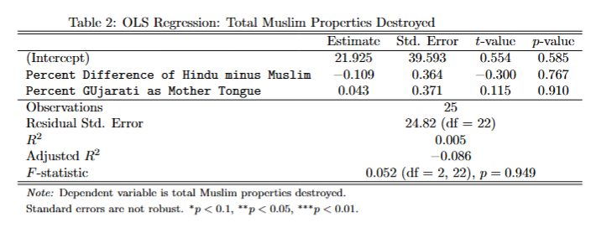
Empirical Model and Testing

Slide 6
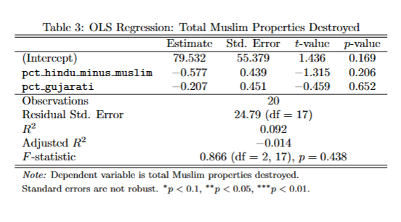
Dropping 0 Muslim Properties Destroyed

Slide 7
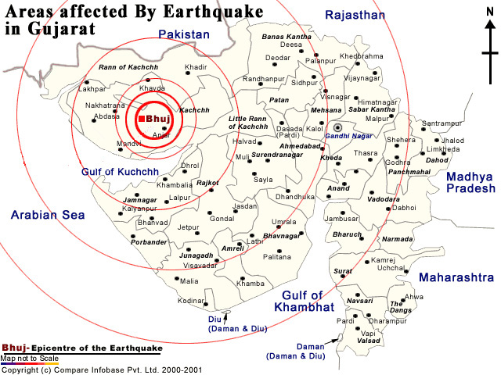

Slide 8
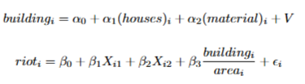
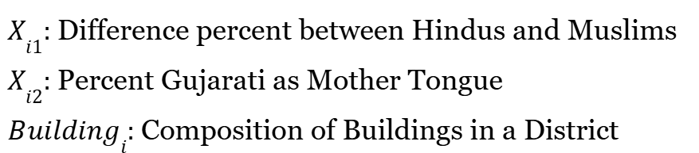
Update with IV

Slide 9
Challenges/Steps Moving Forward
Cleaning Data to include to IV
Create IV
Test with different variables/factors

