Slide 1
Progress Report 1
Raja Chinnakotla

Slide 2
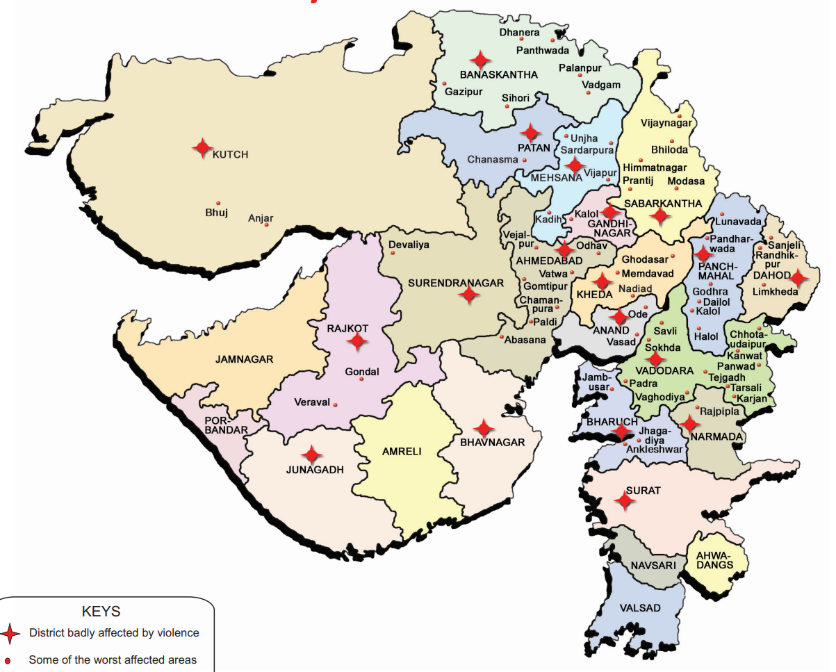
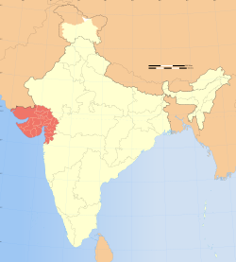
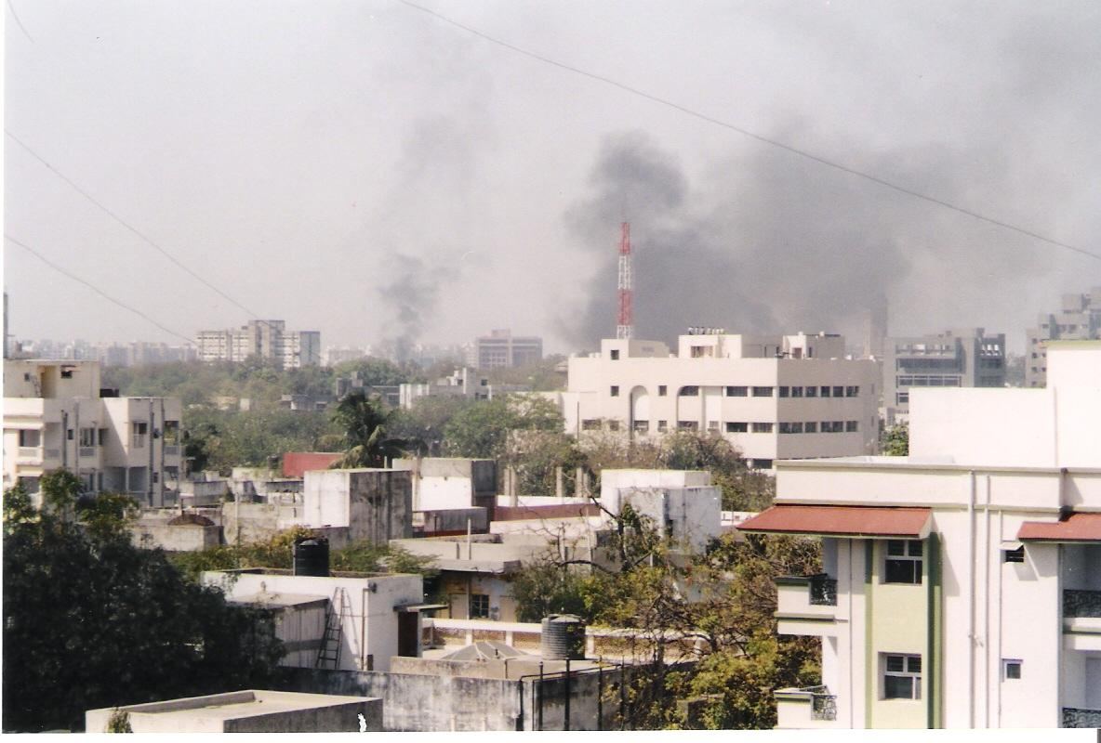
Background
Gujarat is a state in India
Godhra train burning
2002 Riots in Gujarat
Both rural and urban
Between 900-2000+ people killed
Newspaper influence and Gujarati Language
Literature Review:
Surveys on pre-2002 riots
Historical Muslim leadership
Theory on media influence
Goal: Fill gap in literature with empirical analysis on role of media in riots

Slide 3
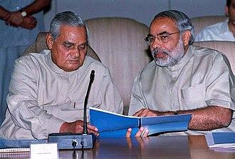
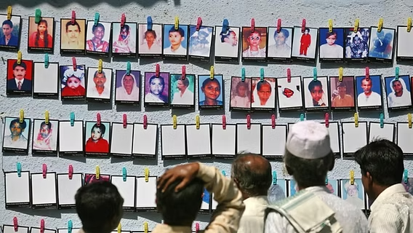
Question
What does language distribution / media play in inter-communal violence in Gujarat 2002 riots?
Motivation:
Gap in literature
Exploit 2001 Census
Prof. Zara Chowdhary – The Lost Ones
Story not well documented/known
Also being erased
Violence 7% Reduction in GDP
Modi

Slide 4
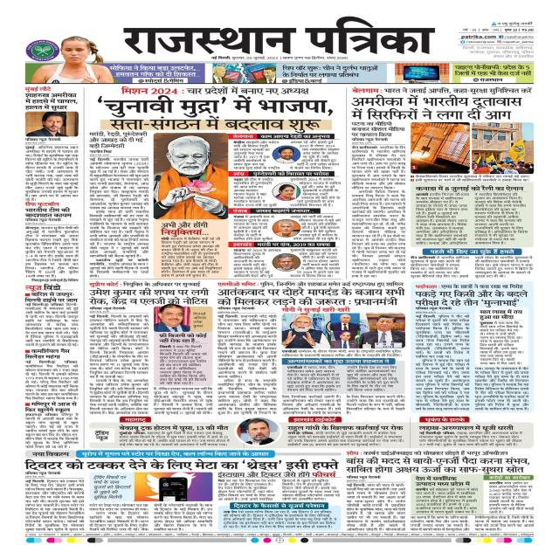
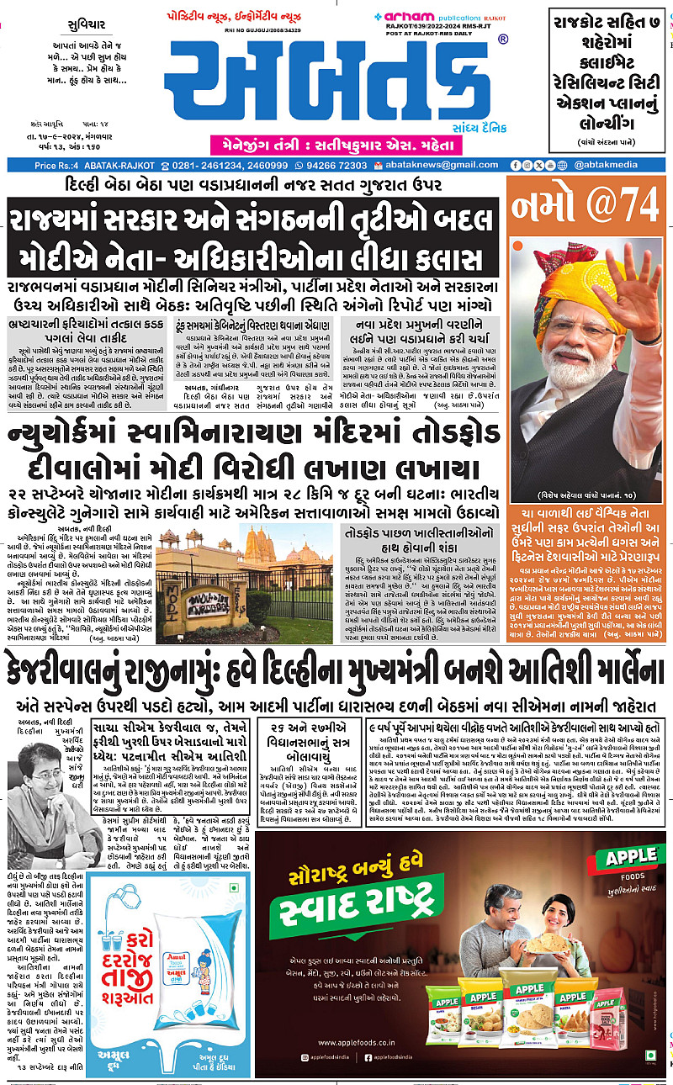
Hindi
Gujarati

Slide 5
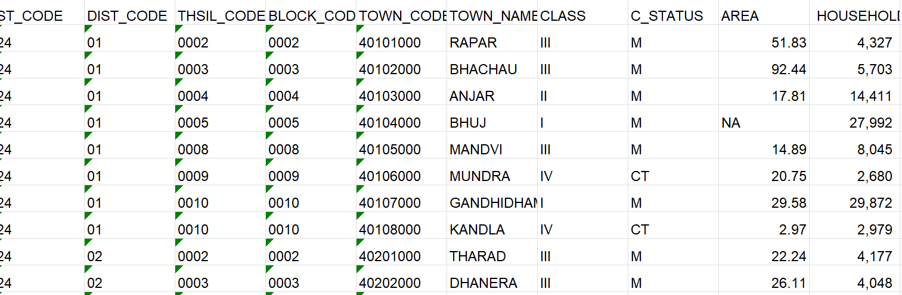
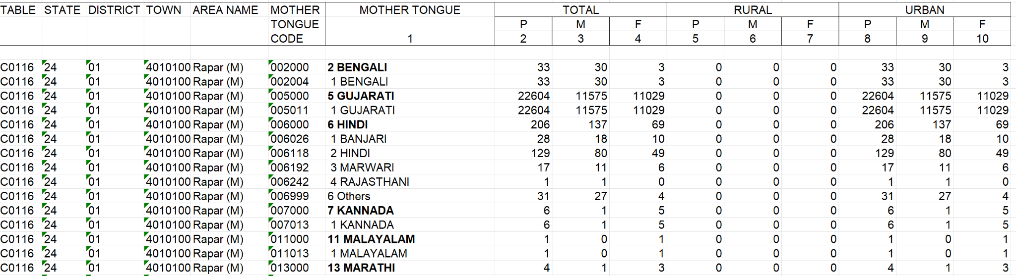
Challenges/Steps Moving Forward
Challenges:
Finding accurate dataset for 2002 riots
inconsistent/inaccessible
Unobserved heterogeneity
Step Moving Forward:
Merging datasets
Using LLM to parse through Gujarat Government/NGO reports
Reach out to CJP for paper

