Slide 1

THIN ICE
PLAY
How to Play
Select Level

Slide 2
THIN ICE
PLAY
How to Play
Select Level

Slide 3
THIN ICE
PLAY
How to Play
Select Level

Slide 4
LEVELS
1
2
3
4
5
6
7
8
9
10
11
12
13
14
15
home
random

Slide 5
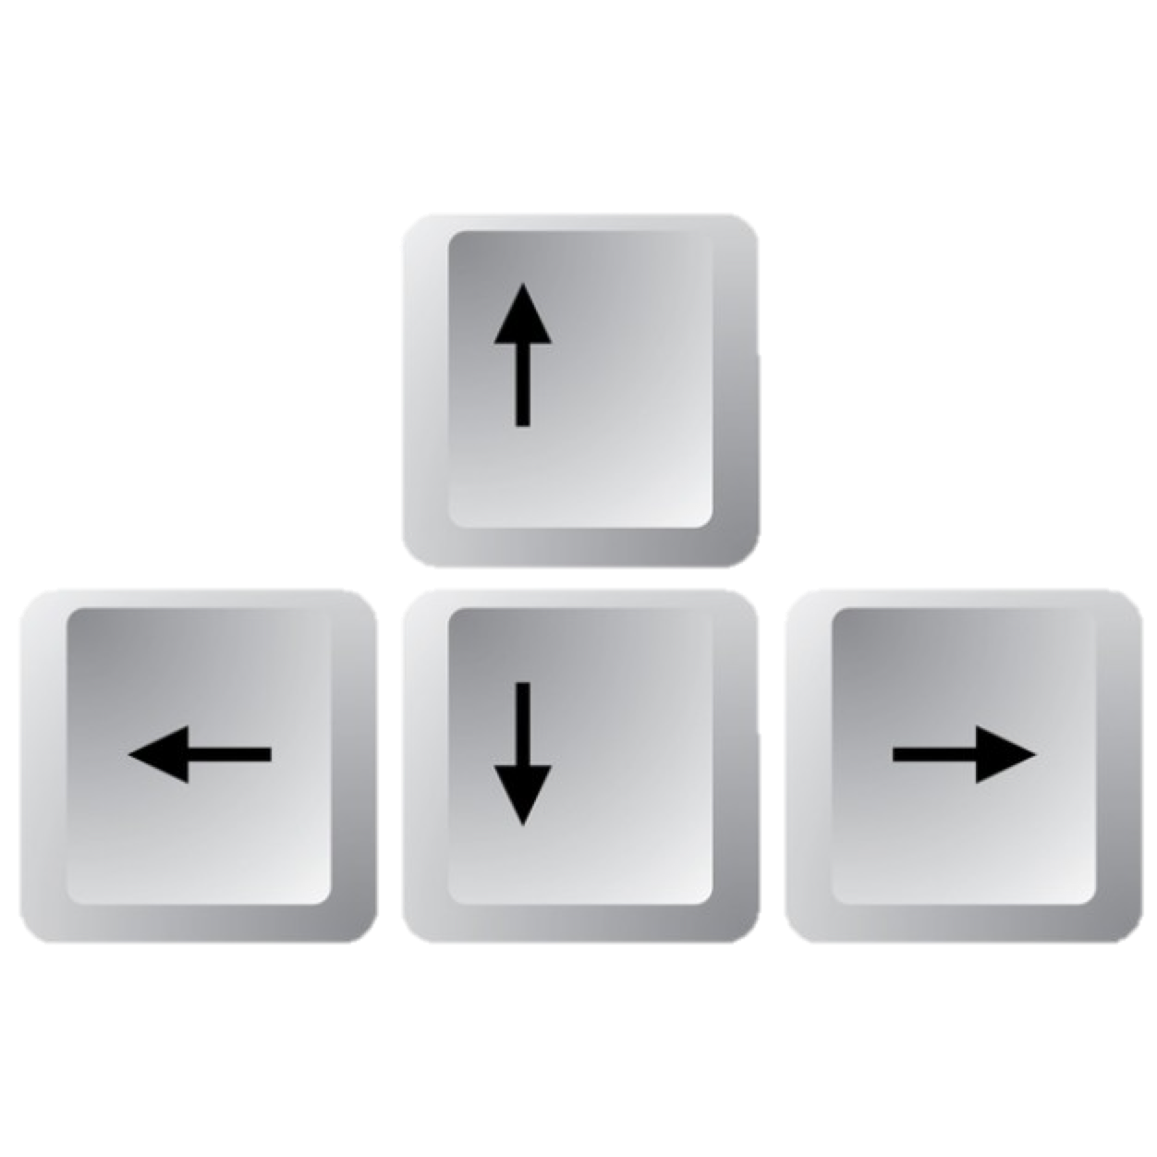


HOW TO PLAY
Use arrow keys to move Blaze through maze
In each level, lead Blaze to the RED exit!
play
back
next

Slide 6

HOW TO PLAY
Earn more points by walking over all the ice in level!
…but don’t let Blaze walk on water because he will sink!
play
back
next

Slide 7


HOW TO PLAY
Higher levels may have these features…
“doube ice”: player can step on a “double ice” tile twice
portal: player can teleport to the other portal in the level
lock: to unlock, player must obtain from another part of the level
play
back
next

Slide 8
GAME OVER
you stepped on melted ice...
try again
scores

Slide 9
GAME OVER
you ran out of time...
try again
scores

Slide 10
YOU WIN!
play again
scores

Slide 11
SCORES
Best Score: 1243
Your Score: 12325
Try again…
play again

Slide 12
SCORES
Your Score:
Best Score:
play again

Slide 13
restart

Slide 14
THIN ICE
PLAY
game instructions

Slide 15





