Slide 1

Notes:
If this activity is working, you should see two circles and a square. Do you see the shapes?

Slide 2
Notes:
This is Jack. Jack has some questions. He’s not sure what the answers are, so he decides to ask other people for help.

Slide 3
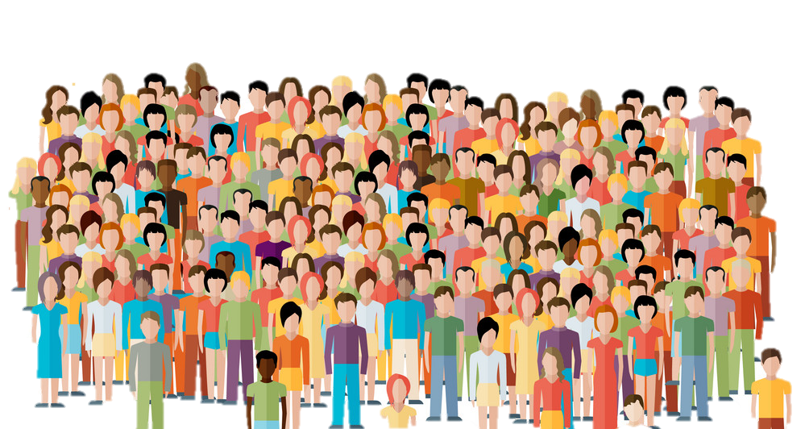
Notes:
Here are the people Jack can ask for help. But there are two ways he can ask for help.

Slide 4








Notes:
One way the people can help Jack is by Talking Together. Jack will ask 5 OF THE PEOPLE to answer the question by TALKING TOGETHER. Each person might think of a different answer at first, but then, all 5 people talk about the question TOGETHER. This way, they decide AS A GROUP what THEY THINK the RIGHT answer is. Then, the group tells Jack the answer it thinks is right.

Slide 5

Notes:
The other way the people can help Jack is by Answering Alone. Jack will ask 50 OF THE PEOPLE to EACH answer the question ON THEIR OWN. Each person might think of a different answer, but they do NOT talk to each other about the question. Each person thinks about the question ON THEIR OWN. This way, EACH PERSON decides what THEY THINK the RIGHT answer is. Then, EACH PERSON tells Jack the answer they think is right.

Slide 6
Notes:
So, you’ll see some of Jack’s questions. Your job is to decide which way of answering will help Jack more: FIVE people Talking Together, so BLUE, or FIFTY people Answering Alone, so GREEN.

Slide 7
Notes:
[LOADING SCREEN]

Slide 8
Notes:
Jack is playing a game called “pick up the pencils”. Each side takes turns picking up pencils. Each turn, you have to pick up either one, two, or three pencils. The winner is the person who picks up the last pencil!
[]
Now, There are five pencils left in this game. If Jack doesn’t make the right move, he could lose the game. So Jack wants to know: should he pick up 1 pencil, 2 pencils, or 3 pencils?
[]
[]
So that was Jack’s question.
[]
But which answer will be more helpful? 5 people Talking Together, so BLUE, or 50 people Answering Alone, so GREEN?
[]
And do you think that answer is PROBABLY more helpful, or DEFINITELY more helpful?
[]
Okay!
[]
[Now let’s see the next question!]

Slide 9
Notes:
Jack is making party hats in different colors for his school party, and he needs to know what people’s favorite color is. Everyone has a color they like best. But there are a lot of different colors. Some people like green most, some like blue or yellow or red or pink best. Jack will make a lot of hats, but he wants to make them in people’s favorite color. So, Jack wanted to know: what do most people say their favorite color is?
[]
[]
So that was Jack’s question.
[]
But which answer will be more helpful? 5 people Talking Together, so BLUE, or 50 people Answering Alone, so GREEN?
[]
And do you think that answer is PROBABLY more helpful, or DEFINITELY more helpful?
[]
Okay!
[]
[Now let’s see the next question!]

Slide 10

Notes:
Jack is planting a garden with blueberries, strawberries, lemons, and apples. He wants to plant his garden in a special way. He doesn’t want two of the same kind of fruit in the same ROW [SLIDE], OR two of the same kind of fruit in the same SECTION [SLIDE]. Jack has already planted some fruit [SLIDE], but now he doesn’t know where to plant the rest of the fruit, so that there’s not two kinds in the same row OR two kinds in the same section. So Jack wanted to know: where should he plant the rest of his fruit?
[]
[]
So that was Jack’s question.
[]
But which answer will be more helpful? 5 people Talking Together, so BLUE, or 50 people Answering Alone, so GREEN?
[]
And do you think that answer is PROBABLY more helpful, or DEFINITELY more helpful?
[]
Okay!
[]
[Now let’s see the next question!]

Slide 11
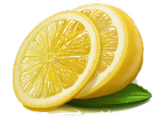
Notes:
Jack is planting a garden with blueberries, strawberries, lemons, and apples. He wants to plant his garden in a special way. He doesn’t want two of the same kind of fruit in the same ROW [SLIDE], OR two of the same kind of fruit in the same SECTION [SLIDE]. Jack has already planted some fruit [SLIDE], but now he doesn’t know where to plant the rest of the fruit, so that there’s not two kinds in the same row OR two kinds in the same section. So Jack wanted to know: where should he plant the rest of his fruit?
[]
[]
So that was Jack’s question.
[]
But which answer will be more helpful? 5 people Talking Together, so BLUE, or 50 people Answering Alone, so GREEN?
[]
And do you think that answer is PROBABLY more helpful, or DEFINITELY more helpful?
[]
Okay!
[]
[Now let’s see the next question!]

Slide 12
Notes:
Jack is planting a garden with blueberries, strawberries, lemons, and apples. He wants to plant his garden in a special way. He doesn’t want two of the same kind of fruit in the same ROW [SLIDE], OR two of the same kind of fruit in the same SECTION [SLIDE]. Jack has already planted some fruit [SLIDE], but now he doesn’t know where to plant the rest of the fruit, so that there’s not two kinds in the same row OR two kinds in the same section. So Jack wanted to know: where should he plant the rest of his fruit?
[]
[]
So that was Jack’s question.
[]
But which answer will be more helpful? 5 people Talking Together, so BLUE, or 50 people Answering Alone, so GREEN?
[]
And do you think that answer is PROBABLY more helpful, or DEFINITELY more helpful?
[]
Okay!
[]
[Now let’s see the next question!]

Slide 13
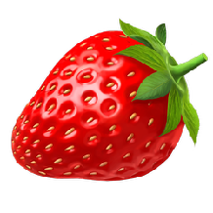
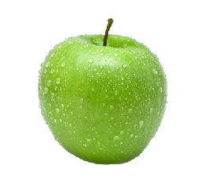
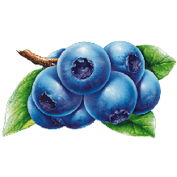
Notes:
Jack is planting a garden with blueberries, strawberries, lemons, and apples. He wants to plant his garden in a special way. He doesn’t want two of the same kind of fruit in the same ROW [SLIDE], OR two of the same kind of fruit in the same SECTION [SLIDE]. Jack has already planted some fruit [SLIDE], but now he doesn’t know where to plant the rest of the fruit, so that there’s not two kinds in the same row OR two kinds in the same section. So Jack wanted to know: where should he plant the rest of his fruit?
[]
[]
So that was Jack’s question.
[]
But which answer will be more helpful? 5 people Talking Together, so BLUE, or 50 people Answering Alone, so GREEN?
[]
And do you think that answer is PROBABLY more helpful, or DEFINITELY more helpful?
[]
Okay!
[]
[Now let’s see the next question!]

Slide 14
Notes:
There are 7 days in the week, and Jack was wondering which day MOST people say they like best. There must be one day people like more than any other. Jack likes Friday best, but wondered if maybe other people like other days better. So Jack wants to know: which day do most people in the world say is their favorite?
[]
[]
So that was Jack’s question.
[]
But which answer will be more helpful? 5 people Talking Together, so BLUE, or 50 people Answering Alone, so GREEN?
[]
And do you think that answer is PROBABLY more helpful, or DEFINITELY more helpful?
[]
Okay!
[]
[Now let’s see the next question!]

Slide 15
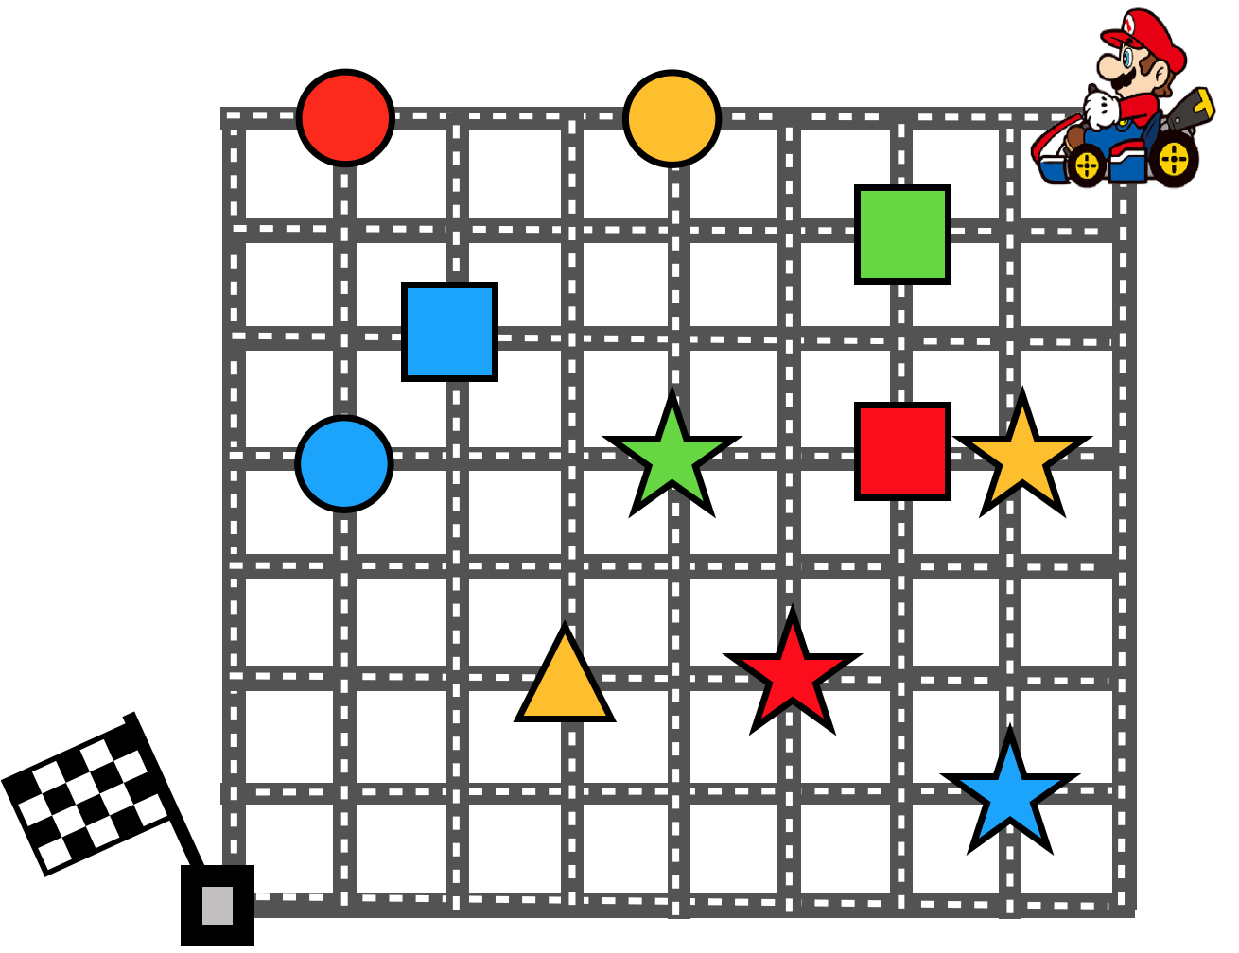
Notes:
Jack has Mario in a race. He wants Mario to collect all of these treasures. But, there’s a rule. He can’t collect two in a row that are the same color or two in a row that are the same shape. But Jack wants Mario to collect all of the treasures on the map as fast as possible. So Jack wanted to know: what is the SHORTEST way for Mario to drive through map?
[]
[]
So that was Jack’s question.
[]
But which answer will be more helpful? 5 people Talking Together, so BLUE, or 50 people Answering Alone, so GREEN?
[]
And do you think that answer is PROBABLY more helpful, or DEFINITELY more helpful?
[]
Okay!
[]
[Now let’s see the next question!]

Slide 16
Notes:
Most people Jack knows don’t like Jack’s favorite fruit. So Jack wondered what OTHER people’s favorite fruit is. He knows that some people like fruits that other people don’t like at all, and that there are fruits that LOTS of people DO like. So Jack wanted to know: what kind of fruit do MOST people in the world say is their FAVORITE?
[]
[]
So that was Jack’s question.
[]
But which answer will be more helpful? 5 people Talking Together, so BLUE, or 50 people Answering Alone, so GREEN?
[]
And do you think that answer is PROBABLY more helpful, or DEFINITELY more helpful?
[]
Okay!
[]
[Now let’s see the next question!]

Slide 17
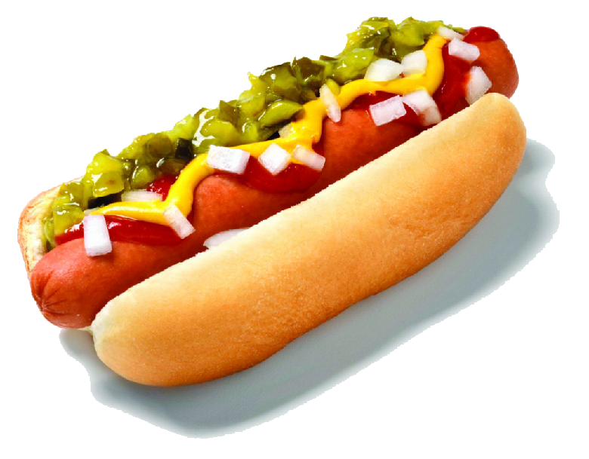
Notes:
Jack needs to find out what MOST people at his school like best for lunch. Some people like pizza more, and some people like hot dogs more. Everyone can eat whichever one they like more, but Jack wants to get more of the one people like the most. So Jack wanted to know: what do MOST people say they like MORE — pizza, or hot dogs?
[]
[]
So that was Jack’s question.
[]
But which answer will be more helpful? 5 people Talking Together, so BLUE, or 50 people Answering Alone, so GREEN?
[]
And do you think that answer is PROBABLY more helpful, or DEFINITELY more helpful?
[]
Okay!
[]
[Now let’s see the next question!]

Slide 18
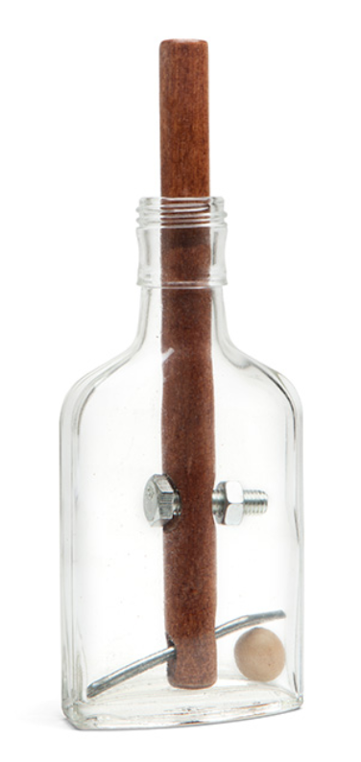
Reas_Bottle
Notes:
This bottle has a stick stuck in it. If you just pull on the stick, it won’t come out. So Jack wanted to know: how can you get the stick out of the bottle without breaking either the bottle or the stick?
[]
[]
So that was Jack’s question.
[]
But which answer will be more helpful? 5 people Talking Together, so BLUE, or 50 people Answering Alone, so GREEN?
[]
And do you think that answer is PROBABLY more helpful, or DEFINITELY more helpful?
[]
Okay!
[]
[Now let’s see the next question!]

Slide 19
CONTROL QUESTIONS
Notes:
[LOADING SCREEN]

Slide 20

Notes:
Now I have a different kind of question. This is Jack’s teacher, Mr. Davis. Mr. Davis has these 5 people in his class. Mr. Davis is giving these 5 people a test because he wants to know which ones did their homework and which ones didn’t. He’s the teacher, so he can tell them to take the test by Talking Together, or he can tell them to take the test by Answering Alone. He can tell them to take the test however he wants.
[SLIDE]

Slide 21
Notes:
So, if Mr. Davis wants find out which of the 5 people did their homework and which ones didn’t, should he tell the 5 people take the test by Talking Together, so Blue, or by Answering Alone, so Green?

Slide 22
Notes:
Now Mr Davis is giving them a test, and he wants all 5 of them to get as many questions right as possible. He’s the teacher, so he can tell them to take the test by Talking Together, or he can tell them to take the test by Answering Alone. He can tell them to take the test however he wants.
[SLIDE]

Slide 23
Notes:
So, if Mr. Davis wants the 5 people to get as many answers right as possible, how should he tell the 5 people to take the test? — by Talking Together, so Blue, or by Answering Alone, so Green?

