Slide 1
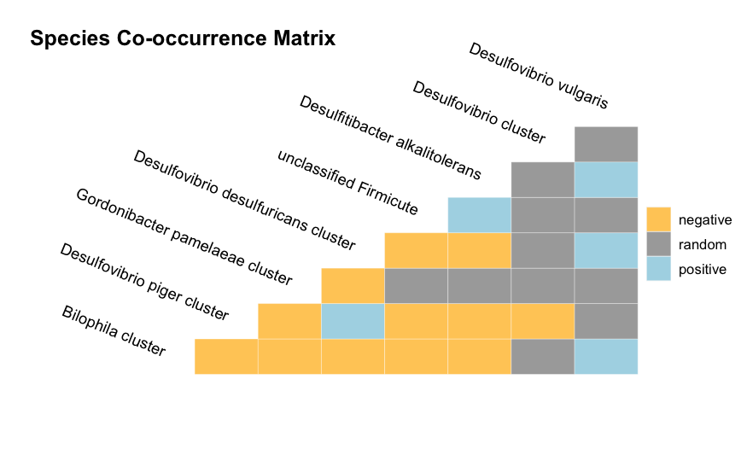

Slide 2
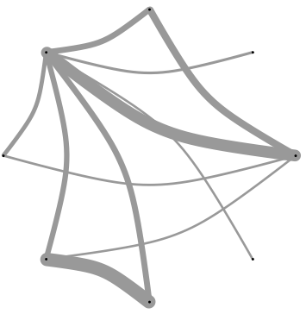
Desulfovibrionaceae
Desulfovibrio piger
Bilophila wadsworthia
uncultured Desulfovibrio sp.
Desulfovibrio vulgaris
Desulfovibrio desulfuricans and Desulfovibrio simplex cluster
Desulfitibacter alkalitolerans
Gordonibacter pamelaeae
uncultured Firmicute
from industrial environment
Firmicutes group

Slide 3

Desulfovibrionaceae family
Desulfovibrio piger
Bilophila wadsworthia
uncultured Desulfovibrio sp. ADDR01000049, ACWM01000066
Desulfovibrio vulgaris
Desulfovibrio desulfuricans
Desulfitibacter alkalitolerans
Gordonibacter pamelaeae
uncultured Firmicute
from industrial environment AY751286
Firmicutes group

