Slide 1
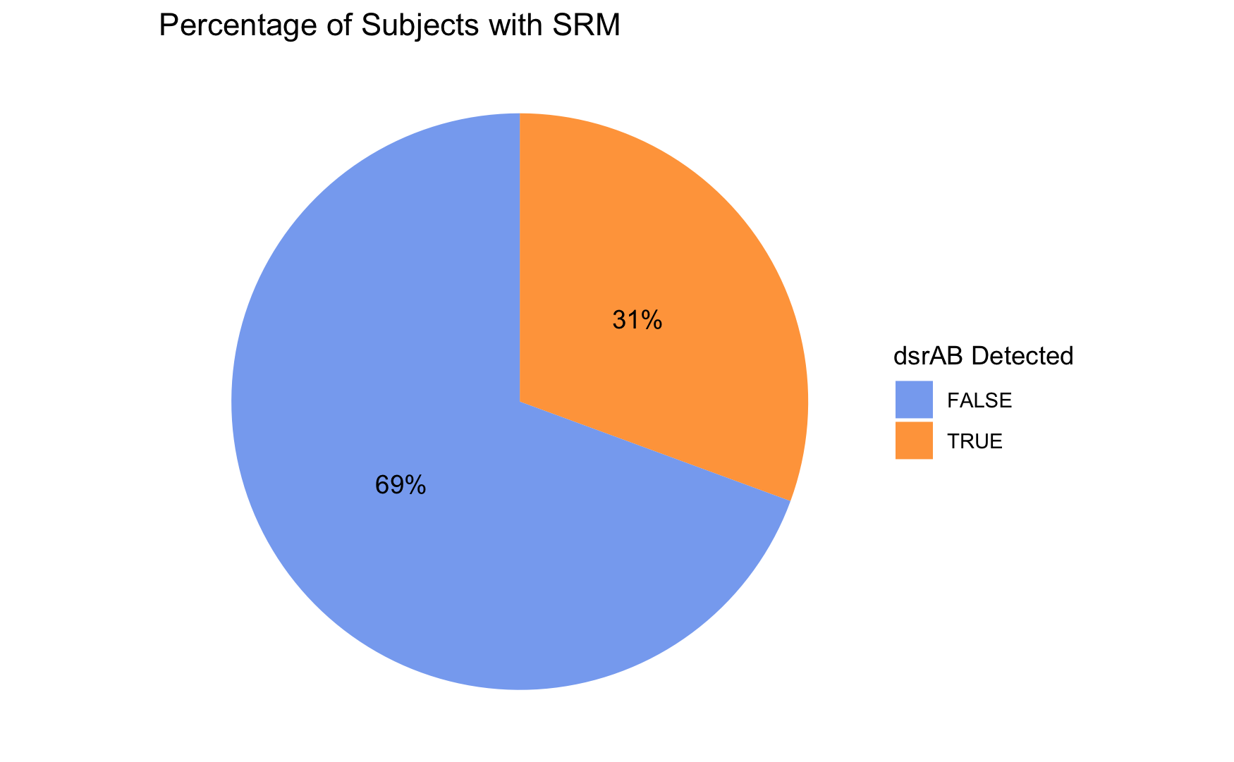
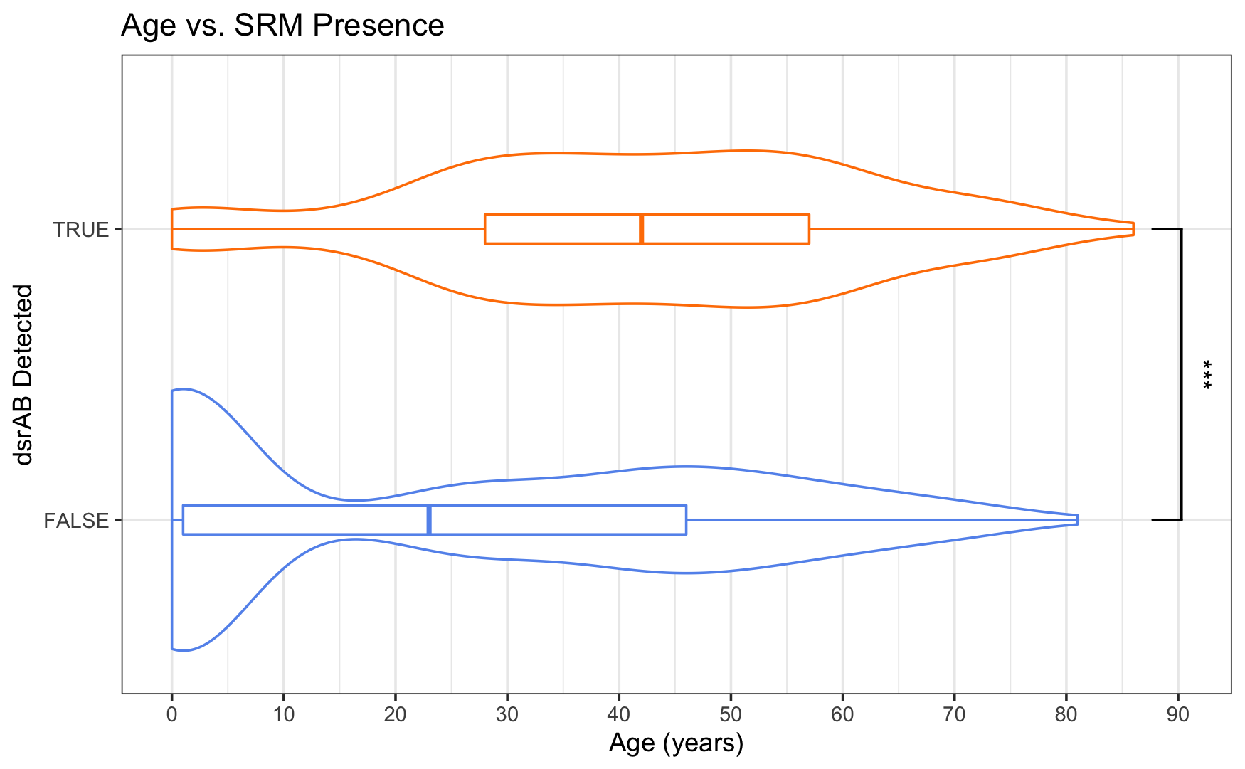
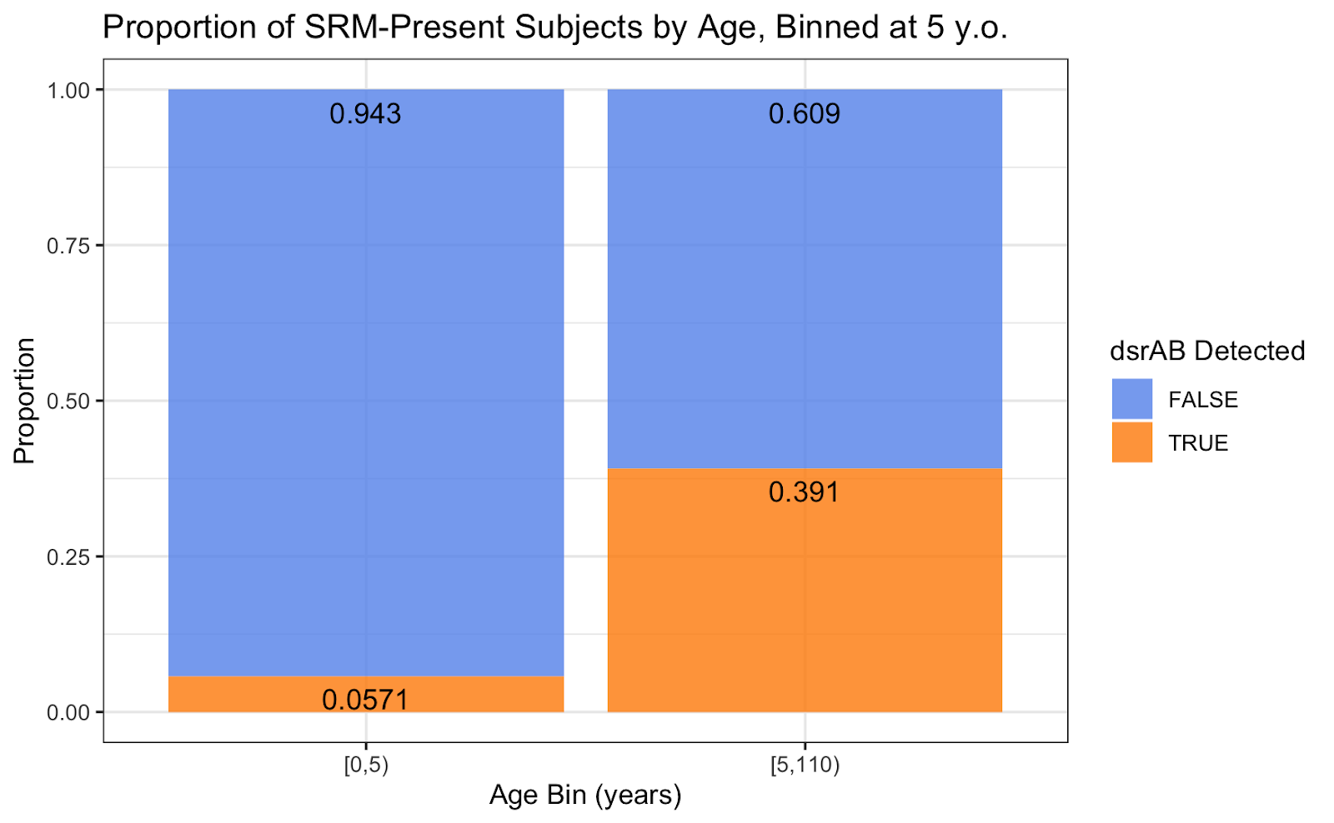
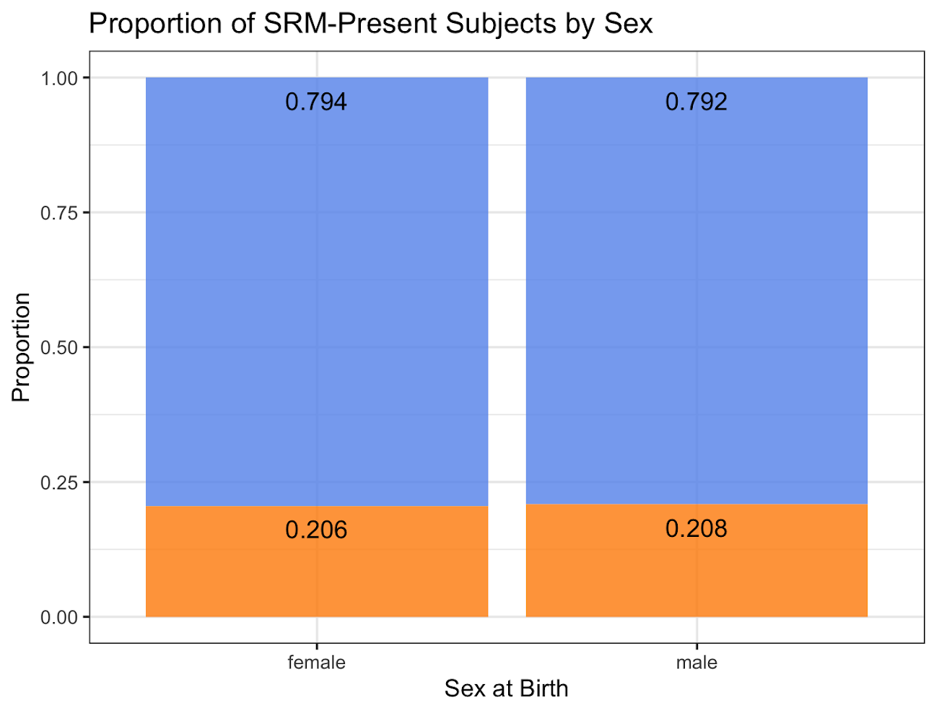
A.
B.
i.
C.
ii.

Slide 2
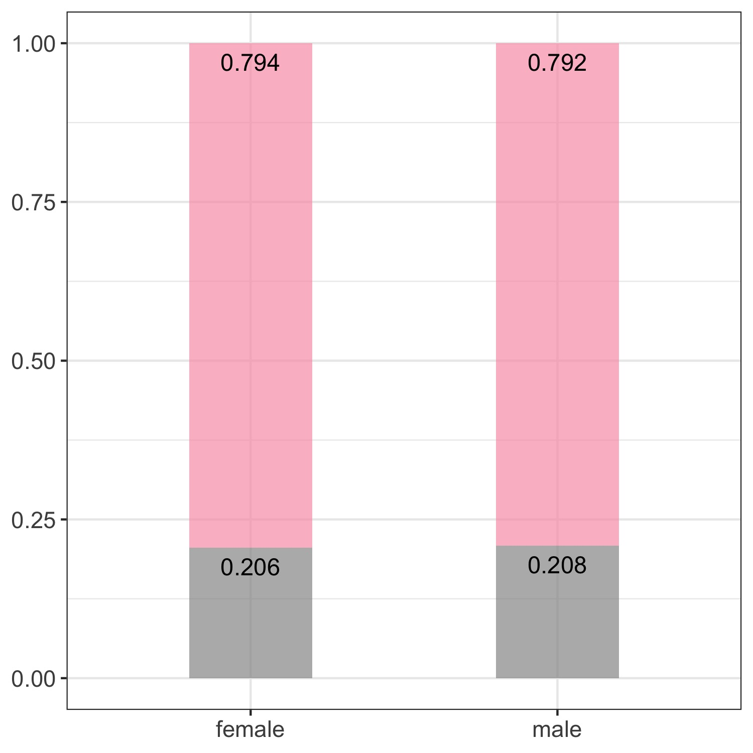
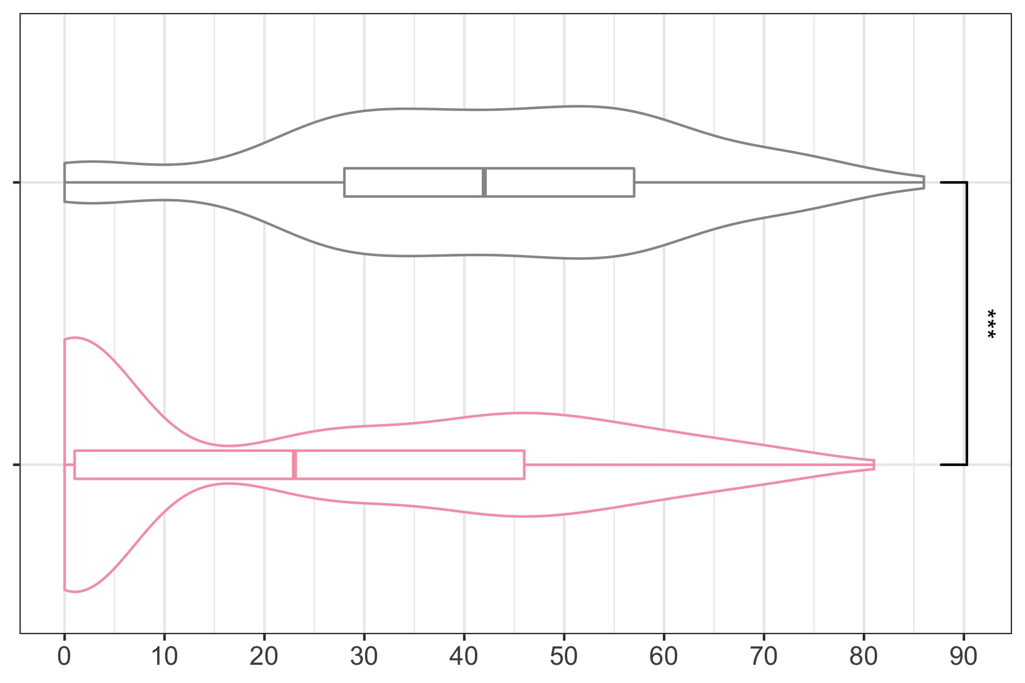
A.
B.
SSRM-positive subjects
SSRM-negative
Proportion of subjects
SSRM-negative subjects
SSRM-positive
female
male
Age (years)
Sex

