Slide 1
Lecture 16: Polymorphism
(Part I)
Copyright (c) Pearson 2013.
All rights reserved.

Slide 2
Polymorphism

Slide 3
Polymorphism
polymorphism:
Ability for the same code to be used with different types of objects and behave differently with each.(Part I Lecture)
  System.out.println can print any type of object.
    Each one displays in its own way on the console.
Ability for a method to take on many forms. (Part II Lecture)

Slide 4
Coding with polymorphism
A variable of type T can hold an object of any subclass of T.
  Employee ed = new Lawyer();
  You can call any methods from the Employee class on ed.
When a method is called on ed, it behaves as a Lawyer.
  System.out.println(ed.getSalary()); // 50000.0
  System.out.println(ed.getVacationForm()); // pink
  Student s1=new GradStudent();
  s1.computeGrade(); //calls GradStudent’s version.

Slide 5
Polymorphism and parameters
You can pass any subtype of a parameter's type.
  public class EmployeeMain {
  public static void main(String[] args) {
  Lawyer lisa = new Lawyer();
  Secretary steve = new Secretary();
  printInfo(lisa);
  printInfo(steve);
  }
  public static void printInfo(Employee empl) {
  System.out.println("salary: " + empl.getSalary());
  System.out.println("v.days: " + empl.getVacationDays());
  System.out.println("v.form: " + empl.getVacationForm());
  System.out.println();
  }
  }
  OUTPUT:
  salary: 50000.0 salary: 50000.0
  v.days: 15 v.days: 10
  v.form: pink v.form: yellow

Slide 6
Polymorphism and parameters
You can pass any subtype of a parameter's type.
  public class EmployeeMain {
  public static void main(String[] args) {
  Lawyer lisa = new Lawyer();
  Secretary steve = new Secretary();
  printInfo(lisa);
  printInfo(steve);
  }
  public static void printInfo(Employee empl) {
  System.out.println("salary: " + empl.getSalary());
  System.out.println("v.days: " + empl.getVacationDays());
  System.out.println("v.form: " + empl.getVacationForm());
  System.out.println();
  }
  }
  Note: This code will remain the same regardless of how many subclasses of Employee we add later in our code.

Slide 7
Polymorphism and arrays
Arrays of superclass types can store any subtype as elements.
  public class EmployeeMain2 {
  public static void main(String[] args) {
  Employee[] e = { new Lawyer(), new Secretary(),
  new Marketer(), new LegalSecretary() };
  for (int i = 0; i < e.length; i++) {
  System.out.println("salary: " + e[i].getSalary());
  System.out.println("v.days: " + e[i].getVacationDays());
  System.out.println();
  }
  }
  }
  Output:
  salary: 50000.0
  v.days: 15
  salary: 50000.0
  v.days: 10
  salary: 60000.0
  v.days: 10
  salary: 55000.0
  v.days: 10

Slide 8
Exercise 1
Suppose that the following four classes have been declared:
  public class Foo {
  public void method1() {
  System.out.println("foo 1");
  }
  public void method2() {
  System.out.println("foo 2");
  }
  public String toString() {
  return "foo";
  }
  }
  public class Bar extends Foo {
  public void method2() {
  System.out.println("bar 2");
  }
  }

Slide 9
Exercise 1
  public class Baz extends Foo {
  public void method1() {
  System.out.println("baz 1");
  }
  public String toString() {
  return "baz";
  }
  }
  public class Mumble extends Baz {
  public void method2() {
  System.out.println("mumble 2");
  }
  }
What would be the output of the following client code?
  Foo[] pity = {new Baz(), new Bar(), new Mumble(), new Foo()};
  for (int i = 0; i < pity.length; i++) {
  System.out.println(pity[i]);
  pity[i].method1();
  pity[i].method2();
  System.out.println();
  }

Slide 10
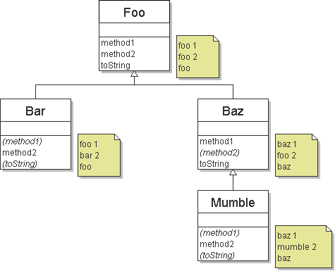
Diagramming the classes
Add classes from top (superclass) to bottom (subclass).
Include all inherited methods. Methods in parenthesis are inherited. For example, method1 of Bar is inherited from Foo.

Slide 11
Exercise 1’s Answers
Foo[] pity = {new Baz(), new Bar(), new Mumble(), new Foo()};
for (int i = 0; i < pity.length; i++) {
System.out.println(pity[i]);
pity[i].method1();
pity[i].method2();
System.out.println();
}
Output:
  baz
  baz 1
  foo 2
  foo
  foo 1
  bar 2
  baz
  baz 1
  mumble 2
  foo
  foo 1
  foo 2

Slide 12
Exercise 2
The order of the classes is jumbled up.
The methods sometimes call other methods (tricky!).
  public class Lamb extends Ham {
  public void b() {
  System.out.print("Lamb b ");
  }
  }
  public class Ham {
  public void a() {
  System.out.print("Ham a ");
  b();
  }
  public void b() {
  System.out.print("Ham b ");
  }
  public String toString() {
  return "Ham";
  }
  }

Slide 13
Exercise 2
  public class Spam extends Yam {
  public void b() {
  System.out.print("Spam b ");
  }
  }
  public class Yam extends Lamb {
  public void a() {
  System.out.print("Yam a ");
  super.a();
  }
  public String toString() {
  return "Yam";
  }
  }
What would be the output of the following client code?
  Ham[] food = {new Lamb(), new Ham(), new Spam(), new Yam()};
  for (int i = 0; i < food.length; i++) {
  System.out.println(food[i]);
  food[i].a();
  System.out.println(); // to end the line of output
  food[i].b();
  System.out.println(); // to end the line of output
  System.out.println();
  }

Slide 14
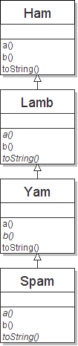
Class diagram

Slide 15
Polymorphism at work
Lamb inherits Ham's a. a calls b. But Lamb overrides b...
  public class Ham {
  public void a() {
  System.out.print("Ham a ");
  b();
  }
  public void b() {
  System.out.print("Ham b ");
  }
  public String toString() {
  return "Ham";
  }
  }
  public class Lamb extends Ham {
  public void b() {
  System.out.print("Lamb b ");
  }
  }
Lamb's output from a:
  Ham a Lamb b

Slide 16
Exercise 2’s Answers
Ham[] food = {new Lamb(), new Ham(), new Spam(), new Yam()};
for (int i = 0; i < food.length; i++) {
System.out.println(food[i]);
food[i].a();
food[i].b();
System.out.println();
}
Output:
  Ham
  Ham a Lamb b
  Lamb b
  Ham
  Ham a Ham b
  Ham b
  Yam
  Yam a Ham a Spam b
  Spam b
  Yam
  Yam a Ham a Lamb b
  Lamb b

Slide 17
Casting references
A variable can only call that type's methods, not a subtype's.
  Employee ed = new Lawyer();
  int hours = ed.getHours(); // ok; it's in Employee
  ed.sue(); // compiler error
  The compiler's reasoning is, variable ed could store any kind of employee, and not all kinds know how to sue .
To use Lawyer methods on ed, we can type-cast it.
  Lawyer theRealEd = (Lawyer) ed;
  theRealEd.sue(); // ok
  ((Lawyer) ed).sue();// shorter version,two sets of()

Slide 18
More about casting
The code crashes if you cast an object too far down the tree.
  Employee eric = new Secretary();
  ((Secretary) eric).takeDictation("hi"); // ok
  ((LegalSecretary) eric).fileLegalBriefs(); // Class cast //exception
  // (Secretary object doesn't know how to file briefs)
You can cast only up and down the tree, not sideways.
  Lawyer linda = new Lawyer();
  ((Secretary) linda).takeDictation("hi"); // error
Casting doesn't actually change the object's behavior.
It just gets the code to compile/run.
  ((Employee) linda).getVacationForm() // pink (Lawyer's)

Slide 19
Exercise 3
Assume that the following classes have been declared:
  public class Snow {
  public void method2() {
  System.out.println("Snow 2");
  }
  public void method3() {
  System.out.println("Snow 3");
  }
  }
  public class Rain extends Snow {
  public void method1() {
  System.out.println("Rain 1");
  }
  public void method2() {
  System.out.println("Rain 2");
  }
  }

Slide 20
Exercise 3
  public class Sleet extends Snow {
  public void method2() {
  System.out.println("Sleet 2");
  super.method2();
  method3();
  }
  public void method3() {
  System.out.println("Sleet 3");
  }
  }
  public class Fog extends Sleet {
  public void method1() {
  System.out.println("Fog 1");
  }
  public void method3() {
  System.out.println("Fog 3");
  }
  }

Slide 21
Exercise 3
  What happens when the following examples are executed?
  Example 1:
  Snow var1 = new Sleet();
  var1.method2();
  Example 2:
  Snow var2 = new Rain();
  var2.method1();
  Example 3:
  Snow var3 = new Rain();
  ((Sleet) var3).method3();

Slide 22
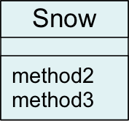
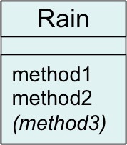
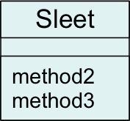
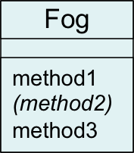
Technique: diagram
Diagram the classes from top (superclass) to bottom. A method in parenthesis is inherited. For example, method3 of Rain is inherited from Snow.

Slide 23
Exercise 3 Answers
Example:
  Snow var1 = new Sleet();
  var1.method2();
Output:
  Sleet 2
  Snow 2
  Sleet 3
variable
object

Slide 24
Exercise 3 Answers
Example:
  Snow var2 = new Rain();
  var2.method1();
Output:
  None!
  There is an error,
  because Snow does not
  have a method1.
variable
object

Slide 25
Exercise 3 Answers
Example:
  Snow var3 = new Rain();
  ((Sleet) var3).method2();
Output:
  None!
  There is an error
  because a Rain is
  not a Sleet.
object
variable

Slide 26
Homework
Redo the 3 exercises in this lecture and check your answers. Then complete the Polymorphism Worksheet.

Slide 27
Review Example
Employee one=new Secretary(); //upcast, always ok
one.getSalary();//calls Secretary’s version
one.takeDictation();//error, even though one holds a
//Secretary object, one is an Employee reference
//and can only call Employee’s methods.
//here’s how to fix the above error.
((Secretary) one).takeDictation();//cast then call
//can’t cast two far down the tree
((LegalSecretary) one).fileLegalBriefs(); //error

Slide 28
Review Example 2
LegalSecretary two=new LegalSecretary();
//upcast doesn’t change behavior.
((Secretary) two).getSalary();//still LegalSecretary’s //version
((Employee) two).getSalary();//still LegalSecretary’s
//version
//can’t cast sideways
((Lawyer) two).sue(); //error

