Slide 1
Processing
Copyright (c) Pearson 2013.
All rights reserved.

Slide 2
Structure of a Sketch
Processing started by Ben Fry and Casey Reas while both were graduate students at MIT Media Lab in 2001.
Processing is Java.
Designed for visual artists with limited programming experience who want to create art without knowing complicated Java syntax.
In its current version, hundred of libraries have been written for computer vision, data visualization, music composition, networking, 3D drawings and programming electronics.

Slide 3
Structure of a Sketch
//declare variables on top
//setup() similar to constructors; initialize variables
void setup()
{…}
//draw is a loop that runs
//automatically 60 frames per second.
//used for animation.
void draw()
{…}

Slide 4
Example
int x,y;
void setup(){
x=5;
y=10;
}
void draw()
{
x+=1; //x increases by 1 60 times per second.
}

Slide 5
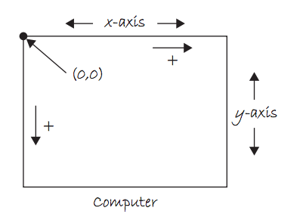
Coordinate System

Slide 6
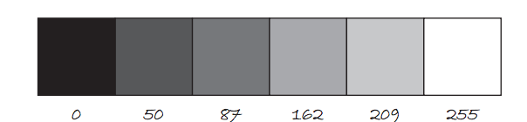
Color
Color is defined by a range of numbers.
In grayscale, 0 is black, 255 is white and any color in between is a shade of gray ranging from black to white.

Slide 7
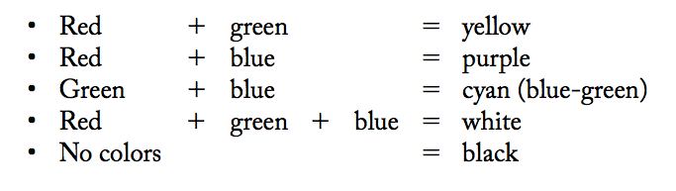
Color
RGB Color is determined by three parameters. Each parameter is in the range 0-255. The first indicates the degree of red(R), the second the degree of green(G) and the last the degree of blue(B).

Slide 8
Some Methods
size(int width, int height): Set the size of the window. This should go in setup(). width and height are reserved words referring to the size of the screen.
background(int range): range can be any integer from 0=black to 255=white. This should go in draw().

Slide 9
Some Methods
fill(int r, int g, int b):By calling fill before a shape will set the color of the shape.
line(int x1, int y1, int x2, int y2):
ellipse(int x, int y, int width, int height): center of ellipse is (x,y); width and height are the lengths of the axes.
rect(int x, int y, int width, int height): position is top left corner by default.

Slide 10
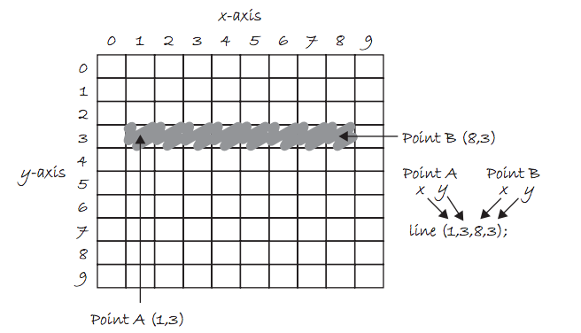
Draw a Line

Slide 11
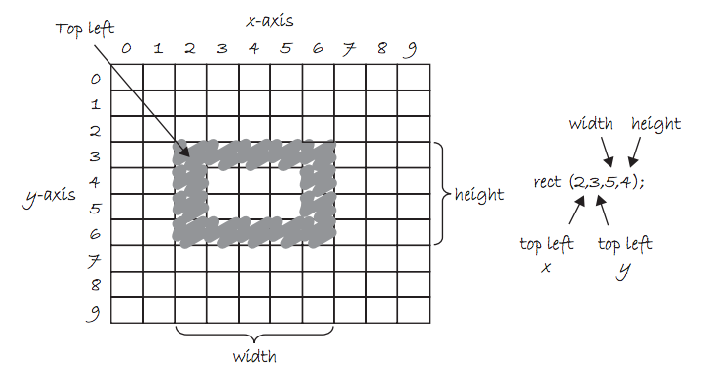
Draw a Rectangle

Slide 12
Example 1
int x,y;
void setup(){
size(800,600); //800 pixels by 600 pixels
x=width/2; //width=800, height=600
y=height/2; }
void draw(){
background(255);//white background
fill(255,0,0);//red fill
ellipse(x,y,80,80);//red-filled circle radius 40

Slide 13
Example 1 Continued..
fill(0,255,0);//green fill
ellipse(x,y,80,80);//green-filled circle radius 40
fill(0,0,255); //blue fill
//blue filled rectangle at (40,50) width=60,height=70
rect(40,50,60,70);
}

Slide 14
Example 2:Make it move.
int x,y,xspeed=5;
void setup(){
size(600,400);
x=width/2;
y=height/2;}
// make a red circle moves horizontally
// across the screen
void draw(){
background(255);//white background
fill(255,0,0); //fill red
ellipse(x,y,80,80);
x+=xspeed;//moves 5*60=300 pixels per sec.
}

Slide 15
Things to Try
Lab 1: Make the ball move horizontally back and forth in the middle of the screen, bouncing each time it hits the left or right side of the screen.
Modify your code so that it is moving in a diagonal direction and bouncing when it hits any side of the screen.
Pong Game: Modify your code again to simulate the Pong game. Make two paddles(rectangles) on each side of the screen and let the user control the paddles. The ball bounces if it hits a paddle or a top/bottom sides of the screen. To do user keyboard input, see the next slide.

Slide 16
Things to Try
Lab 2: Draw a ball at the center of the screen. Let the user move the ball up, down, left, right using the keyboard arrow keys. You need the following method in your code.
//if a key is pressed, the draw() loop is temporarily interrupted
//to execute this method; once done, it returns to the draw loop.
void keyPressed(){
// depends on which key is pressed, a specific action is performed.
if(key==‘a’){} //for letter keys
if(keyCode==UP) {} //for arrow keys: UP,DOWN, LEFT, RIGHT
}

